Slide 1
Name: Yun-Chen Tsai
Advisor: Prof. Yu-Jung (Yuri) Lu^{1,2}
¹Research Center for Applied Sciences, Academia Sinica, Taipei 11529, Taiwan
²Department of Physics, National Taiwan University, Taipei 10617, Taiwan
Date: 2024.xx.xx

Slide 2
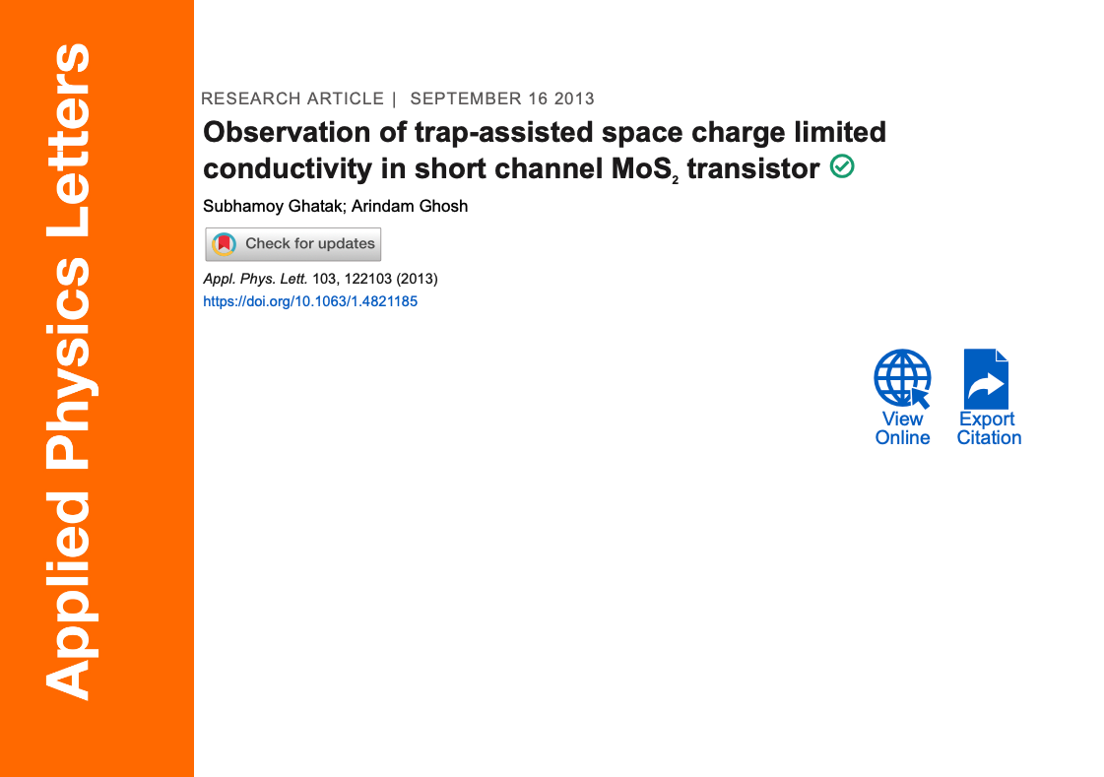

Slide 3
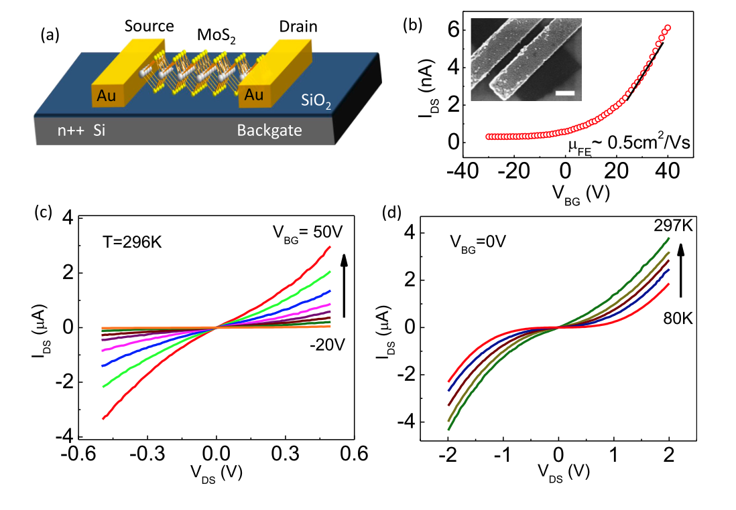
Figure 1
Inset: SEM image
two-probe single-layer MoS₂ device on Si/SiO₂ with Au contacts
I–V curves at VBG=0 V across different T. Nonlinearity increases as T decreases, excluding Schottky/tunneling effects.
Work function:
MoS2: 5.1 eV
Au: 4.5 eV
I–V curves at room T for different VBG.
Linear and symmetric at low VDS,
showing quasi-ohmic contacts.
nonlinearity arises from SCLC

Slide 4
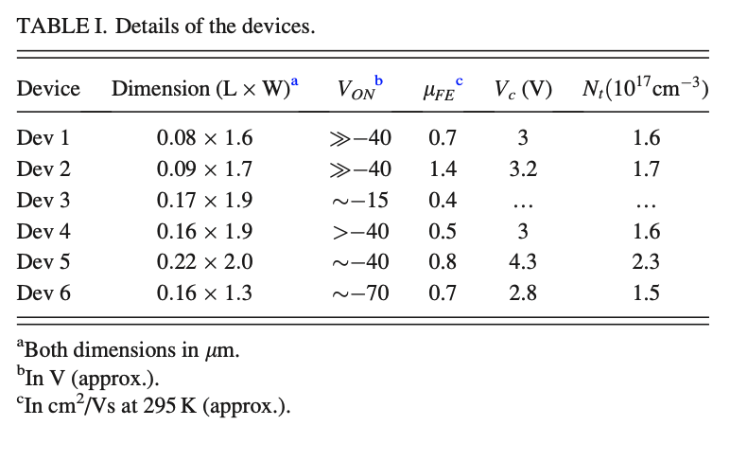
channel length ~80–200 nm

Slide 5
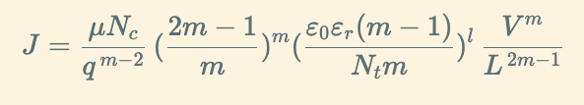
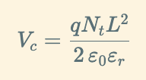
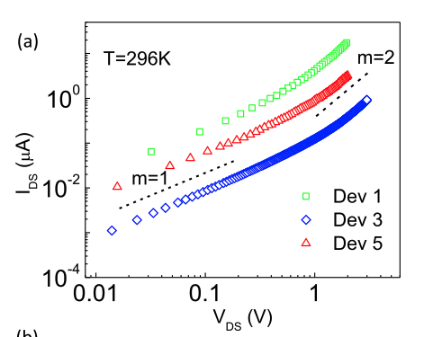
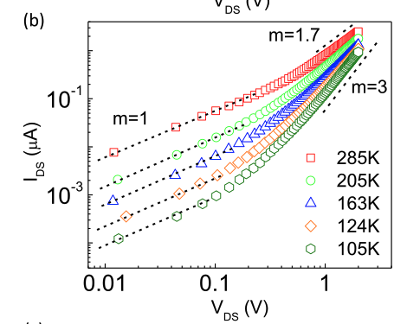
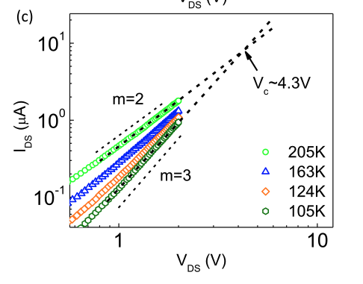
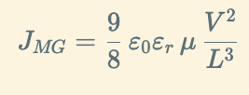
Figure 2
Dev 5
Extrapolation of I–V curves at low T yields a T-independent critical voltage ≈4.3 V, giving trap density 2.3×10¹⁷ cm⁻³
Log–log I–V curves (room T, VBG=0).
At low VDS slope = 1 (ohmic)
At higher VDS slope → 2 (SCLC).
Temperature dependence:
slope increases from
1.7 (285 K) → 2 (205 K) → 3 (105 K)
At RT > Tc, m = 1.7 < 2
At Tc, m = 2
At T < Tc, m increases
Confirms exponential trap distribution and provides a method to quantify trap density

Slide 6
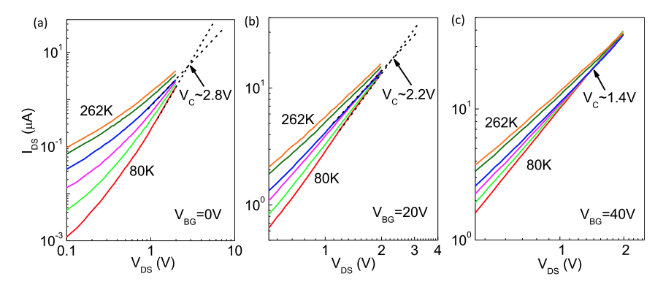
Figure 3
I–V curves at VBG = 0, 20, 40 V for multiple T.
Intersection points (critical voltage) decrease with gate bias
High gate voltage fills more traps at equilibrium
reducing effective trap density and lowering Vc​

Slide 7


ACKNOWLEDGEMENT
Lu Lab 2024

