Slide 1
Replication in MySQL

Slide 2
Course Agenda
Introduction to Replication and its types.
Configure replication (dump,extrabackup,xbstream,Mydumper,clone plugin).
Difference btw GTID/traditional log position base replication.
Configure Semi-syn replication.
Failure scenarios of Mysql sync replication.
How to solve errors, errant transection.
How to configure multi threaded replication.
Pt-heartbeat, pt-table-checksum ,pt-table-sync.
Configure Orchestrator.
Configure proxysql for Load balancer.

Slide 3
Replication in MySQL
Replication enables data from one MySQL server (the master) to be replicated to one or more MySQL servers (the slaves). MySQL Replication is very easy to setup, and is used to scale out read workloads, provide high availability and geographic redundancy, and offload backups and analytic jobs.
High Availability
Load Balancing
Backups
Dedicated Queries
Long-distance Data Distribution
Testing Experiment
Analytics

Slide 4
Replication Scheme
Replication Scheme:
There are currently two replication schemes supported by MySQL Replication:
• Asynchronous replication
• Semi-synchronous replication
There is no restriction in mixing replication schemes in the same topology. Both have their pros and cons. At the time of writing, there is no fully-synchronous solution for MySQL replication

Slide 5
Replication Scheme:
Asynchronous Replication:
With asynchronous replication, the master writes events to its binary log and slaves request them when they are ready. There is no guarantee that any event will ever reach any slave. It’s a loosely coupled master-slave relationship, where:
Master does not wait for Slave.
Slave determines how much to read and from which point in the binary log.
Slave can be arbitrarily behind master in reading or applying changes.
If the master crashes, transactions that it has committed might not have been transmitted to any slave. Consequently, failover from master to slave in this case may result in failover to a server that is missing transactions relative to the master.
Asynchronous replication provides lower write latency, since a write is acknowledged locally by a master before being written to slaves. It is great for read scaling as adding more replicas does not impact replication latency

Slide 6
Replication Scheme:
Semi-Synchronous Replication:
MySQL also supports semi-synchronous replication, where the master does not confirm transactions to the client until at least one slave has copied the change to its relay log, and flushed it to disk. To enable semi-synchronous replication, extra steps for plugin installation are required, and must be enabled on the designated MySQL master and slave.
Semi-synchronous seems to be good and practical solution for many cases where high availability and no data-loss is important.
Performance impact due to the additional round trip.
A good use case for semi-synchronous replication is a backup master to reduce the impact of a master failure by minimizing the risk of data loss

Slide 7
Topology for MySQL Replication

Slide 8
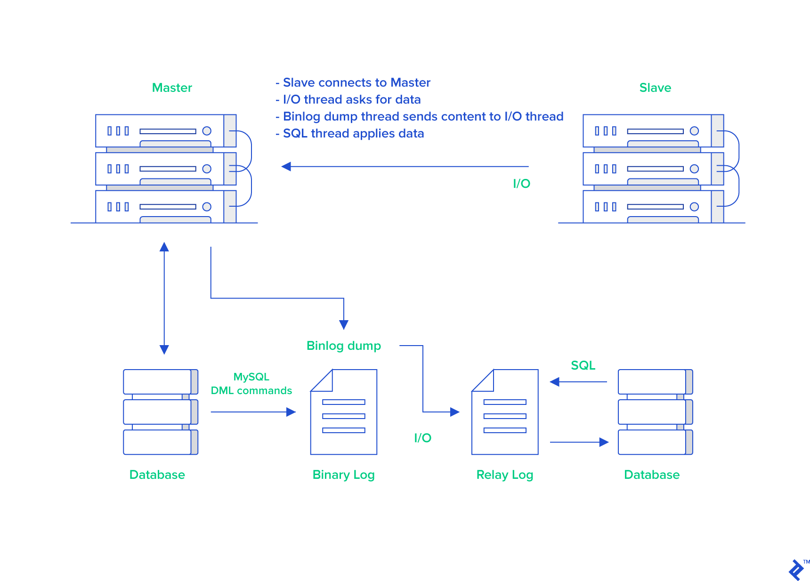
Master with Slave
Slave

Slide 9
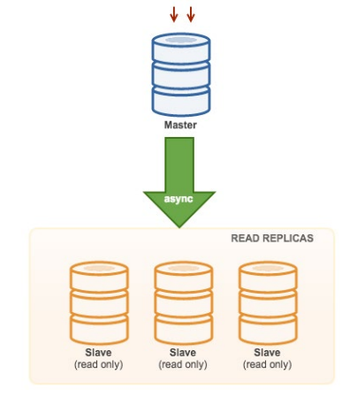
Master with Slaves (Single Replication)

Slide 10
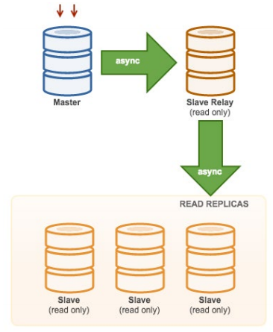
Master with Relay Slaves (Chain Replication)

Slide 11
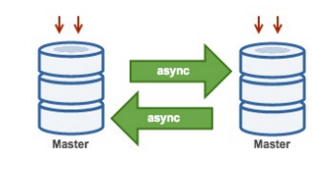
Master with Active Master (Circular Replication)

Slide 12
Master with Active Master (Circular Replication)
Also known as ring topology, this setup requires two or more MySQL servers which act as master. All masters receive writes and generate binlogs with a few caveats:
You need to set auto-increment offset on each server to avoid primary key collisions.
There is no conflict resolution.
MySQL Replication currently does not support any locking protocol between master and slave to guarantee the atomicity of a distributed update across two different servers.
Common practice is to only write to one master and the other master acts as a hot-standby node. Still, if you have slaves below that tier, you have to switch to the new master manually if the designated master fails.

Slide 13
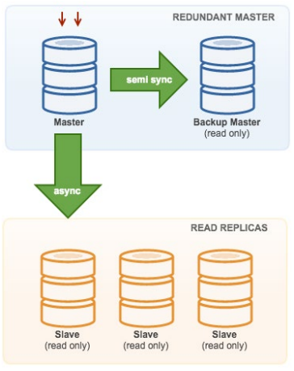
Master with Backup Master (Multiple Replication)

Slide 14
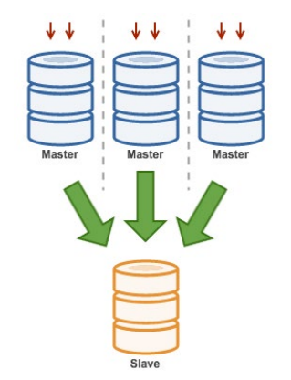
Multiple Masters to Single Slave (Multi-Source Replication)

Slide 15
Setting Up Replication
Enable binary logs on the master.
Assign a server id to each server and restart the servers.
Grant a user on the master server.
Take the backup of master server.
Initialize the slave with a replica of data.
Configure the slave.
Start replication.

Slide 16
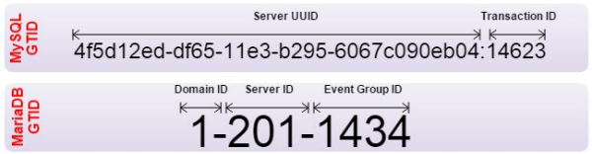
Global Transaction Identifier (GTID)
Global Transaction Identifiers (GTID) was introduced in MySQL 5.6. GTID is a unique identifier created and associated with each transaction committed on the server of origin (master). This identifier is unique not only to the server on which it originated, but is unique across all servers in a given replication setup. There is a one-to-one mapping between all transactions and all GTIDs

Slide 17
Replication in MySQL 5.5 and Earlier
In MySQL 5.5, resuming a broken replication setup required you to determine the last binary log file and position, which are distinct on nodes if binary logging is enabled.
If the MySQL master fails, replication breaks and the slave will need to switch to another master.
You will need to promote the most updated slave node to be a master, and manually determine a new binary log file and position of the last transaction executed by the slave.
Another option is to dump the data from the new master node, restore it on slave and start replication with the new master node. These options are of course doable, but not very practical in production

Slide 18
How GTID Solves the Problem
In MySQL 5.5. or before, Replication works in such a way that all nodes will generate different binlog files. Binlog events are the same and in the same order, but binlog file offsets may vary.
With GTID, slaves can see a unique transaction coming in from several masters and this can easily be mapped into the slave execution list if it needs to restart or resume replication.
It’s not important anymore in which binary log position a transaction was recorded, all you need to know is the GTID: ‘966073f3-b6a4-11e4-af2c-080027880ca6:4’.
MySQL knows which transactions have been executed and therefore it knows which transactions need to be executed next. Forget about binary logs, it’s now all in the GTID

Slide 19
Multi-Threaded Slave
MySQL 5.6 allows you to execute replicated events in parallel as long as data is split across several databases. This feature is named “Multi-Threaded Slave” (MTS) LOGICAL_CLOCK and it is easy to enable by setting slave_parallel_workers to a > 1 value.
In MySQL 5.7, it can now be used for any workload, including intra-schema, unlike 5.6 where it could only be applied with one thread per schema. MySQL 8.0 introduced write-sets, which allows for even better parallelization of applying binary log events

Slide 20
Crash-Safe Slave
Crash safe means even if a slave mysqld /OS crash, you can recover the slave and continue replication without restoring MySQL databases onto the slave. To make crash safe slave work, you have to use InnoDB storage engine only, and in 5.6 you need to set relay_log_info_repository=TABLE and relay_log_recovery=1.
Durability (sync_binlog = 1 and innodb_flush_log_at_trx_commit = 1) is NOT required.
Variable innodb_flush_log_at_trx_commit makes sure that every transaction is written to the disk and that it can survive the server crash. In case the binary log is used for replication sync_binlog makes sure that every transaction written to the binary log matches the one executed in the storage engine.

Slide 21
Group Commit
InnoDB, like any other ACID-compliant database engine, flushes the redo log of a transaction before it is committed. InnoDB uses group commit functionality to group multiple such flush requests together to avoid one flush for each commit.
With group commit, InnoDB issues a single write to the log file to perform the commit action for multiple user transactions that commit at about the same time, significantly improving throughput.

