Slide 1
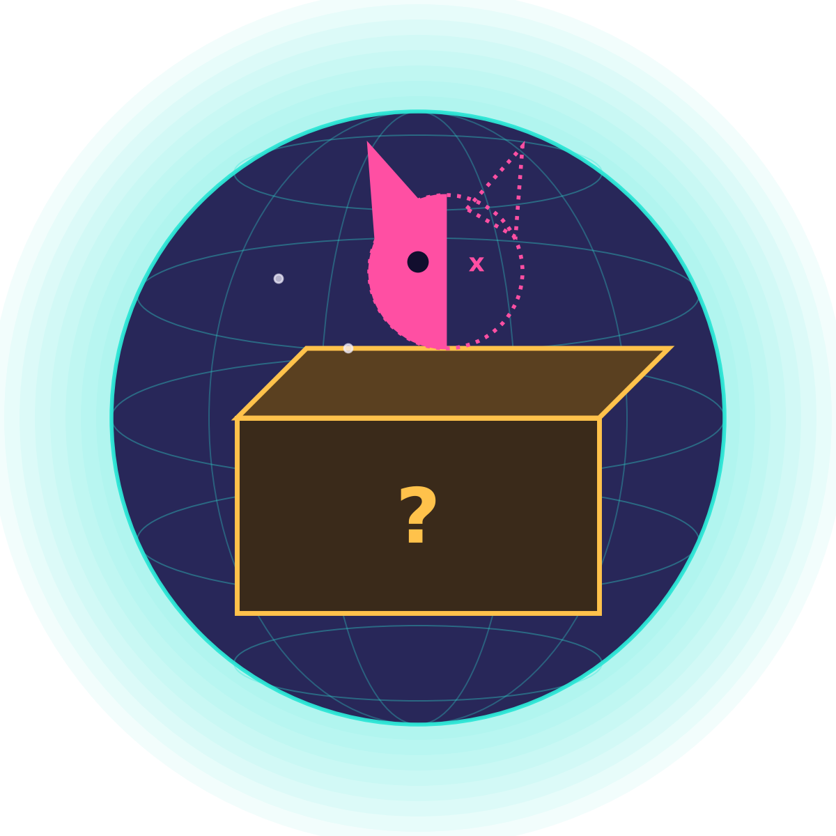
SCHRÖDINGER'S DEPOT
My quantum journey in 10 katas
Superposition, gates, entanglement, search, noise, finance, repair and teleportation, explained for a beginner.
Python · Qiskit · uv
Notes:
This deck sums up ten coding katas. You don't need to remember any formulas: each slide has one idea, one picture and one result I actually ran. The cat in the box is Schrödinger's cat, the classic picture of 'both at once until you look'.

Slide 2
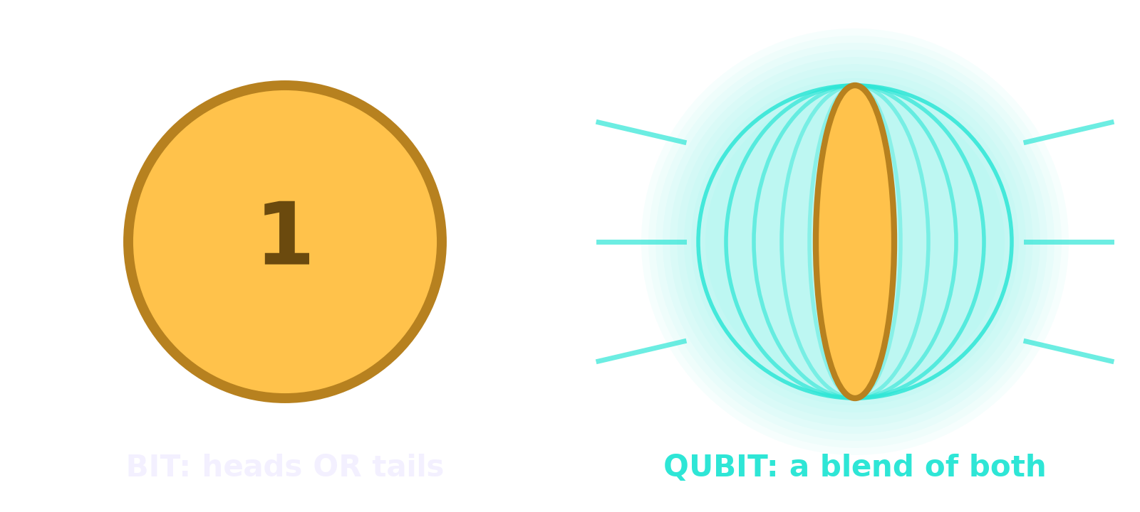
A bit is a coin. A qubit is a spinning coin.
Kata 1
Looking = the coin lands. While a qubit spins, it holds both 0 and 1 with some weight. The moment you measure, it lands on one of them at random, and the blend is gone.
A perfect 50/50 coin, made of one qubit.
Notes:
The H (Hadamard) gate puts a qubit into an even blend of 0 and 1. Measuring 1000 times gave 502 zeros and 498 ones. That randomness isn't a bug; it's how the qubit behaves. The trick of quantum computing is to steer the weights BEFORE you look.

Slide 3
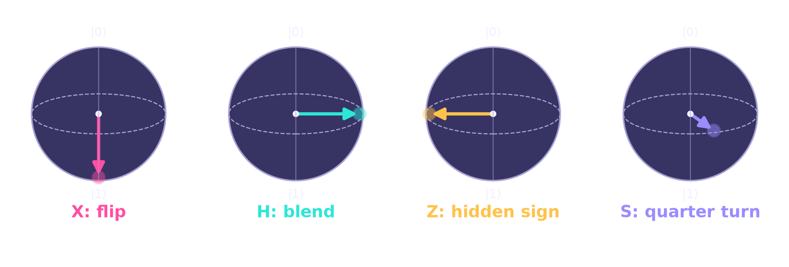
Gates are just turns of an arrow
Katas 2–3
Picture the qubit as an arrow in a ball: pointing up is 0, down is 1, anywhere in between is a blend.
H then H = do nothing
S then S = Z
H, Z, H = X
Notes:
X flips 0 and 1. H makes the 50/50 blend. Z and S change a hidden 'direction' (the phase): you can't see it by measuring directly, but it matters later. The combos at the bottom are ones I discovered in the katas: for example, H-Z-H turns an invisible sign into a visible flip.

Slide 4
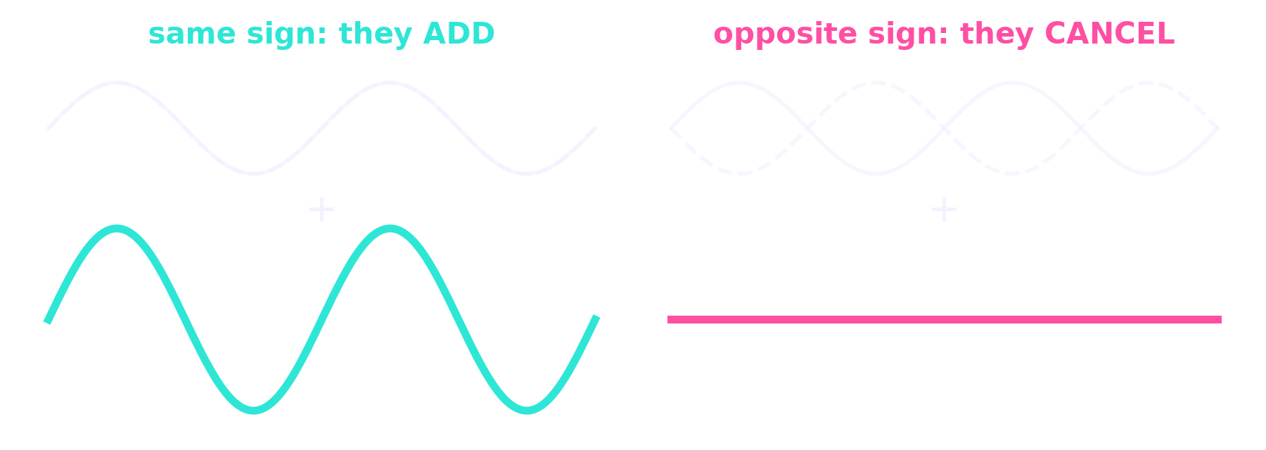
The secret sauce: interference
The myth
“A quantum computer tries every answer at once.”
The truth
Qubit weights behave like waves. Arrange the hidden signs so the wrong answers cancel and the right one adds up. Then measure.
That's why Z and S matter. They flip or turn the hidden sign, which decides whether two paths add or cancel.
Every algorithm in this deck is this trick in disguise.
Notes:
If there's one idea to keep, it's this one. Think of noise-cancelling headphones: two waves with opposite signs cancel to silence. Quantum algorithms choreograph the signs so wrong answers cancel and the right answer gets louder.

Slide 5
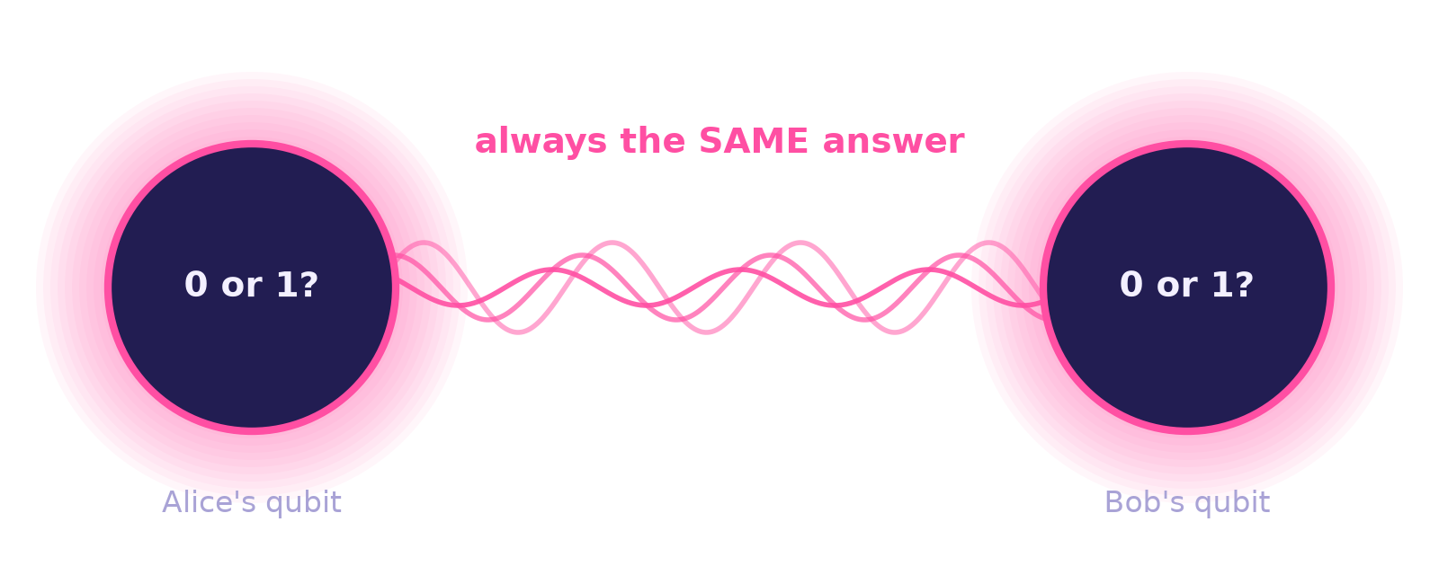
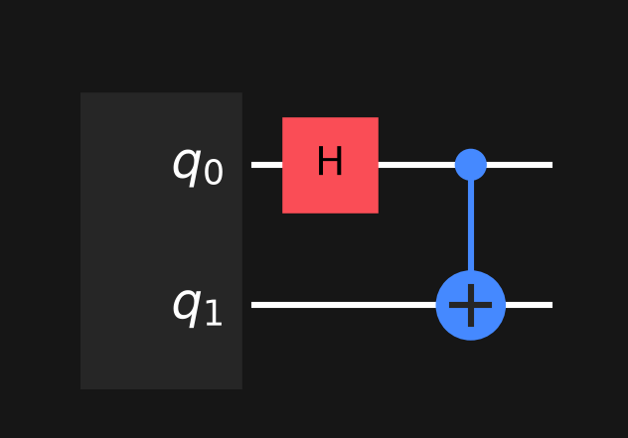
Entanglement: two coins, one answer
Kata 4
The recipe is just two gates:
H blends qubit 0.
CX copies that blend onto qubit 1.
Now they're a single “Bell pair”.
Never 01 or 10: they always agree.
Notes:
Each qubit on its own is still a random coin. But the two are linked: whenever one lands on 0 the other does too, even though neither had decided beforehand. Einstein called this 'spooky action at a distance'. We use it again for teleportation at the end.

Slide 6
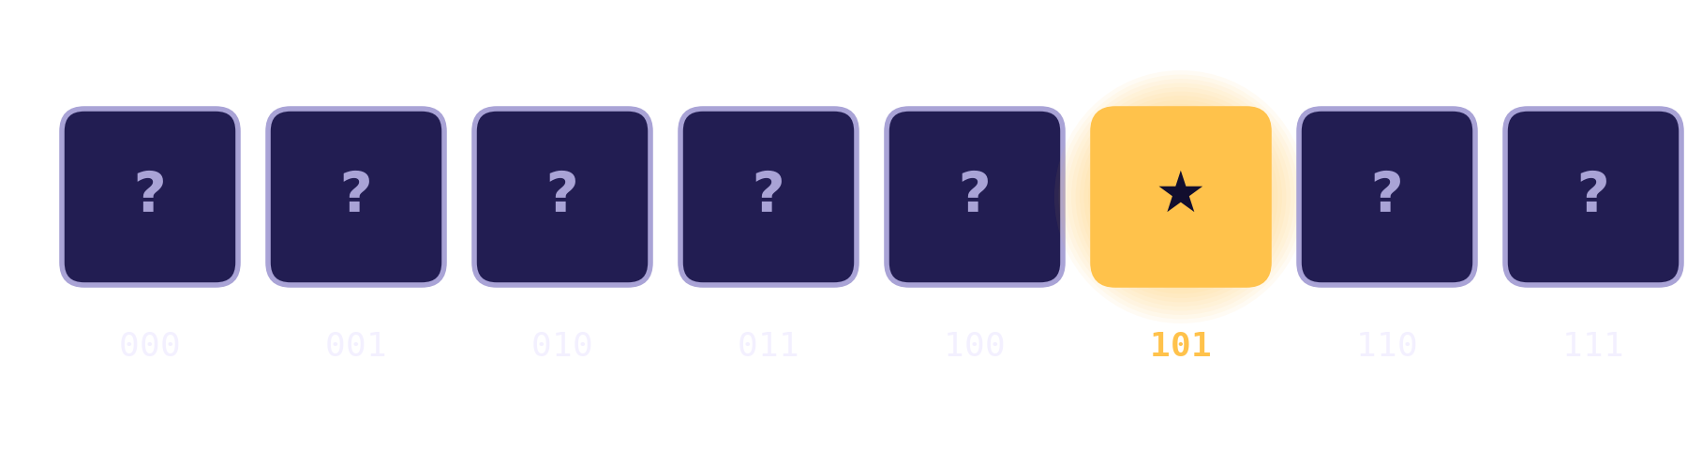
Grover's search: find the prize faster
Katas 5–6
1. Blend all 8 boxes (12.5% each).
2. Oracle puts a hidden minus sign on the prize.
3. Diffuser uses interference to turn that sign into a bigger weight.
Repeat 2–3 the right number of times, then open one box.
Too many rounds overshoots!
Notes:
With 8 boxes, a normal search needs up to 8 tries. Grover needs about the square root: 2 rounds reach 94.5%. The surprise: a third round makes it WORSE (33%), because the arrow turns past the target. Quantum algorithms need exactly the right number of steps.

Slide 7
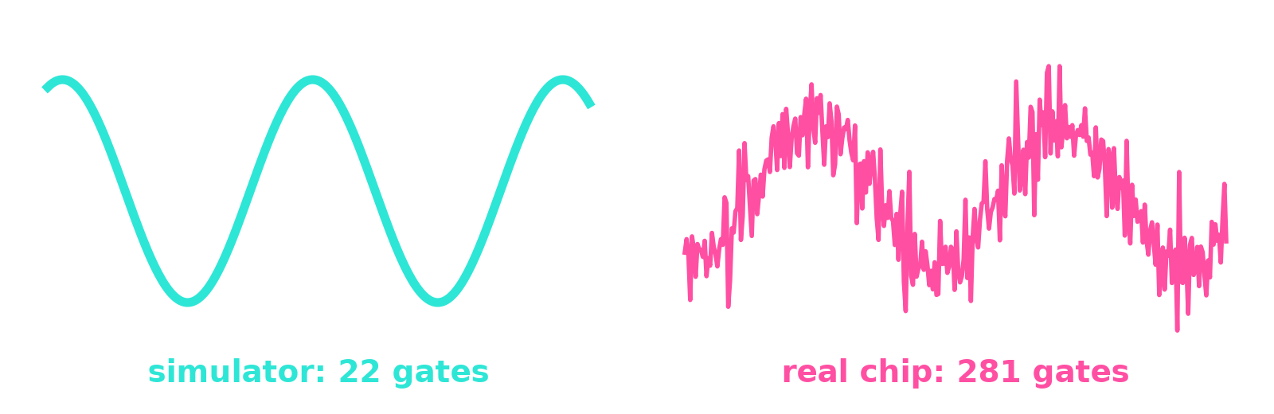
Real quantum chips are noisy
Kata 7
94.5%
found the prize on a perfect simulator
66.8%
on a copy of a real IBM chip (FakeBrisbane)
Same Grover circuit, two machines.
A real chip only knows a few basic gates and only lets some qubits talk to each other. Translating our 22 neat gates for IBM's Brisbane chip made 281, and every gate adds a little error.
13×
more gates after translating for the chip
Notes:
Qubits are fragile: heat, vibration and imperfect control all nudge them. On a perfect simulator Grover found the prize 945 times out of 1000; on a simulated real chip only 668. That's why today's machines are called NISQ: Noisy Intermediate-Scale Quantum. It's also why error correction (later) matters so much.

Slide 8
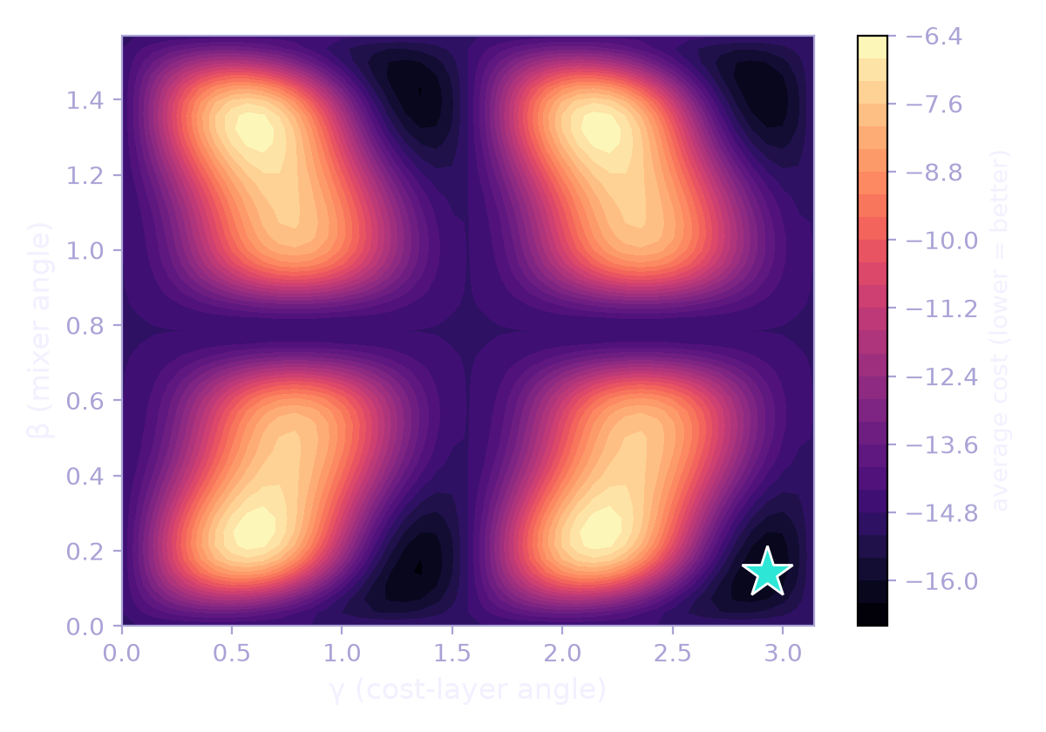
QAOA: quantum and classical as a team
Kata 8
1
Write the problem as a cost
Which stocks to buy? Each yes/no is one qubit. Cost = risk − return + penalty.
2
Quantum circuit scores two angles
γ turns each answer by its cost, β mixes answers so they interfere.
3
Classical optimizer tunes the angles
Try, score, adjust, repeat until the cost stops dropping. The star on the map is the best spot.
Notes:
QAOA = Quantum Approximate Optimization Algorithm. The map shows the real 8-stock problem: for every pair of angles, the colour is the average cost the circuit produces. Dark is good. The classical computer walks downhill on this map; the quantum circuit tells it how high each spot is.

Slide 9
The real test: 5 years of stock prices
Bonus
Honest result
QAOA found the truly best pick in 16 of 16 quarters.
But plain equal weighting still won on risk-adjusted return.
Quantum pays off at hundreds of assets. At 8, it's practice.
JNJ 40% · XOM 25% · AAPL 25% · GLD 10%
Notes:
I ran the full pipeline on real prices for AAPL, MSFT, JPM, JNJ, XOM, PG, gold and bonds, re-deciding every quarter using only past data. QAOA picked the 4 assets, a classical optimizer split the money. It earned the most (21.5% a year) but took more risk; equal weighting had the best return per unit of risk. Educational, not investment advice.

Slide 10
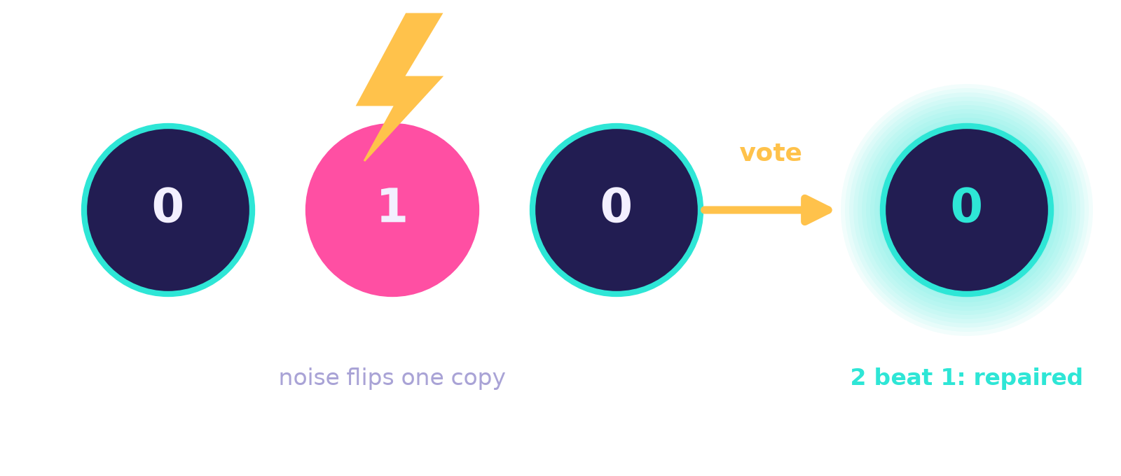
Fixing errors with a majority vote
Kata 9
20 / 80
the precious blend before the error
20 / 80
after an error on qubit 0, 1 or 2, repaired
The catch: you can't copy a qubit or peek at it. So instead of copies we entangle it with 2 helpers (CX, CX). An error then shows up as disagreement, and a CCX gate flips the odd one out back.
3 → 1
three physical qubits protect one logical qubit
Notes:
This is the bit-flip repair code. It survives any ONE flip on any of the three qubits: the result was 20% zero, 80% one in every case. Real error correction (like Google's and IBM's) uses the same idea with hundreds of physical qubits per logical one.

Slide 11
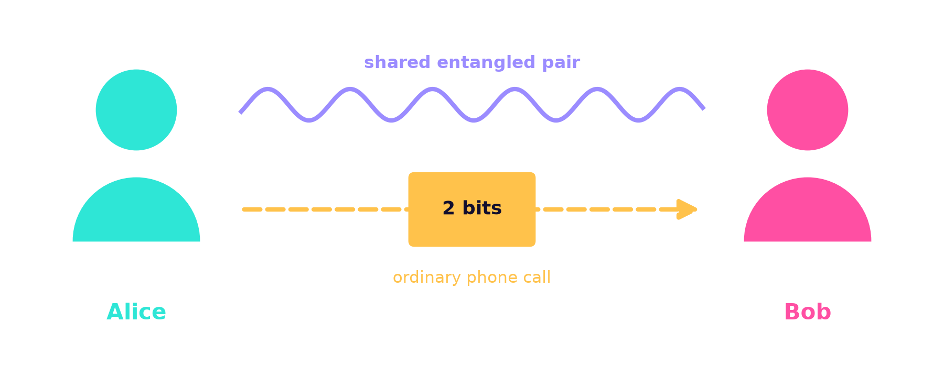
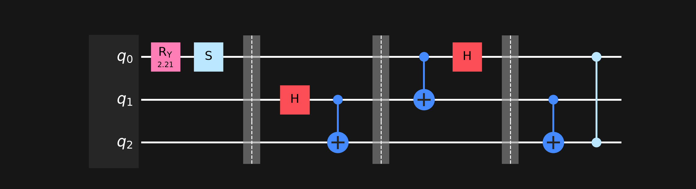
Teleportation: moving a qubit with 2 bits
Kata 10
Nothing travels faster than light: Bob needs Alice's 2 bits.
message · make Bell pair · Alice mixes & measures · Bob fixes
Notes:
Alice has a qubit she wants Bob to have. They share an entangled pair from earlier. Alice mixes her message with her half, measures, and phones Bob two ordinary bits. Bob uses them to pick a fix (flip and/or sign). With both fixes he gets the message 100% exactly. Alice's original is destroyed, so it's a move, not a copy.

Slide 12
Six ideas that carry everything
1
Superposition
2
Interference
3
Entanglement
A qubit is a blend of 0 and 1 until you look.
Hidden signs make wrong answers cancel and right ones grow.
Linked qubits give linked answers.
4
Noise
5
Teamwork
6
Repair
Real chips make small errors; more gates, more errors.
Quantum scores, classical steers (QAOA).
Spread one qubit over several and vote.
Notes:
If a slide earlier felt fuzzy, this is the version to remember. Every kata was one of these ideas, or two of them combined.

Slide 13
You don't need to understand it all yet.
Physicists spent decades on this. In 10 katas I built circuits that search, compete with stock strategies, repair errors and teleport.
Next: run a circuit on a real IBM quantum computer (free tier) and watch the noise for real.
Educational project. Nothing here is investment advice.
Notes:
A good closing line: 'I don't claim to understand quantum mechanics. Nobody really does. But I can now build with it.'

