Slide 1
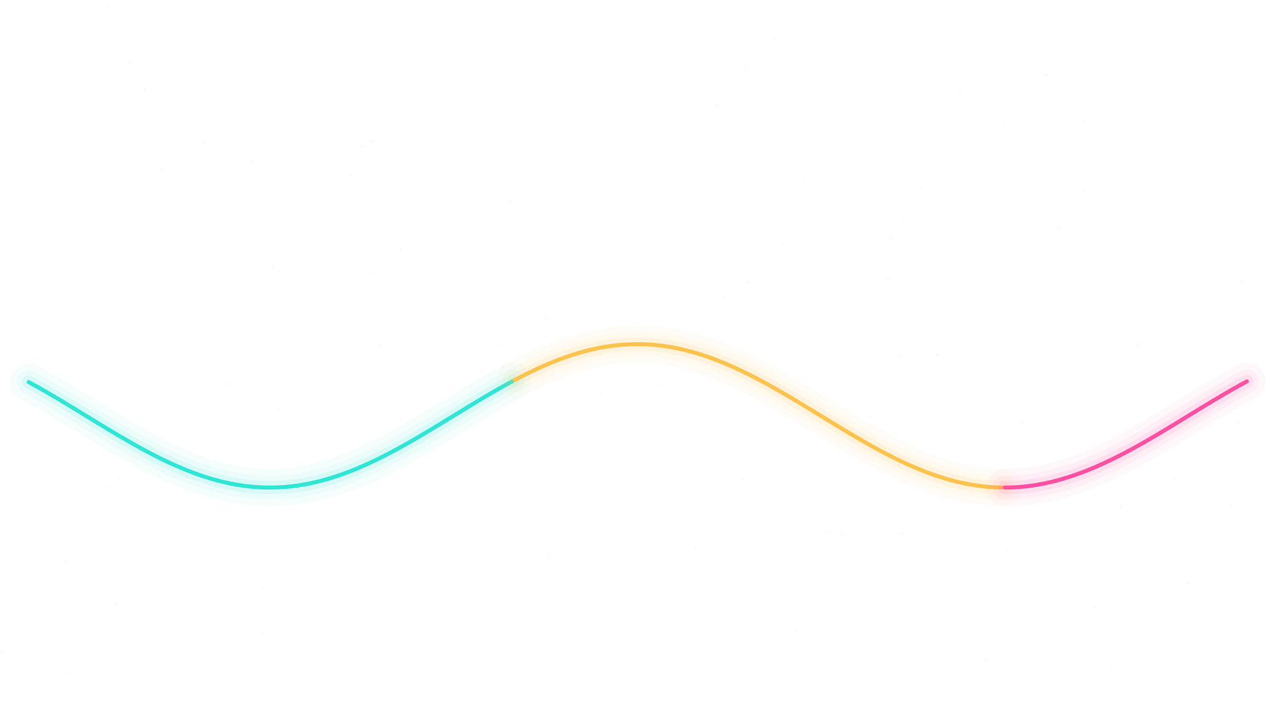
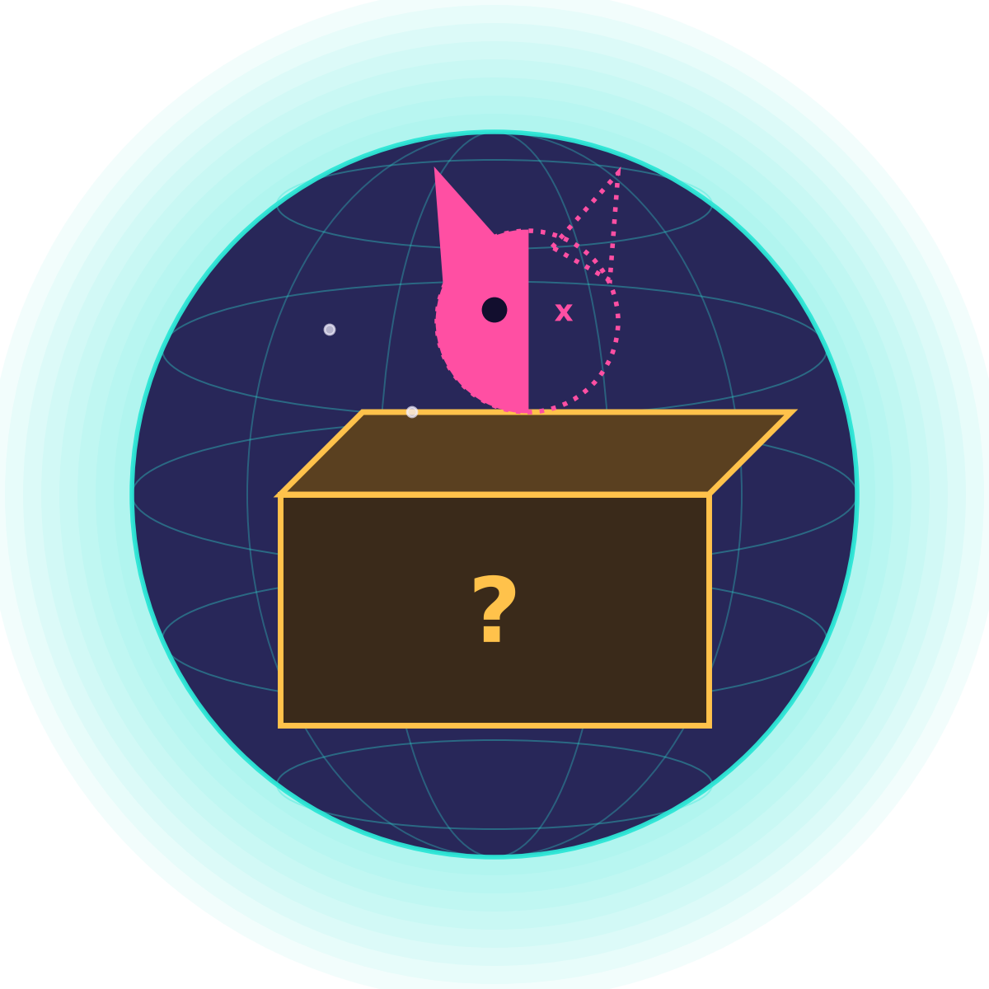
My quantum journey
10 katas, from one spinning qubit to teleportation
ACT 1 · THE BUILDING BLOCKS
ACT 2 · ALGORITHMS
ACT 3 · MAKING IT REAL
Grover × 8
3 qubits, 2 rounds
Entanglement
two linked coins
Teleportation
Alice → Bob
5
6
Flip & blend
X and H gates
QAOA
picking stocks
1
4
7
10
Grover
find the prize
2
3
8
9
Superposition
a spinning coin
Noise
real chips make errors
Hidden signs
Z and S gates
Error repair
majority vote
“
Spooky action at a distance.
— Albert Einstein, on entanglement (stop 4), 1947
Notes:
Act 1: the pieces. A qubit is a blend of 0 and 1 until you look; gates turn it; hidden signs matter; two qubits can be linked. Act 2: putting pieces together into algorithms: Grover finds a marked box fast, noise shows why real chips struggle, QAOA teams a quantum circuit with a normal computer to pick stocks. Act 3: making it robust and useful: repairing errors by majority vote and teleporting a qubit.

Slide 2
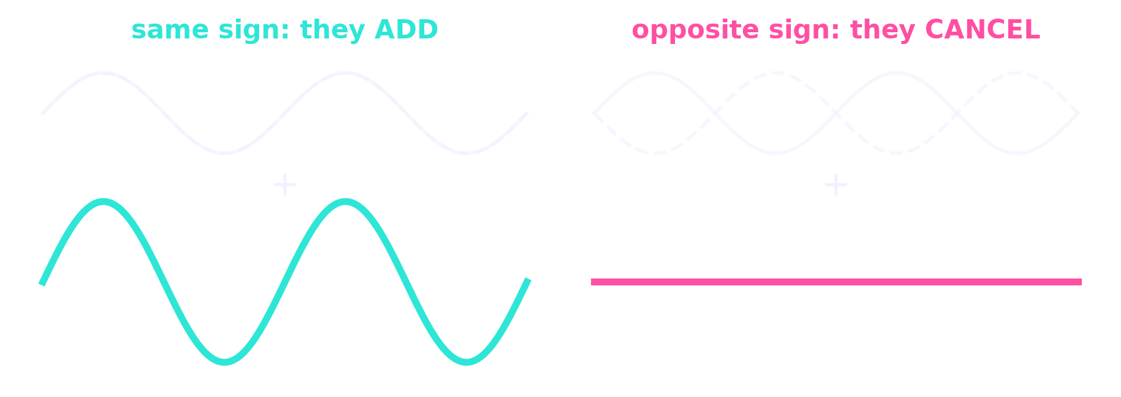
“
I think I can safely say that nobody understands quantum mechanics.
— Richard Feynman, 1965
THE ONE THING I'LL REMEMBER
A quantum computer doesn't try every answer at once. It makes the wrong answers cancel and the right one grow.
94.5%
66.8%
100%
Grover found the prize among 8 boxes in 2 rounds
the same search on a noisy copy of a real IBM chip
of the message arrived when I teleported a qubit
Notes:
Noise-cancelling headphones are the best picture: two waves with opposite signs make silence. Every algorithm in the katas arranges hidden signs so the wrong answers cancel out. The three numbers are my own results: the algorithm works, real hardware is noisy, and entanglement lets you move a qubit's state perfectly. Feynman's line is a comfort: not fully understanding it is normal. He also proposed quantum computers in 1981, because nature is quantum, so simulating it needs a quantum machine.

