Slide 1
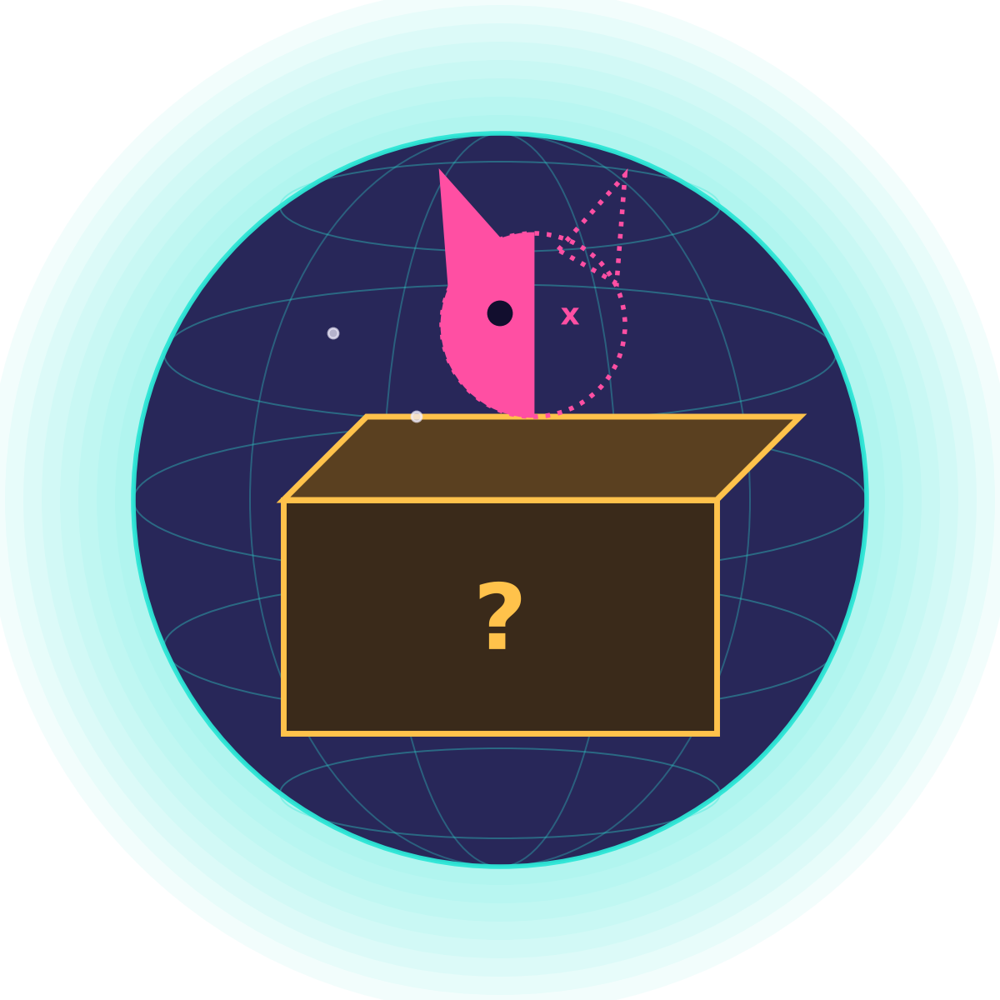
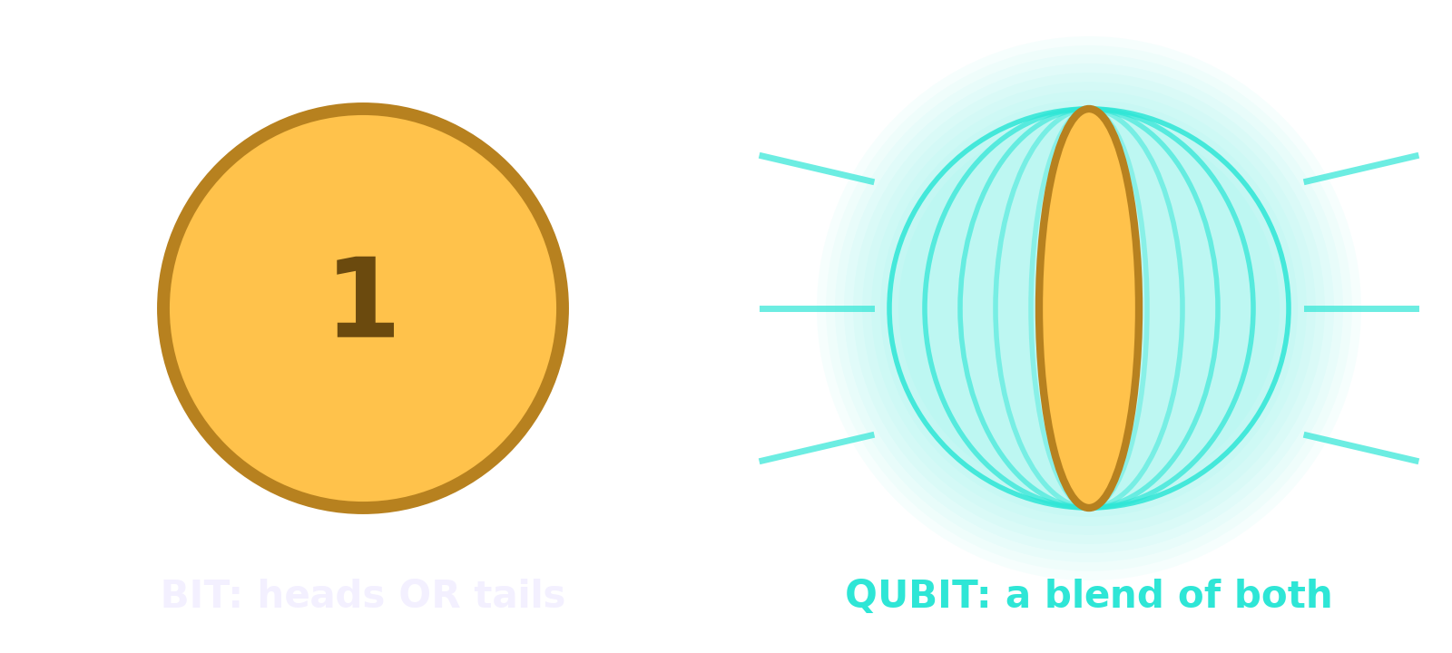
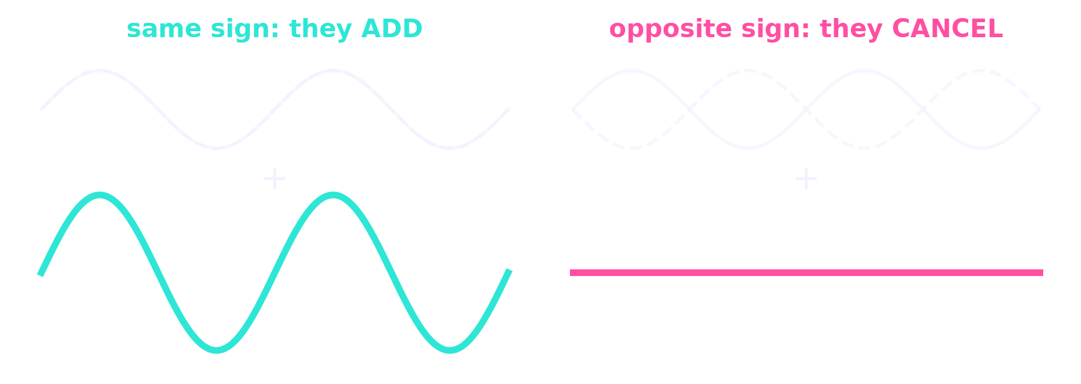
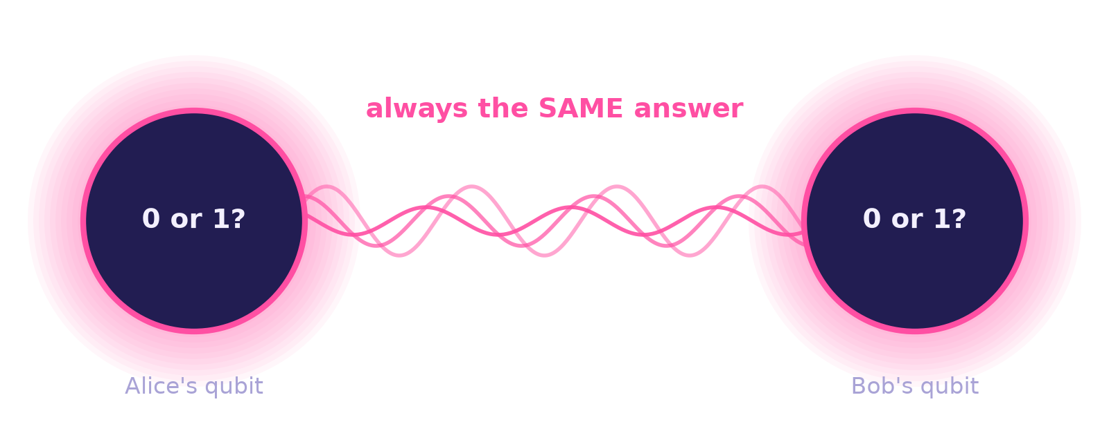
SCHRÖDINGER'S DEPOT · 10 QUANTUM KATAS
Quantum computing in three ideas
1 · Superposition
2 · Interference
3 · Entanglement
A qubit is a spinning coin: a blend of 0 and 1 until you look. Looking makes it land at random.
The blend behaves like waves. Arrange hidden signs so wrong answers cancel and the right one grows.
Two linked qubits always give matching answers, even though each is random on its own.
Notes:
Everything I did in the katas uses these three ideas. Superposition: the H gate makes a 50/50 blend (1000 measurements gave 502 zeros, 498 ones). Interference is the real secret: gates like Z and S flip hidden signs so paths add or cancel. Entanglement: H then CX makes a Bell pair that only ever shows 00 or 11.

Slide 2
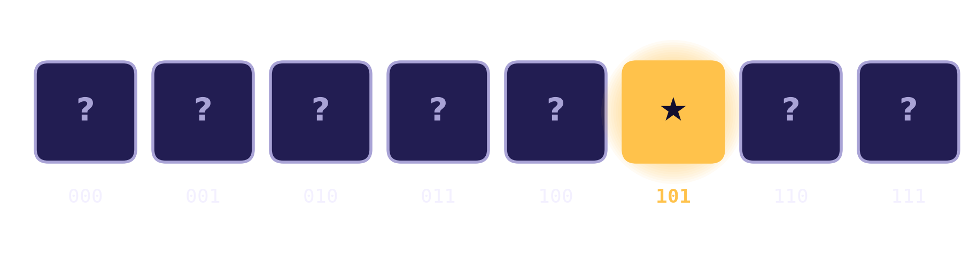
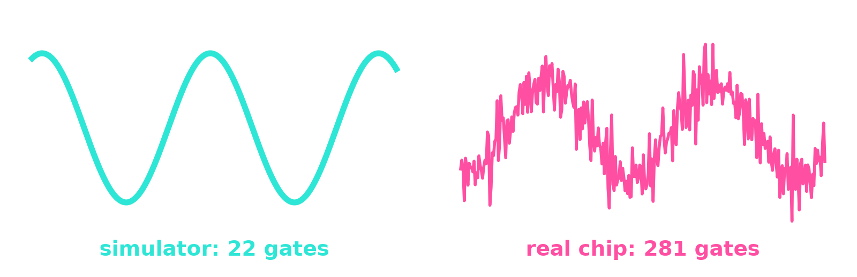
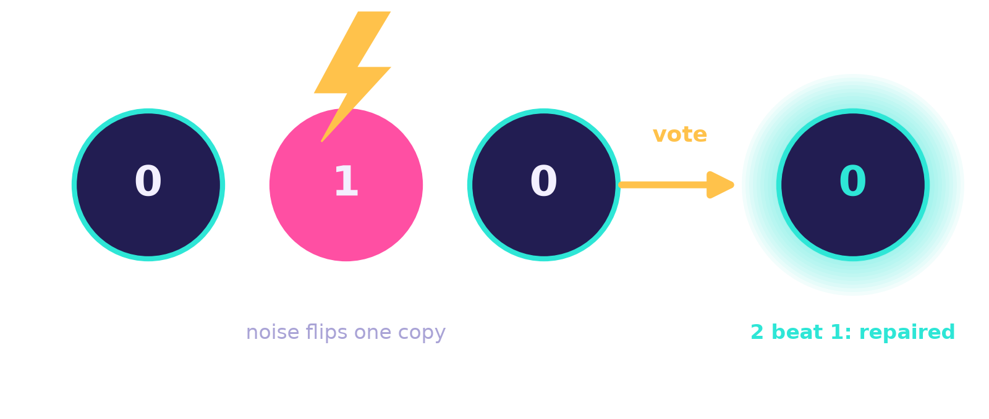
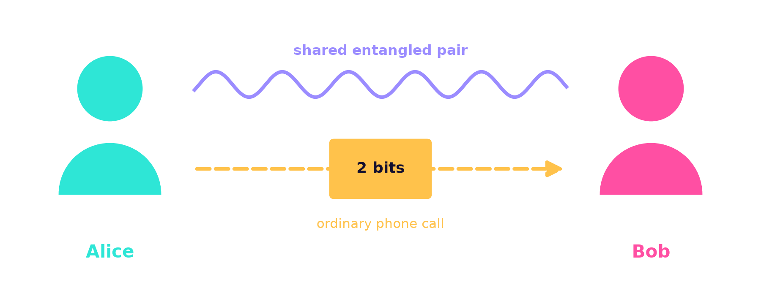
What I built with them
QAOA on 5 years of real stocks
94.5%
66.8%
JNJ 40%
XOM 25%
AAPL 25%
GLD 10%
Grover search
Real-chip noise
found the hidden box out of 8 in just 2 rounds
same search on a copy of an IBM chip: 13× more gates, more errors
The quantum circuit picks which 4 of 8 assets to hold; a classical optimizer splits the money.
It found the best pick in 16 of 16 quarters, but simple equal weighting still had the best return for its risk.
20 / 80
100%
Error repair
Teleportation
a qubit's blend survives a flip on any of 3 qubits
a qubit moved from Alice to Bob with an entangled pair + 2 bits
Notes:
Four circuits and one real-world test. Grover finds a marked item faster than checking every box, but one round too many overshoots (33%). Noise is why real chips struggle. The repair code uses 3 qubits to protect 1. Teleportation needs both of Bob's fixes. The portfolio test is educational, not investment advice.

Slide 3
What I take away
1
Not magic, choreography.
Quantum computers don't try every answer; they make wrong ones cancel.
2
Noise is the enemy.
Today's chips make errors, so we repair qubits by spreading them out.
3
Teamwork wins today.
Quantum circuits + classical computers together (QAOA).
Next: run a circuit on a real IBM quantum computer.
Notes:
You don't need to understand it all yet. Nobody fully does, but I can now build with it.

