Slide 1

Dive through the market of
MAGIST

Slide 2

Eniac offers 100% HIGH- END TECH products which are heavily based on Apple-compatible accessories
The company would like to group with Magist for it’s expansion to Brazilian market

Slide 3
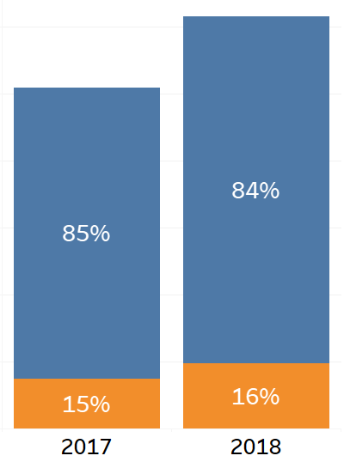

The percentage of tech-product orders is relatively low

Slide 4
Average Price of Tech Products Sold
Price Category | Average Price | Percentage
Low | 40.8 | 71 %
Medium | 189.4 | 26 %
High | 1015.3 | 3 %

Slide 5
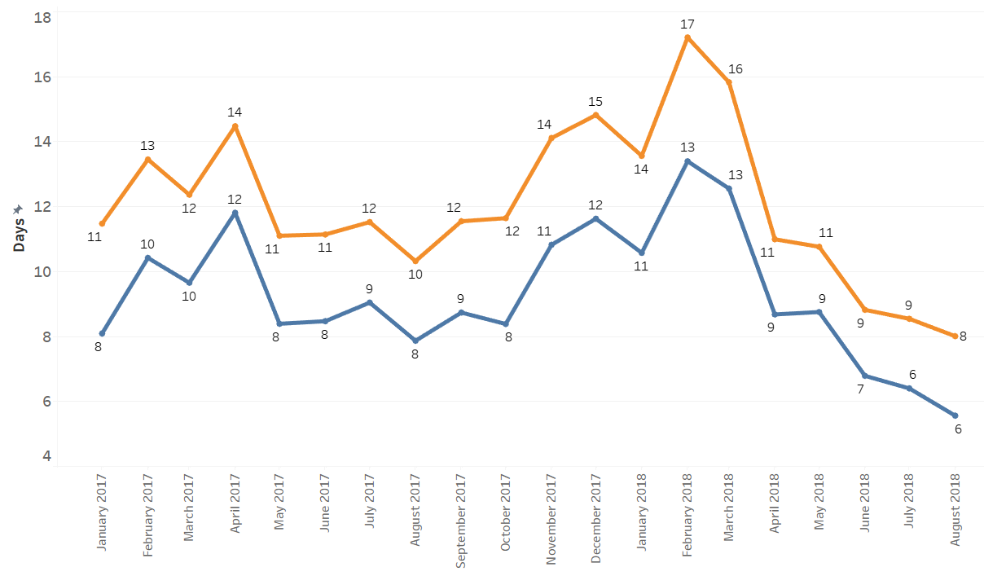

Delivery days vs. Days in Post (for Tech products)

Slide 6
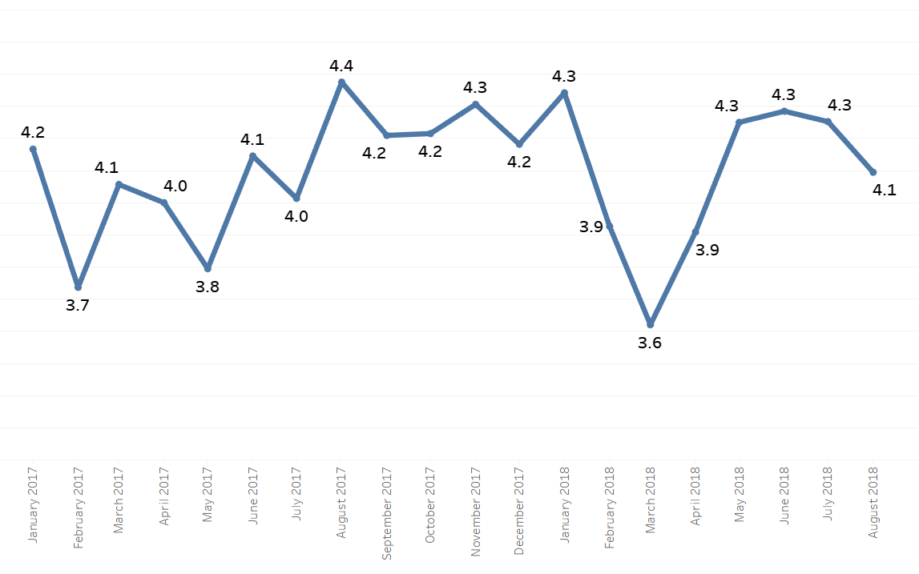
Average review score per month

Slide 7
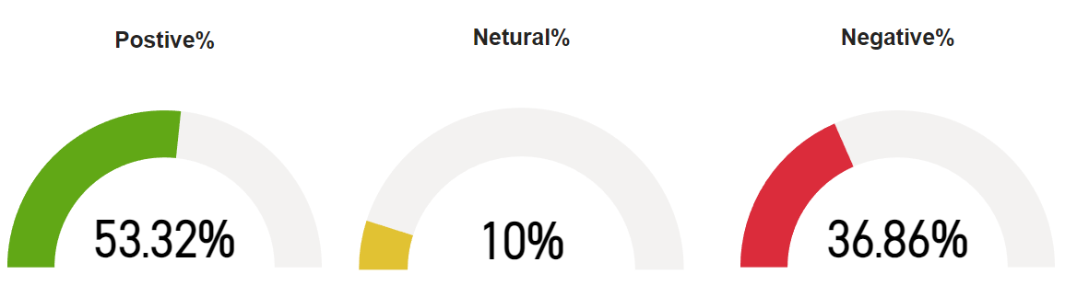
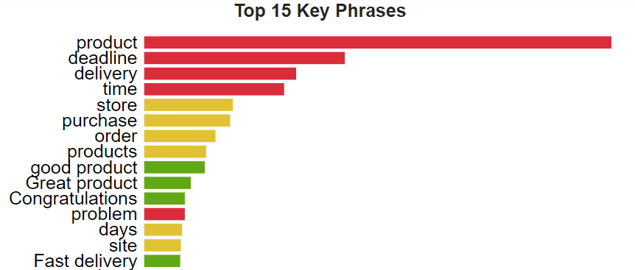
Sentiment Analysis of Customer Reviews
Result: Customers are Unsatisfied

Slide 8
SUMMARY
Less number of High-end Tech products were sold
Delay in delivery of the product
Reviews show that the customers are unsatisfied
As per the following conclusions, we would not suggest MAGIST as a good partner for the High-end Tech products.

