Slide 1
Business Change Schema Quizlet 9
Carl Edwards
{cne2}@illinois.edu

Slide 2
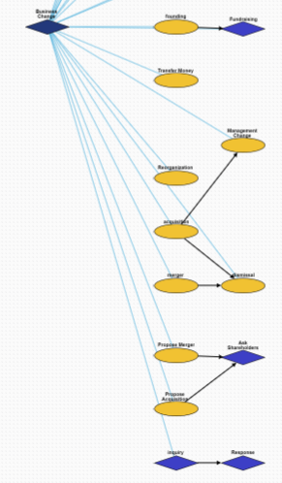
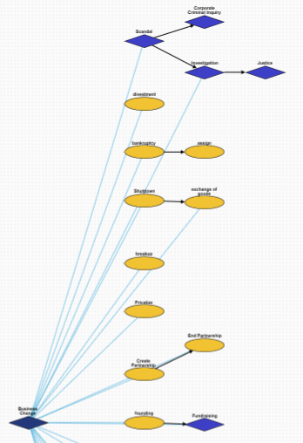
Overview

Slide 3
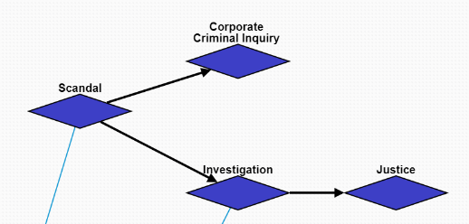
Scandal
10464:Scandal: A scandal occurs at the company.
10494:Investigation->10523:Justice: This branch involves the investigation and justice of an individual person.
10494:Corporate Criminal Inquiry: This branch involves the company as a whole being investigated for crimes.

Slide 4
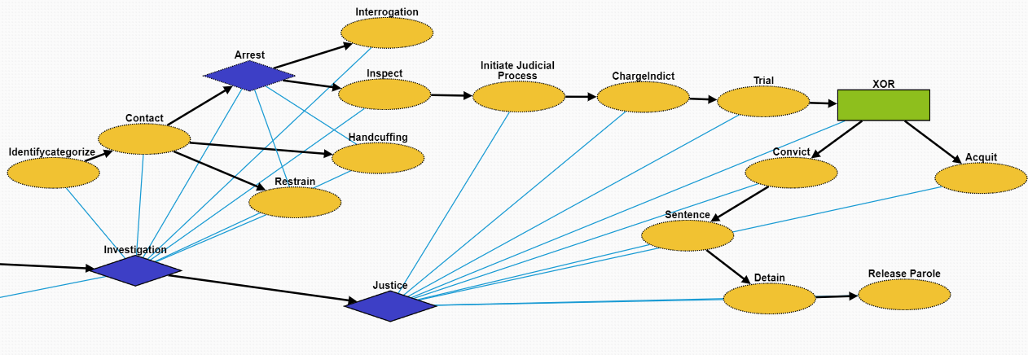
Investigation
This is the same as Criminal Justice in Quizlet 8.
10510:Identifycategorize: Identification of the suspect.
10511:Contact: Make contact with the suspect
10512:Arrest: Taking the suspect who violated laws during the outbreak into custody
10524:Handcuffing: Using handcuffs to secure a suspect who violated law
10526:Restrain:Physical restraint on the suspect
10525:Interrogation: Interviewing with the goal of eliciting useful information related to suspected crime
10513:Inspect: Organized examination or formal evaluation on the suspect

Slide 5
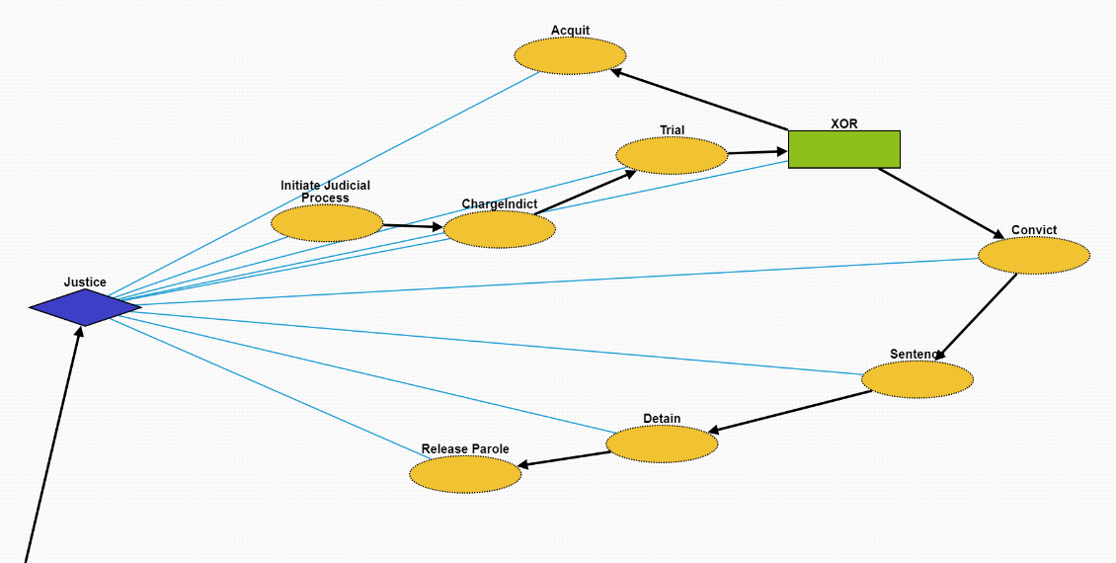
Justice
This is the same as Criminal Justice in Quizlet 8.
10514:Initiate Judicial Process: Initiate a legal proceeding on the suspect.
10515:ChargeIndict: Formal accusation made by a governmental authority on the suspect.
10516:Trial: Coming together of parties to a dispute, to present information in a tribunals on the case.
10521:Acquit: In common law jurisdictions, an acquittal certifies that the accused is free from the charge of an offense, as far as the criminal law is concerned
10517:Convict: A state or private citizen lawfully holds the criminal responsible by removing their freedom or liberty at that time.
10518:Sentence:
10519:Detain:
10520:Release Parole: Release or early release of the criminal responsible.

Slide 6
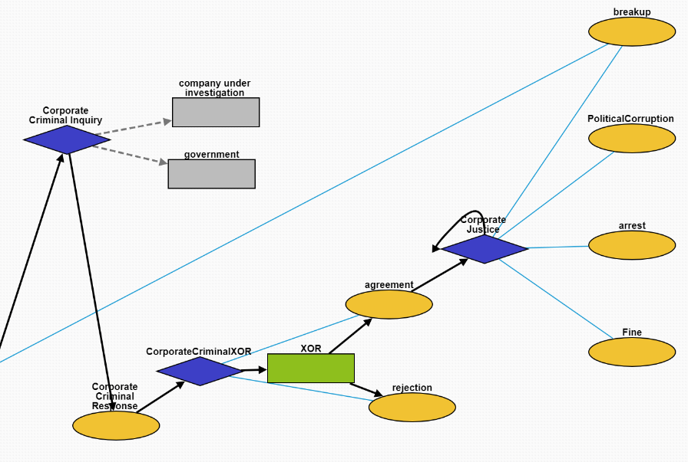
Corporate Criminal Inquiry
10492:Corporate Criminal Response: A response to a corporate criminal investigation. Created to distinguish from criminal response against people.
10503:CorporateCriminalXOR: Node to enable XOR children.
10501:agreement: The government decides a corporation broke the law.
10502:rejection: The government decides a corporation did not break the law.
10465:Corporate Justice: Government actions taken as a result of investigating a corporation.
10496:breakup: Government breaks up a company.
10466:PoliticalCorruption: The execs send money to their politician friends who pull some strings.
10495:arrest: Executives are arrested for crimes they committed carrying out their duties.
10484:Fine: The government fines a company for doing something wrong.

Slide 7
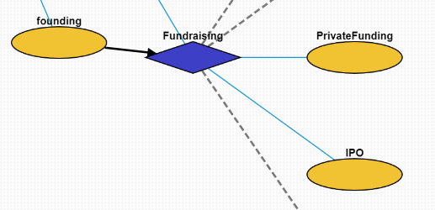
Fundraising
10462:founding: A company is founded.
10469:Fundraising: The company raises money for some goal.
10471:PrivateFunding: The company raises money from private investors (the opportunity is not available to the public).
10470:IPO: The company becomes publicly listed on a stock exchange.

Slide 8
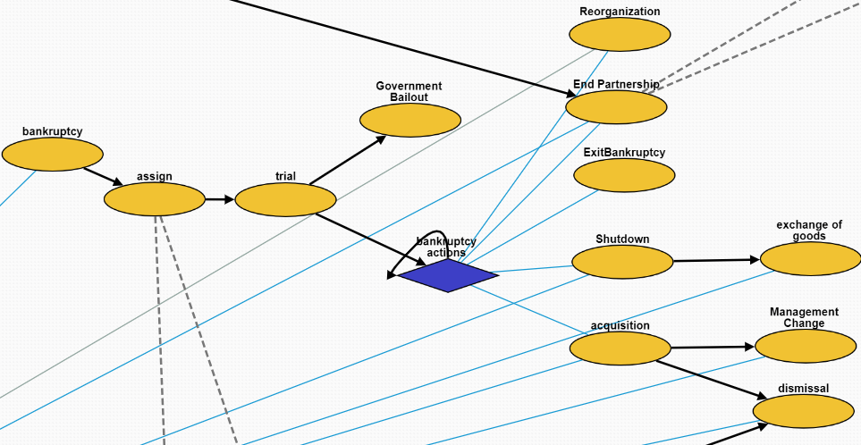
Bankruptcy
10475:assign: Government assigns a trustee to the bankruptcy case.
10476:trial: A bankruptcy case begins.
10480:Government Bailout: The government loans a lot of money to a company when it's 'too big too fail' without damaging the economy.
10472:bankruptcy actions: Different actions taken when the company is undergoing the bankruptcy process.
10461:Reorganization: The company is reorganized.
10482:End Parternship: Two companies decide to end their partnership.
10483:ExitBankruptcy: A company leaves bankruptcy.
10460:Shutdown: A company has to close for some reason.
10456:acquisition: A company is acquired by another company.
10473:exchange of goods: A company sells its assets.
10479:Management Change: The management is changed.
10504:dismissal: A bunch of employees are fired.

Slide 9
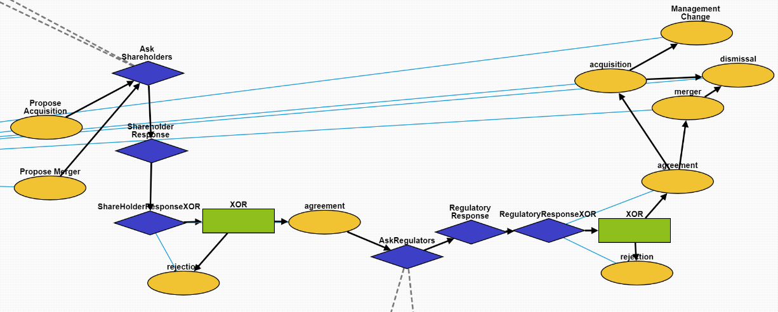
Propose Acquisition/Merger
10487:Propose Acquisition: One company proposes acquiring another company.
10486:Propose Merger: Two companies decide to try and become one company.
10505:Ask Shareholders: The companies ask their shareholders for approval.
10506:Shareholder Response: The shareholders respond.
There is also a XOR version (10509) to indicate only one child answer.
10507,10488:agreement: A positive response.
10508,10489:rejection: A negative response.
10485:AskRegulators: Ask the regulators to approve the merger/acquisition.
10491:Regulatory Response: The regulators respond.
There is also a XOR version (10490) to indicate only one child answer.
10457:merger: The companies merge together.
10456:acquisition: One company acquires another.
10504:dismissal: Employees are fired from a company.
10479:Management Change: The managers of a company are
replaced with new managers.

Slide 10
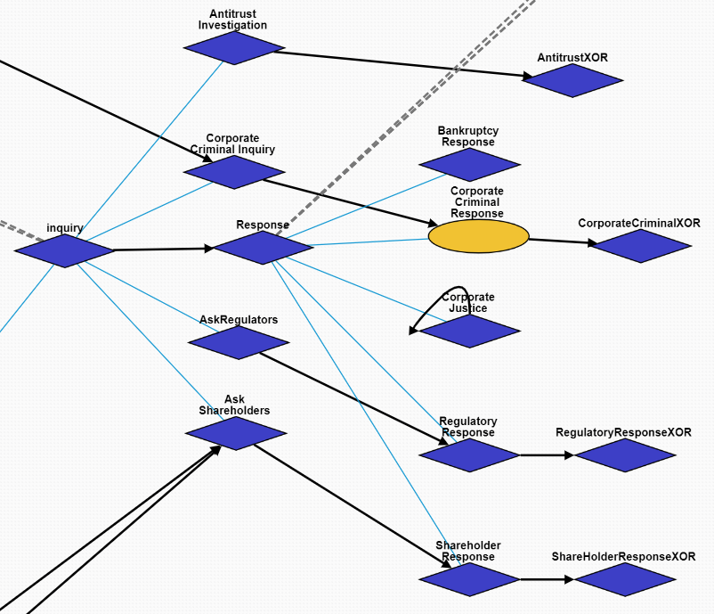
Inquiry/Response Superclasses
Overall hierarchy structure of Inquiry and Response

Slide 11
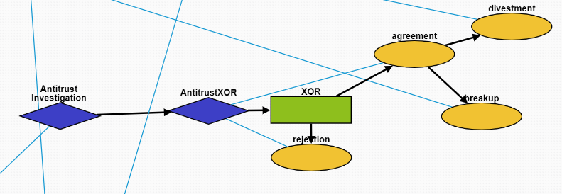
Antitrust Investigation
10497:Antitrust Investigation: The government investigates whether a company is a monopoly.
There is also a XOR version (10500) to indicate only one child answer.
10498:agreement: A positive response.
10499:rejection: A negative response.
10458:divestment: The company is forced to sell off parts of its business by the government.
10496:breakup: The company is broken up into smaller pieces by the government.

Slide 12
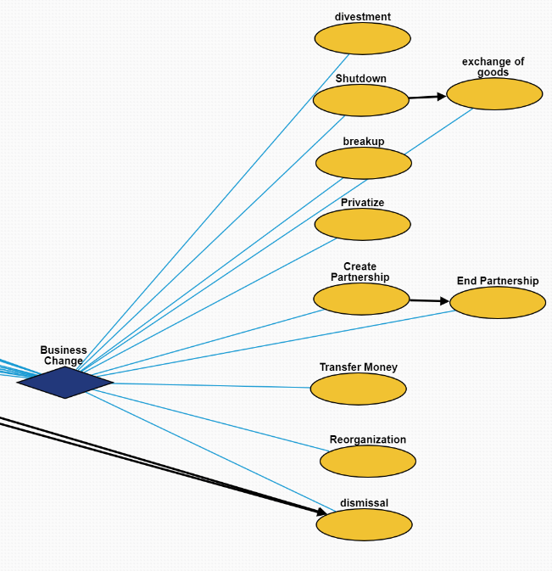
Other Business Change Events
10458:divestment: A company divests assets.
10460:Shutdown: A company shuts down.
10473:exchange of goods: A company sells assets.
10496:breakup: A company breaks up into smaller companies.
10474:Privatize: A public company’s stocks are bought up and it becomes private again.
10481:Create Partnership: Two companies partner together to do something mutually beneficial. They remain seperate entities.
10482:End Partnership: Two companies stop working together.
10477:Transfer Money: Money is transferred between two parties. This can be internal in a company.
10461:Reorganization: The structure of a company is reorganized.
10504:dismissal: Workers are fired.

