Slide 1
RESIN Civil Unrest Schema

Slide 2
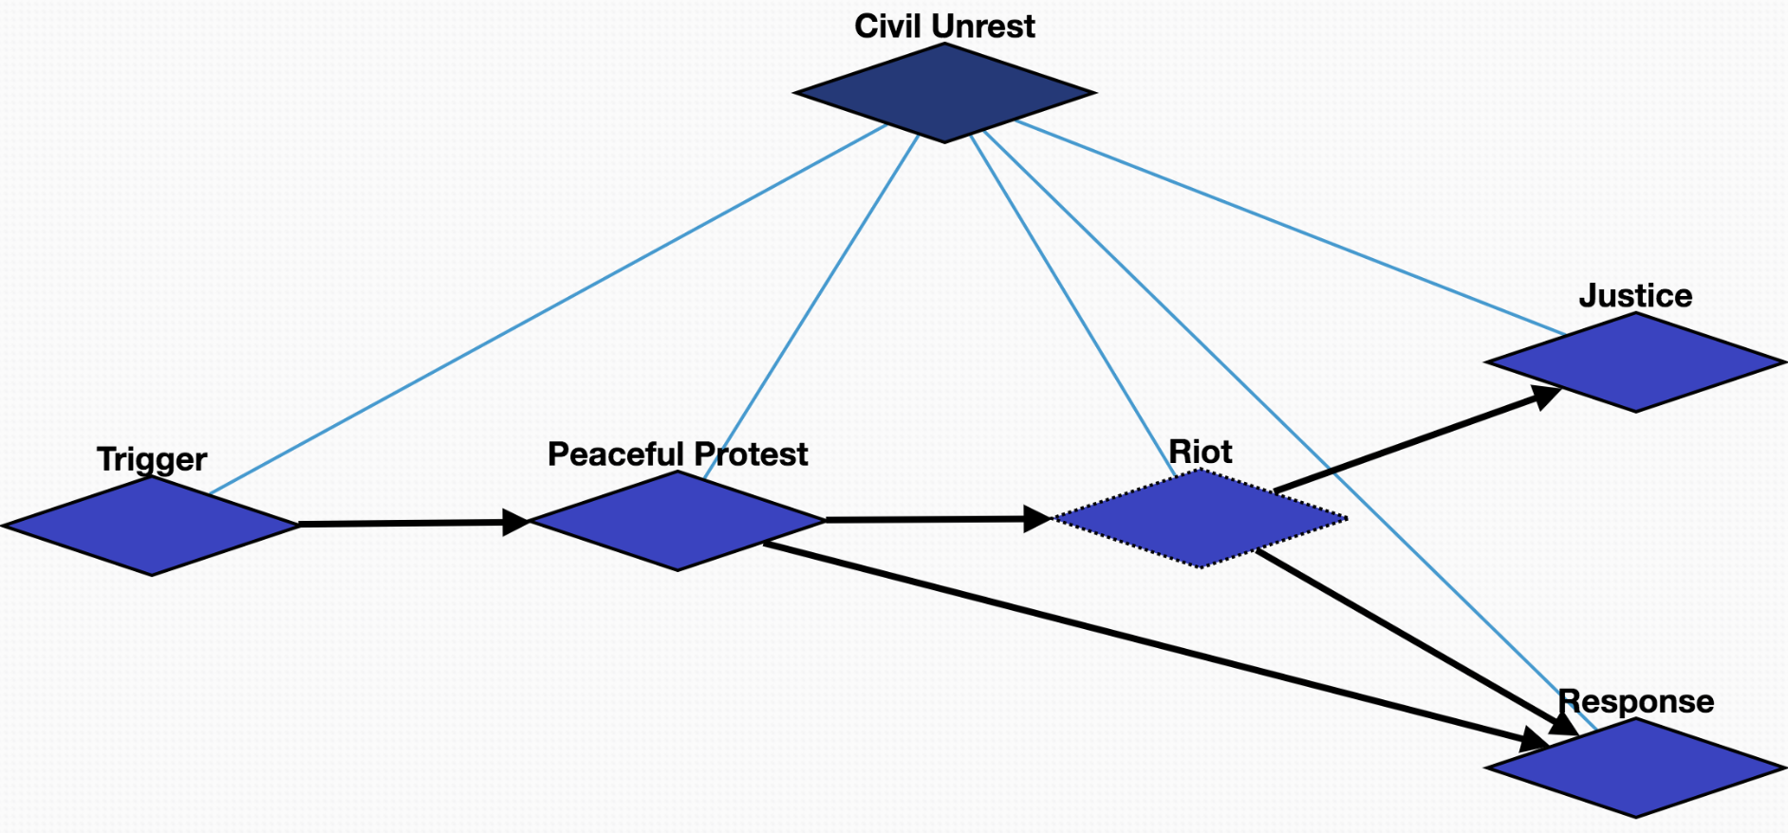
Overview

Slide 3
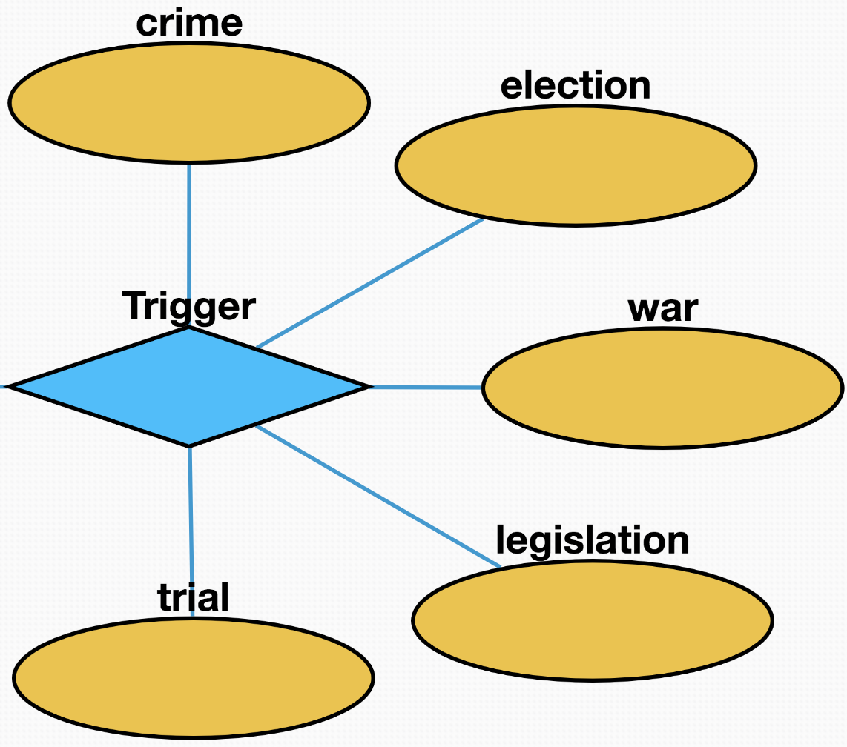
Trigger (10544)
Crime (10549): crimes that seriously threaten social security and cause widespread concerns
Election (10552): the results of the election did not meet the expectations of some people or the fairness of the election was questioned
War (10550): people suffer from injustice or protracted wars
Legislation (10548): the legal provisions are unreasonable or against the requirements of some people
Trial (10551): trials of legal cases do not meet public expectations

Slide 4
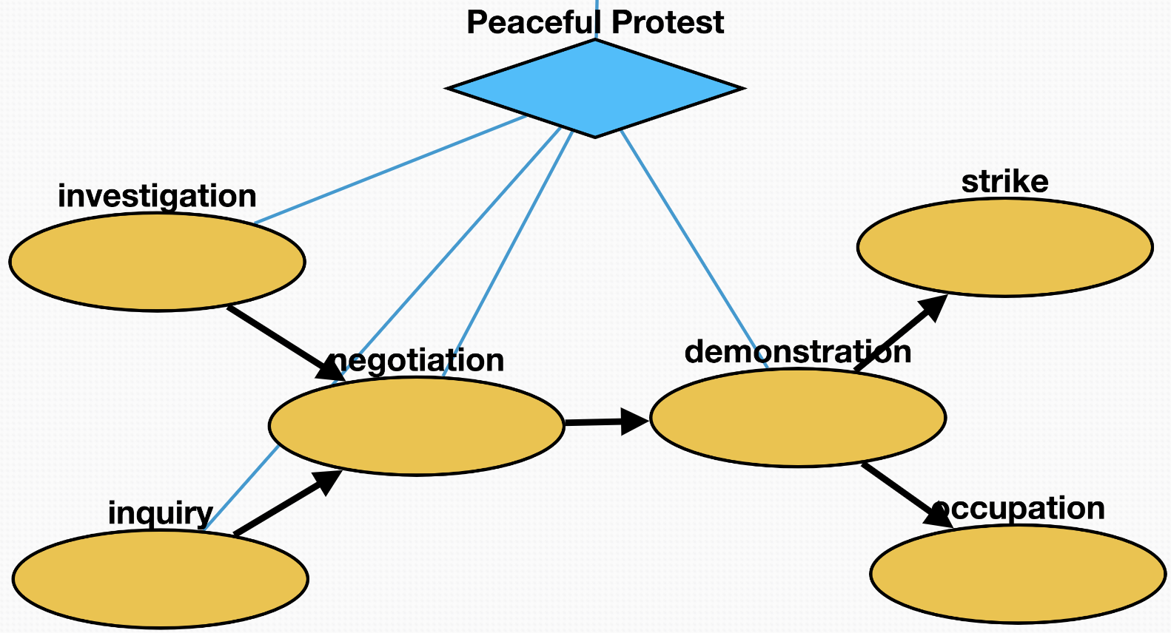
Peaceful Protest (10545)
Inquiry (10556): people seek more information about the trigger
Investigation (10557): people investigate the process or truth of the trigger
Negotiation (10555): protesters try to communicate and negotiate to look for a solution
Demonstration (10535): protest activity taking the form of a public gathering of people in a rally or walking in a march
Strike (10553): workers refuse to work as a typical form of protest to gain a concession
Occupation (10554): protesters hold public spaces or critical infrastructure as an act of protest

Slide 5
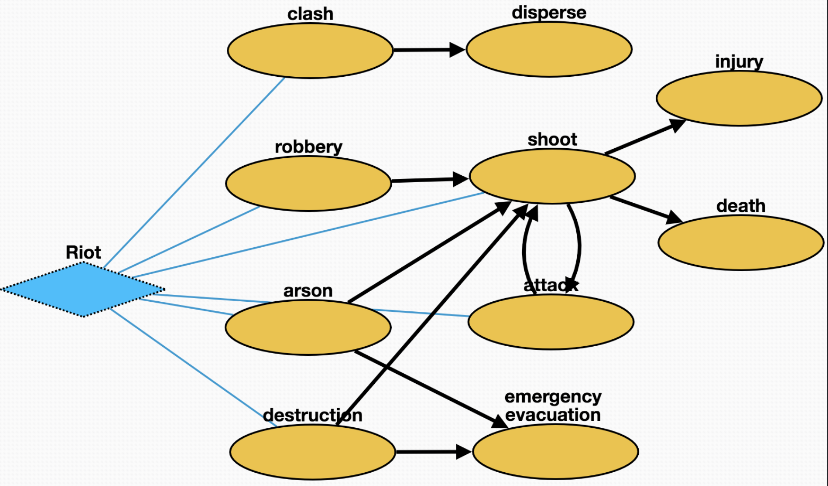
Riot (10530)
Clash (10533): Protesters clash with police
Disperse (10537): police ordered the crowd to disperse
Robbery (10541): protesters looted surrounding shops or residents
Arson (10529): protesters set fire to surrounding buildings or objects
Destruction (10543): protesters causing damage to residents' property
Shoot (10536): police shoot criminals to maintain order
Injury (10532): people get injured in conflict
Death (10540): people die in conflict
Attack (10534): protesters attack police during clash
Emergency_evacuation (10542): residents evacuated from burning or destroyed buildings

Slide 6
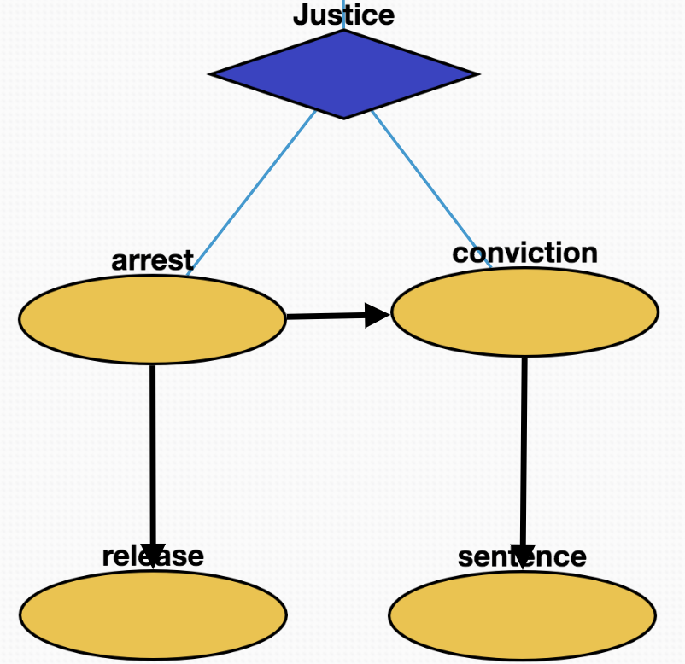
Justice (10546)
Arrest (10531): police arrest some criminal or protester
Conviction (10561): protester guilty of breaking the law
Sentence (10539): protesters for breaking the law sentenced
Release (10560): protesters with minor or no offenses released

Slide 7
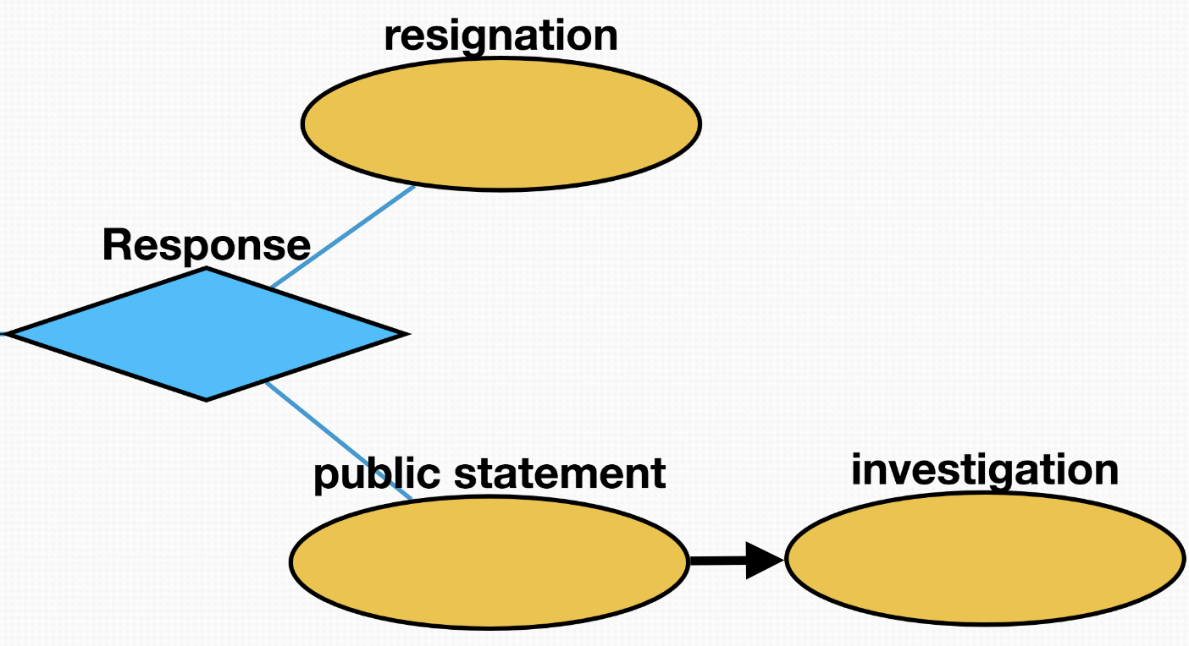
Response (10547)
Resignation (10558): the directors responsible for the incidence resign from the position
Public statement (10538): the head of government makes a public speech to call for clam and provide resolutions to the problem
Investigation (10557): head of government promises to re-investigate to meet public expectations

