Slide 1
RESIN Disaster and Rescue Schema Quizlet 9
Veronica Qing Lyu

Slide 2
Manmade Disaster and Rescue

Slide 3
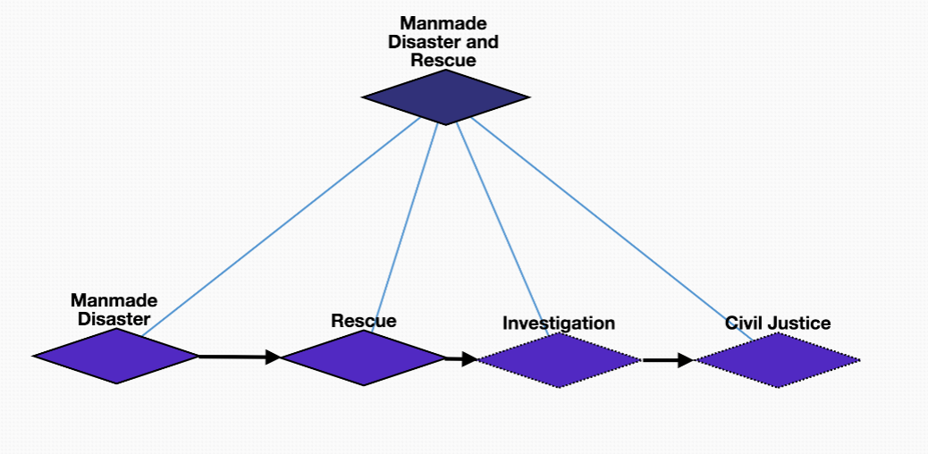
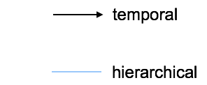
Overview

Slide 4
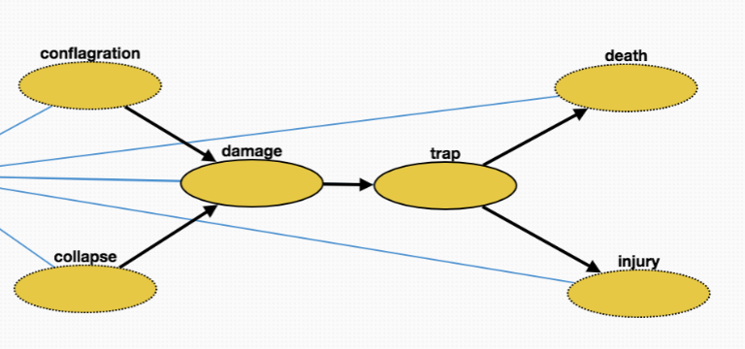
Manmade disaster
Collapse (10602): Collapse of a building etc., in a disaster
Conflagration (10604): large and destructive fire that threatens human life, animal life, health, and/or property
Trap (10605): victims are trapped in the disaster site
Damage (10603): changes introduced into a system that adversely affect its current or future performance
Injury (10606): physiological wound caused by an external source
Death (10607): permanent cessation of vital functions

Slide 5
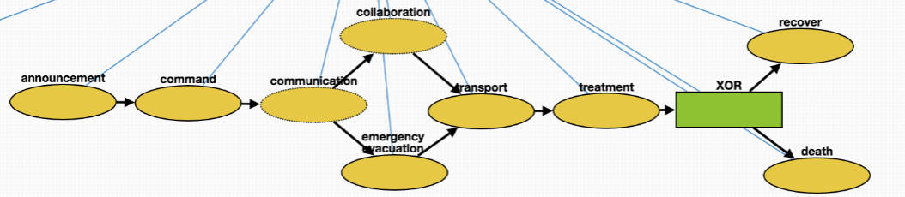
Rescue
Announcement (10608): government announces the disaster to public
Command (10609): government commands rescuers to carry out rescue
Communication (10610): rescuers communicate with trapped victims
Emergency_evacuation (10611): rescuers evacuate trapped victims
Collaboration (10612): different parties of rescuers collaborate
Transport (10613): rescuers transport victims to medical sites
Treatment (10614): medical treatment of the victims
Recover (10633): victims recover from injuries
Death (10634): permanent cessation of vital functions

Slide 6
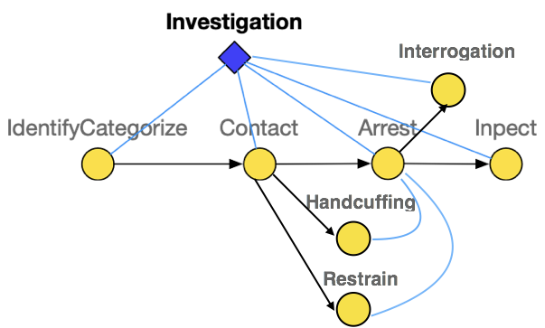
Investigation
IdentifyCategorize (10616): Investigation of a manmade disaster includes identifying its initiators
Contact (10617): Make contact with the suspect
Arrest (10618): Taking the suspect who caused the disaster into custody
Inspect (10621): Organized examination or formal evaluation on the initiator of the disaster
Interrogation (10622): Interviewing with the goal of eliciting useful information related to suspected crime Handcuffing (10619): Using handcuffs to secure a suspect who initiated the disaster
Restrain (10620): Physical restraint on the suspect

Slide 7
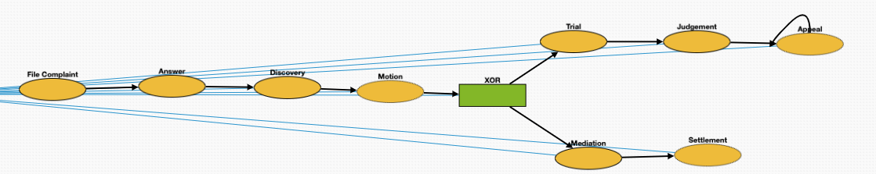
Civil Justice
File Complaint (10623): Plaintiff files a complaint to initiate a lawsuit
Answer (10624): In law, a solemn assertion in opposition to someone or something by the defendant
Discovery (10625): Pre-trial procedure in common law countries for obtaining evidence
Motion (10626): In US law, a procedural device to bring a limited, contested issue before a court for decision
Trial (10630): Coming together of parties to a dispute, to present information in a tribunal
Judgement (10631): The formal decision made by a court following a lawsuit
Appeal (10632): Resort to a superior court to review the decision of an inferior court or administrative agency
Mediation (10628): Dispute resolution with assistance of an impartial third party moderator through the use of communication and negotiation techniques
Settlement (10629): The dispute is resolved through a payment of money

Slide 8
Natural Disaster and Rescue

Slide 9
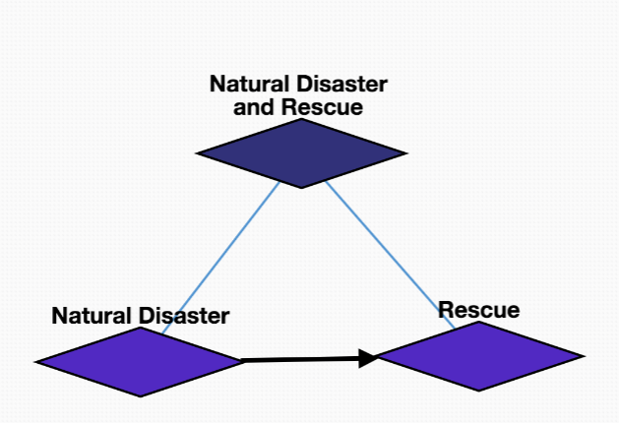
Overview

Slide 10
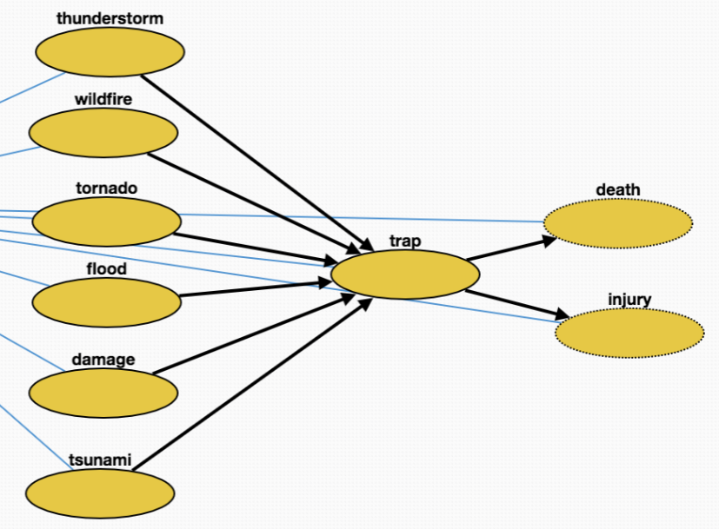
Natural disaster
Tornado (10638): violently rotating column of air that is in contact with both the earth's surface and a cumulonimbus cloud in the air
Flood (10640): overflow of water that submerges land
Wildfire (10641): uncontrolled fire in an area of combustible vegetation that occurs in the countryside or a wilderness area
Earthquake (10657): result of a sudden release of energy in the Earth's crust that creates seismic waves
Tsunami (10642): series of water waves caused by the displacement of a large volume of a body of water
Thunderstorm (10643): type of weather
Trap (10639): victims are trapped in the disaster site
Injury (10644): physiological wound caused by an external source
Death (10645): permanent cessation of vital functions

Slide 11
Rescue
Announcement (10647): government announces the disaster to public
Command (10648): government commands rescuers to carry out rescue
Communication (10649): rescuers communicate with trapped victims
Emergency_evacuation (10650): rescuers evacuate trapped victims
Collaboration (10651): different parties of rescuers collaborate
Transport (10652): rescuers transport victims to medical sites
Treatment (10653): medical treatment of the victims
Recover (10655): victims recover from injuries
Death (10656): permanent cessation of vital functions

