Slide 1
RESIN Election Schema Quizlet 9
Charles Yu

Slide 2
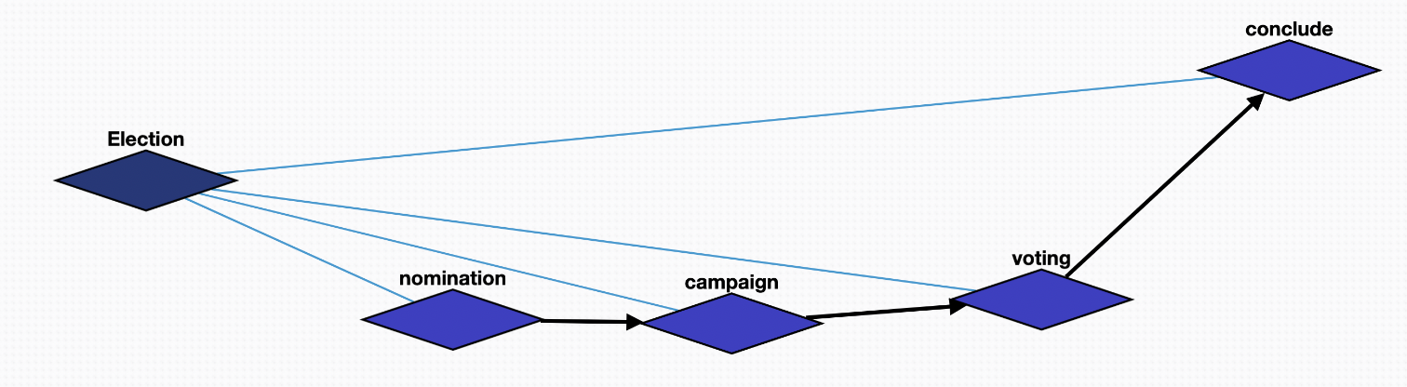
Overview

Slide 3
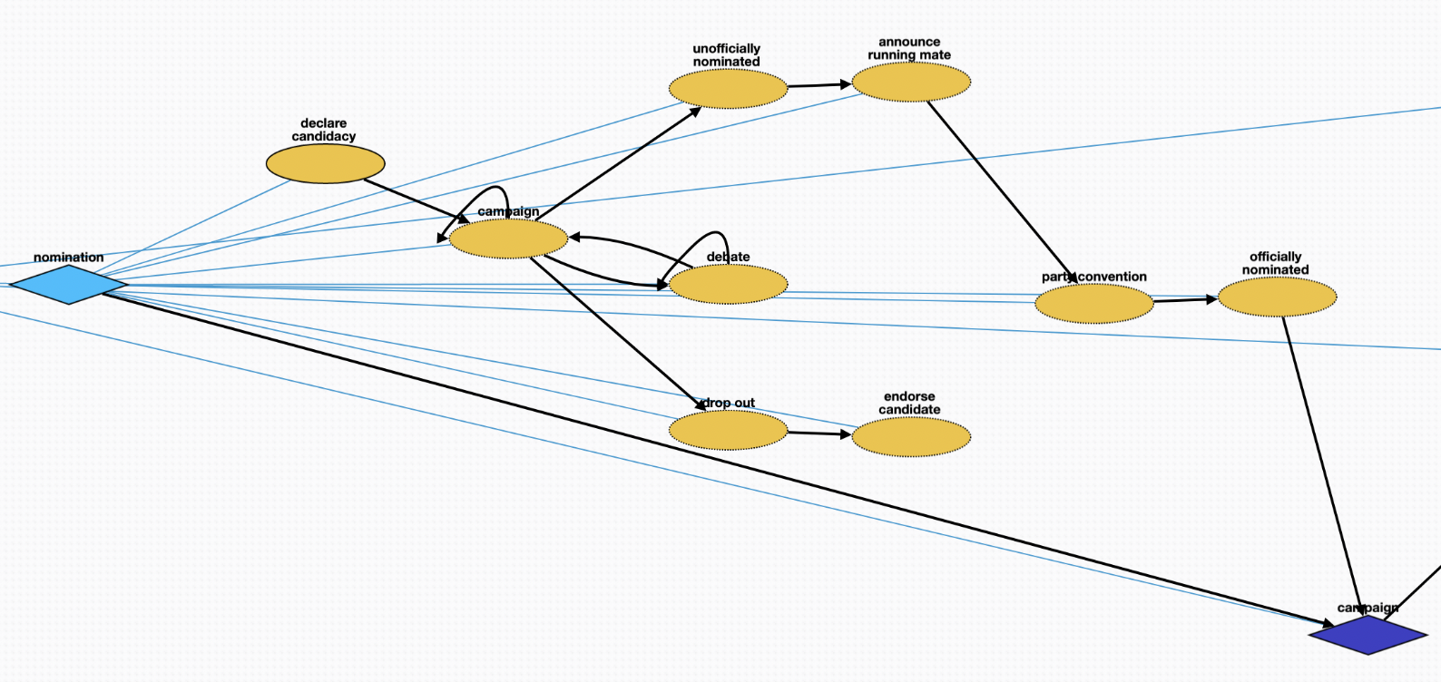
Nomination episode
nomination – container for the episode declare candidacy – a person declares themselves a candidate for nomination campaign – a candidate campaigns throughout the political region debate – a candidate attends debates with other candidates to clarify their political platform drop out – a candidate may drop out of the race endorse candidate – a candidate who has dropped out will typically endorse a different candidate whose views best align with theirs unofficially nominated – a candidate is unofficially nominated (i.e., they received a majority of votes already) announce running mate – a candidate will announce their running mate for their ticket party convention – a political party will hold a convention to discuss their overall platform for the election officially nominated – a candidate is officially declared a party’s nominee campaign – next episode

Slide 4
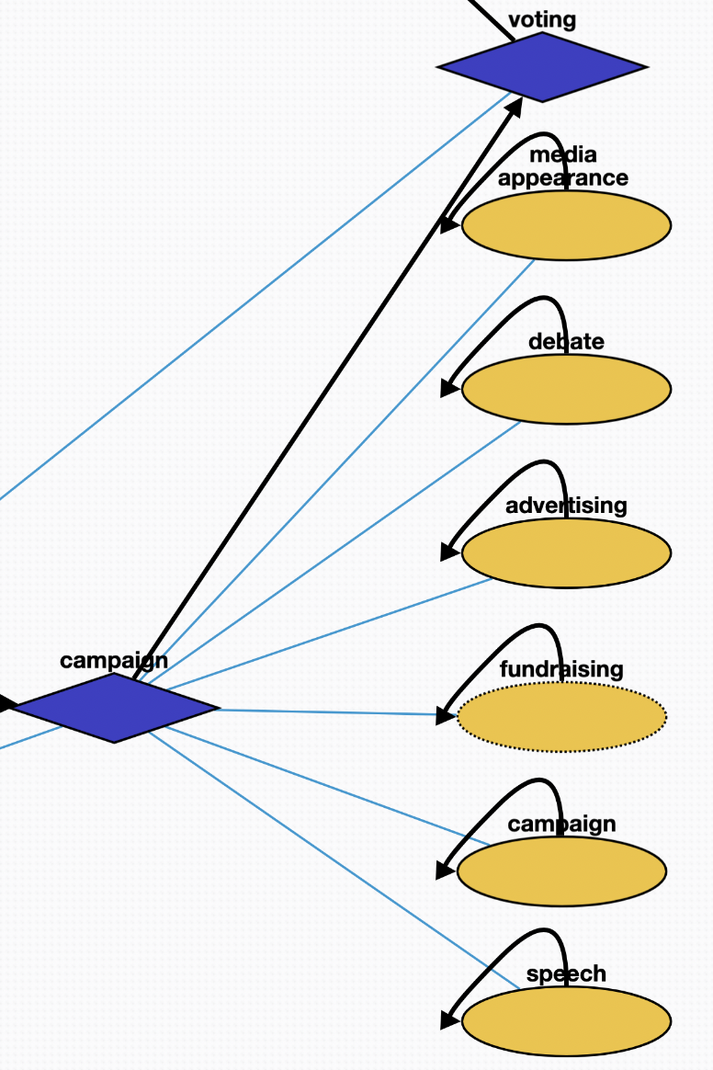
Campaign episode
campaign (diamond shape) – container for the episode speech – a candidate will give a speech about their platform to generate hype and support campaign (ellipse shape) – candidate will hold rallies or meet and greets to generate support fundraising – candidate will raise funds to support their campaign advertising – candidate will run advertisements to reach a wider audience debate – candidate will attend debates with other candidates media appearance – candidate will appear in the media via interviews and events
voting – next episode

Slide 5
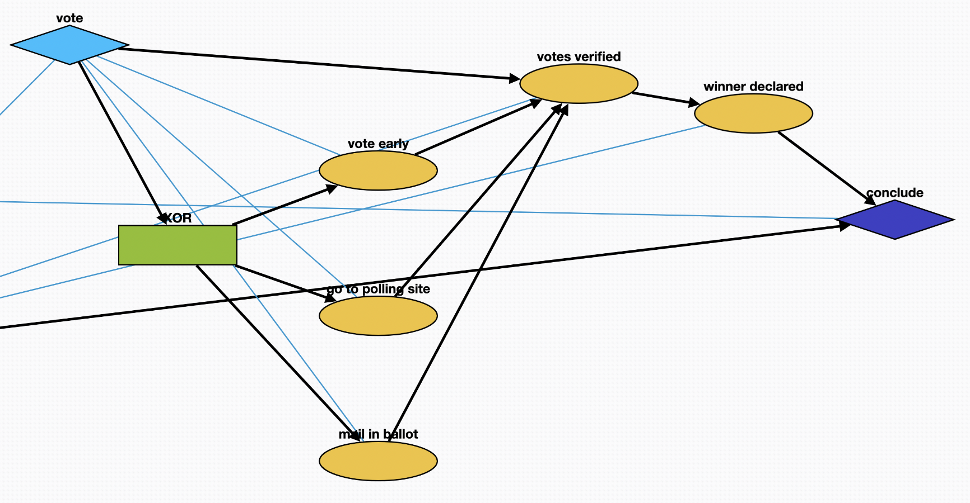
Vote episode
vote – container for the episode vote early – some voters will follow a special process to vote early go to polling site – some voters will vote on election day at the polling site mail in ballot – some voters will mail in a ballot to vote votes verified – votes are counted and verified to prevent fraud winner declared – the winner of the election is declared based on the votes
conclude – next episode

Slide 6
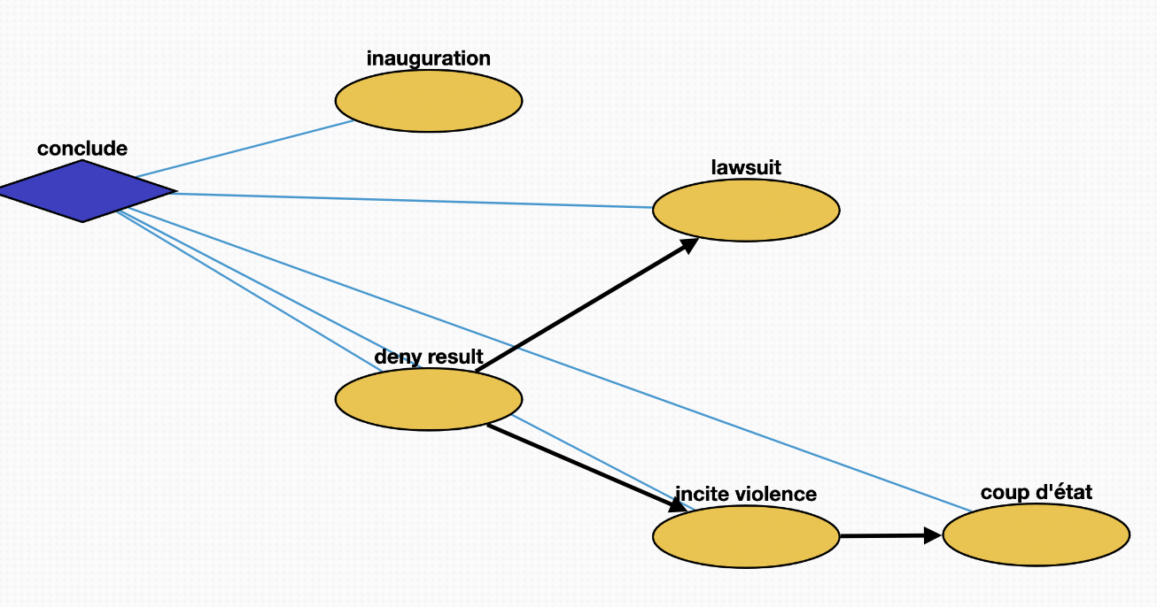
Conclude episode
conclude – container for the episode inauguration – the winner of the election is inaugurated deny result – a loser of the election may deny the result of the election incite violence – a loser of the election may incite violence to try to overturn the result lawsuit – a loser of the election may sue in order to attempt to overturn the result coup d'état – a loser of the election may attempt a coup

