Slide 1
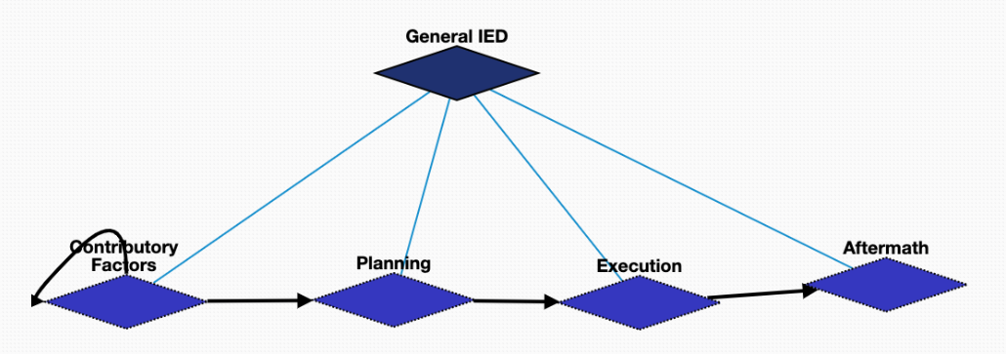
General IED Schema Overview

Slide 2
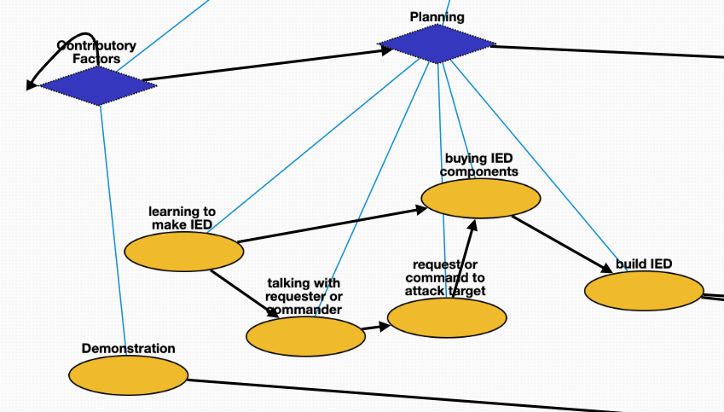

General IED: Contribution Factors & Planning
Demonstration | Q175331 | demonstration that triggered the bomb
learning to make IED | Q8434 | learn about the bomb making
talking with requester or commander | Q1472062 | asking the requester about the bomb plan
request or command to attack target | Q1665268 | requester asks to attack a specific target
buying IED components | Q21651837 | buy the materials to make the bomb
build IED | Q187939 | manufacturing the bomb

Slide 3
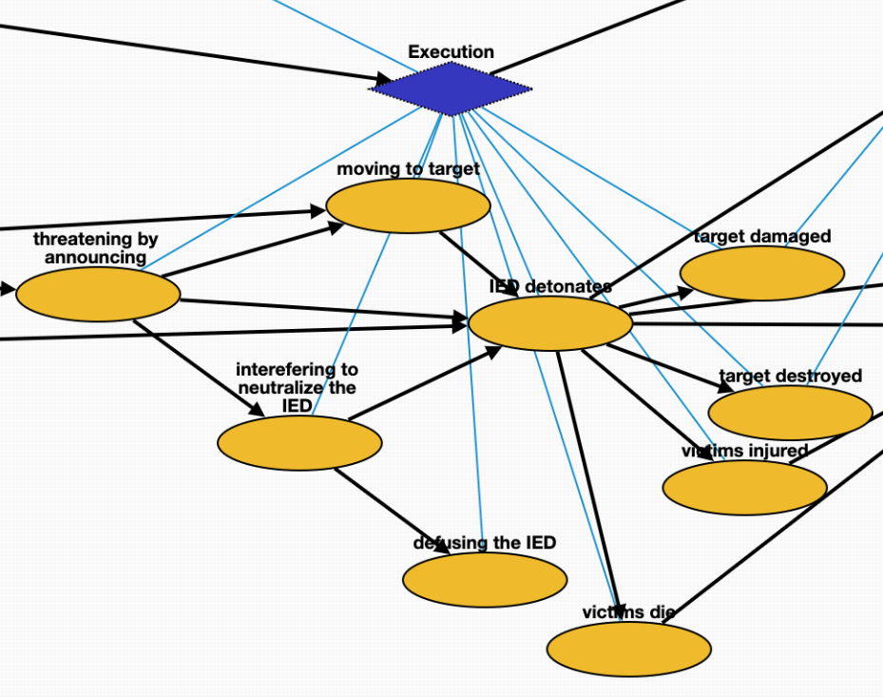
General IED: Execution
threatening by announcing | Q325980 | threatening the possible bombing
moving to target | Q7590 | transport the bomb to the target
interefering to neutralize the IED | Q16515105 | interefer the bombing
defusing the IED | Q649416 | leave the bomb
IED detonates | Q891854 | bomb attack starts
target destroyed | Q17781833 | destruction of the target
target damaged | Q481609 | damage of the target
victims injured | Q193078 | injury of victims
victims die | Q4 | death of victims
interefering to defuse more potential IEDs | Q16515105 | interefer other remaining bombs
Investigation begins | Q1964968 | criminal investigation

Slide 4
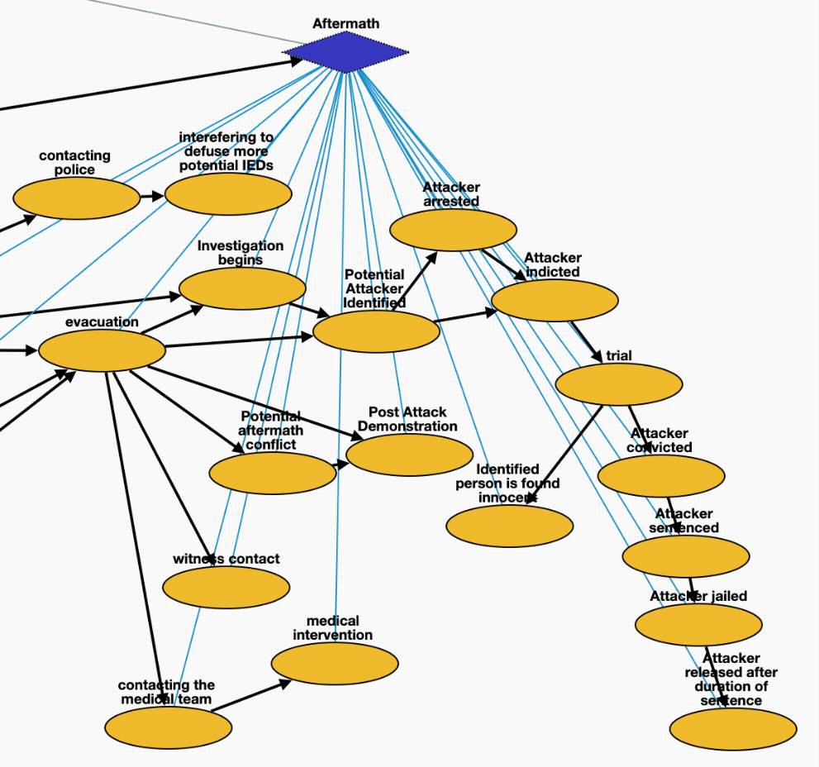
General IED: Aftermath
interefering to defuse more potential IEDs | Q16515105 | interefer other remaining bombs
Investigation begins | Q1964968 | criminal_investigation
evacuation | Q606332 | emergency_evacuation
witness contact | Q11024 | communication with witness
A demonstration event happening after the detonation event. | Q175331 | demonstration after the bombing
Potential aftermath conflict | Q1174599 | attack after the bombing
evacuation | Q606332 | emergency_evacuation
contacting the medical team | Q1472062 | contacting the medical team
contacting police | Q1472062 | contacting the police
Intelligence identified ibrahim hussein berro as bomber at some place. | Q3265221 | identification of the bomber
Attacker indicted | Q19357312 | accusation of the bomber
trial | Q545861 | legal_hearing
Attacker convicted | Q2916183 | conviction of the bomber
Attacker sentenced | Q1763090 | sentence of the bomber
Attacker jailed | Q1403016 | arrest of the bomber
Attacker released after duration of sentence | Q3237993 | release the bomber from prison
Identified person is found innocent | Q3237993 | release the innocent people

Slide 5
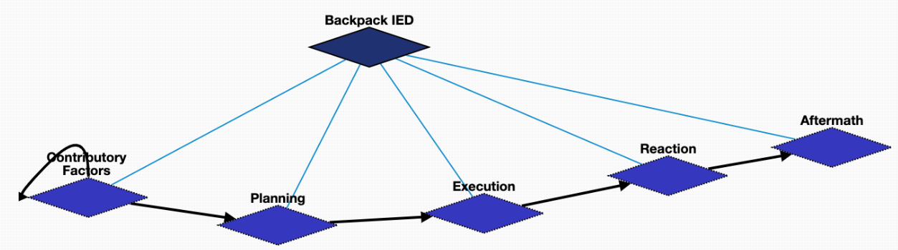
Backpack IED

Slide 6
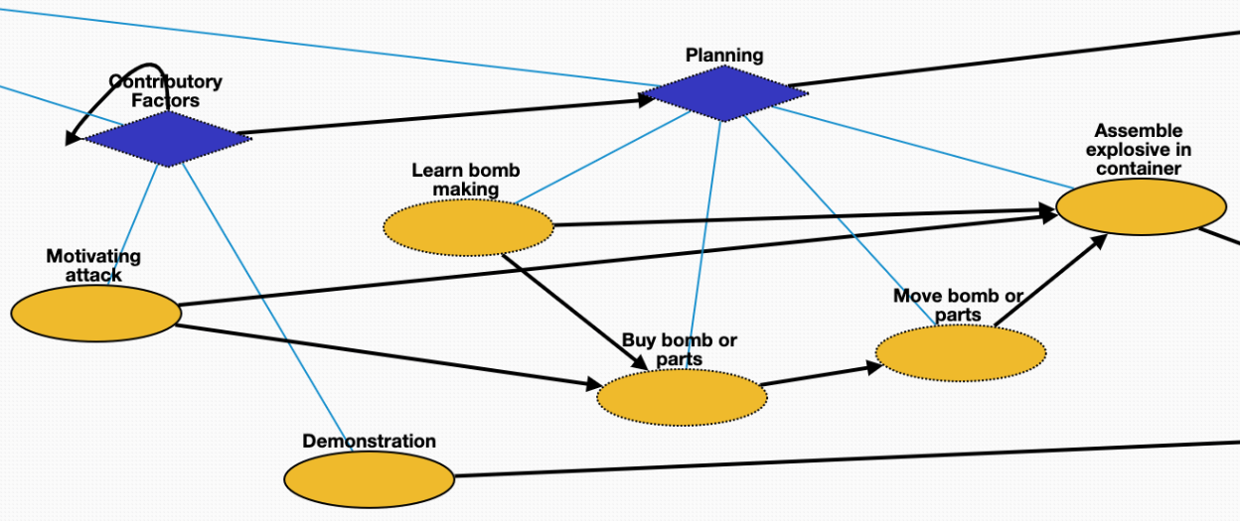
Backpack-IED Schema: Contributory Factors & Planning
Learn bomb making | Q8434 | learn about the bomb making
Motivating attack | Q1174599 | the bomber starts to want to attack people
Buy bomb or parts | Q21651837 | but materials for the bomb
Move bomb or parts | Q7590 | transport the bomb
Assemble explosive in container | Q187939 | manufacturing the bomb
Demonstration | Q175331 | demonstration that triggered the bomb

Slide 7
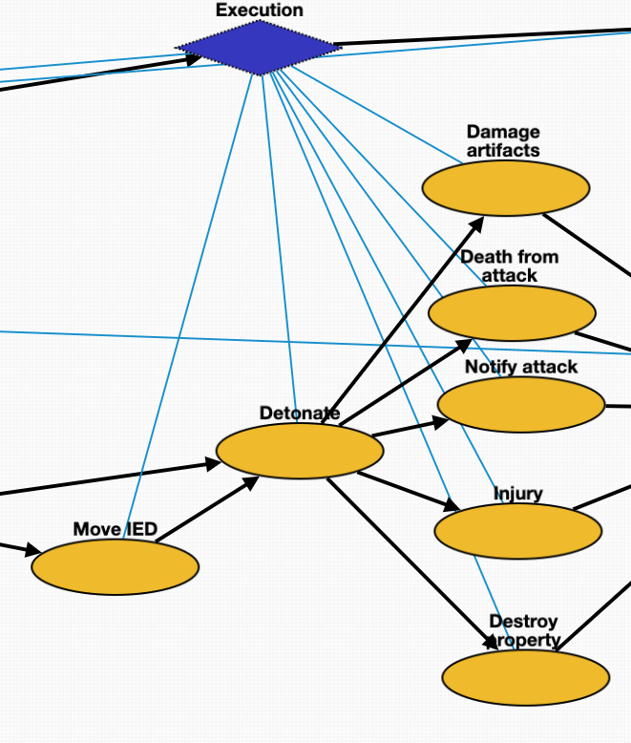
Backpack-IED Schema: Execution
Damage artifacts | Q481609 | damage by the bomb
Injury | Q193078 | victim injury
Detonate | Q891854 | bomb attack
Destroy property | Q17781833 | destruction of the surrounding properties
Death from attack | Q4 | death due to the attack
Move IED | Q7590 | transport IED to the attacking target
Notify attack | Q1472062 | announcement of the attacking event

Slide 8
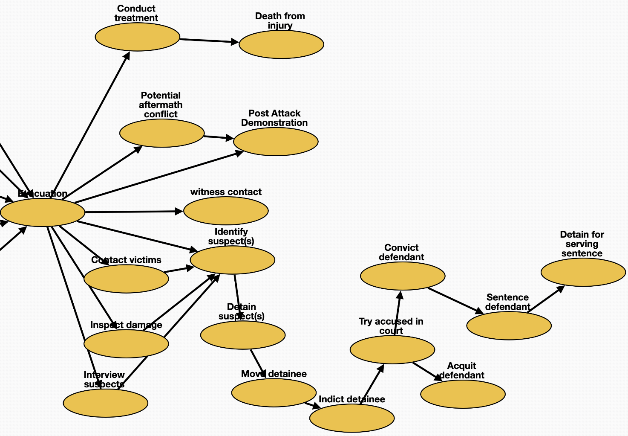
Backpack-IED: Reaction & Aftermath
Evacuation | Q606332 | emergency evacuation
Potential aftermath conflict | Q1174599 | attack after the bombing
Post-Attack Demonstration | Q175331 | demonstration after the bombing
Conduct treatment | Q179661 | treatment for victims
Evacuation | Q606332 | emergency_evacuation
witness_contact | Q11024 | communication with the witness
Identify suspect(s) | Q3265221 | identification of the bomber
Notify attack | Q1472062 | notification of the attack
Contact victims | Q11024 | communication with the victims
Inspect damage | Q193181 | observation of the demage
Interview suspects | Q21170798 | meeting with suspects
Move detainee | Q7590 | transport the detainee
Indict detainee | Q19357312 | accusation of the bomber
Detain suspect(s) | Q1403016 | arrest the bomber
Try accused in court | Q545861 | legal_hearing
Acquit defendant | Q1454723 | acquittal of the bomber
Convict defendant | Q2916183 | conviction of the bomber
Sentence defendant | Q1763090 | sentence of the bomber
Detain for serving sentence | Q1403016 | arrest the bomber

Slide 9
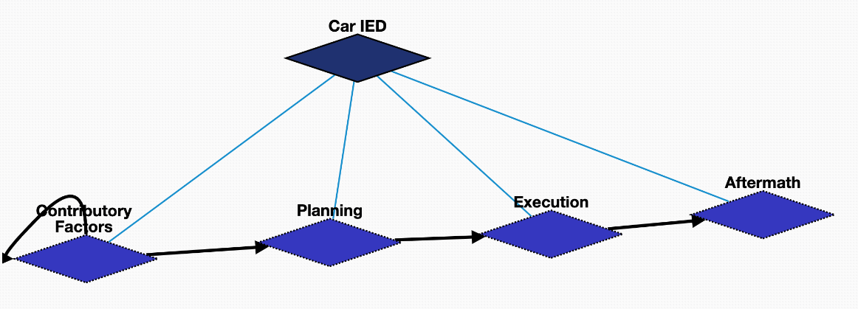
Car IED

Slide 10
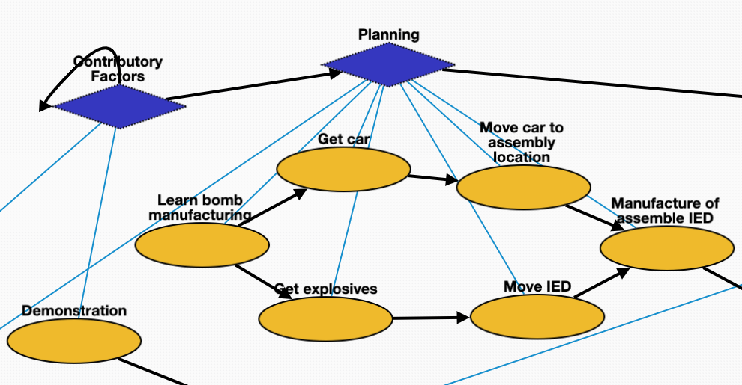
Car IED: Contributing Factors & Planning
Demonstration | Q175331 | demonstration that triggered the bomb
Learn bomb manufacturing | Q8434 | learn about bomb making
Get explosives | Q21651837 | buy the materials to make the bomb
Get car | Q21651837 | buy the vehicle
Manufacture of assemble IED | Q187939 | manufacturing the bomb
Move IED | Q7590 | transport the bomb to some place
Move car to assembly location | Q7590 | transport the vehicle to some place

Slide 11
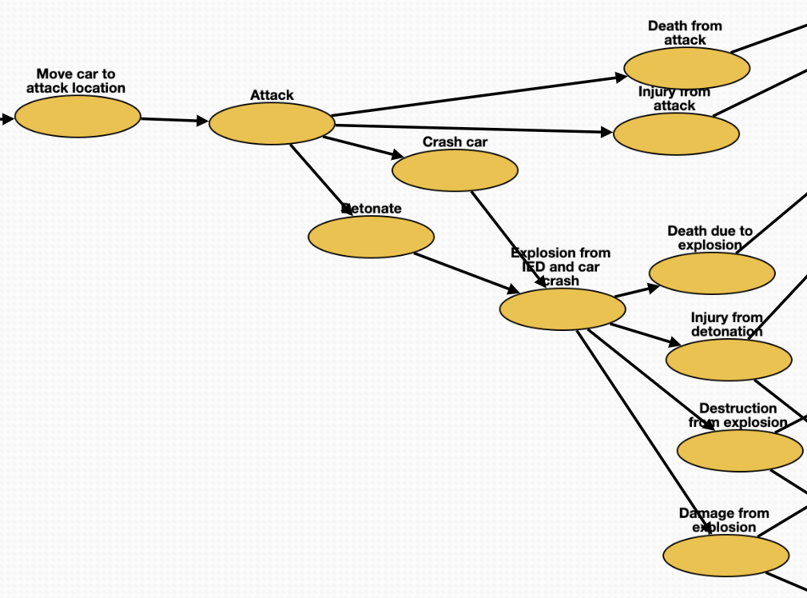
Car IED: Execution
Attack | Q1174599 | attack
Detonate | Q891854 | bomb_attack
Crash car | Q11822042 | crash the car and the bomb
Explosion from IED and car crash | Q179057 | explosion
Injury from attack | Q193078 | injury from the attack
Destruction from explosion | Q17781833 | destruction from the explosion
Damage from explosion | Q481609 | damage from the explosion
Death from attack | Q4 | death from the attack
Injury from detonation | Q193078 | injury from the explosion
Medical intervention | Q179661 | treatment for victims
Death due to explosion | Q4 | death from the explosion
Move car to attack location | Q7590 | transport the car to attack people

Slide 12
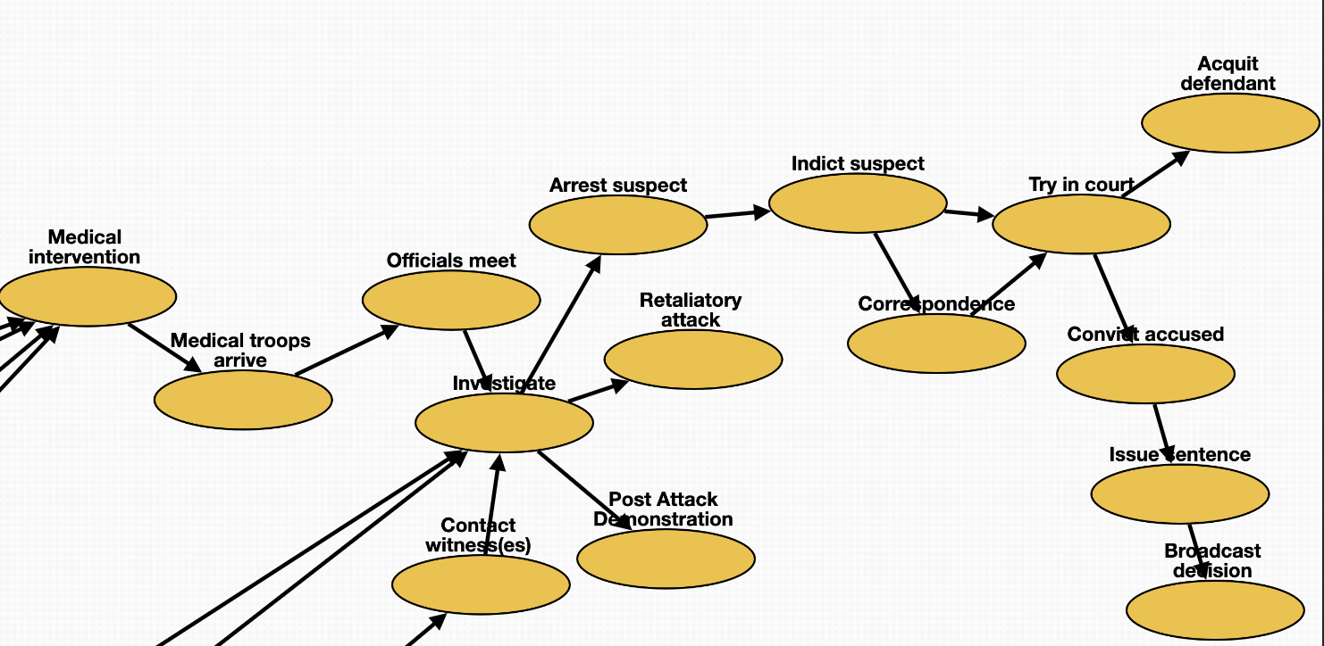
Car-IED: Aftermath
Acquit defendant | Q1454723 | acquittal of the attacker
Medical intervention | Q179661 | treatment for the victim
Contact witness(es) | Q11024 | communication with the witness
Try in court | Q545861 | legal_hearing
Officials meet | Q21170798 | meeting with officials
Investigate | Q1964968 | criminal_investigation
Retaliatory attack | Q1174599 | attack after the bombing
Arrest suspect | Q1403016 | arrest the bomber
Indict suspect | Q19357312 | accusation of the bomber
Correspondence | Q1472062 | remote_communication with witness
Convict accused | Q2916183 | conviction of the bomber
Broadcast decision | Q567303 | announcement of the final decision
Issue sentence | Q1763090 | sentence of the bomber
Medical troops arrive | Q7590 | medical team arrives

Slide 13
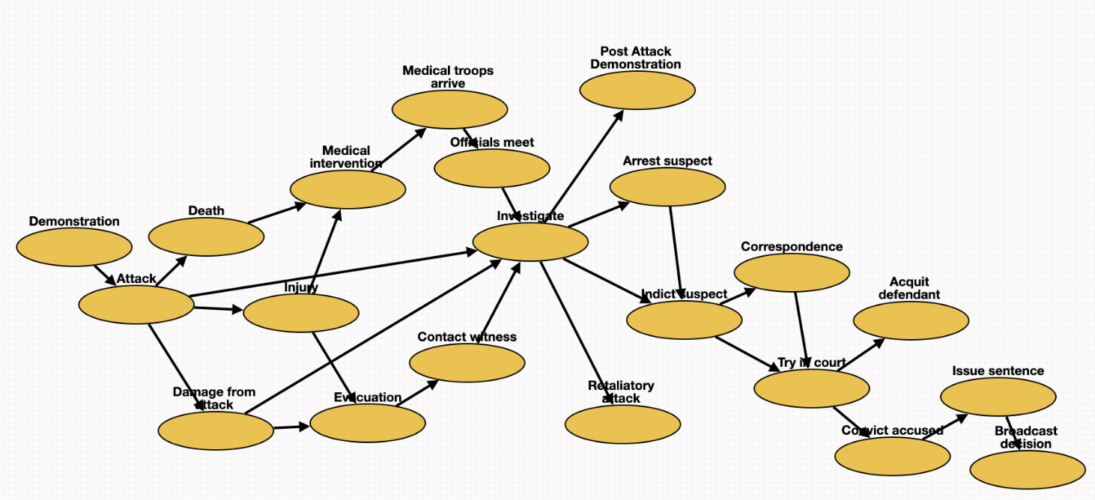
General Attack Schema
Medical intervention | Q179661 | treatment of the victims
Arrest suspect | Q1403016 | arrest suspects
Try in court | Q545861 | legal_hearing
Officials meet | Q21170798 | meeting with officials
Investigate | Q1964968 | criminal_investigation
Evacuation | Q606332 | emergency_evacuation
Contact witness | Q11024 | communication with witness
Demonstration | Q175331 | demonstration that triggered the attack
Post-Attack Demonstration | Q175331 | demonstration after the attack
Retaliatory attack | Q1174599 | attack after the previous attack
Indict suspect | Q19357312 | accusation of the attacker
Correspondence | Q1472062 | remote_communication
Convict accused | Q2916183 | conviction of the attacker
Broadcast decision | Q567303 | announcement
Issue sentence | Q1763090 | sentence
Attack | Q1174599 | attack happens
Damage from attack | Q481609 | damage from the attack
Acquit defendant | Q1454723 | acquittal of the attacker
Death | Q4 | death of the victims
Medical troops arrive | Q7590 | medical team arrives
Injury | Q193078 | injury of victims

