Slide 1
RESIN International Conflict Schema
Qi Zeng

Slide 2
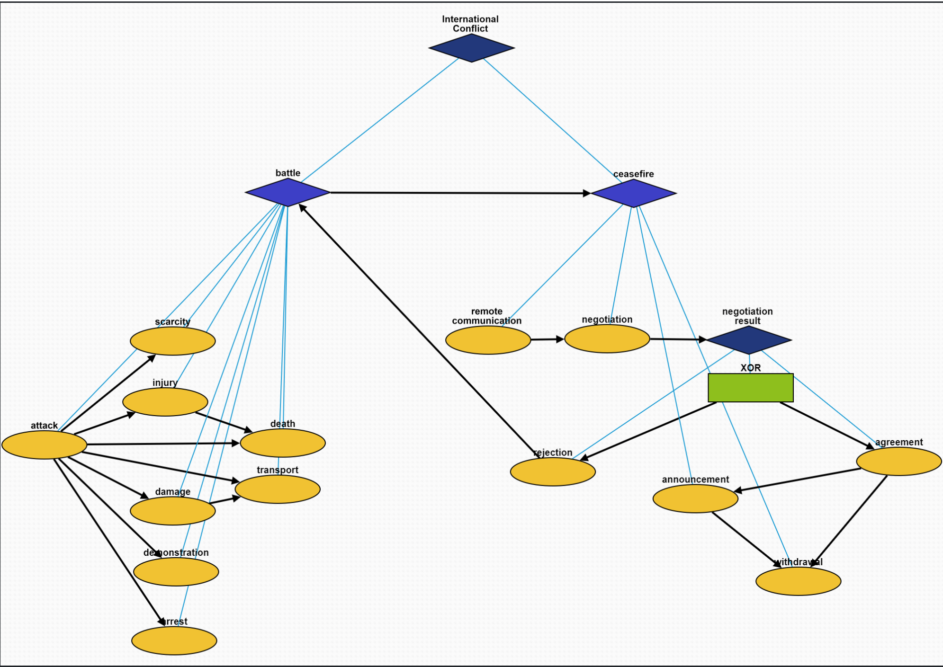
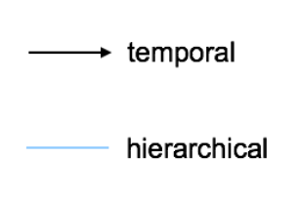
Overview
International Conflict (10277)

Slide 3
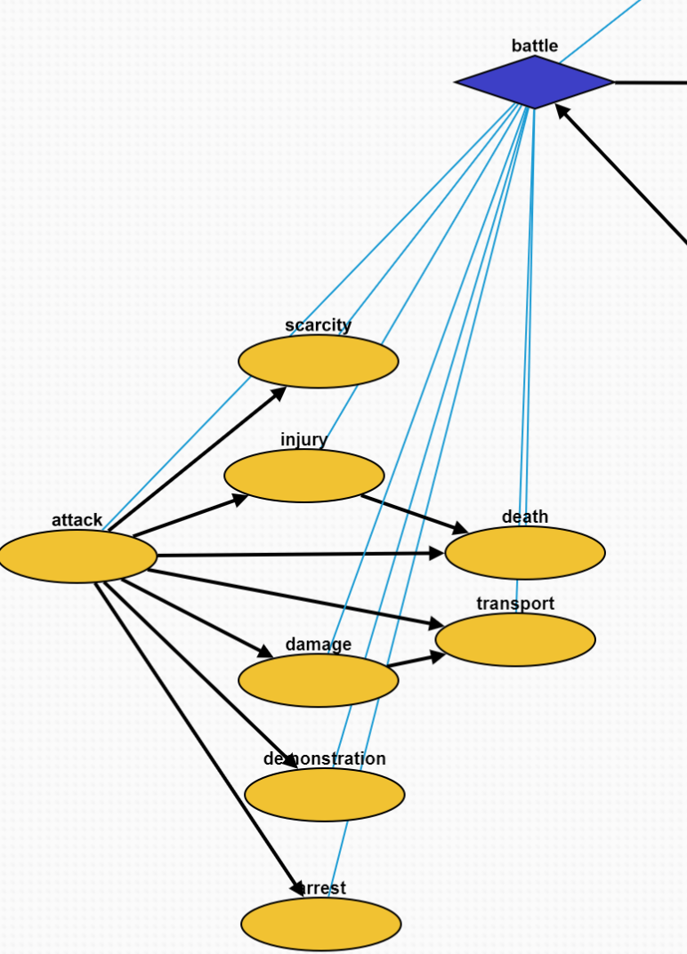
Battle Episode (10286)
Attack (10278): A conflict between two countries
Scarcity (10282): Food or resource shortage caused by the attacks
Injury (10280): Victims get injured because of the attacks
Death (10279): Victims die because of the attack
Damage (10281): Constructions are damaged because of the attack
Transport (10283): Victims have to migrate to other places
Demonstration (10284): People demonstrate to against the battle
Arrest (10285): People triggering this attack is arrested

Slide 4
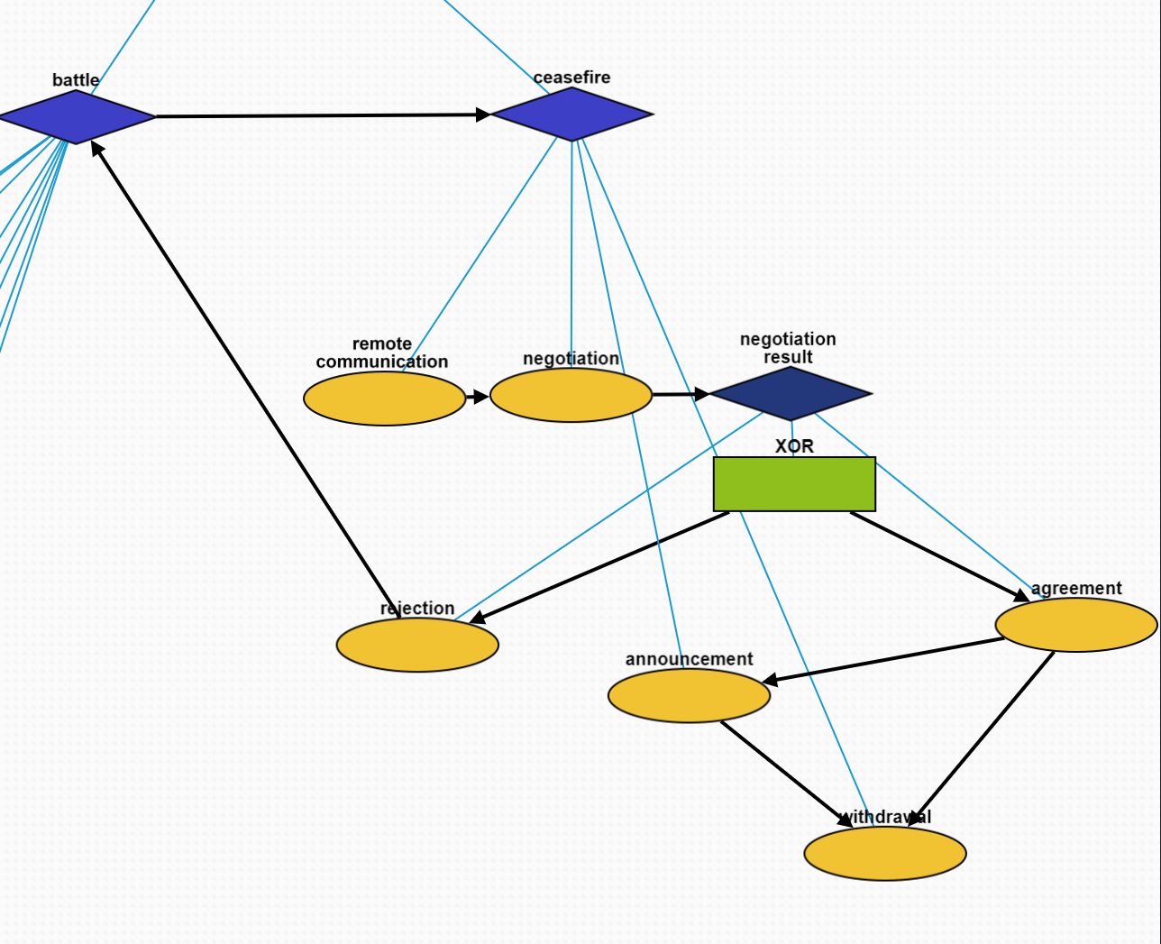
Ceasefire Episode (10292)
Remote Communication (10287): A third-party organization requests ceasefire
Negotiation (10288): Battle participants negotiate a ceasefire agreement
Negotiation Result (10289): a container
Rejection (10290): Battle participants do not reach an agreement
Agreement (10291): Battle participants reach an agreement
Announcement (10293): The ceasefire agreement is announced
Withdrawal (10294): The attacking army is withdrawn

