Slide 1
RESIN Kidnapping Schema
Quizlet 9

Slide 2
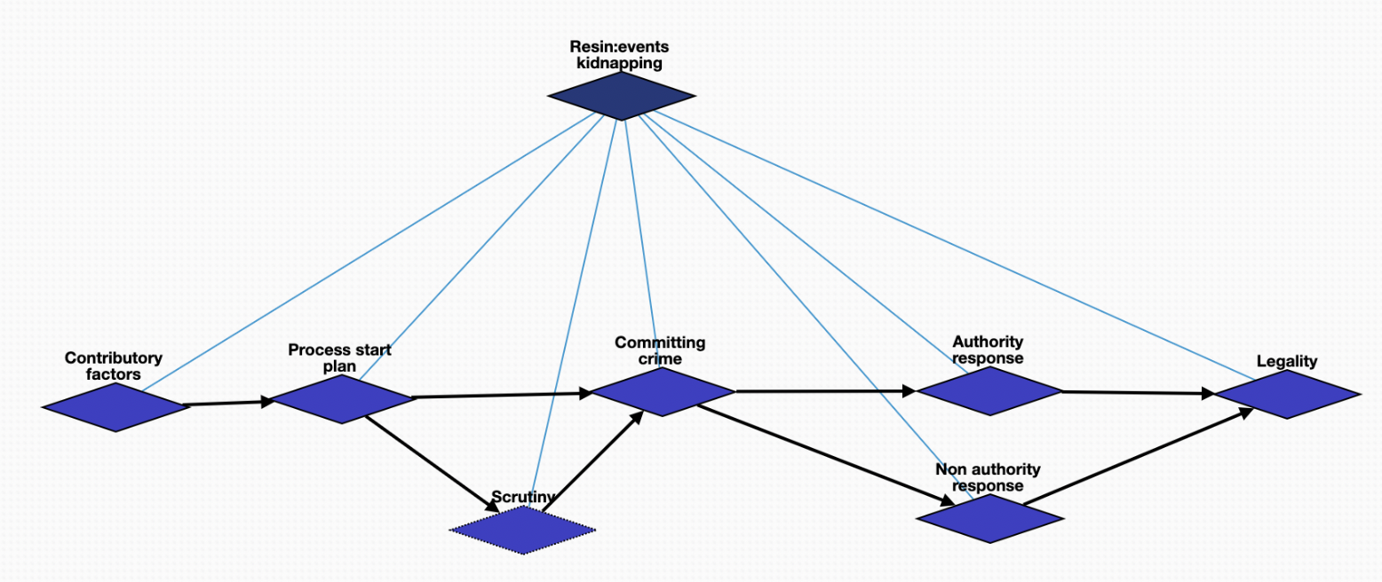
Overview

Slide 3
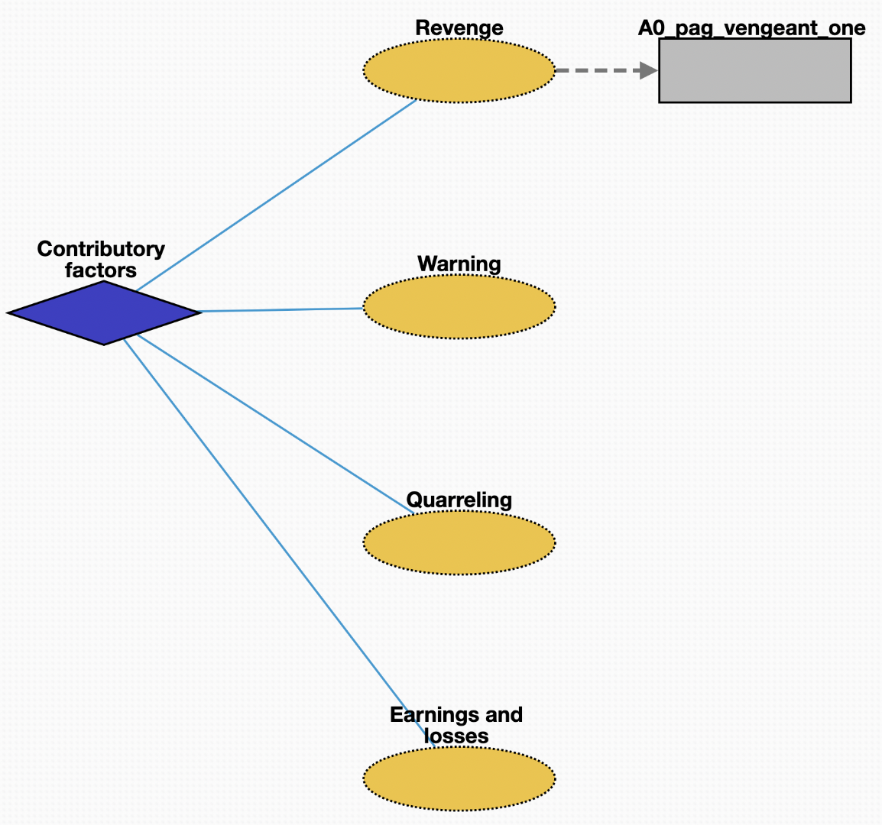
Contributory factors (10219)
Revenge (10228): harmful action in response to a grievance
Warning (10229): preventative measure taken to ensure someone's health
Quarreling (10227): struggle for agency or power in society
Earnings and losses (10226): consumption and savings opportunity gained by an entity within a specified timeframe

Slide 4
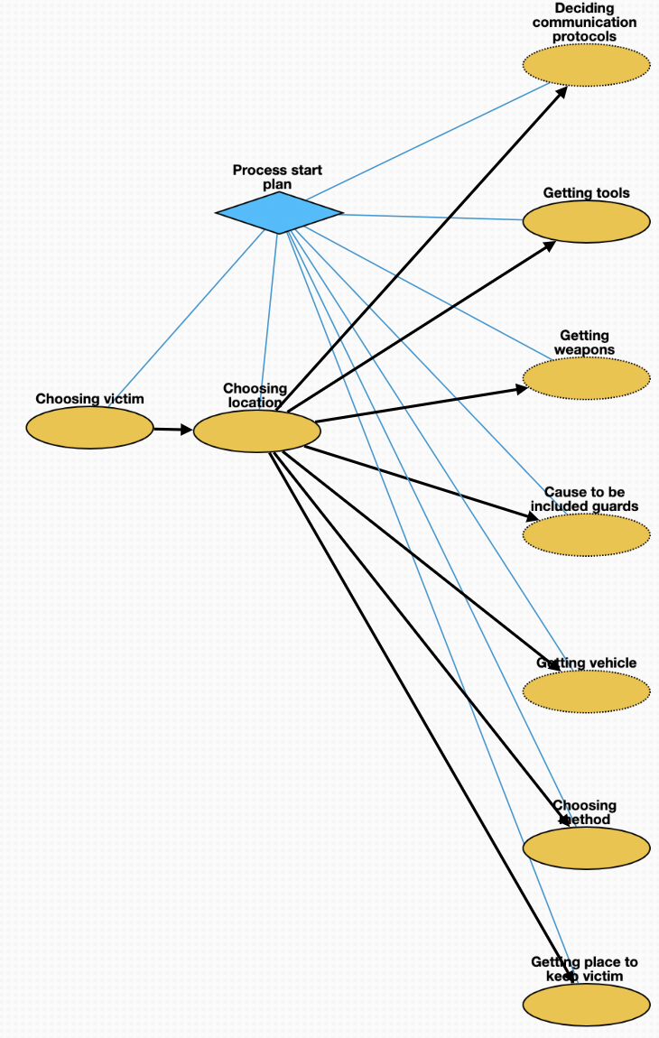
Planning (10220)
Choosing victim (10230): act of selecting one or more victims
Choosing location (10231): act of selecting location where to kidnap victim
Deciding communication protocols (10233): deliberation about how kidnappers should communicate before, during, and after the crime
Getting tools (10234): purchase of tools necessary for crime
Getting weapons (10236): purchase of weapons needed for crime
Cause to be included guards (10238): employment of personnel needed to guard victim
Getting vehicle (10235): purchase of vehicle needed for crime
Choosing method (10232): act of judging the merits of multiple kidnapping methods and selecting one or more of them
Getting place to keep victim (10237): acquisition of location where victim will stay

Slide 5
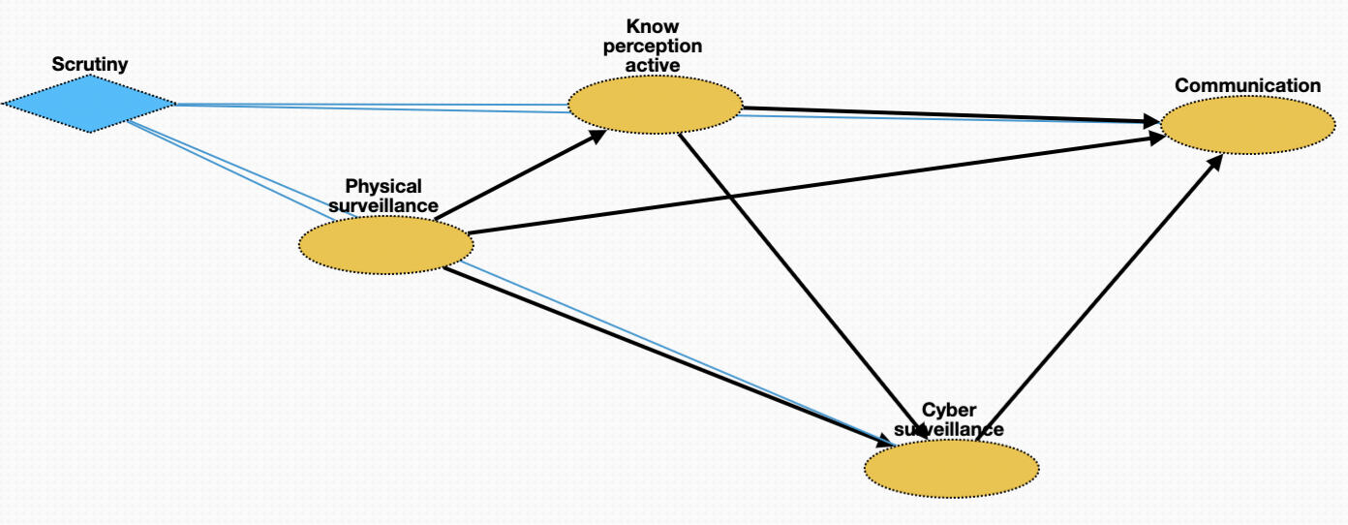
Scrutiny (10221)
Physical surveillance (10239): monitor of behavior, activities, or other changing information about victim
Know perception active (10240): mental process; act of recognizing attributes of victim
Cyber surveillance (10241): clandestine acquisition of confidential information about victim via online resources
Communication (10242): act of conveying intentions about kidnapping to other members of criminal network

Slide 6
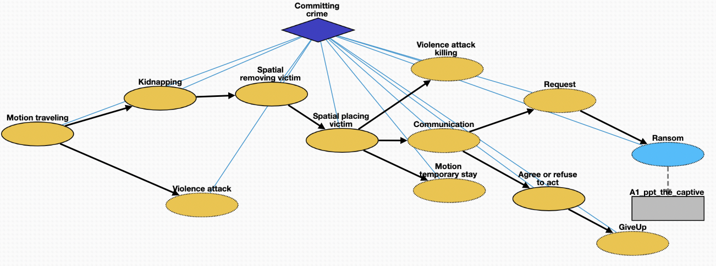
Committing crime (10222)
Motion traveling (10243): movement of kidnapper from a place to location where is planned
Attack (10244): control of victim by kidnapper
Kidnapping (10245): taking away or transportation of a person against that person's will
Removing victim (10246): process removing the victim from a location
Placing victim (10247): net movement of victim from one location to another
Killing (10254): death of victim as a result of action by kidnapper
Temporary stay (10250): short stay of victim in safehouse or other location
Communication (10248): act of conveying intended meanings from kidnapper to authorities or non-authorities
Request (10249): act of asking formally for something in return for safety of victim
Ransom (10251): practice of holding a prisoner or item to extort money or property
Agree or refuse to act (10253): understanding between entities to follow a specific course of conduct
GiveUp (10252): form of surrender when kidnapper decides to stop crime

Slide 7
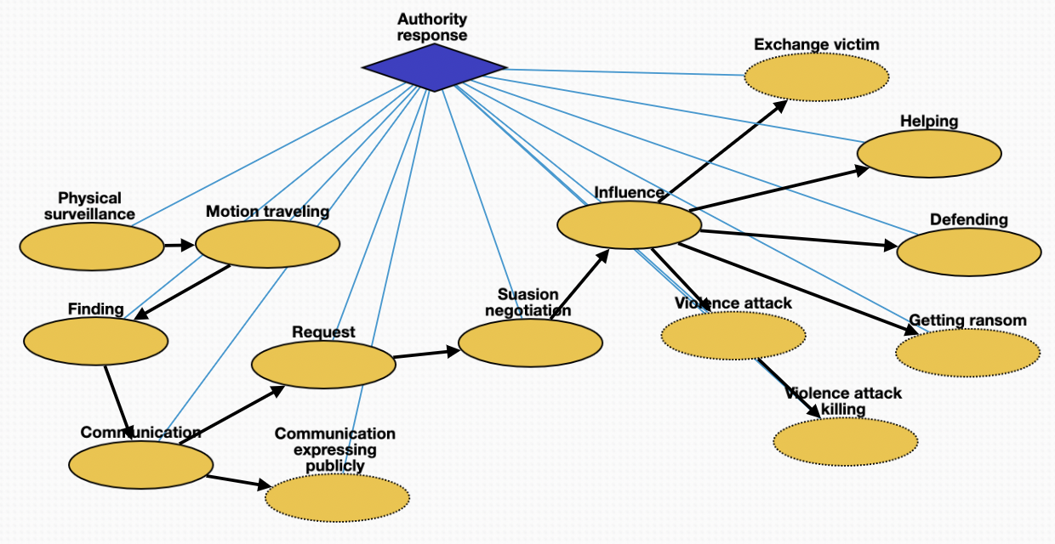
Authority response (10223)
Physical surveillance (10255): monitoring of behavior, activities, or other changing information about kidnapper
Traveling (10256): movement of authorities to location of kidnapper or victim
Finding (10257): physical finding of location of kidnapper or victim
Communication (10258): act of conveying intended meanings between authorities
Expressing publicly (10259): revealing of restricted information about crime to public
Request (10260): act of asking formally for demands of kidnapper
Negotiation (10261): meeting held between authorities and kidnapper
Influence (10262): umbrella term of influence and mode of communication
Helping (10265): cooperation between authorities and people impacted by crime
Defending (10264): act of protecting victim from attack
Exchange victim (10268): voluntary exchange of victim for other person or resource
Getting ransom (10263): money made available to secure safety of victim
Attack (10266): attempt to control situation by authorities
Killing (10267): act of killing the kidnapper or accidental killing of victim

Slide 8
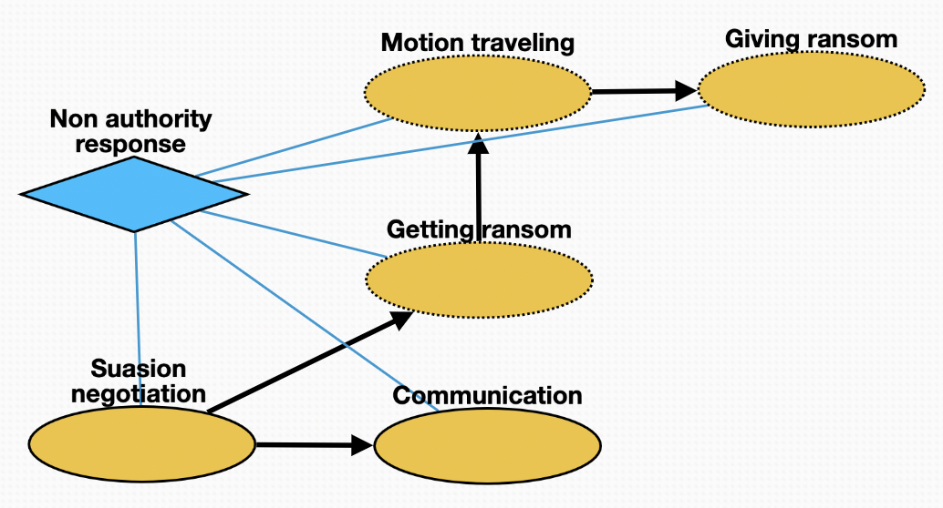
Non-authority response (10224)
Negotiation (10269): meeting held between non-authorities and kidnapper
Communication (10273): conveying meaning between non-authorities and kidnapper
Getting ransom (10270): procuring money to secure safety of victim
Traveling (10272): movement of non-authorities to location for delivery of ransom
Giving ransom (10271): handing over ransom to kidnapper

Slide 9
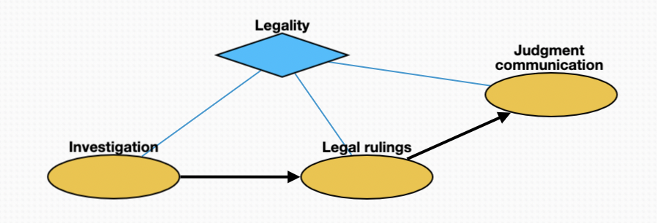
Legality (10225)
Investigation (10274): investigation of crimes by police
Legal rulings (10275): proceedings in any civil lawsuit or criminal prosecution
Judgment communication (10276): instruction directed by law, judgment or administrative act to defendant or litigant to obey a certain behavior

