Slide 1
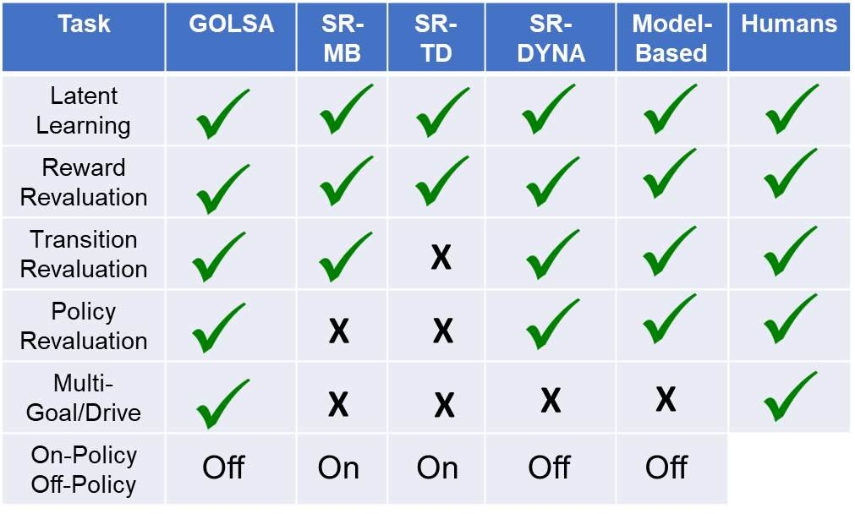

Task | GOLSA | SR-MB | SR-TD | SR-DYNA | Model-Based | Humans
Latent Learning
Reward Revaluation
Transition Revaluation
Policy Revaluation
Multi-Goal/Drive
On-Policy Off-Policy
X
X
X
X
X
X
X
Off
On
On
Off
Off
SR-DYNA is approximate to dynamic programming and tree-search given its ability to solve transition and policy
Revaluation tasks. However, this requires a specific and sufficient number of offline replay backups. Without these, it cannot
Pass all revaluation tasks. In fact, with insufficient amounts, it turns into a model-free agent that will fail at tasks. Therefore,
The issue is about necessity of replay in general and the amount of replay. In contrast, a different mechanism like spreading activation
Online that propagates activity, though similar to value iteration, could drive such replanning/revaluation behavioral output.

Slide 2

Latent Learning task
Agent randomly explores for 30 trials, for 300 time steps.
Agent notified of goal (reward) position.

Slide 3

Goal switch (devaluation) task
Agent notified reward in certain position.
Agent notified of goal position after latent learning.
Agent notified goal in different position. Goes to new goal on 1st trial.

Slide 4

Transition Revaluation
1st trial after learning barrier

Slide 5

Agent notified reward in certain position.
2x
Agent notified reward in certain position.
Agent notified reward also in new position.
Policy revaluation emerges from goal competition
70% of trials
1
0.8
2x
0.6
0.4
2x
0.2
0
Goal unit Activation
1
2
3
4
5
30% of trials
1
0.8
2x
0.6
0.4
0.2
0
1
2
3
4
5
Time (a.u.) at first state

Slide 6
1
0.8
0.6
0.4
2x
0.2
0
Goal unit Activation
1
2
3
4
5
1
0.8
0.6
0.4
0.2
0
1
2
3
4
5
Time (a.u.) at first state

Slide 7
Rt – 2nd step:
State 14: 11.45: 35% (r==0.35)
State 21: 16.45: 65% (r==0.8)
Rt – 2nd step:
State 21: 14.75: 100% (r==0.8)
THE RIGHT WAY WOULD BE DRIVES TO GOALS, BECAUSE GOAL ACTIVITY IS SAME HEIGHT. WOULD HAVE TO CHANGE WEIGHT, OTHERWISE. Weight embodies RWD
Notes:
Russek et al.…this task defeats SR-MB (as well as, shown in supplemental materials, the depth limited model-free planners and SR-TD; see also [22]), though it can be solved by standard model-based learning using. It defeats it because its policy dependence of SR mapping has no notion of value in the new state ‘2X’, Furthermore, SR-DYNA does succeed here.

Slide 8
Multi - Goal

Slide 9
Drives
Goal-states
Agent learns drives can be fulfilled at certain states. Effectively establishing drive specific goal states.
This is like learning a reward function R(S) for terminal states.
Terminal meaning the drive is fulfilled there. It is readily possible to learn a state-space (non-terminal) reward function and have this influence desired next state.

Slide 10
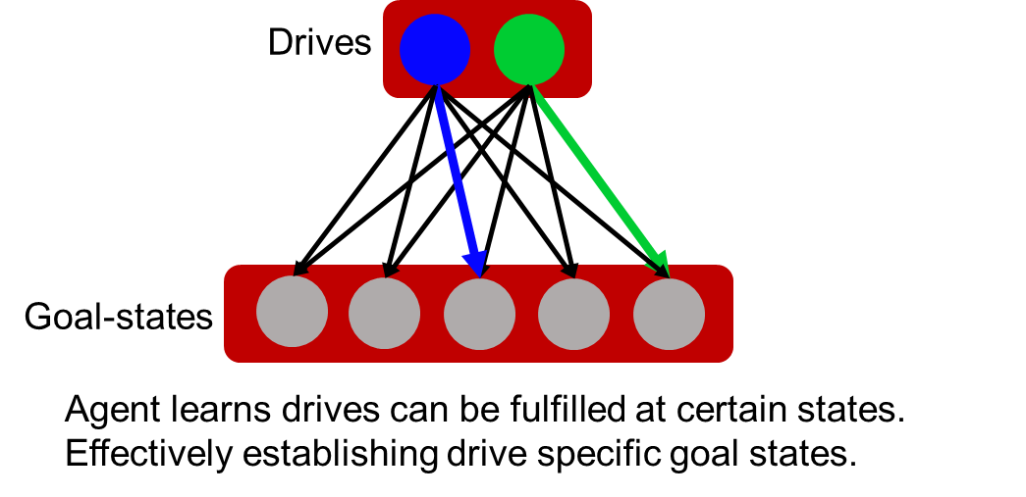
A
B
Drives
Goals
C
0.1
0.1
1
Activity
0.01
0.1
D
1
Time (a.u.)
Notes:
None of these have mutual goal_goal suppression.

Slide 11

Drives
Goals
B
0.1
0.1
1
A
Activity
0.01
0.1
C
1
Time (a.u.)
Notes:
None of these have mutual goal_goal suppression.

Slide 12
Drives
Goals
0.1
0.1
1
Activity
0.01
0.1
1
Time (a.u.)

Slide 13
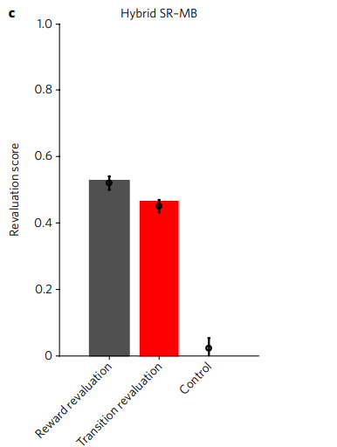
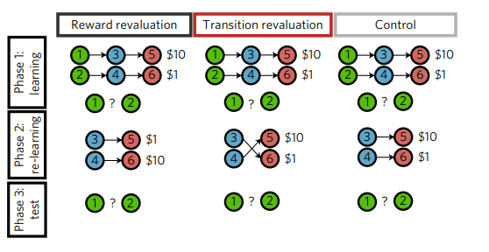

Slide 14
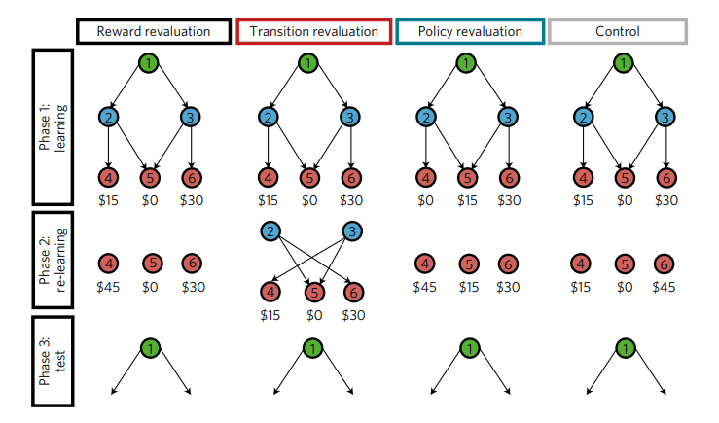
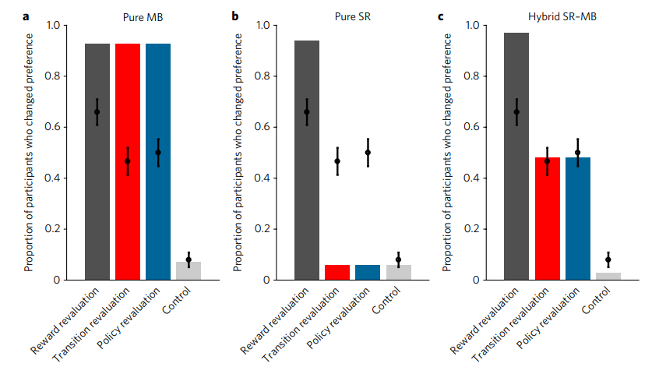

Slide 15
State space

