Slide 1
Goal Model Details

Slide 2
Model Components

Slide 3
Network
Main properties
layerList
projectionList
nodeList
accessDict
Main methods
addLayer, addNode
Update
Outer loop cycles through layers, inner loops cycle through projections to that layer, nodes connected to that layer, and inhibitors connected to that layer. Finally, nodes are cyclically updated as well.
Connect
Connects a layer or node to a layer or projection, creating a new projection
Reset
Resets all activities and traces, but not weights (used to, e.g., change environment and run again – not required for normal functioning)

Slide 4
Layer
Main Properties
Act – vector of activity
ActFunc – function governing activity
Projections – list of projections terminating on the layer
Nodes – list of nodes terminating on the layer
Inhibitors – list of objects which serve to strongly inhibit global layer activity when the activity (and/or time derivative) of the inhibitor is within a specified range
Main Methods
Update – updates activity based on sumExcite and sumInhib (calculated at network-level update)

Slide 5
Main layer update functions
shunt
obj.actTemp = obj.act + dt*((-obj.decayRate*obj.act +
(1-obj.act).*totalExcit + obj.act.*totalInhib + randn(1,obj.numUnits)*obj.noiseGain+obj.bias)/obj.timeConst);
latInhib (non-shunting inhibition)
obj.actTemp = max(obj.act + dt*(( min(-obj.decayRate*obj.act,0)
+ (1-obj.act).*totalExcit+ totalInhib + randn(1,obj.numUnits)*obj.noiseGain+obj.bias)/obj.timeConst),0);

Slide 6
Projection
Main properties
Weights – matrix of synaptic strengths
Source, target – names of source and target objects
timeTrace – matrix of traces (same size as weights)
Gates – List of objects acting as gates (as well as the open/closed conditions). All gates must be open for activity to pass.
Channels – similar to gates, but operate on a unitwise basis.
learnType – string specifying learning law
Main methods
Update – updates synaptic strengths based on preAct, postAct and whether all gates are open (each input calculated at network-level update)

Slide 7
Node
Main properties
Vals – vector analogous to activities
updateFunc – optional property specifying how vals evolve over time (alternatively vals can be hard-set by the external script)
Inputs - cell array of layers or nodes connecting to node (no weights)
Main methods
update - update vals according to updateFunc using the sum of all inputs

Slide 8
Important Nodes
State input (to state layer) (n_env or n_inn)
Goal output (to goal layer) (n_goalOut)
Novelty inhibition (n_novInhib)
Every state transition, starts at 1 and decays linearly. Different layers are inhibited at different times along this cycle (the closer a layer is to ‘state’, the earlier it’s inhibition starts and ends).
Final motor output (n_bg)
Activated for a set duration when motor layer activity reaches a fixed threshold (if more than one action are above threshold, winner take all)
Frustration (n_frust)
Increases linearly up to a set value (of 2, which takes 20 “seconds” to reach), then returns to 0. Is also reset to 0 whenever an action is taken. Connects one-to-all to the frustration layer which itself is connected one-to-one to motorInput. The frustration layer has strong lateral inhibition to create a WTA. Basically, if no actions are taken, this mechanism causes the agent to try a random action.

Slide 9
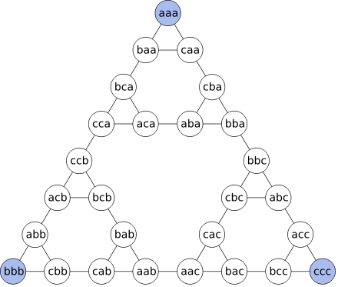
State Space
Main properties
Transitions – n x 3 matrix where each row is [state1, state2, action]
If the agent takes an action in a state where that action leads to no new state, the agent stays where it is – such failed actions are not coded as “transitions” here.
currentState – current state of the agent
Main methods
Rwalk – randomly move to a new state
Mwalk – receives an input vector with one element per action. If any elements are above .9999, take the highest one (there should only be one active due to the motor output node).
State space was previously called environment

Slide 10
Technicalities
All components are subclasses of handle so that functions directly modify contents.
E.g., I can do network.update() instead of network=network.update()
Objects other than the network (called ‘n’ in my simulations) and the stateSpace (called ‘e’ in my simulations) are accessed via the network’s select object method rather than directly. For example, to access the ‘state’ layer, I use n.so(‘state’). The so method looks into the access dictionary for the index of the object in the appropriate list.

Slide 11
Simulation Timestep
Check if any motor activity is sufficient to take a step (using a stateSpace method)
If it is, update the input node, the novelty inhibition node, and the frustration node.
Update network
(In the recent past, oscillatory nodes had to be updated during network update)

Slide 12
Model Architecture

Slide 13
Overall Architecture
Determine Goal
Determine Action
Determine next State
Environment

Slide 14
Determine Next State
Goal
Next State
“Channel” connection. Goal proximity input to Next State gated by Adjacent States activity
Adjacent States
Proximity to Goal
(Connection during learning only)
Current State

Slide 15
Learning State Adjacency (Future)
Adjacent States
Weights initialized at 1-to-1 with values of 2
Target weight pattern: For each current state s, the unit in the current state layer representing that state u_s should be strongly connected to each unit v_s’ in adjacent states, where s’ is a state adjacent to s (including when s’==s).
Basic strategy: use presynaptic traces to make recently active states eligible to learn. Then, when strong current state information comes in, strengthen the connection between the high-trace post-synaptic units and the high-activity adjacentStates units
Current State

Slide 16
T1
Agent enters state 1. State layer is activated and activates corresponding unit in AdjFuture due to one-to-one connections.
AdjFuture
State
T2
Connections from highly active unit become eligible to learn.
AdjFuture
State
T3
Unit moves to state 2, strongly activating unit 2 of adjFuture. Weight between eligible connections and strongly active unit increases.
AdjFuture
State

Slide 17
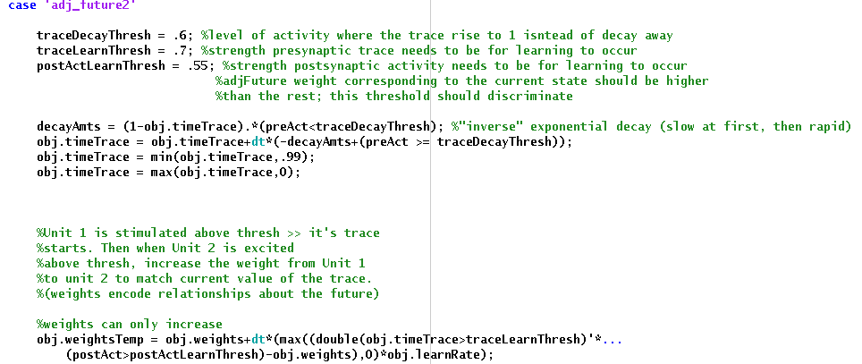
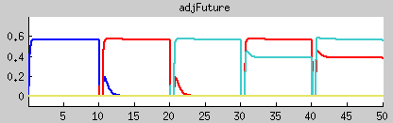
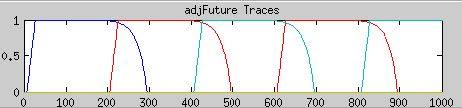
Adjacent States
Learning State Adjacency
Current State
Are binarizations realistic? How to adjust for greater biological plausibility?

Slide 18
Learning State Proximity (Past)
Goal
Connections within proxPast encode adjacency relations. If these connections are of equal strength and less than 1, activity filtering through the network from an external input represents a distance gradient.
Target: for each state s, the proxPast unit p_s representating that state should project to all and only proxPast units representing adjacent states s’. The strengths should be equal and less than one.
Complication: When pursuing a goal, external input should come from Goal but in order to learn gradient, input needs to come from Current State. Initially I just learned and acted in separate phases, but an oscillatory mechanism should be used.
Strategy: When receiving state information, form a postsynaptic trace on highly active unit (the most active proxPast unit should be the one receiving external input. When a new unit becomes highly active, strengthen the projection from it to the unit with the trace.
State Proximity
Current State

Slide 19
T1
Agent enters state 1. State layer is activated and activates corresponding unit in proxPast due to one-to-one connections.
proxPast
State
T2
Connections to highly active unit from other proxPast units become eligible to learn.
proxPast
State
T3
Unit moves to state 2, strongly activating unit 2 of proxPast. Weight from active unit to previously active unit increases
proxPast
State

Slide 20
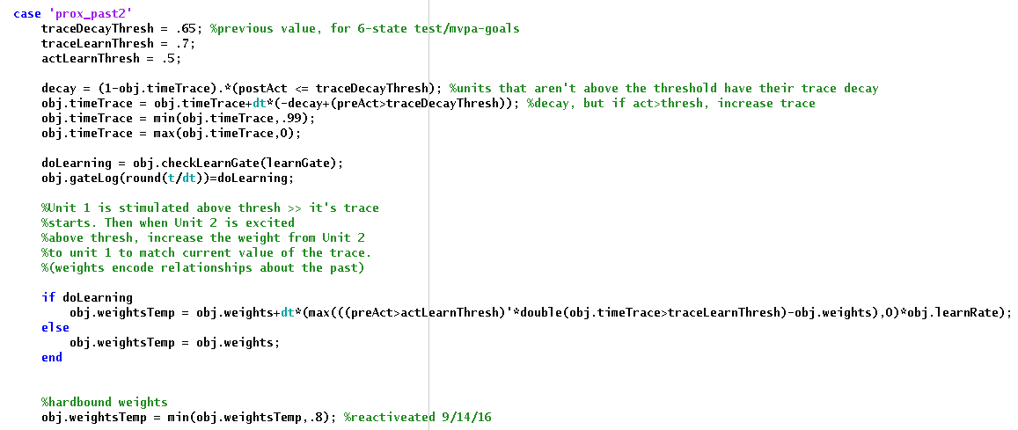
Learning State Proximity (Past)
Goal
State Proximity
Current State
Are binarizations realistic? How to adjust for greater biological plausibility? How to maintain stability while allowing flexible relearning (above, weights can only increase)?

Slide 21

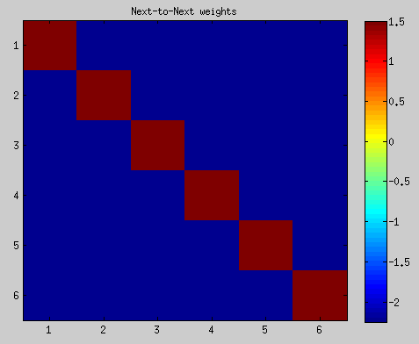
Determining Next State
Next State
From network.m update()
Adjacent States
Proximity to Goal

Slide 22
Determine Next Action
Hard Coded
Next State
Desired Transition
Transition Output
Current State
Observed Transition
Previous State
Learning
Action In
Previous Action
Action Out

Slide 23
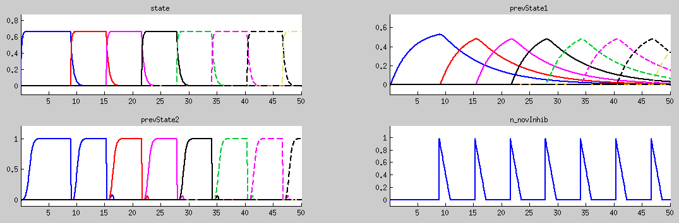
Maintaining the past
High time constant, no novelty inhibition
Node set to 1 after state transition
Input from prevState1, mutual inhibition, novelty inhibition

Slide 24
Learning Transition to Action Mapping
Desired Transition
Transition Output
Learning
Observed Transition
Transition Output -> Action In weights need to learn on every transition.
Strategy: Maintain the previously seen transition and previous action to learn from. Oscillate between learning mode and acting mode.
Action In
Previous Action
Action Out

Slide 25
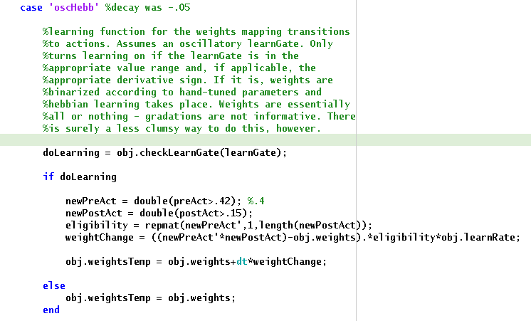
Learning Transition to Action Mapping

Slide 26
(drive learning not yet implemented with latest model changes)
Current State
Drives
Drive Learning
Goals
Target weight pattern: drives strongly connected to the states that satisfy them. (E.g. ‘hunger’ drive unit connected to the ‘refrigerator’ goal unit.
Strategy: Current State has a modulatory one-to-one connection to Goals. Units receiving modulatory input are eligible to learn. When a drive is sharply reduced, strengthen connection between that drive and the eligible goal unit.

Slide 27
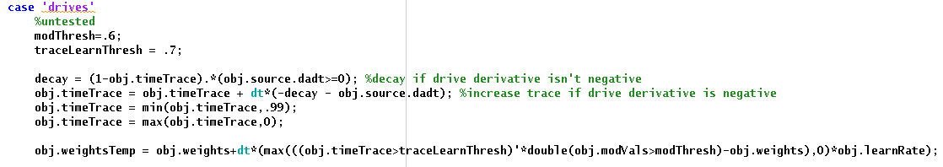
Drive Learning
Current State
Drives
Goals

Slide 28
Overall Architecture with the Queue
Transition Queue
Determine Goal
Determine Action
Determine next State
Environment

Slide 29
Queue
Target: Maintain a competitive queue of transitions (if representing actions, no way to represent that an action must be taken multiple times without disrupting queue order)
Strategy: Essentially, run the model “offline” and store the desired transitions. Uses four new layers: simulated state, queue input, queue storage, and queue output. On each step, store the transition (simulatedState, nextState), then make the nextState the simulatedState. Temporally organize the necessary steps with an oscillation.
Control signals: Queue-Load, Queue-Read, Queue-Oscillation

Slide 30
Storing a plan
––– Queue Load
––– ~Queue Load
––– Queue Read
QueueIn
Desired next state
QueueStore
Goal
QueueOut
Desired state transition (conjunction)
StateSim
Transition output (conjunction)
Adjacent state (future)
Proximity map (past)
Observed state transition (conjunction)
Previous state (2 layers)
Learning
Action In
State
Previous action (2 layers)
Action Out
Environment
BG

Slide 31
The Queue stack
Desired Conjunction
Role: provide a very brief input to Queue-Store inversely proportional to the number of transitions stored in Queue-Store. Currently actually a node because I was having a lot of trouble getting it working correctly.
Queue In
Queue Store
Role: Maintain transitions with activity level representing temporal precedence. Instantiated as a layer with 0 decay.
Role: Read out the most active transition from Queue-Store, then remove that transition from Queue-store. Instantiated as a WTA layer with one-to-one inhibition to Queue-Store (gated by the Queue-Oscillation).
Queue Out

Slide 32
Desired next state
X
X
Desired state transition (conjunction)
Queue_In
X
StateSim
Queue_Store
Queue_Out

