Slide 1


Differentiable collision detection for autonomous driving
Autonomous and Mobile Robotics, a.y. 2024-2025
Professor Giuseppe Oriolo
Supervisor Michele Cipriano
Rota Benedetta
Rota Camilla
Palumbo Simone
1936424
1936447
1938214

Slide 2
Overview
Key Challenge
Collision detection is crucial for autonomous robotics but traditional methods are non-differentiable and limited.
Preliminary Support
DCOL Approach
The DCOL Algorithm
Differentiable Collision Detection (DCOL) reformulates collision as a convex optimization problem to compute minimum scaling for intersection.
ALTRO Algorithm
Practical Applications
Advantages
Provides smooth, differentiable collision metric even for interpenetrating objects. Integrates with gradient-based optimization.
Future Implementations
AMR - Differentiable collision detection for autonomous driving
25/02/2025
2

Slide 3
Background
 | Differentiability | Computational Efficiency | Collision Metric Type | Handles Interpenetration
GJK & En-GJK |  |  | closest point distance
MPR |  |  | closest point distance
EPA |  |  | penetration depth
Smoothed GJK |  |  | closest point distance
DCOL |  |  | scaling-based metric
[3], [4]
[5], [6]
[7]
*
[8]
[1]
*Not always differentiable.
AMR - Differentiable collision detection for autonomous driving
25/02/2025
3

Slide 4
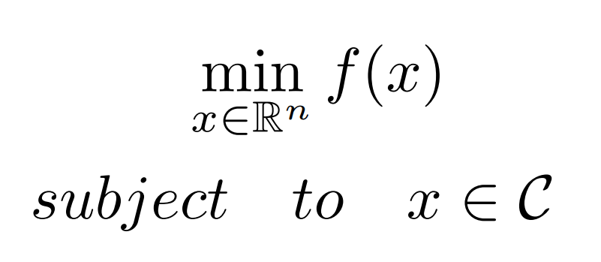
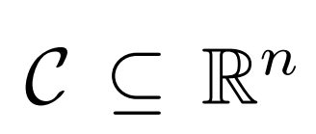
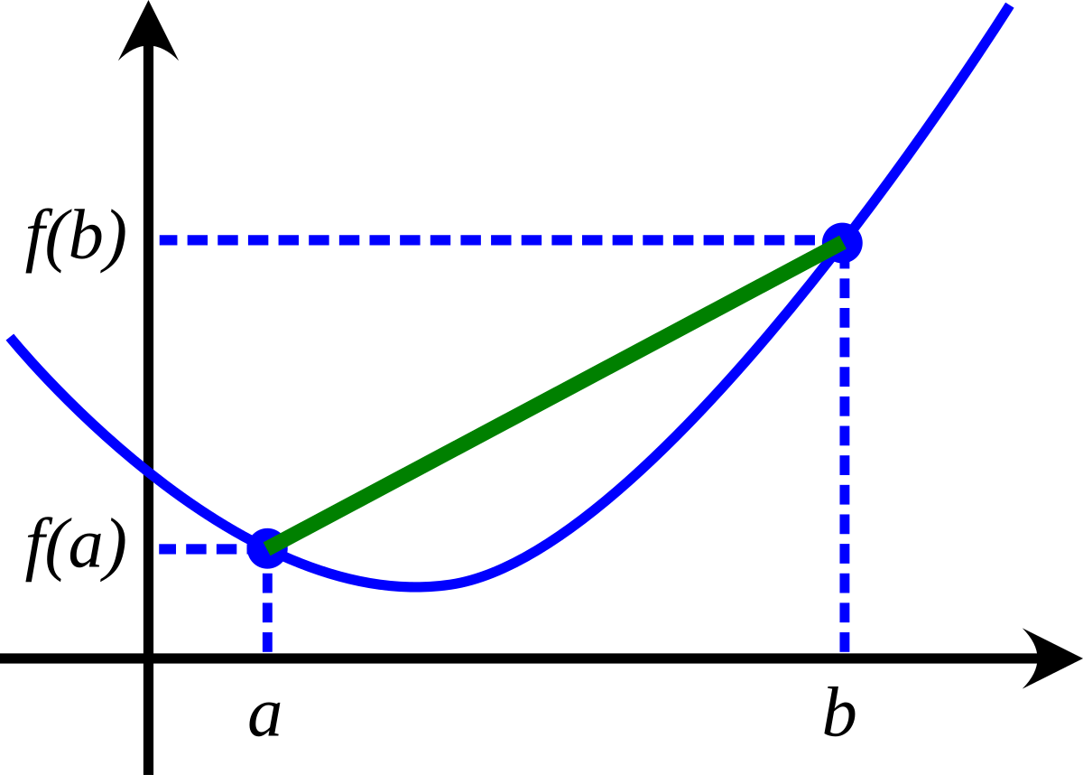
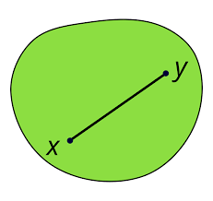
Preliminary Support
Convex optimization problem
A general optimization problem takes the following form:
where:
- is the objective function to be optimized;
- is the set of constraints.
The problem is said to be convex if
the convexity conditions hold:
Main properties
Uniqueness of Solution
is convex
is a convex set
Computational Efficiency
Robustness
AMR - Differentiable collision detection for autonomous driving
25/02/2025
4

Slide 5
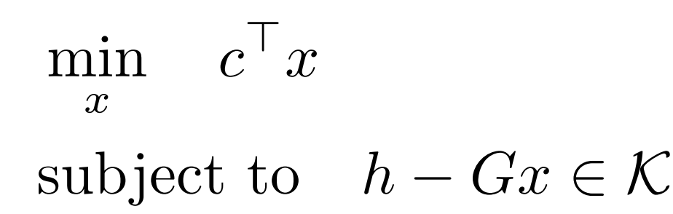
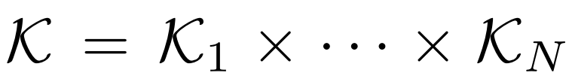

Preliminary Support
Conic Optimization and Differentiating Through a Cone Program
The conic optimization problem has the form:
where:
is the Cartesian product of N convex cones.
Conic problems enjoy strong duality.
A wide range of problems can be expressed as conic programs:
- SOCP
AMR - Differentiable collision detection for autonomous driving
25/02/2025
5

Slide 6
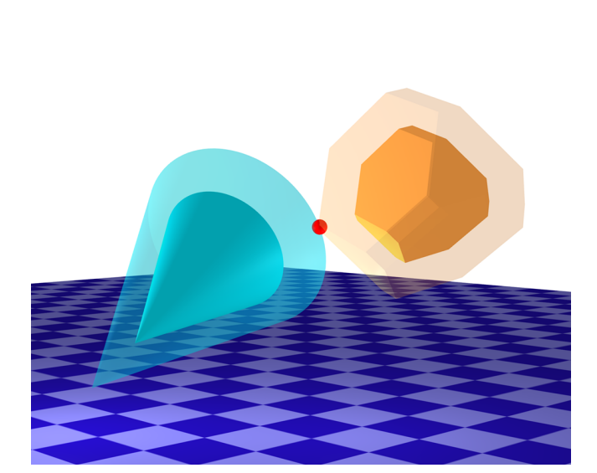

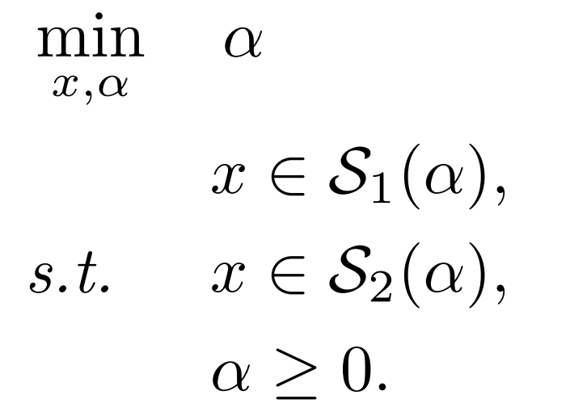
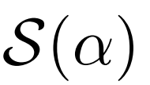

The DCOL algorithm
The DCOL algorithm is based on the resolution of a convex optimization problem, which allows to determine the minimum uniform scaling factor , applied simultaneously to two convex objects, necessary for a collision to occur between them.
no collision
The primitives are in contact.
Optimization Problem
interpenetration
Convexity
Boundedness
where represents a convex primitive
scaled by a factor .
Feasibility
AMR - Differentiable collision detection for autonomous driving
25/02/2025
6

Slide 7

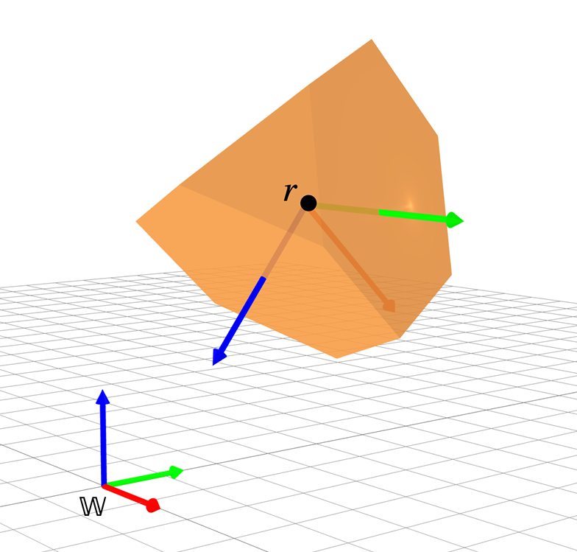
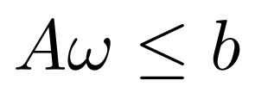


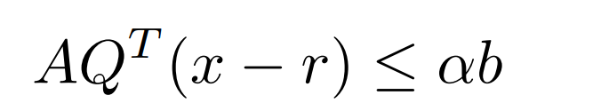
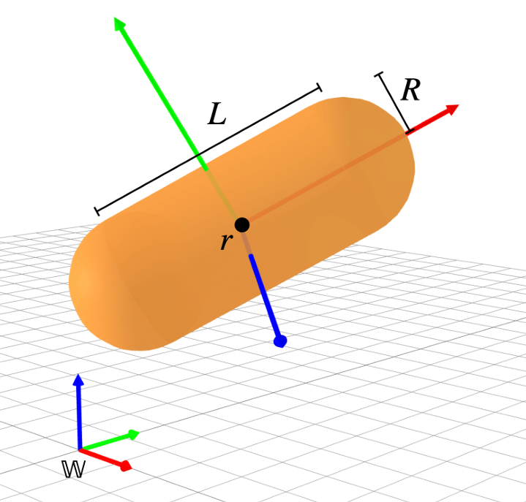
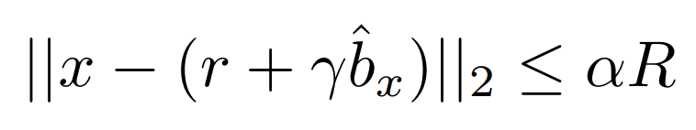
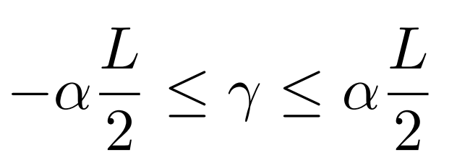
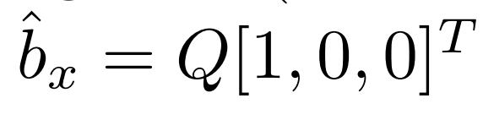
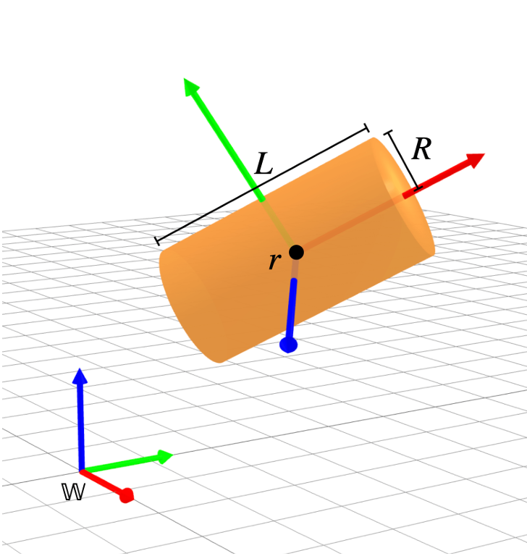
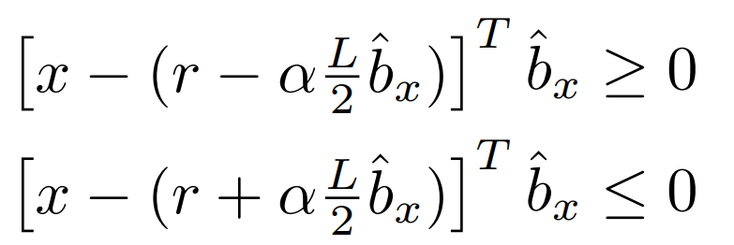
Primitives
The constraints are represented as:
Polytope
The constraint to check if a point
is inside the scaled polytope is:
The constraints to check if a point is inside the scaled capsule are:
Capsule
where:
is the slack variable indicating
the position along the segment
The constraints are the same used to represent the capsule, with the addiction of:
Cylinder
AMR - Differentiable collision detection for autonomous driving
25/02/2025
7

Slide 8
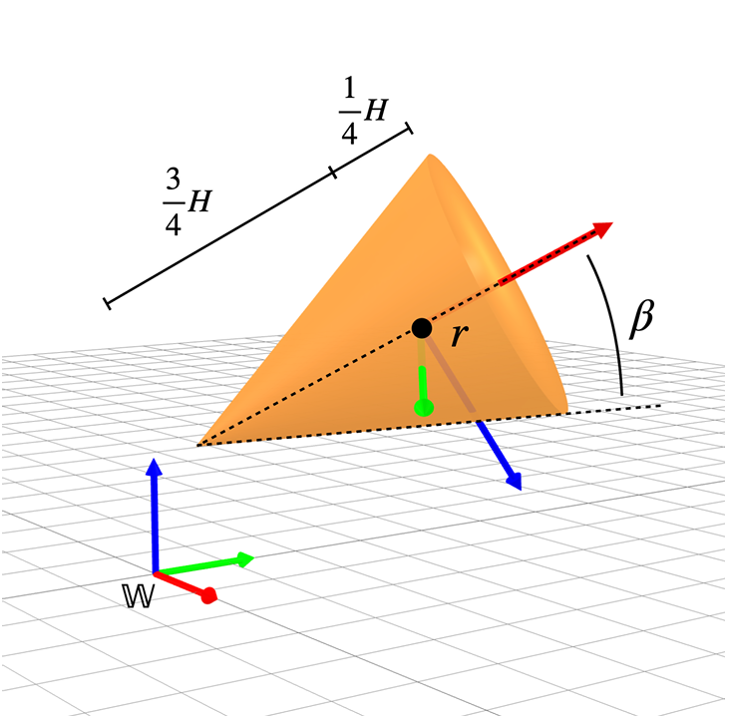
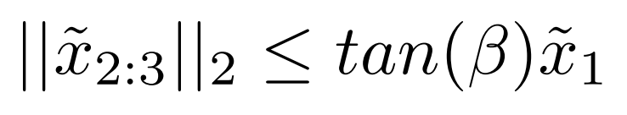
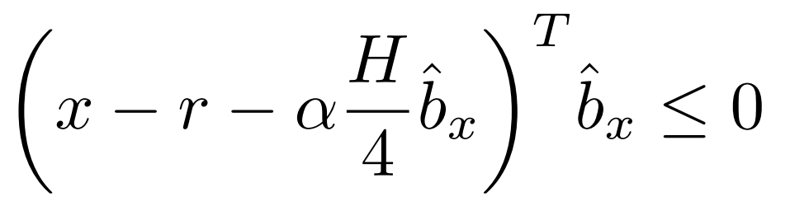
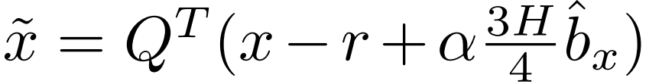
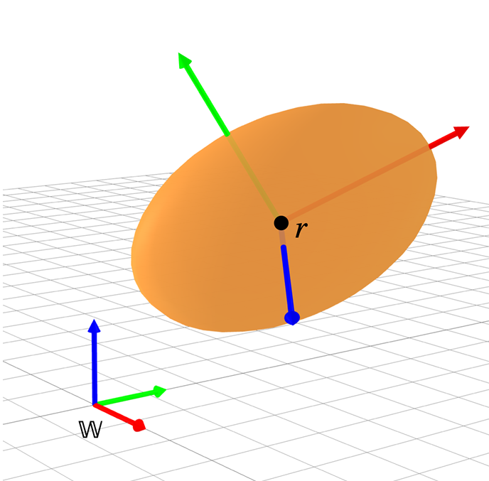

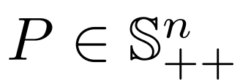
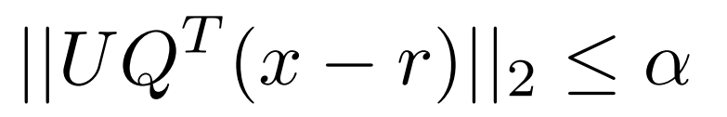

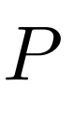
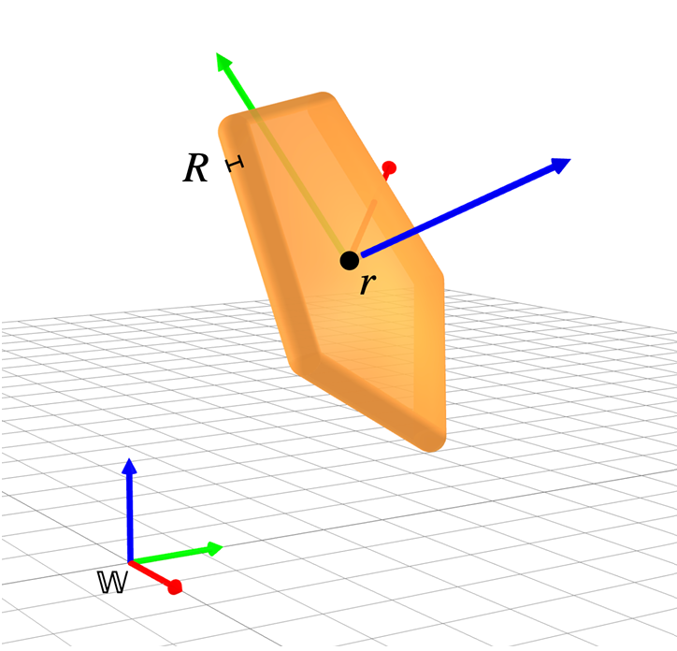
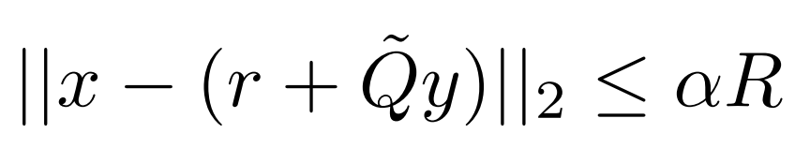

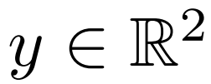
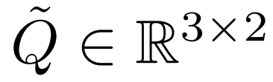

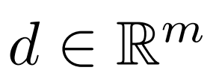
Primitives
The constraints of the cone are:
Cone
with:
The ellipsoid is defined by:
Ellipsoid
The constraint to represent a scaled ellipsoid is:
where
is the
Cholesky factor for
Padded Polygon
The constraint to check if a point is inside the scaled padded polygon are:
where , , and .
AMR - Differentiable collision detection for autonomous driving
25/02/2025
8

Slide 9
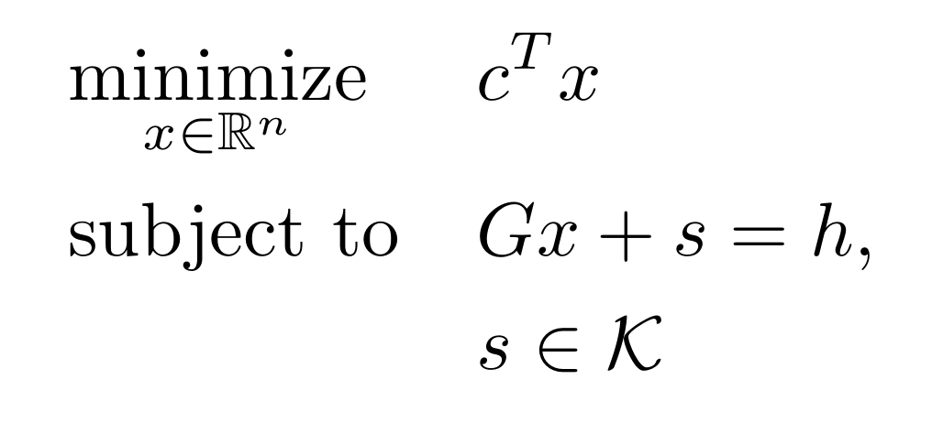

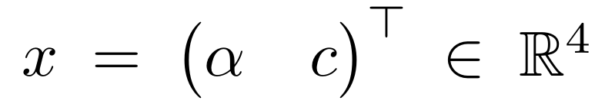
Primal-Dual Interior Point
PDIP is used to solve a conic program of the form:
where:
is a is a combination of nonnegative orthants and second order cones.
s is a slack variable
The solution
contains both the proximity distance and the coordinates of the contact point.
PDIP starts from a feasible initial guess of the solution and it iteratively improves it by solving, at each iteration, the linearization of the Karush Kuhn-Tucker (KKT) conditions, in order to find the step directions
1. Primal Feasibility:
2. Dual Feasibility:
3. Complementarity
condition:
AMR - Differentiable collision detection for autonomous driving
25/02/2025
9

Slide 10
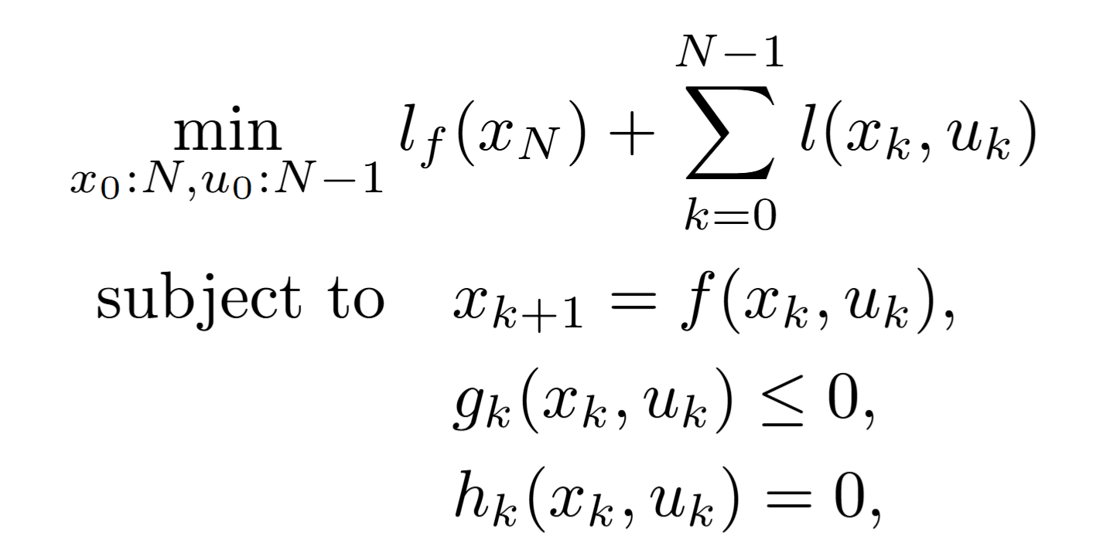

ALTRO Algorithm
Strengths
Method for solving trajectory constrained optimization problems.
Speed
Numerical Robustness
Handling Complex Constraints
The general optimization problem to be solved with ALTRO [2] is:
where:
and are the final and stage cost functions;
and are the state and input control variables;
is the discrete dynamics function;
and are inequality and equality constrains.
ALTRO algorithm consists of two main phases:
AL-iLQR
Projected Newton
AMR - Differentiable collision detection for autonomous driving
25/02/2025
10

Slide 11
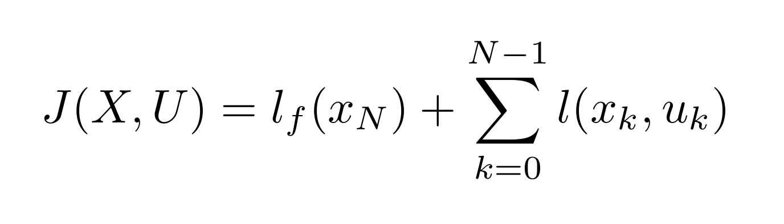
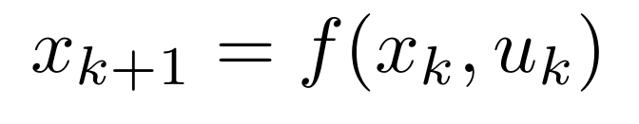
iLQR
This algorithm minimizes the following general cost function:
where:
is the system state
is the control input
subject to
two main steps:
Backward Pass
computes the optimal control correction that minimizes the overall system cost, with a recursive backward approach from the final time step (N) to the initial step (0).
computes the updated state trajectory by applying the corrected controls derived from the Backward Pass, starting from the initial state (rollout).
Forward Pass
AMR - Differentiable collision detection for autonomous driving
25/02/2025
11

Slide 12
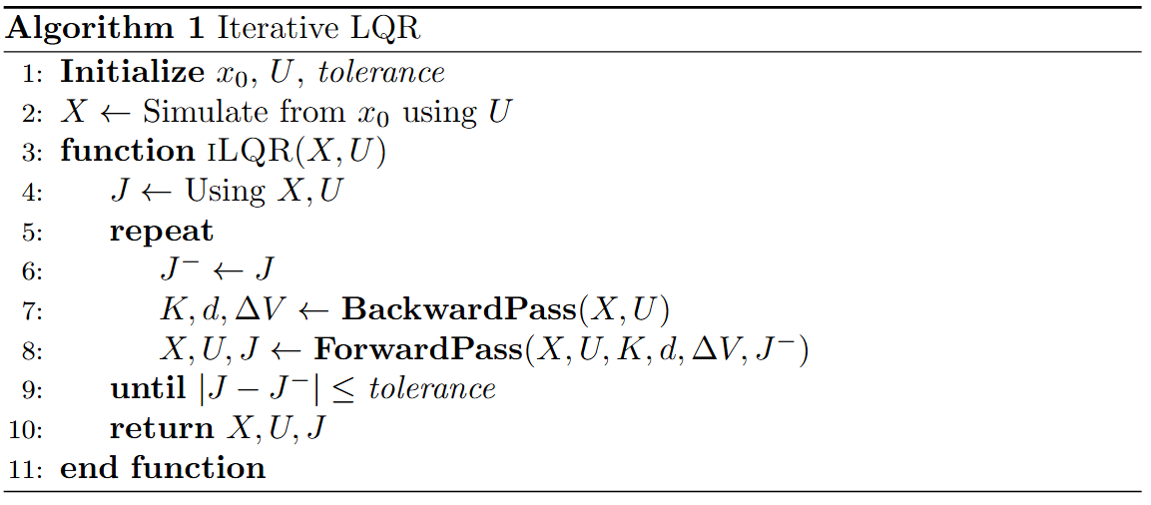
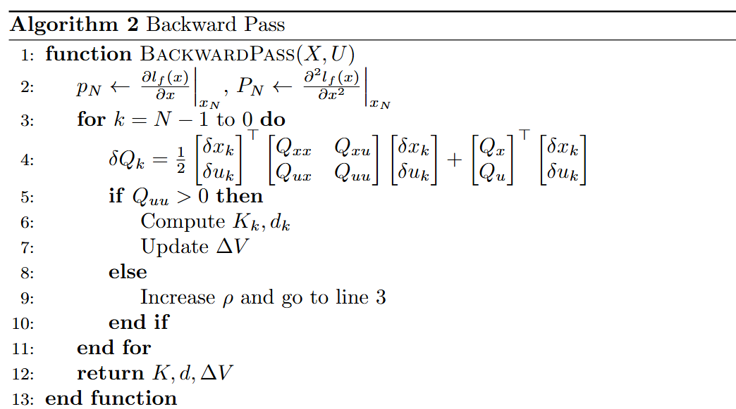
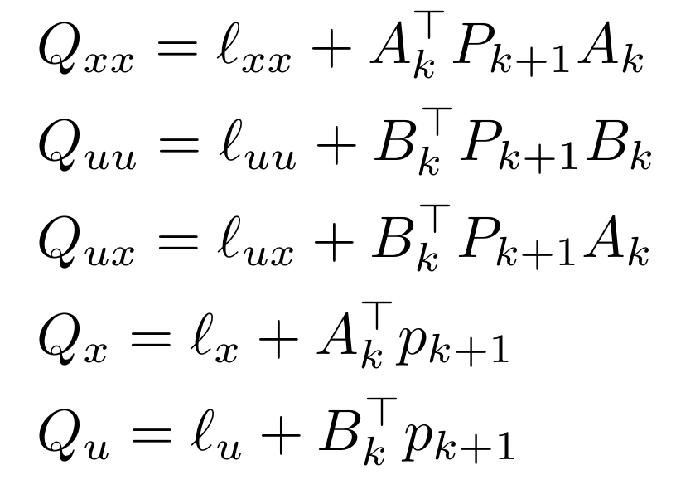
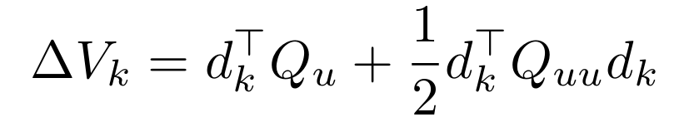
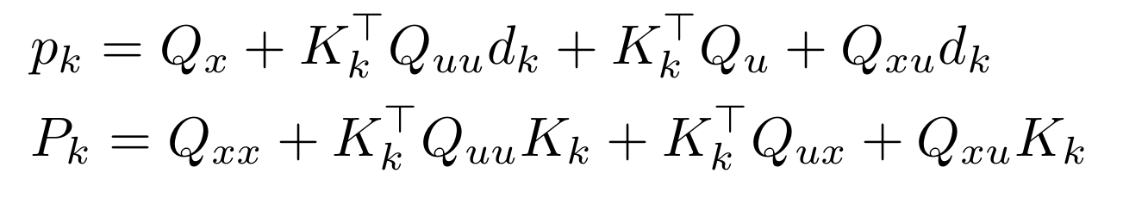
iLQR – Backward Pass
Moreover, we compute:
AMR - Differentiable collision detection for autonomous driving
25/02/2025
12

Slide 13
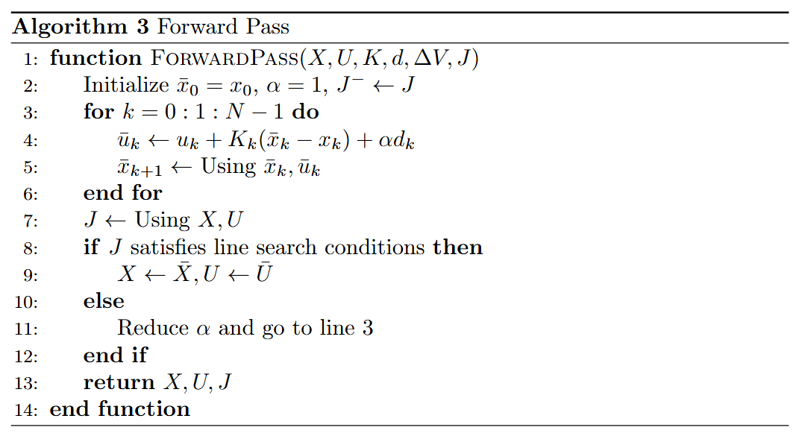
iLQR – Forward Pass
AMR - Differentiable collision detection for autonomous driving
25/02/2025
13

Slide 14
AL-iLQR
AL-iLQR (Augmented Lagrangian Iterative Linear Quadratic Regulator) extends iLQR to handle constraints effectively by adjusting multipliers and penalty terms iteratively until a feasible and optimal trajectory is found.
How It Works
Two Phases:
Solving the Constrained Optimization Problem
Updating Dual Variables
Uses iLQR to minimize a modified cost function.
Adjusts the multipliers to enforce constraints more strictly.
Incorporates constraints using Lagrange multipliers and penalty weights.
Increases penalty weights to refine the solution.
Computes optimal control and state trajectories through iterative updates.
Repeats the process until constraints are fully satisfied.
AMR - Differentiable collision detection for autonomous driving
25/02/2025
14

Slide 15
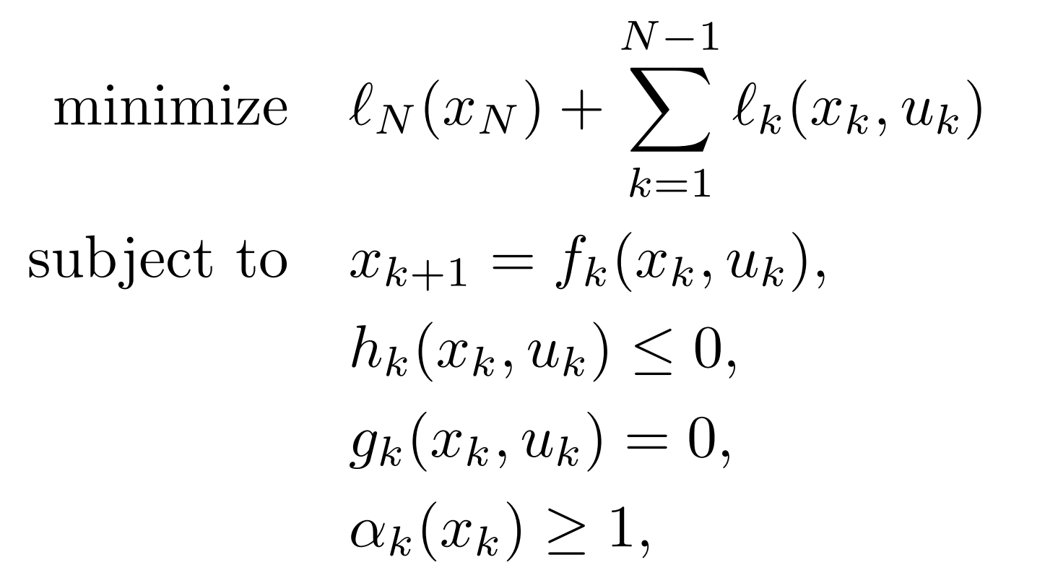
Practical Applications
Trajectory Optimization
A generic trajectory optimization problem with DCOL-based collision avoidance constraints can be formulated as follows:
Problem Formulation
Define dynamics, state/control bounds, and collision constraints.
1
DCOL Integration
Collision avoidance constraint α(x) ≥ 1 imposed at each timestep.
2
where
is the discrete dynamics of the systems,
indicates bounds on the state and control inputs,
imposes the initial and final states,
the collision constraint is imposed to ensure no interpenetration.
ALTRO Solution
Combines AL-iLQR with DCOL to solve constrained optimization problem.
3
We can solve this type of problems combining ALTRO with DCOL.
AMR - Differentiable collision detection for autonomous driving
25/02/2025
15

Slide 16
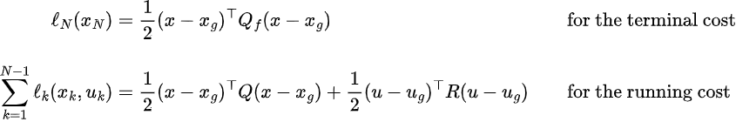
Cost Function
For all three applications, the cost function is
To be augmented by the AL term for the state and control constraints (h) and the initial, goal constraints (g).
AMR - Differentiable collision detection for autonomous driving
25/02/2025
16

Slide 17
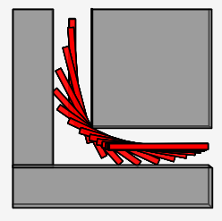
Piano Mover
Scenario
Challenge
A piano must navigate through a narrow corridor and make a 90-degree turn without colliding with the walls.
Size of the piano : 2.6 m
Width of the corridor : 1 m
Dynamics
Primitives
Piano
cylinder
Obstacles
polytopes
state vector:
control vector:
AMR - Differentiable collision detection for autonomous driving
25/02/2025
17

Slide 18
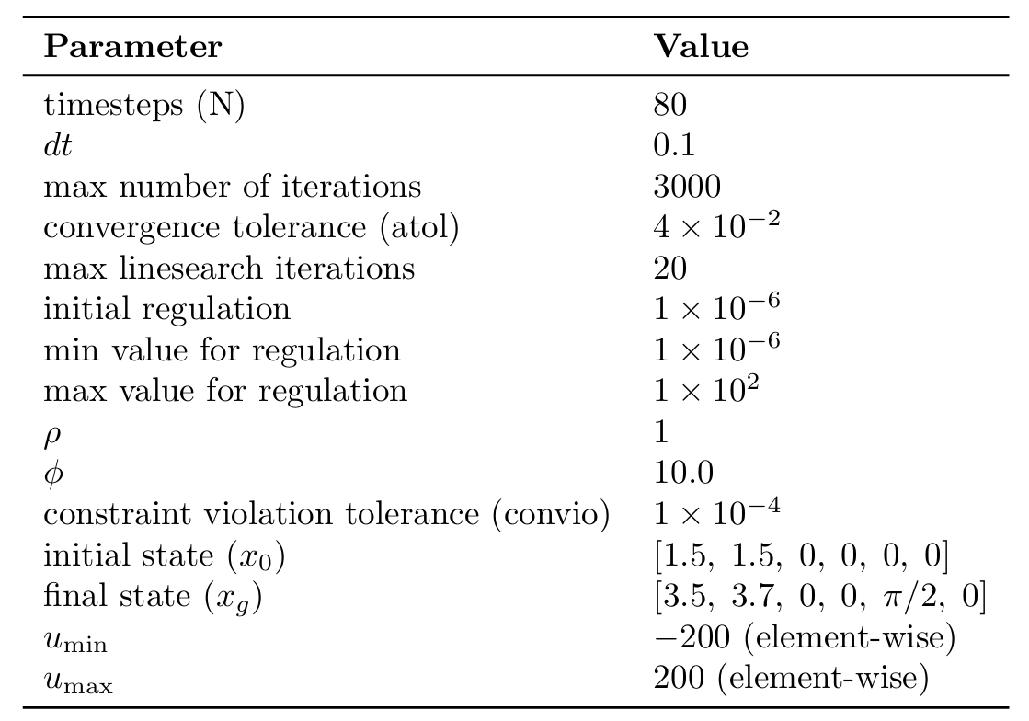
Piano Mover - Parameters
AMR - Differentiable collision detection for autonomous driving
25/02/2025
18

Slide 19
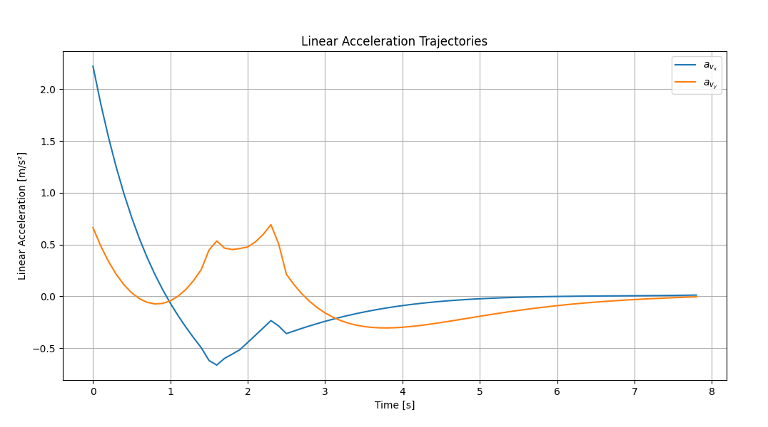
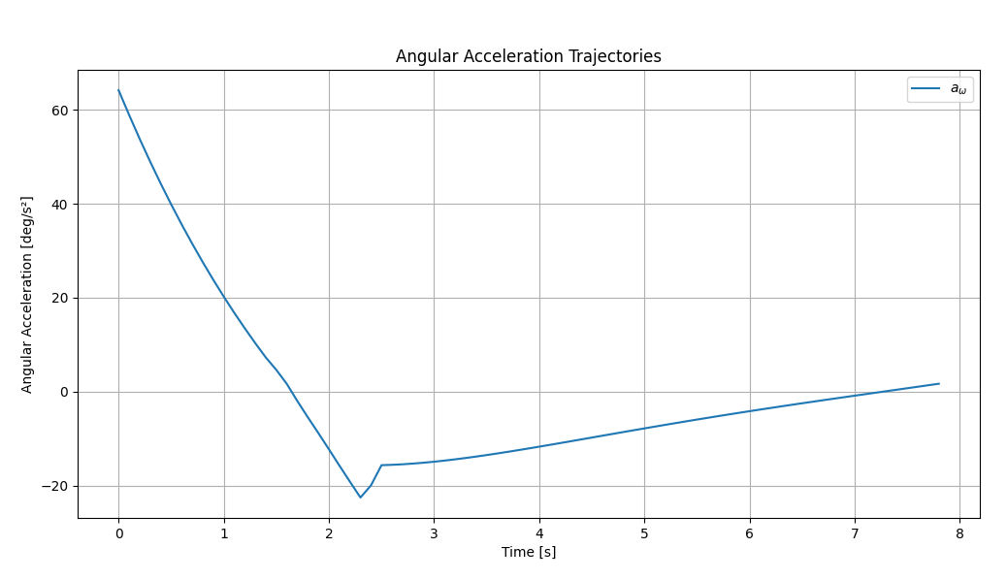
Piano Mover
Control for the piano mover
AMR - Differentiable collision detection for autonomous driving
25/02/2025
19

Slide 20
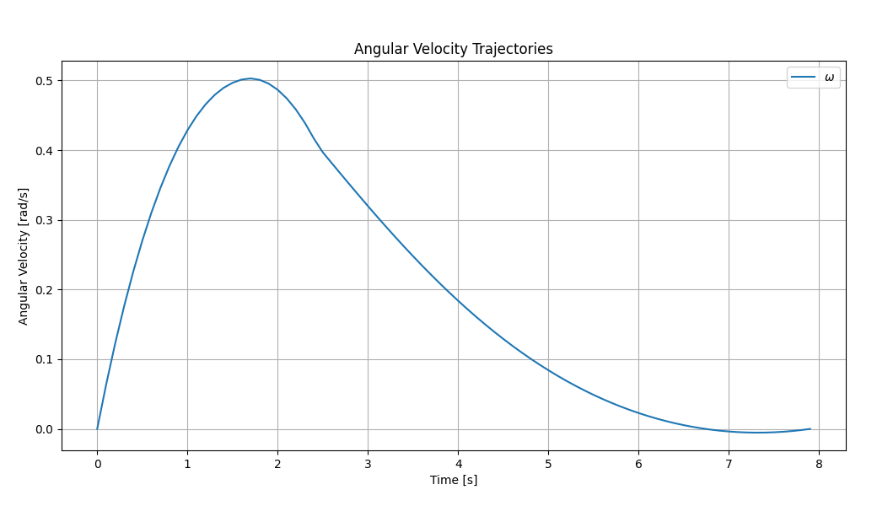
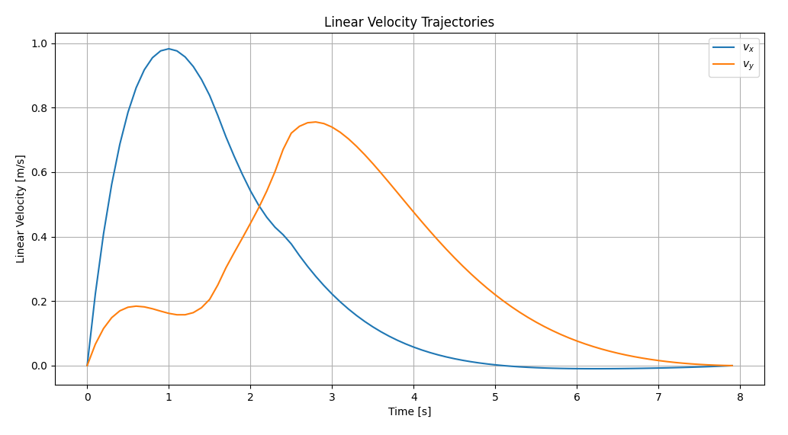
Piano Mover
State trajectory
AMR - Differentiable collision detection for autonomous driving
25/02/2025
20

Slide 21


Piano Mover
State trajectory
AMR - Differentiable collision detection for autonomous driving
25/02/2025
21

Slide 22


Quadrotor
Scenario
planning the trajectory of a quadrotor, an air vehicle with four rotors, in a complex three-dimensional environment populated by 12 obstacles.
Dynamics
Challenge
complexity of the environment
Primitives
where:
L is the distance from quadrotor center to rotor,
and
Quadrotor
sphere
Obstacles
polytopes, cones, capsules, cylinders, sphere and padded polygon.
state vector:
control vector:
AMR - Differentiable collision detection for autonomous driving
25/02/2025
22

Slide 23

Quadrotor - Parameters
AMR - Differentiable collision detection for autonomous driving
25/02/2025
23

Slide 24

Quadrotor
Control for the quadrotor
AMR - Differentiable collision detection for autonomous driving
25/02/2025
24

Slide 25


Quadrotor
State trajectory
AMR - Differentiable collision detection for autonomous driving
04/02/2025
25

Slide 26


Quadrotor
State trajectory
AMR - Differentiable collision detection for autonomous driving
04/02/2025
26

Slide 27

Cone Through a Wall
Scenario
Challenge
A three-dimensional rigid cone must pass through an opening in a wall.
Reach a specified final configuration without collision.
Primitives
Cone
cone
Dynamics
Obstacles
polytopes
state vector:
control vector:
AMR - Differentiable collision detection for autonomous driving
25/02/2025
27

Slide 28

Cone Through a Wall - Parameters
AMR - Differentiable collision detection for autonomous driving
25/02/2025
28

Slide 29


Cone Through a Wall
Control for the cone.
AMR - Differentiable collision detection for autonomous driving
25/02/2025
29

Slide 30


Cone Through a Wall
State trajectory
AMR - Differentiable collision detection for autonomous driving
25/02/2025
30

Slide 31


Cone Through a Wall
State trajectory
AMR - Differentiable collision detection for autonomous driving
25/02/2025
31

Slide 32

Future Implementations
Implementation Speed:
The implemented Python code is characterized by a high and unsatisfactory execution time when compared to the Julia implementation.
overall code is slow !!
 | Python (s) | Julia (s)
Piano Mover | 104 | 0.445
Quadrotor | 2000 | 6.98
Cone Through Wall | 300 | 0.866
AMR - Differentiable collision detection for autonomous driving
25/02/2025
32

Slide 33

Future Implementations
AMR - Differentiable collision detection for autonomous driving
25/02/2025
33

Slide 34

Future Implementations
Convex Decomposition
Many objects in real-world robotics and simulations are non-convex, making collision detection more challenging.
The framework can be advanced handling objects with arbitrary, non-convex geometries.
AMR - Differentiable collision detection for autonomous driving
25/02/2025
34

Slide 35
Conclusions
The DCOL methodology stands out from traditional solutions thanks to its differentiable formulation and direct integration with gradient-based optimization methods.
The integration of DCOL into the ALTRO framework allows to effectively manage collision constraints already during the trajectory optimization process.
The examples shown demonstrated the effectiveness and flexibility of the method, producing optimal trajectories while respecting collision constraints.
Despite the promising results, there is still room for improvement.
AMR - Differentiable collision detection for autonomous driving
25/02/2025
35

Slide 36
Thanks
for the
attention
AMR - Differentiable collision detection for autonomous driving
25/02/2025
36

Slide 37
References
[1]
K. Tracy, T. A. Howell, and Z. Manchester, “Differentiable collision detec tion for a set of convex primitives,” in 2023 IEEE International Conference on Robotics and Automation (ICRA), pp. 3663–3670, IEEE, 2023.
[2]
T. A. Howell, B. E. Jackson, and Z. Manchester, “Altro: A fast solver for constrained trajectory optimization,” in 2019 IEEE/RSJ International Conference on Intelligent Robots and Systems (IROS), pp. 7674–7679, IEEE, 2019.
[3]
E. G. Gilbert, D. W. Johnson, and S. S. Keerthi, “A fast procedure for com puting the distance between complex objects in three-dimensional space,” IEEE Journal on Robotics and Automation, vol. 4, no. 2, pp. 193–203, 1988.
[4]
S. Cameron, “Enhancing gjk: Computing minimum and penetration dis tances between convex polyhedra,” in Proceedings of international confer ence on robotics and automation, vol. 4, pp. 3112–3117, IEEE, 1997.
G. Snethen., “Xenocollide: Complex collision made simple,” 2008.
[5]
[6]
J. Newth, “Minkowski portal refinement and speculative contacts in box2d,” 2013.
G. VanDenBergen, “Proximity queries and penetration depth computation on 3d game objects,” in Game developers conference, vol. 170, p. 209, 2001.
[7]
[8]
L. Montaut, Q. Le Lidec, A. Bambade, V. Petrik, J. Sivic, and J. Car pentier, “Differentiable collision detection: a randomized smoothing approach,” in 2023 IEEE International Conference on Robotics and Automa tion (ICRA), pp. 3240–3246, IEEE, 2023.
AMR - Differentiable collision detection for autonomous driving
25/02/2025
37

Slide 38






PDIP Appendix – Primitives
In order to be digested by PDIP, primitives must be rewritten in the following standard forms
For polytopes
For cylinders
is the nonnegative orthant in n-dimensions
  ORT constraints capture linear alignment and boundary conditions (e.g. limits along the object’s axis)
is the n-dimensional second-order cone
  SOC constraints capture nonlinear, curved aspects (e.g. maintaining a constant radius)
ORT and SOC constraints are then concatenated to get G and h for each primitive, to be used as constraints in the conic problem
For capsules
For ellipsoids
For cones
For padded polygons
AMR - Differentiable collision detection for autonomous driving
25/02/2025
38

Slide 39













PDIP Appendix – Algorithm insight
Represent how much the current solution is violating KKT
Measure complementarity of updated variables w.r.t. current ones. is then used to correct:
then , and are recomputed, this time corrected.
AMR - Differentiable collision detection for autonomous driving
25/02/2025
39

Slide 40




PDIP Appendix – Cone Product
Denoted by ◦
  For orthant-related constraints it's an elementwise product
  For SOCs is
The inverse cone product is
  Element-wise division for the orthant-related constraints
  For SOCs is
Where:
AMR - Differentiable collision detection for autonomous driving
25/02/2025
40

Slide 41








PDIP Appendix – Nesterov Todd Scaling
NT scaling is used to handle the SOC structure in the PDIP method. Essentially, NT scaling maps each SOC into an equivalent space that resembles the nonnegative orthant. Assuming a SOC in :
  Normalize s and z
  Compute
  Compute
  Construct the scaling matrix
  Scale by to obtain
γ controls how we combine the primal and dual directions in the normalized cone space so that the resulting vector remains well-centered (i.e. if and are very aligned, γ is closer to 1)
= () is the blend of normalized primal and dual vectors used to build the NT scaling matrix W
Note, in our implementation, we computed the NT scaling for a composite cone consisting of an orthant and two SOCs, so we need an additional factor:
Moreover, we perform Cholesky factorizations of the two SOC matrices, since NTScaling should be SPD in the interior of the cone
AMR - Differentiable collision detection for autonomous driving
25/02/2025
41

Slide 42






PDIP Appendix – Linesearch
Linesearch computes the maximum allowable step size α ∈ [0,1] s.t. the updated state y remains within the feasible region of the composite cone (orthant + SOC)
We took the minimum between and
Orthant linesearch: computes the minimum s.t.
SOC linesearch: computes the minimum s.t.
  The closed form solution is:
where:
AMR - Differentiable collision detection for autonomous driving
25/02/2025
42

Slide 43





AL-iLQR Appendix
AMR - Differentiable collision detection for autonomous driving
25/02/2025
43

