Slide 1
Department of Psychology, University of Tübingen, Schleichstraße 4, 72076, Tübingen, Germany
The processing of event roles in pictures
Presenter: Wenjia Xu Supervisor: Prof. Dr. Markus Huff Dr. Frank Papenmeier

Slide 2
Background
When trying to understand the daily environment, human observers represent the incoming sensory information in event models, thus guiding comprehension (Huff et al., 2014; Zacks et al., 2007).
An essential component of building the event model is event roles, including the agent and the patient (Cohn & Pacynski, 2013; Papenmeier et al., 2019; Stawarczyk et al., 2021).
Incoming Sensory Information
Event models
Comprehend Daily Environment
Event model:
construct event representations from text, movies, and reality (Radvansky & Zacks, 2017).
structured fragments derived from the event's internal makeup, including the time, space, and character relationships (Huff et al., 2014; Zacks, 2020)
Event Roles
Agent and Patient

Slide 3
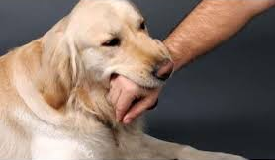
Event Roles
asymmetry
Agent: the performer of the action
Patient: the person or thing acted upon
Agent
Patient
Event roles are asymmetric during the cognitive process, and agents are more salient (Isasi-Isasmendi et al., 2023; Segalowitz & Hansson, 1979)
Agent Advantage Effect
Human observers are faster in responding to the agent information than the patient information (Segalowitz, 1982).
Language: linguistic theories (Clark, 1965; Cohn & Paczynski, 2013).
Visual Representations: comics (Cohn & Paczynski, 2013) and pictures (Segalowitz, 1982)

Slide 4

Agent Advantage Effect
Language: linguistic theories (Clark, 1965; Cohn & Paczynski, 2013), related to the sequential order of semantic roles in the grammatical structure (Jackendoff, 1972; Keenan, 1976).
Visual Representations: comics (Cohn & Paczynski, 2013) and pictures (Segalowitz, 1982)
Linguistic Theories
subject-verb-object (SVO)
Agent Patient
Alice is biting an apple. (Active sentence)
The apple is bitten by Alice. (Passive sentence)
Predict the event based on the agent
Agent is more salient and easier to process

Slide 5
Project
Study 1
Study 3
Study 2
Agent Advantage Effect in pictures
Study the underlying process of the agent advantage effect
Eye-tracking Study
Motion Line Study
Abstract Fish Study
Study how comic elements impact the agent advantage effect in single pictures
Study the agent advantage effect in with abstract fish
Key: reaction time and search task

Slide 6
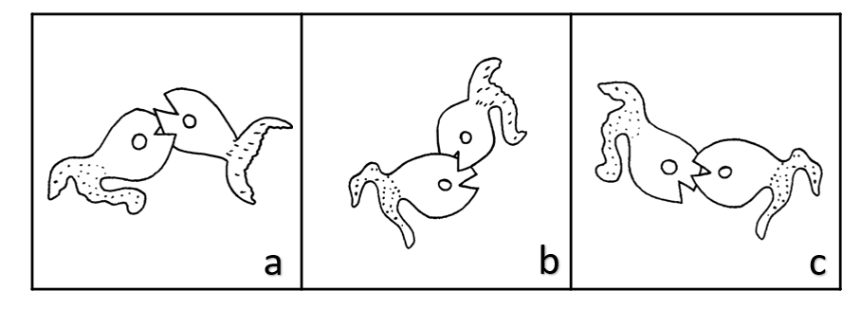
Project
Study 1
Results
Agent Advantage Effect in pictures
Study the underlying process of the agent advantage effect
Eye-tracking Study
1. Replicated the agent advantage effect: RT _{agent search} < RT _{patient search}
2. During the patient search: Last Fixation_{agent} < Last Fixation_{patient}
Key: reaction time and search task

Slide 7
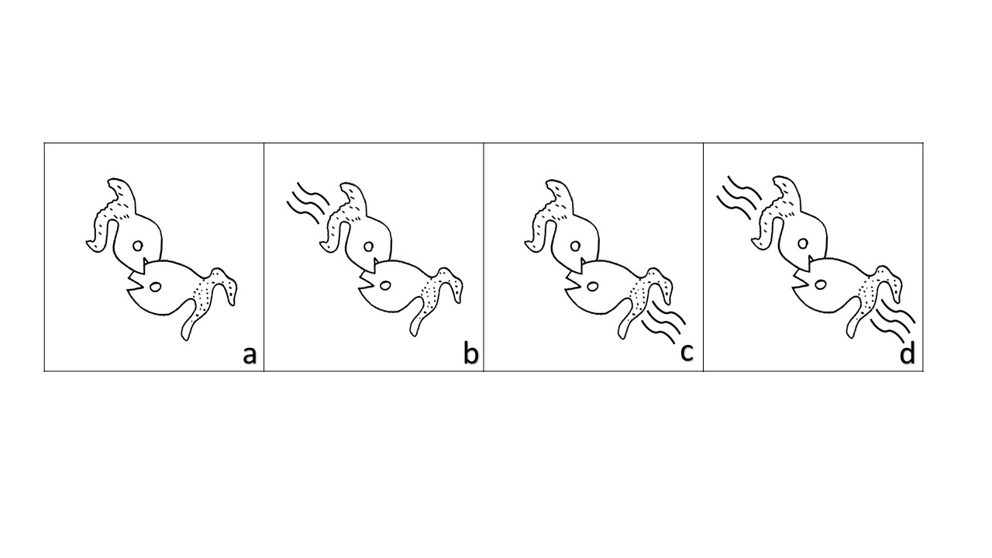
Project
Results
Study 2
Agent Advantage Effect in pictures
Motion Line Study
1. Replicated the agent advantage effect: RT _{agent search} < RT _{patient search}
Study how comic elements impact the agent advantage effect in single pictures
2. Motion lines had no impact toward the agent advantage effect.
Key: reaction time and search task

Slide 8
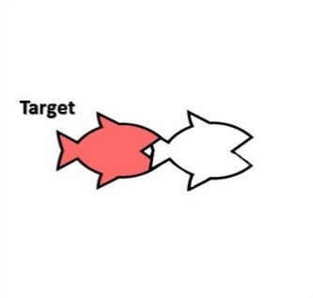


Project
Study 1
Study 3
Study 2
Agent Advantage Effect in pictures
Study the underlying process of the agent advantage effect
Eye-tracking Study
Motion Line Study
Abstract Fish Study
Study how comic elements impact the agent advantage effect in single pictures
Study the agent advantage effect in with abstract fish
Key: reaction time and search task

Slide 9
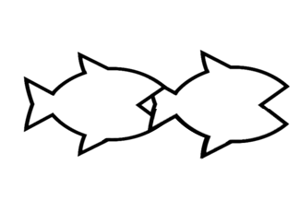
Study 3: Exp 1
Research question:
We aim to investigate whether we can replicate the agent advantage effect using abstract fish.
Hypotheses:
We predict replicating the agent advantage effect as reported by Segalowitz (1982). Thus, participants should respond faster during agent search compared to patient search.
Experiment Design:
One factorial within-subjects design: we manipulate search task (agent search, patient search)
Participants：24 participants to achieve 80% power

Slide 10




Study 3: Exp 1
Agent/Patient Search
Introduction
Key Response
Only for
Practice Trials
Feedback
True/False
500 ms

Slide 11
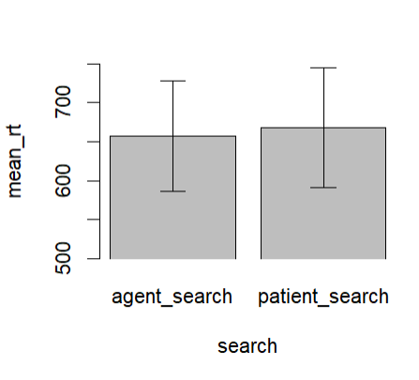
Results
To investigate hypothesis, we ran a paired t-test with the dependent variable reaction time and the independent variable search task (agent search, patient search).
Search | RTMean | RTSD
Agent search | 657 | 347
Patient search | 668 | 377
No Agent advantage effect
t(23) = -0.27, p = .788
Notes:
Each image was subtended 20.4° visual angle horizontally and 15.4° vertically.

Slide 12
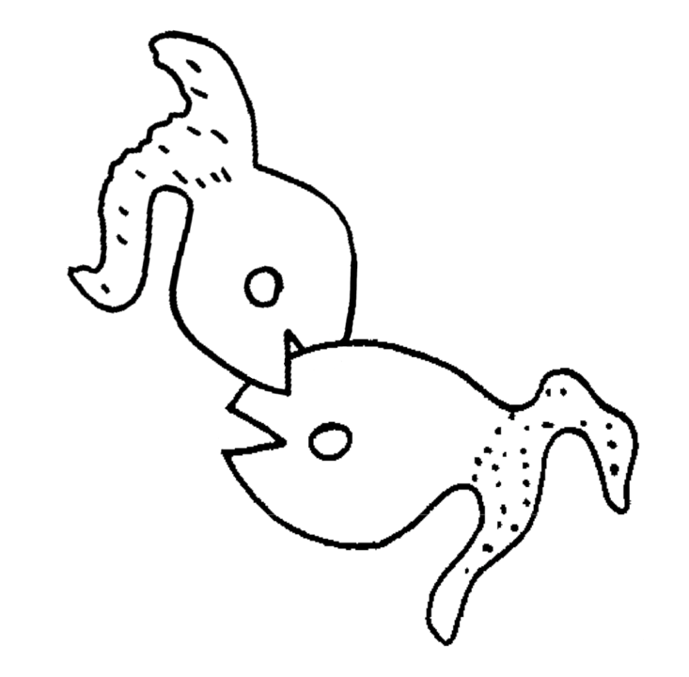
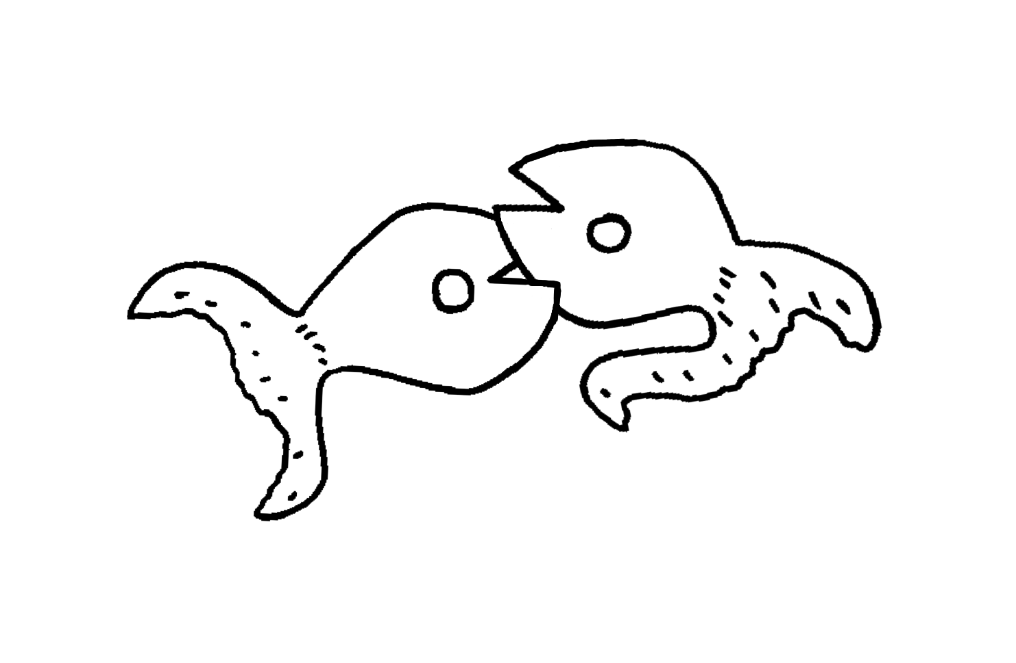
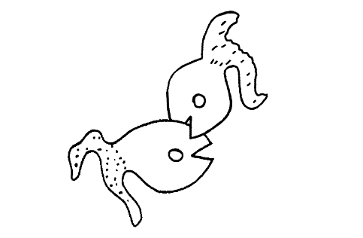
Discussion
Potential Reason: 1. Change of positions
Same size
Center
t(23) = -0.27, p = .788
Face-to-face
Face-to-tail
Notes:
Each image was subtended 20.4° visual angle horizontally and 15.4° vertically.

Slide 13





Discussion
Potential Reason: 2. Detailed fish vs. Abstract fish
Eyes
Eyes
t(23) = -0.27, p = .788
Tail
Tail
Notes:
Each image was subtended 20.4° visual angle horizontally and 15.4° vertically.

Slide 14
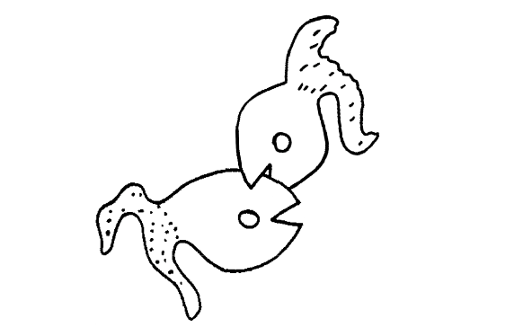

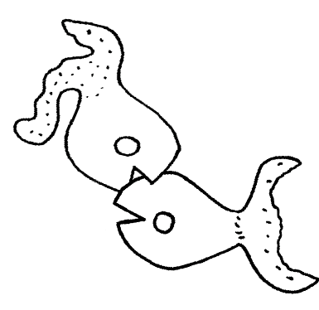

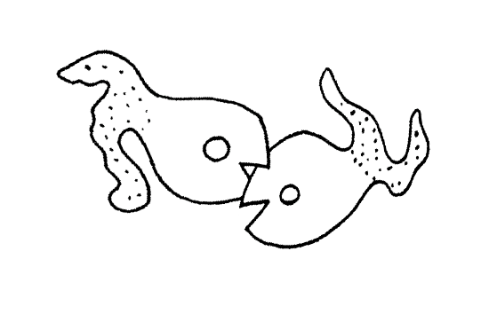

Discussion
Next Experiment: 1. Use the abstract fish to mimic the positions of the former stimulus (which replicated the agent advantage effect)
Notes:
Change of positions, if didn’t, we add eyes

Slide 15

Study 3: Exp 2
Agent/Patient Search
Introduction
Research question:
We aim to investigate whether we can replicate the agent advantage effect using abstract fish mimicking the stimulus in the motion line experiment.
Hypotheses:
We predict replicating the agent advantage effect as reported by Segalowitz (1982). Thus, participants should respond faster during agent search compared to patient search. Experiment Design:
One factorial within-subjects design: we manipulate search task (agent search, patient search)
Participants：24 participants to achieve 80% power
Key Response
Feedback
True/False
Only for
Practice Trials
500 ms

Slide 16
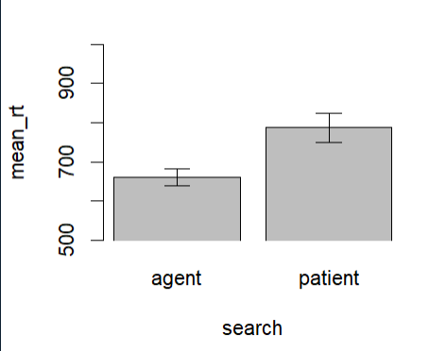
Results
To investigate hypothesis, we ran a paired t-test with the dependent variable reaction time and the independent variable search task (agent search, patient search).
*
Search | RTMean | RTSD
Agent search | 660 | 102
Patient search | 787 | 182
Agent advantage effect!
t(23) = -4.41, p < .001
Notes:
Each image was subtended 20.4° visual angle horizontally and 15.4° vertically.

Slide 17
Discussion
Exp 1: x
Exp 2: √
Same size
*
Center
t(23) = -4.41, p < .001
Biting Orientation?
face-to-face
face-to-tail
Notes:
Biting orientation

Slide 18

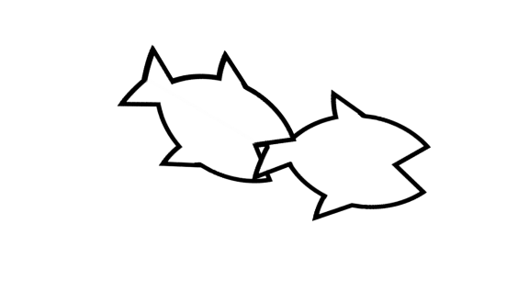
Study 3: Exp 3
Face-to-face
Face-to-tail
Hypotheses: If the biting orientations impact the agent advantage effect, we should see an interaction between the biting orientation (face-to-face, face-to-tail) and the search task (agent search, patient search) regarding reaction time.
Predictions:
RT Difference _{face-to-tail} < RT Difference _{face-to-face}
Face-to-face Condition:
RT _{agent search} < RT _{patient search}
Face-to-tail Condition:
RT _{agent search} ≤ RT _{patient search}
Notes:
We predict that the difference in reaction times between the agent search and patient search will be larger for the face-to-face stimuli than for the face-to-tail stimuli. Thus, participants will respond with faster reaction times when locating the agent compared to locating the patient in the face-to-face condition, and this difference is expected to be larger than the difference observed in the face-to-tail condition.

Slide 19
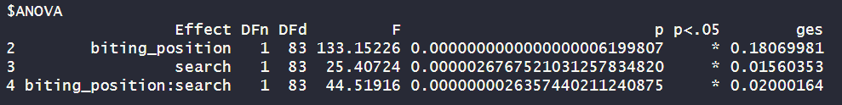
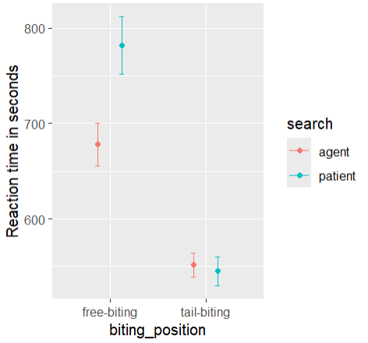
Results
Face-to-face
Face-to-tail
repeated-measures 2 (search-task: agent search, patient search) x 2 (biting orientation: face-to-face, face-to-tail)
Face-to-face Condition:
Search | RTMean | RTSD
Agent search | 678 | 203
Patient search | 782 | 278
t(83) = -6.83, p < .001
Face-to-tail Condition:
Search | RTMean | RTSD
Agent search | 552 | 114
Patient search | 545 | 140
t(83) = 0.68, p = .497
We replicated the agent advantage effect in the face-to-face condition, but not in the face-to-tail condition.
Notes:
repeated-measures 2 (search-task: agent search, patient search) x 2 (biting orientation: face-to-face, face-to-tail) ANOVA with the dependent measure response time, thus investigating the interaction of biting orientation and search task.

Slide 20
Discussion
Face-to-face
Face-to-tail
Reaction time for the face-to-tail condition is faster than for the face-to-face condition. → There were no differences between the two fish other than the biting orientations. Is the task easier?
There is no reaction time difference between agent search and patient search in the face-to-tail conditions. → Same-level difficulties in locating the agent and patient in the face-to-tail condition?
Notes:
Each image was subtended 20.4° visual angle horizontally and 15.4° vertically.

Slide 21
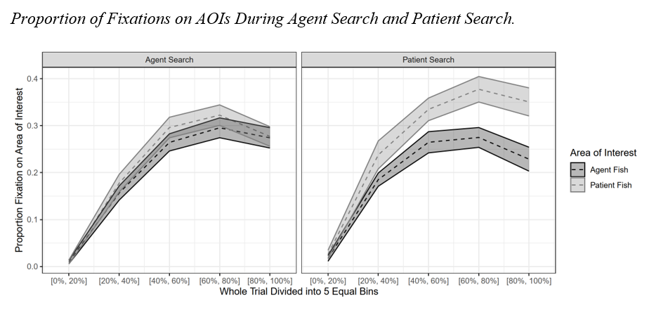
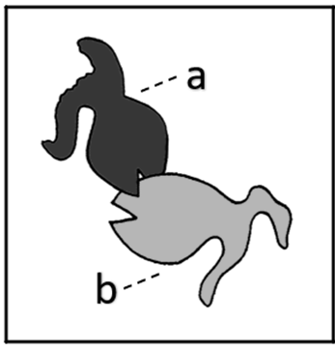
Discussion
Face-to-face
Face-to-tail
Link to former eye-tracking results:
AOI: Areas of Interest
Notes:
Each image was subtended 20.4° visual angle horizontally and 15.4° vertically.

Slide 22
Results
AOI: Areas of Interest
Overall Number of Fixations
Overall Fixation Duration
t(15) = -2.00, p = .064, d_{z} = -0.50
t(15) = -1.43, p = .173, d_{z} = -0.36
(M = 3.02, SD = 0.42)
(M = 3.29, SD = 0.58)
(M = 987 ms, SD = 220)
(M = 1139 ms, SD = 306)
Notes:
For each bin, mean proportion of time participants fixated on the
This suggested that at the beginning of the trial, the proportion of fixation on the agent fish and the patient fish was similar during both the agent search and the patient search. However, toward the end of the search task, just before participants made their decision, it seemed that there might be a higher proportion of fixation on the patient fish compared to the agent fish during the patient search but not the agent search.

Slide 23
Discussion
Face-to-face
Face-to-tail
Link to former eye-tracking results:
Potential reasons:
1. Overlapping position 2. Fighting or chasing action (biting orientation)
Stimulus related or general effect?
Change materials and new experiment

Slide 24
Conclusion – Study 3
Exp 1 | Exp 2 | Exp 3
x
√
√
x
With the abstract fish, we replicated the agent advantage effect in the face-to-face condition but not in the face-to-tail condition.

Slide 25
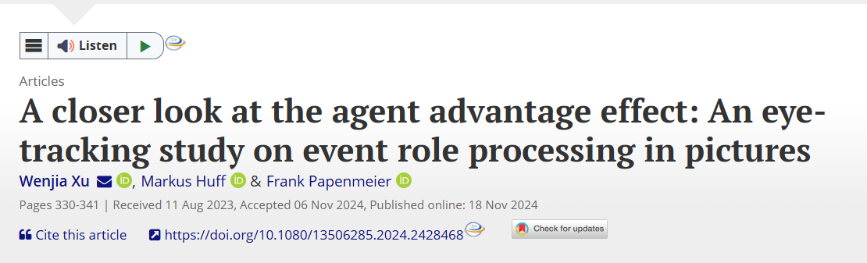
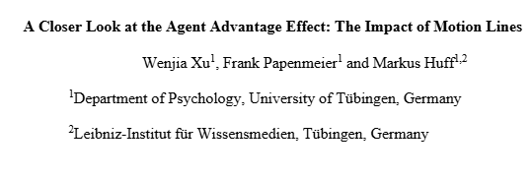
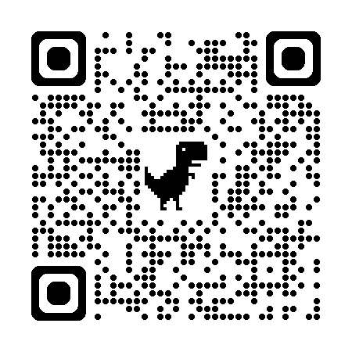
Study 1: Published paper
Study 2: Preprint, under review

Slide 26


Thank you for your attention.
Prof. Dr. Markus Huff
Dr. Frank Papenmeier

Slide 27
Reference:
Clark, H. H. (1965). Some structural properties of simple active and passive sentences. Journal of Verbal Learning and Verbal Behavior, 4(5), 365-370. https://doi.org/10.1016/S0022-5371(65)80073-1
Cohn, N., & Maher, S. (2015). The notion of the motion: The neurocognition of motion lines in visual narratives. Brain Research, 1601, 73-84.
Cohn, N., & Paczynski, M. (2013). Prediction, events, and the advantage of Agents: The processing of semantic roles in visual narrative. Cognitive Psychology, 67(3), 73-97. https://doi.org/10.1016/j.cogpsych.2013.07.002
Hafri, A., Papafragou, A., & Trueswell, J. C. (2013). Getting the gist of events: recognition of two-participant actions from brief displays. Journal of Experimental Psychology: General, 142(3), 880. https://doi.org/10.1037/a0030045
Huff, M., Meitz, T. G., & Papenmeier, F. (2014). Changes in situation models modulate processes of event perception in audiovisual narratives. Journal of Experimental Psychology: Learning, Memory, and Cognition, 40(5), 1377. https://doi.org/10.1037/a0036780
Isasi-Isasmendi, A., Andrews, C., Flecken, M., Laka, I., Daum, M. M., Meyer, M., ... & Sauppe, S. (2023). The Agent Preference in Visual Event Apprehension. Open Mind, 1-43. https://doi.org/10.1162/opmi_a_00083
Jackendoff, R. S. (1972). Semantic interpretation in generative grammar. https://doi.org/10.2307/413161
Keenan, E. L. (1976). Towards a universal definition of subject. In C. N. Li (Ed.), Subject and topic (pp. 303–333). Academic Press.
Papenmeier, F., Boss, A., & Mahlke, A. K. (2019). Action goal changes caused by agents and patients both induce global updating of event models. Journal of Experimental Psychology: Learning, Memory, and Cognition, 45(8), 1441. https://doi.org/10.1037/xlm0000651
Radvansky, G. A., & Zacks, J. M. (2017). Event boundaries in memory and cognition. Current Opinion in Behavioral Sciences, 17, 133-140. https://doi.org/10.1016/j.cobeha.2017.08.006
Salvucci, D. D., & Goldberg, J. H. (2000). Identifying fixations and saccades in eye-tracking protocols. Proceedings of the 2000 Symposium on Eye Tracking Research & Applications, 71–78. https://doi.org/10.1145/355017.355028
Segalowitz, N. S. (1982). The perception of semantic relations in pictures. Memory & Cognition, 10(4), 381-388. https://doi.org/10.3758/BF03202430
Segalowitz, N., & Hansson, P. (1979). Hemispheric functions in the processing of agent-patient information. Brain and Language, 8(1), 51-61. https://doi.org/10.1016/0093-934X(79)90039-7
Zacks, J. M. (2020). Event perception and memory. Annual Review of Psychology, 71, 165. https://doi.org/10.1146/annurev-psych-010419-051101
Zacks, J. M., Speer, N. K., Swallow, K. M., Braver, T. S., & Reynolds, J. R. (2007). Event perception: a mind-brain perspective. Psychological Bulletin, 133(2), 273. https://doi.org/10.1037/0033-2909.133.2.273

Slide 28
Study 3: Exp 1
Research question:
We investigate the default event role that human observers assign to a member of an agent-patient pair in pictures. We study whether this assignment is based (more) on bottom-up (i.e., general default) or top-down (i.e., task-dependent) processes. Experiment Design:
The experiment consists of a 4 (duration of the preview phase: 0 ms, 50 ms, 150 ms, 500 ms) x 2 (preview object: agent, patient) x 2 (search task: agent search, patient search) within-participants design.
Participants：90 participants to achieve 80% power

Slide 29
Study 3: Exp 1
Agent/Patient Search
Introduction
2 x 96 Trials
0/50/150/500 ms
Second fish appear +Key Response
Only for
Practice Trials
Feedback
True/False
500 ms

Slide 30
Study 3: Exp 1
Hypotheses: 1. For trials without preview (i.e., the 0 ms preview phase conditions) : RT _{agent search} < RT _{patient search} 2. Bottom-up (default event role):
2-way interaction
preview object (agent, patient)
duration of the preview phase (0 ms, 50 ms, 150 ms, 500 ms)
3. Top-down (task-dependent) :
3-way interaction
duration of the preview phase (0 ms, 50 ms, 150 ms, 500 ms)
preview object (agent, patient)
search task (agent search, patient search)

Slide 31
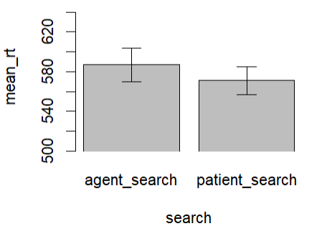
Results
To investigate hypothesis 1, we ran a paired t-test with the dependent variable reaction time and the independent variable search task (agent search, patient search) for trials without preview.
Search | RTMean | RTSD
Agent search | 587 | 163
Patient search | 571 | 134
t(93) = 1.33, p = .186
To investigate hypotheses 2 and 3, we ran a repeated-measures 4 (duration of the preview phase: 0 ms, 50 ms, 150 ms, 500 ms) x 2 (preview object: agent, patient) x 2 (search task: agent search, patient search) ANOVA with the dependent measure response time.
Cofunding Factor: Pop-up action
Thus, difficult to interpret the data.
Focus on why the agent advantage effect could be replicated, is it because of the change of materials, or because the experiment is too complicated
Notes:
Each image was subtended 20.4° visual angle horizontally and 15.4° vertically.

Slide 32
Results
To investigate hypothesis 1, we ran a paired t-test with the dependent variable reaction time and the independent variable search task (agent search, patient search) for trials without preview.
Search | RTMean | RTSD
Agent search | 587 | 163
Patient search | 571 | 134
No Agent advantage effect
t(93) = 1.33, p = .186
Why?
Notes:
Each image was subtended 20.4° visual angle horizontally and 15.4° vertically.

Slide 33
Discussion
Potential Reasons: 1. Change of experiment materials
The change of tail?
The disappearance of eyes?
The new fish is too abstract?
t(93) = 1.33, p = .186
Notes:
Each image was subtended 20.4° visual angle horizontally and 15.4° vertically.

Slide 34
Discussion
Potential Reasons: 1. Change of experiment materials
2. The experiment is too complicated
0 ms
50 ms
150 ms
t(93) = 1.33, p = .186
500 ms
One Still Picture
Two Pictures, Dynamic
Notes:
Each image was subtended 20.4° visual angle horizontally and 15.4° vertically.

Slide 35
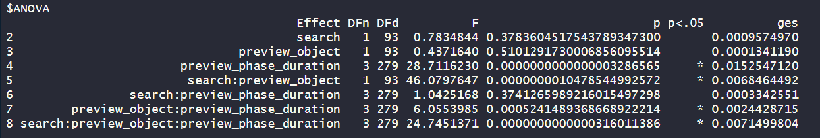
Results
To investigate hypotheses 2 and 3, we ran a repeated-measures 4 (duration of the preview phase: 0 ms, 50 ms, 150 ms, 500 ms) x 2 (preview object: agent, patient) x 2 (search task: agent search, patient search) ANOVA with the dependent measure response time.
Cofunding Factor: Pop-up action
Thus difficult to interpret the data.
Focus on why the agent advantage effect could be replicated, is it because of the change of materials, or because the experiment is too complicated
Notes:
Agent advantage effect is the core

Slide 36
Study 3: Exp 4
Face-to-face
Face-to-tail
Exploratory analysis: Exploratory analysis of whether there are transfer effects (carry-over effects) between the biting orientation blocks:
If the agent advantage effect can be transferred from face-to-face stimuli to face-to-tail stimuli, we should see an interaction of biting orientation (face-to-face, face-to-tail), search task (agent search, patient search) and block order (face-to-face first, face-to-tail first).
For this exploratory hypothesis, we will run a repeated-measures 2 (block order: face-to-face first, face-to-tail first) x 2 (search task: agent search, patient search) x 2 (biting position: face-to-face, face-to-tail) ANOVA with the dependent measure response time thus investigating the interaction of biting orientation, search task and block order.

Slide 37
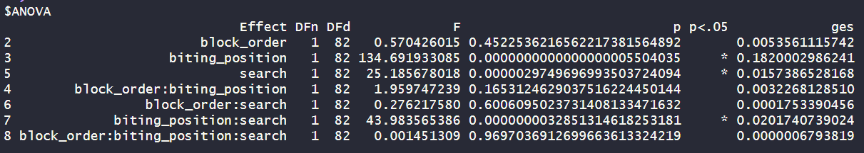
Exploratory Analysis Results
We ran repeated-measures 2 (block order: face-to-face first, face-to-tail first) x 2 (search task: agent search, patient search) x 2 (biting position: face-to-face, face-to-tail) ANOVA with the dependent measure response time thus investigating the interaction of biting orientation, search task and block order.
Face-to-face First
Face-to-tail First
No transfer effect
Notes:
Each image was subtended 20.4° visual angle horizontally and 15.4° vertically.

Slide 38
Study 1
Hypothesis: We conducted an eye-tracking study to investigate the temporal dynamics of the underlying process of the agent advantage effect. 1. Participants' reaction times in the agent search conditions are faster than in the patient search condition thus replicating the agent advantage effect (Segalowitz, 1982).
2. We would like to investigate whether participants’ eye movements differed on the event roles depending on the search task and thus studied the underlying process of the agent advantage effect. Experiment Design: one factorial within-subjects design

Slide 39
Study 1
Hypothesis: We conducted an eye-tracking study to investigate the temporal dynamics of the underlying process of the agent advantage effect. 1. Participants' reaction times in the agent search conditions are faster than in the patient search condition thus replicating the agent advantage effect (Segalowitz, 1982).
2. We would like to investigate whether participants’ eye movements differed on the event roles depending on the search task and thus studied the underlying process of the agent advantage effect. Experiment Design: one factorial within-subjects design

Slide 40
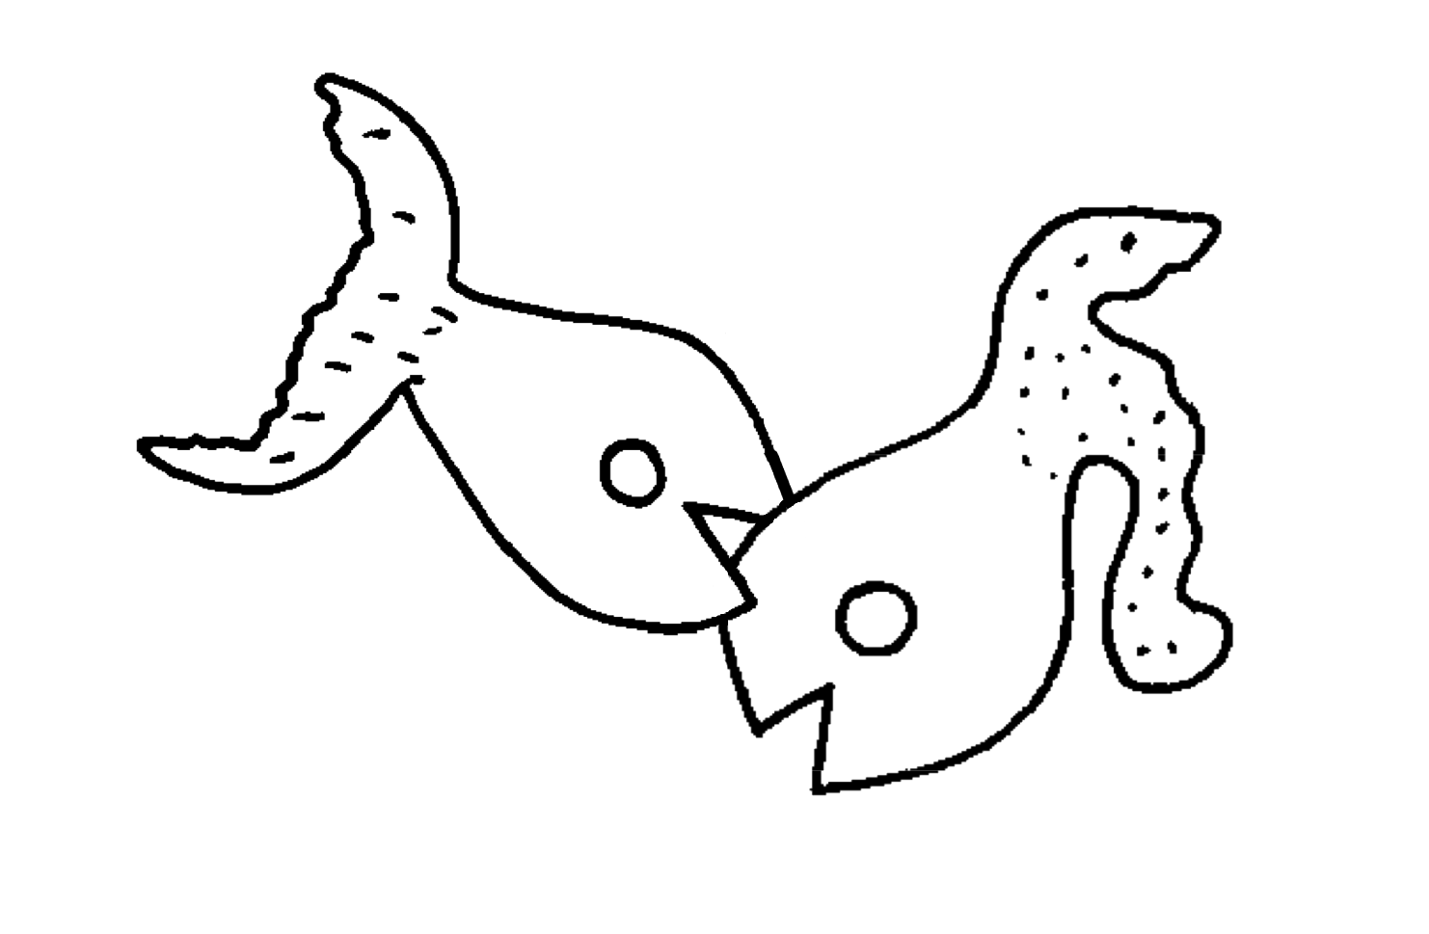
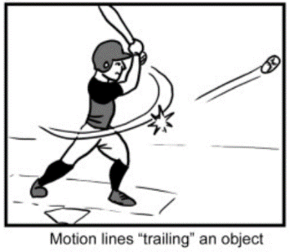
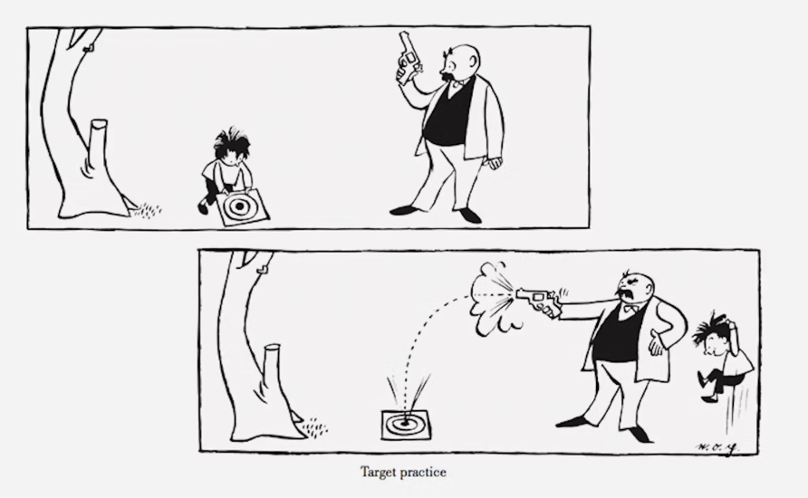
Research Interest:
exploring the event roles in visual narrative, which eventually contributes to the application of pictorial media.
Underlying process of the agent advantage effect
Whether motion lines might impact the agent advantage effect
Agent advantage effect in dynamics
(Segalowitz, 1982)
(Cohn & Maher, 2015)
(Cohn & Pacynski, 2013)
Notes:
We would like to take a step back, use the simple comic stimuli thus exploring the event roles ……pictorial media(comics)
A and P no big difference, attention resources on both event roles
motion lines have been shown to influence the processing of comics (Cohn & Maher, 2015). Discover
C&P viewing the agent resulted in slower reaction times, with the explanation being that viewing agents may trigger the process of "event building“. Inconsistent to our findings. Agent search are faster. we investigate whether the early appearance of event roles (agent, patient), although they are ambiguous, influences the agent advantage effect.

Slide 41
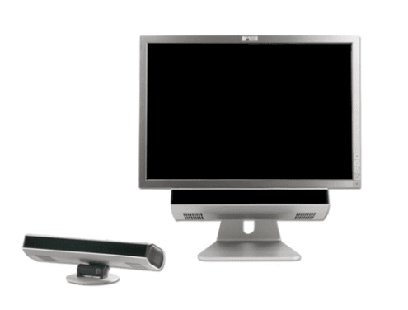
Study 1
Participants:
Sixteen participants were recruited from the University of Tübingen. The sample size was large enough to detect effects with a size (dz) of 0.75 with a power of 80 percent.
Apparatus
PsychoPy Experiment Builder (v1.80.04) SMI RED eye tracker → binocular tracking at a sampling rate of 60 Hz for each eye A headrest → stabilized the participants’ head position
Notes:
Each image was subtended 20.4° visual angle horizontally and 15.4° vertically.

Slide 42
Study 1
Materials:
Note. (a) the left fish biting the right fish, (b) the right fish biting the left fish, (c) no biting action (filler trials).
Notes:
Each image was subtended 20.4° visual angle horizontally and 15.4° vertically.

Slide 43
Study 1
Agent search
9-point binocular calibration and validation
Patient search
Introduction
Agent/Patient Search
Unlimited Time
Fixation Cross
Practice
agent
practice
patient
Notes:
Each image was subtended 20.4° visual angle horizontally and 15.4° vertically.

Slide 44
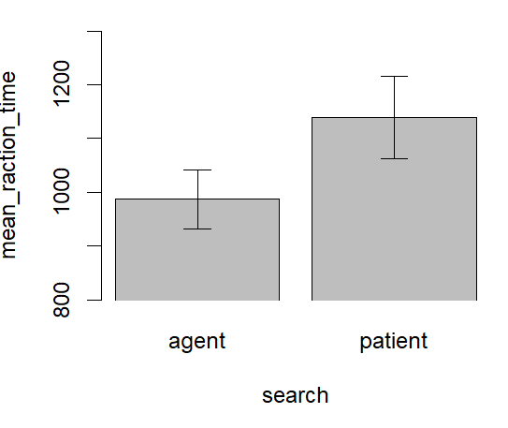
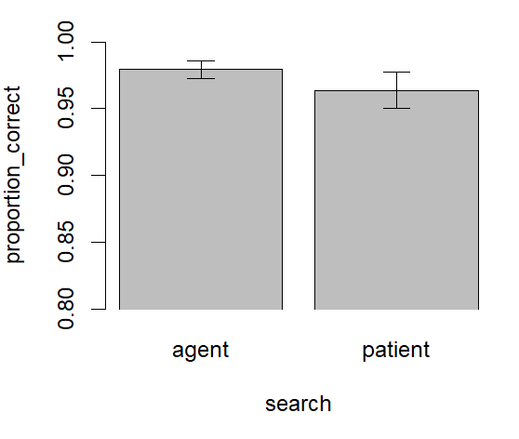
Results
Search Task Performance
Replicate the Agent Advantage Effect
t(15) = 1.07, p = .304
t(15) = -2.41, p = 0.029
Correct response
Reaction time
(M = .98, SD = .03)
(M = .96, SD = .05)
(M = 987 ms, SD = 220)
(M = 1139 ms, SD = 306)
reaction time benefit = 152 ms
Notes:
Each image was subtended 20.4° visual angle horizontally and 15.4° vertically.

Slide 45
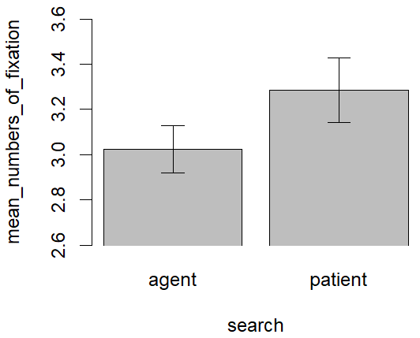
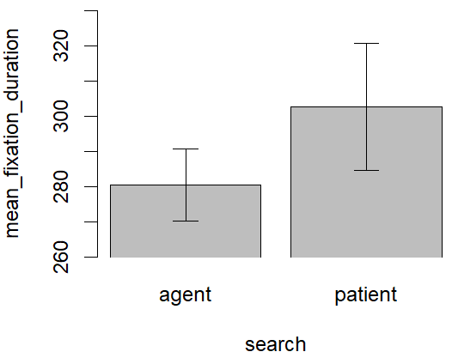
Results
Overall Number of Fixations
Overall Fixation Duration
t(15) = -2.00, p = .064
t(15) = -1.43, p = .173
Notes:
We first investigated whether the task of identifying the location of the agent fish or patient fish influenced the overall fixation durations and the number of fixations. We used paired t-tests to compare participants’ mean fixation duration and participants’ mean number of fixations between agent search and patient search. There was no significant difference in mean fixation duration between the agent search (M = 280 ms, SD = 41) and the patient search (M = 303 ms, SD = 72) conditions, t(15) = -1.43, p = .173, d_{z} = -0.36. Regarding the number of fixations, we also observed no significant difference between the agent search (M = 3.02, SD = 0.42) and patient search (M = 3.29, SD = 0.58) conditions, t(15) = -2.00, p = .064 , d_{z} = -0.50.
Reviewer 2, point 7: Like the authors, I was puzzled that the Patient search condition would feature more last fixations on Patients than Agents, but for there also to be no overall significant difference in the number of fixations in the two conditions. The authors provide some possible reasons for this in the General Discussion paragraph starting on line 331. But I think the authors might be making too much of the lack of significant difference here. The effect is marginal (line 206) at p = .064, so despite not meeting the "p = .05" bar, perhaps one could argue that this provides at least some tentative evidence that the number of fixations differs. Maybe it would have been observed with more data.
Which means more data.

Slide 46
Results
AOI: Areas of Interest
Overall Number of Fixations
Overall Fixation Duration
t(15) = -2.00, p = .064, d_{z} = -0.50
t(15) = -1.43, p = .173, d_{z} = -0.36
(M = 3.02, SD = 0.42)
(M = 3.29, SD = 0.58)
(M = 987 ms, SD = 220)
(M = 1139 ms, SD = 306)
Notes:
For each bin, mean proportion of time participants fixated on the
This suggested that at the beginning of the trial, the proportion of fixation on the agent fish and the patient fish was similar during both the agent search and the patient search. However, toward the end of the search task, just before participants made their decision, it seemed that there might be a higher proportion of fixation on the patient fish compared to the agent fish during the patient search but not the agent search.

Slide 47
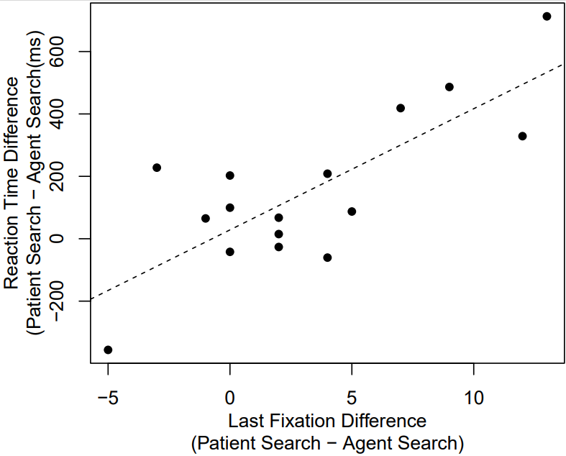
Results
Number of Fixations on AOIs. A: First Fixation of a Search. B: Last Fixation of a Search.
a strong correlation, r(14) = .78, p < .001
The tendency of participants to perform a last fixation toward the patient fish during patient search might in part, explain the agent advantage effect
Notes:
we were interested in whether those participants that showed a stronger influence of the search task on their last fixation toward the patient fish were also the participants that showed a stronger agent advantage effect in reaction times.

Slide 48
Study 1
Conclusion of study 1:
We observed faster reaction times when participants searched for the agent than when participants searched for the patient, thus replicating the agent advantage effect Segalowitz (1982).
Regarding eye movements, we observed that participants’ last fixation landed on one of the two fish before they made their decisions was preferentially directed toward the patient fish rather than the agent fish during the patient search. There was no bias in the agent search.
We also observed a strong correlation between the impact of the search task on reaction times and the impact of the search task on participants’ eye movements during the last fixation.

Slide 49
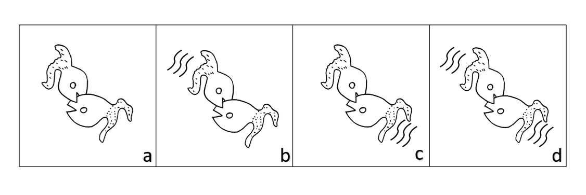
Study 2
We investigate whether the presence of motion lines behind the agent or patient impacts the agent advantage effect.
Experiment 1
parallel motion lines
Experiment 2
orthogonal motion lines

Slide 50
Study 2
Research question:
With the present experiment, we investigate whether the presence of motion lines behind the agent or patient impacts the agent advantage effect.
Hypotheses:
1.) For the stimuli without motion lines, we predict to replicate the agent advantage effect as reported by Segalowitz (1982). Thus, participants should respond faster when locating the agent than when locating the patient.
2.) If the presence of motion lines behind the agent impacts the agent advantage effect, we should see an interaction of search tasks (agent search, patient search) and agent motion lines (with, without).
3.) If the presence of motion lines behind the patient impacts the agent advantage effect, we should see an interaction of search tasks (agent search, patient search) and patient motion lines (with, without).

Slide 51
Study 2
Experiment Design:
The experiment consists of a 2 (search-task: agent search, patient search) x 2 (agent parallel/orthogonal motion lines: with, without) x 2 (patient parallel/orthogonal motion lines: with, without) design. Participants are assigned to all conditions (within-participants design).
Participants：
Experiment 1: 74 participants to achieve 80% power
Experiment 2: 72 participants to achieve 80% power

Slide 52
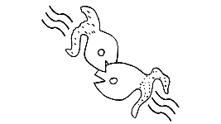
Study 2
Instruction
Agent/Patient Search
blank
500 ms
Key response
500 ms
Practice
agent
practice
patient

Slide 53
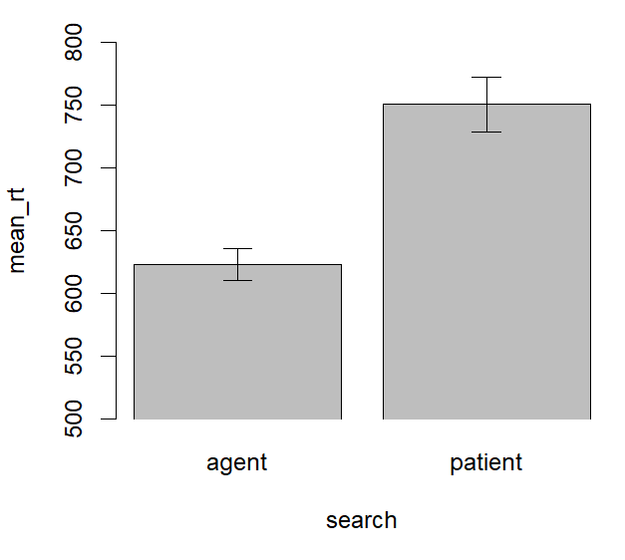
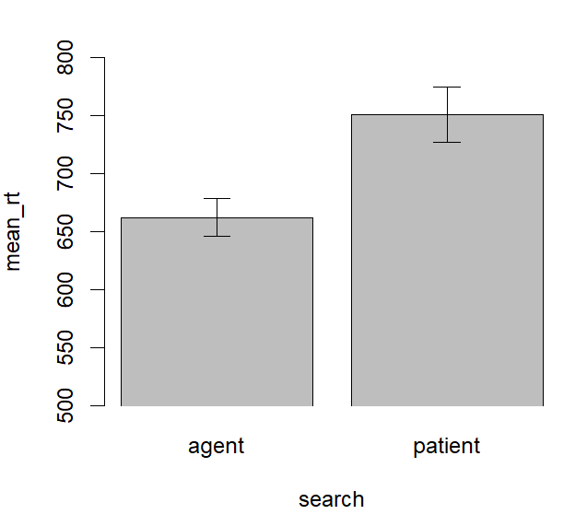
Results
To investigate hypothesis 1, we ran a paired t-test with the dependent variable response time and the independent variable search task (agent search, patient search) for the stimuli without motion lines.
Exp 1：parallel motion lines
Exp 2: orthogonal motion lines
t(73) = -9.33, p < .001
t(73) = -4.71, p < .001
reaction time benefit = -127.9 ms
reaction time benefit = -90.1 ms
Notes:
Each image was subtended 20.4° visual angle horizontally and 15.4° vertically.

Slide 54
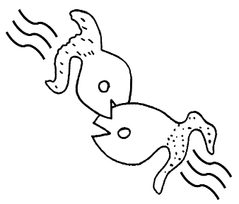
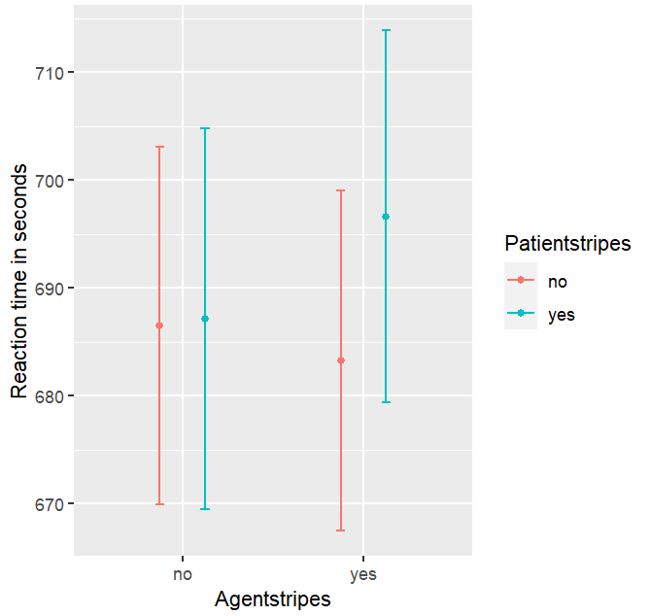
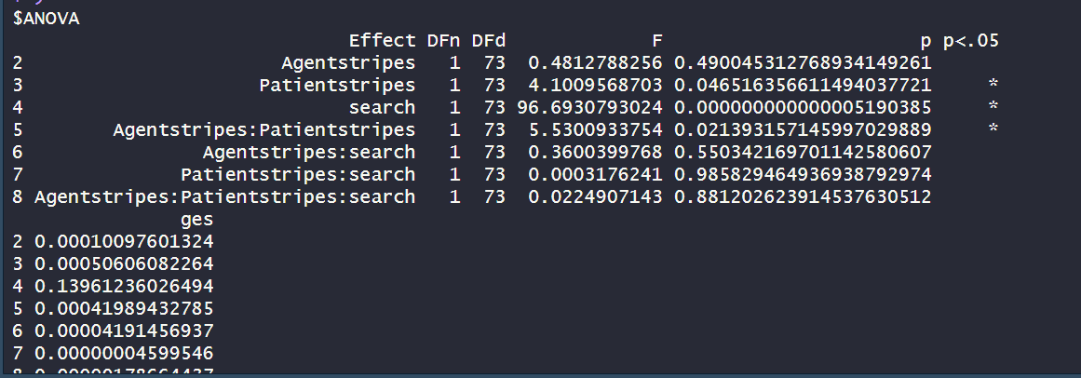
Results
To investigate hypotheses 2 and 3, we ran a repeated-measures 2 (search-task: agent search, patient search) x 2 (agent motion lines: with, without) x 2 (patient motion lines: with, without) ANOVA with the dependent measure response time.
Exp 1：parallel motion lines
Notes:
Each image was subtended 20.4° visual angle horizontally and 15.4° vertically.

Slide 55

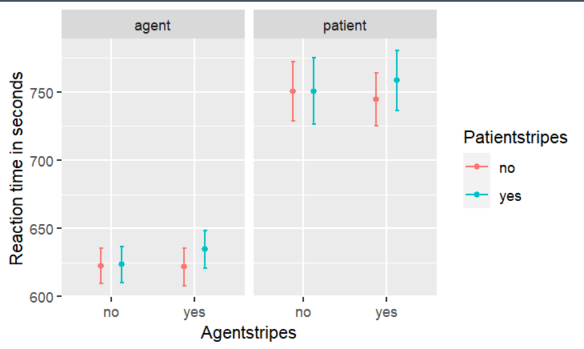

Results
Exp 1：parallel motion lines
Agent condition
Patient condition
Notes:
Each image was subtended 20.4° visual angle horizontally and 15.4° vertically.

Slide 56
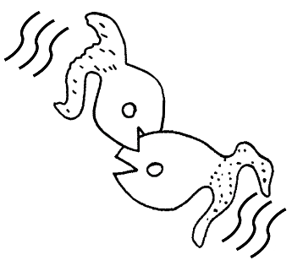
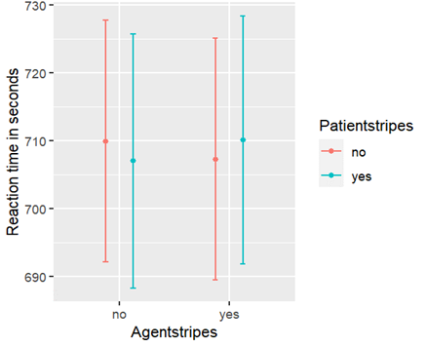
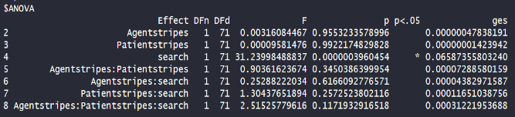
Results
To investigate hypotheses 2 and 3, we ran a repeated-measures 2 (search-task: agent search, patient search) x 2 (agent motion lines: with, without) x 2 (patient motion lines: with, without) ANOVA with the dependent measure response time.
Exp 2： orthogonal motion lines
Notes:
Each image was subtended 20.4° visual angle horizontally and 15.4° vertically.

Slide 57
Study 2
Conclusion of study 2:
We replicated the agent advantage effect when there were no motion lines within the pictures.
Although motion lines have been shown to influence the processing of comics (Cohn & Maher, 2015), the motion lines do not impact the agent advantage effect.

Slide 58
Study 3
Research question:
In the present experiment, we investigate whether the early appearance of event roles (agent, patient) influences the agent advantage effect.
Hypotheses:
1.) There should be a significant interaction between the early appearance of event roles (agent, patient) and search tasks (agent search, patient search).
2.) If the agent first shows up, we should see a significant main effect of the agent on the search task (agent search, patient search). When the agent first shows up, participants should respond faster when performing the agent search compared to the patient search.
3.) If the patient first shows up, we should see a non-significant main effect of the patient on the search task (agent search, patient search).

Slide 59
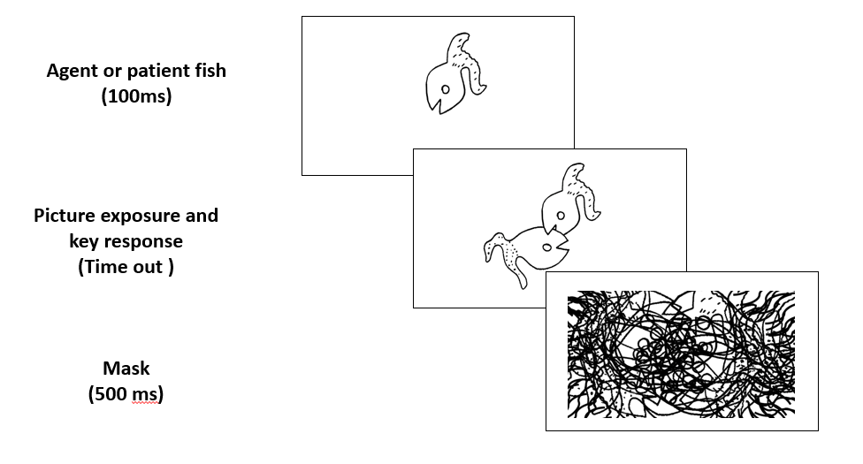
Study 3
The experiment consists of a 2 (early appearance of event roles: agent, patient) x 2 (search-task: agent search, patient search) design. Participants are assigned to all conditions (within-participants design).

Slide 60
Ph.D. Project Plan
Study 1
Study 3
Study 2
Agent Advantage Effect in pictures
Study the underlying process of the agent advantage effect
Eye-tracking Study
Motion Line Study
Ambiguity Study
Study how comic elements impact the agent advantage effect in single pictures
Study the agent advantage effect in dynamics
Key: reaction time and search task

Slide 61
Thank you for your attention.

Slide 62
Reference:
Clark, H. H. (1965). Some structural properties of simple active and passive sentences. Journal of Verbal Learning and Verbal Behavior, 4(5), 365-370. https://doi.org/10.1016/S0022-5371(65)80073-1
Cohn, N., & Maher, S. (2015). The notion of the motion: The neurocognition of motion lines in visual narratives. Brain Research, 1601, 73-84.
Cohn, N., & Paczynski, M. (2013). Prediction, events, and the advantage of Agents: The processing of semantic roles in visual narrative. Cognitive Psychology, 67(3), 73-97. https://doi.org/10.1016/j.cogpsych.2013.07.002
Hafri, A., Papafragou, A., & Trueswell, J. C. (2013). Getting the gist of events: recognition of two-participant actions from brief displays. Journal of Experimental Psychology: General, 142(3), 880. https://doi.org/10.1037/a0030045
Huff, M., Meitz, T. G., & Papenmeier, F. (2014). Changes in situation models modulate processes of event perception in audiovisual narratives. Journal of Experimental Psychology: Learning, Memory, and Cognition, 40(5), 1377. https://doi.org/10.1037/a0036780
Isasi-Isasmendi, A., Andrews, C., Flecken, M., Laka, I., Daum, M. M., Meyer, M., ... & Sauppe, S. (2023). The Agent Preference in Visual Event Apprehension. Open Mind, 1-43. https://doi.org/10.1162/opmi_a_00083
Jackendoff, R. S. (1972). Semantic interpretation in generative grammar. https://doi.org/10.2307/413161
Keenan, E. L. (1976). Towards a universal definition of subject. In C. N. Li (Ed.), Subject and topic (pp. 303–333). Academic Press.
Papenmeier, F., Boss, A., & Mahlke, A. K. (2019). Action goal changes caused by agents and patients both induce global updating of event models. Journal of Experimental Psychology: Learning, Memory, and Cognition, 45(8), 1441. https://doi.org/10.1037/xlm0000651
Radvansky, G. A., & Zacks, J. M. (2017). Event boundaries in memory and cognition. Current Opinion in Behavioral Sciences, 17, 133-140. https://doi.org/10.1016/j.cobeha.2017.08.006
Salvucci, D. D., & Goldberg, J. H. (2000). Identifying fixations and saccades in eye-tracking protocols. Proceedings of the 2000 Symposium on Eye Tracking Research & Applications, 71–78. https://doi.org/10.1145/355017.355028
Segalowitz, N. S. (1982). The perception of semantic relations in pictures. Memory & Cognition, 10(4), 381-388. https://doi.org/10.3758/BF03202430
Segalowitz, N., & Hansson, P. (1979). Hemispheric functions in the processing of agent-patient information. Brain and Language, 8(1), 51-61. https://doi.org/10.1016/0093-934X(79)90039-7
Zacks, J. M. (2020). Event perception and memory. Annual Review of Psychology, 71, 165. https://doi.org/10.1146/annurev-psych-010419-051101
Zacks, J. M., Speer, N. K., Swallow, K. M., Braver, T. S., & Reynolds, J. R. (2007). Event perception: a mind-brain perspective. Psychological Bulletin, 133(2), 273. https://doi.org/10.1037/0033-2909.133.2.273

Slide 63
Study 3: Exp 1
Hypotheses:
1. For trials without preview (i.e., the 0 ms preview phase conditions) : RT _{agent search} < RT _{patient search} 2. Bottom-up (default event role):
duration of the preview phase (0 ms, 50 ms, 150 ms, 500 ms)
2-way interaction
preview object (agent, patient)
Without Preview：
RT _{agent preview}
≈
RT _{patient preview}
With Preview：
RT _{target match preview}
<
RT _{target mismatch preview}
Bottom-up
Without Preview
With Preview
Reaction Time
Reaction Time
Preview Object:
p
a
a: agent p: patient
a/p
p
a/p
a
Agent Search
Patient Search
Agent Search
Patient Search

Slide 64
Study 3: Exp 1
Hypotheses:
3. Top-down (task-dependent) :
3-way interaction
duration of the preview phase (0 ms, 50 ms, 150 ms, 500 ms)
preview object (agent, patient)
search task (agent search, patient search)
Without Preview
RT _{agent preview}
≈
RT _{patient preview}
RT _{agent search difference} _{(agent – RT patient)}
RT _{patient search difference} _{(agent – RT patient)}
With Preview
<
Top-down
Without Preview
With Preview
Reaction Time
Reaction Time
Preview Object:
a
a/p
p
a: agent p: patient
p
a/p
a
Agent Search
Patient Search
Agent Search
Patient Search

Slide 65
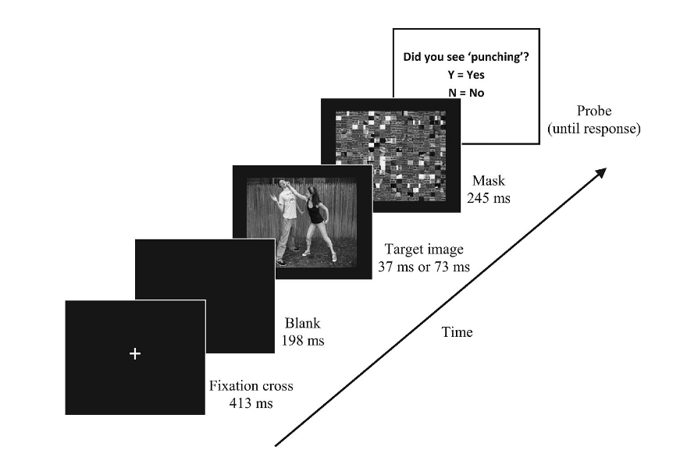
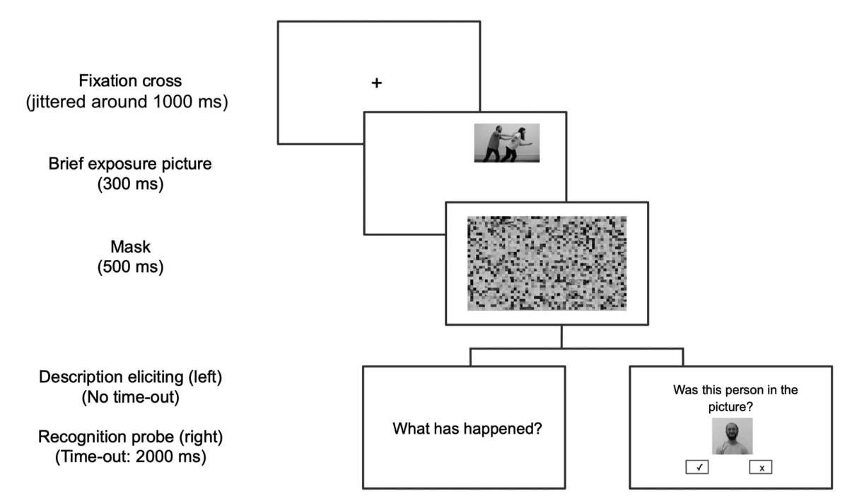
Research Gap 2:
Studies have explored the early process of the agent advantage effect with mask
The process after the mask remains unknown
(Hafri et al., 2013)
(Isasi-Isasmendi et al., 2023)

Slide 66

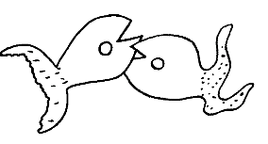
Experiment
Agent Search
Patient Search

Slide 67
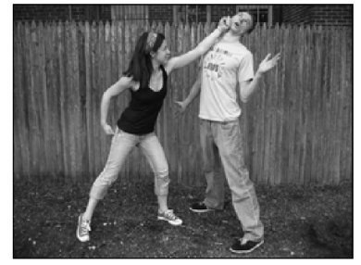
Research Gap 1:
Event roles can be processed within a short time due to the physical characteristics (head orientation, body orientation and extremities) (Hafri et al., 2013)
There is the agent advantage effect within the picture in which the agent and patient look similar to each other (Segalowitz, 1982)

