Slide 1



In the game Tetris, there are 7 “Zoids”

Slide 2
O
I
J
L
Z
S
T
Named

Slide 3
O
I
J
L
Z
S
T
In this experiment, you’ll be given the following task

Slide 4
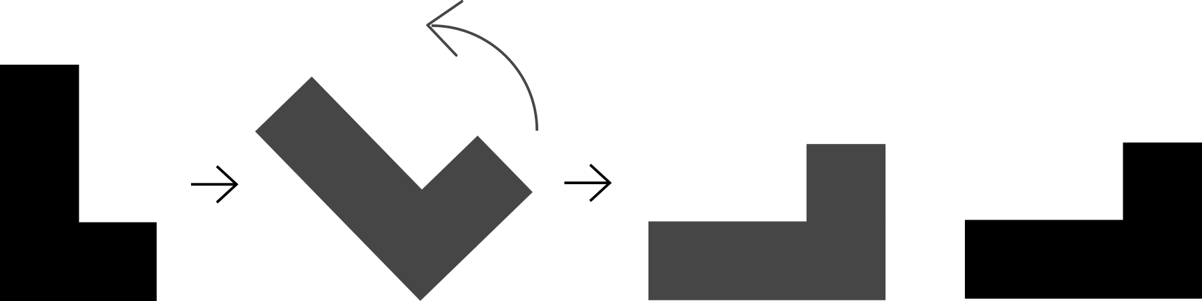
A pair of Zoids like this will appear on the screen

Slide 5
Your task is to determine if those 2 Zoids are the same

Slide 6
DIFFERENT
SAME
Here are 2 examples

Slide 7
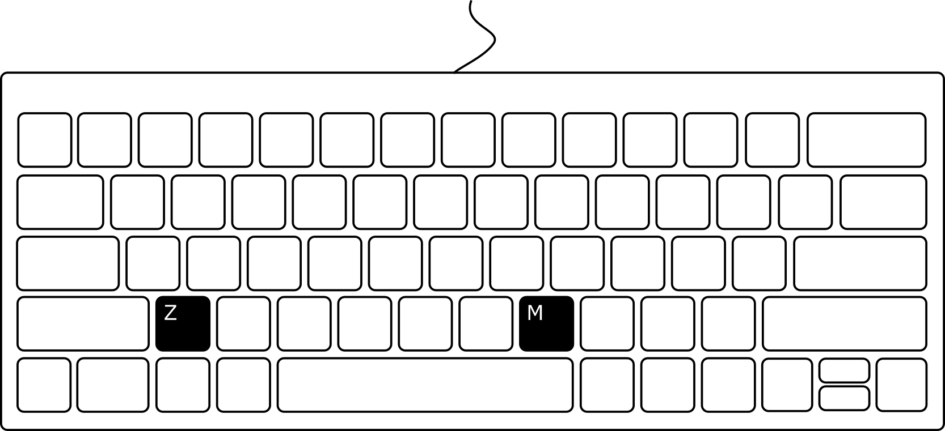
To respond, press Z key or M key, one for “SAME,” the other one for “DIFFERENT”

Slide 8
Z: SAME M: DIFFERENT
or
Z: DIFFERENT M: SAME
It’ll be either of the cases shown above
Specific instructions will be given at the beginning of the experiment

Slide 9
Try to respond as accurate and quick as possible

Slide 10
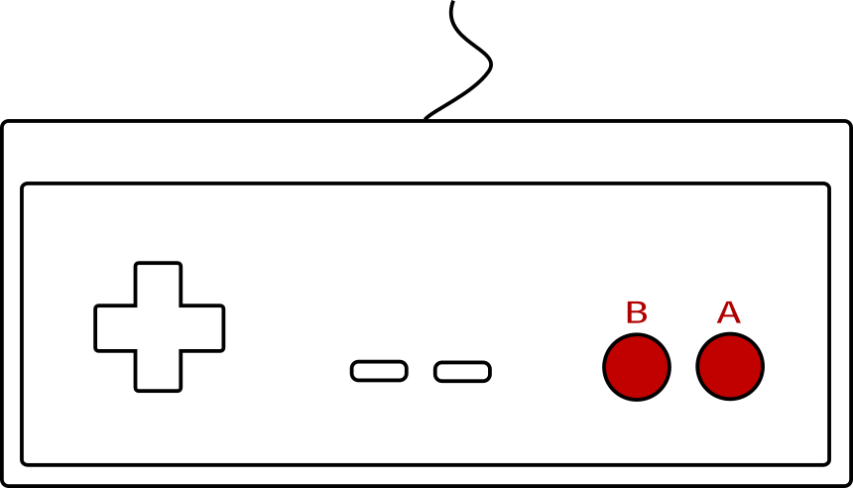
To respond, press A button or B button, one for “SAME,” the other one for “DIFFERENT”

Slide 11
B: SAME A: DIFFERENT
or
B: DIFFERENT A: SAME
It’ll be either of the cases shown above
Specific instructions will be given at the beginning of the experiment

Slide 12
Try to respond as accurate and quick as possible

Slide 13
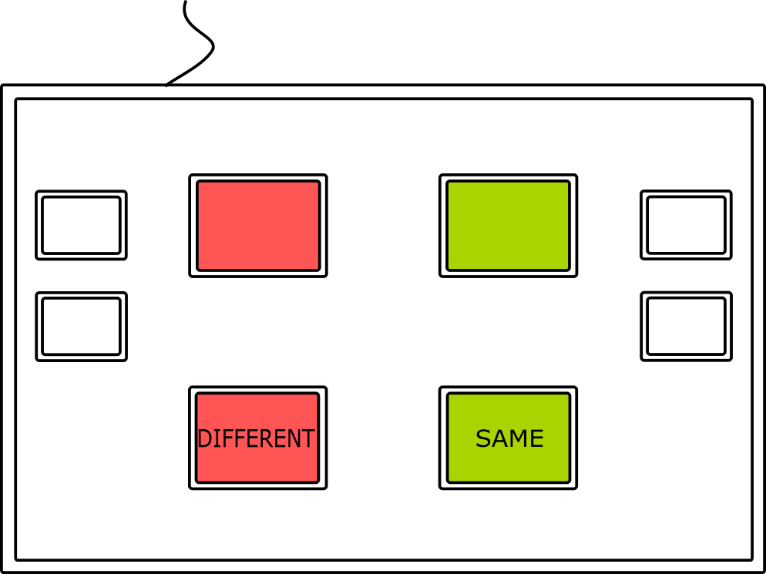
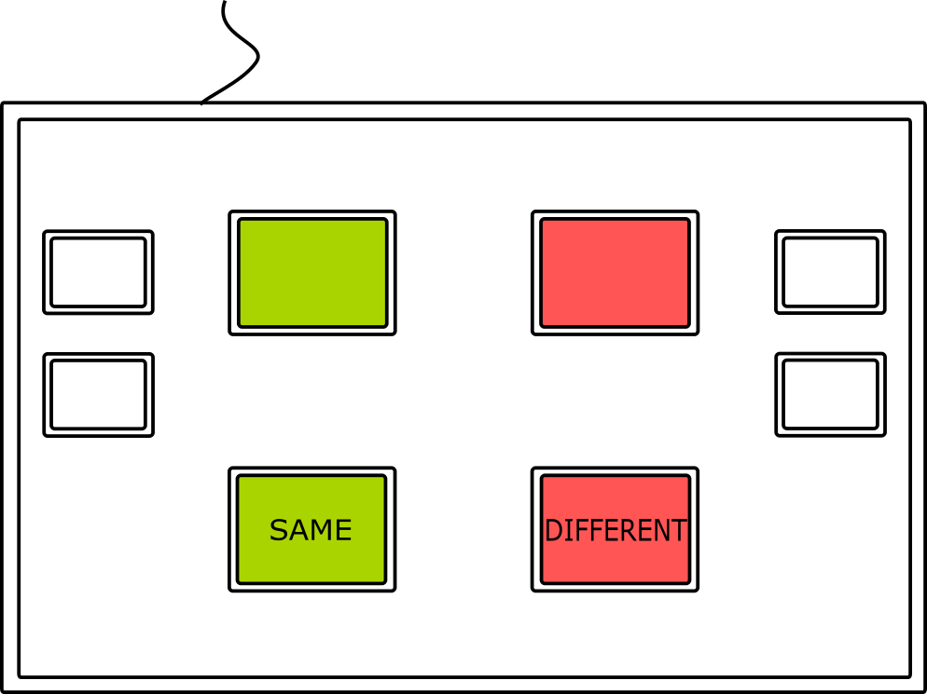
or
To respond, use the button box, one side for “SAME,” the other one for “DIFFERENT”

Slide 14
or
LEFT: DIFFERENT RIGHT: SAME
LEFT: SAME RIGHT: DIFFERENT
Your button box is either of the cases shown above

Slide 15
or
Try to respond as accurate and quick as possible

Slide 16
After you responded, a circle will appear on the screen

Slide 17
Please look at the circle when it shows up
A new pair of Zoids will be given to you in a moment

Slide 18
+
And you’ll repeat the previous process,
determining if those 2 Zoids are the same

Slide 19
Z: SAME M: DIFFERENT
or
Z: DIFFERENT M: SAME
Again, try to respond as accurate and quick as possible

Slide 20
B: SAME A: DIFFERENT
or
B: DIFFERENT A: SAME
Again, try to respond as accurate and quick as possible

Slide 21
or
LEFT: DIFFERENT RIGHT: SAME
LEFT: SAME RIGHT: DIFFERENT
Again, try to respond as accurate and quick as possible

Slide 22
Keep in mind that in a Tetris game, a same Zoid can be rotated

Slide 23
So, in this experiment, for example

Slide 24
Zoid on the left can be rotated as shown

Slide 25
Which appears to be the same with the Zoid on the right

Slide 26
SAME
So those are the same Zoid (Zoid “L”)

Slide 27
Here is another example

Slide 28

Trying to rotate the Ziod on the left

Slide 29
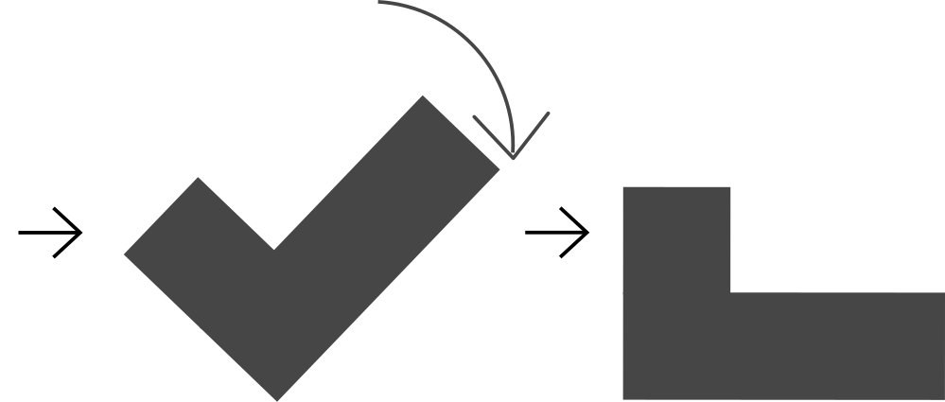
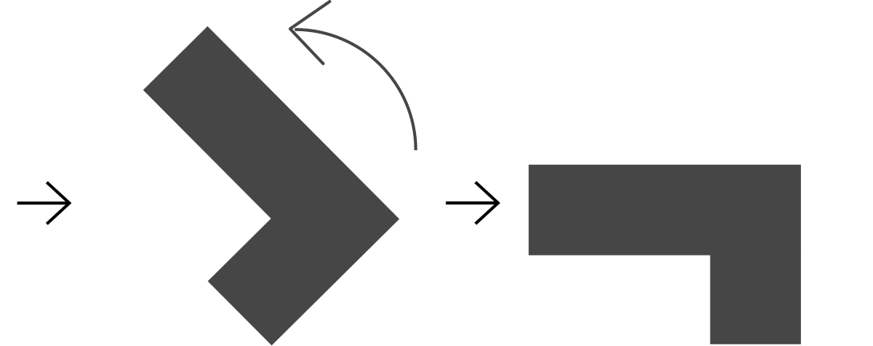
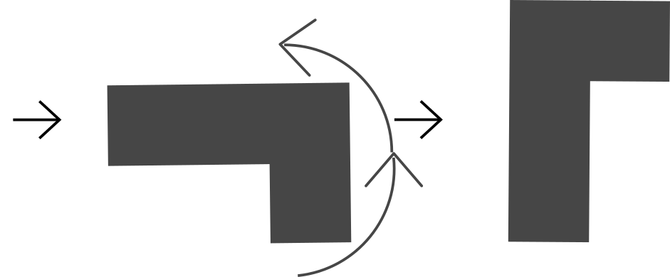
No matter how it’s rotated, they won’t match

Slide 30
DIFFERENT
So they are 2 different Zoids (In fact, they are mirrored, “J” and “L,” respectively)

Slide 31
DIFFERENT
SAME
Notice that you won’t be able to preform a on-screen Zoid rotation during the experiment,
But you are still expected to give the correct respond as if the Zoids can rotate

Slide 32
Block 1
Block 2
Block 3
Block 10
~60
pairs
~60
pairs
~60
pairs
~60
pairs
Experiment (10 blocks)
You’ll be doing 10 blocks of this task, with around 60 comparisons each block

Slide 33
Block 1
Block 2
Block 3
Block 10
~60
pairs
break
~60
pairs
break
~60
pairs
~60
pairs
Experiment (10 blocks)
You can take breaks in between blocks, they are self-paced, each one up to 3 minutes

Slide 34
Great Job! Your performance this block:
Try to answer more quickly to reduce your response time!
You can now take a break. When you are ready to continue, place you fingers on any keys, and press.
Accuracy
Speed
97%
2.2s
Example similar to what you’ll see
When it comes to a block break, you’ll see feedbacks like this

Slide 35
Great Job! Your performance this block:
Try to answer more quickly to reduce your response time!
You can now take a break. When you are ready to continue, place you fingers on any keys, and press.
Accuracy
Speed
97%
2.2s
Example similar to what you’ll see
Please follow the instructions

Slide 36
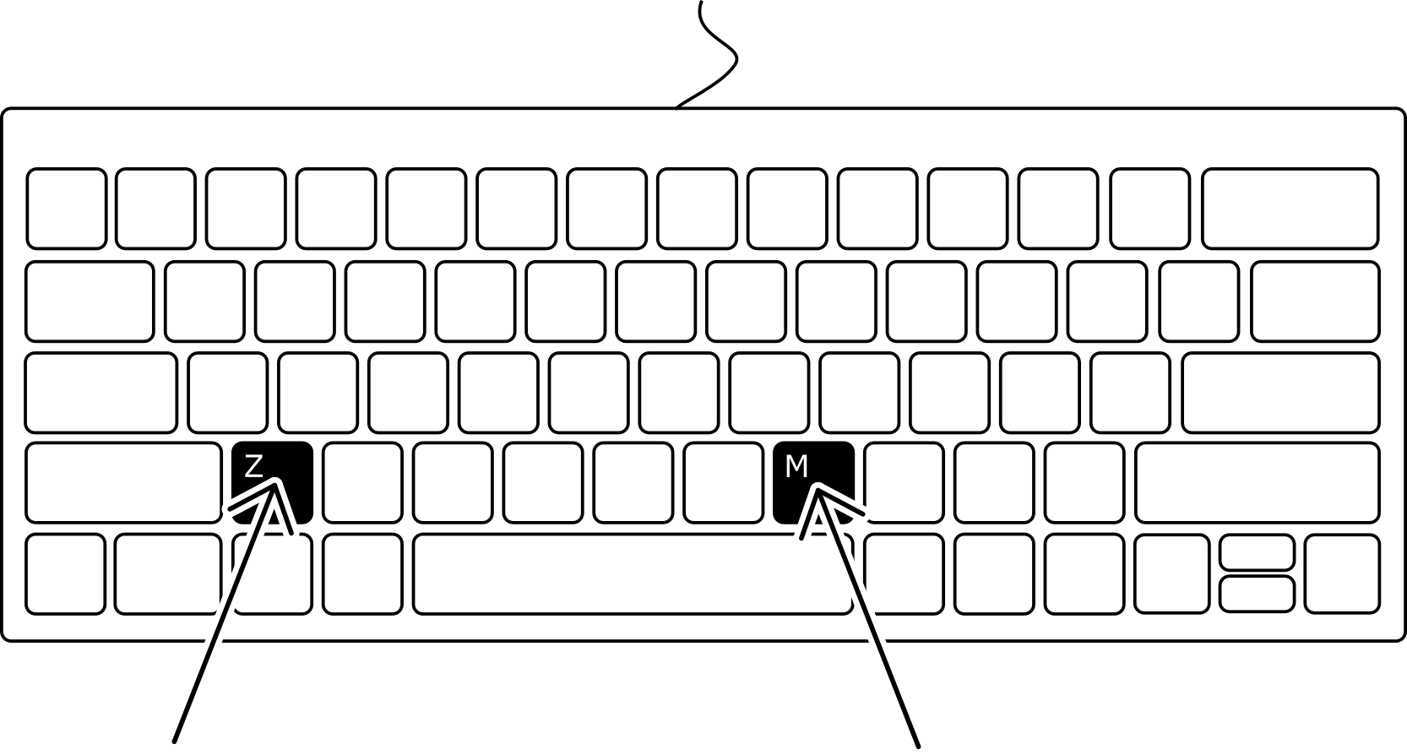
Place your fingers on the Z key and the M key, the experiment will now start

Slide 37
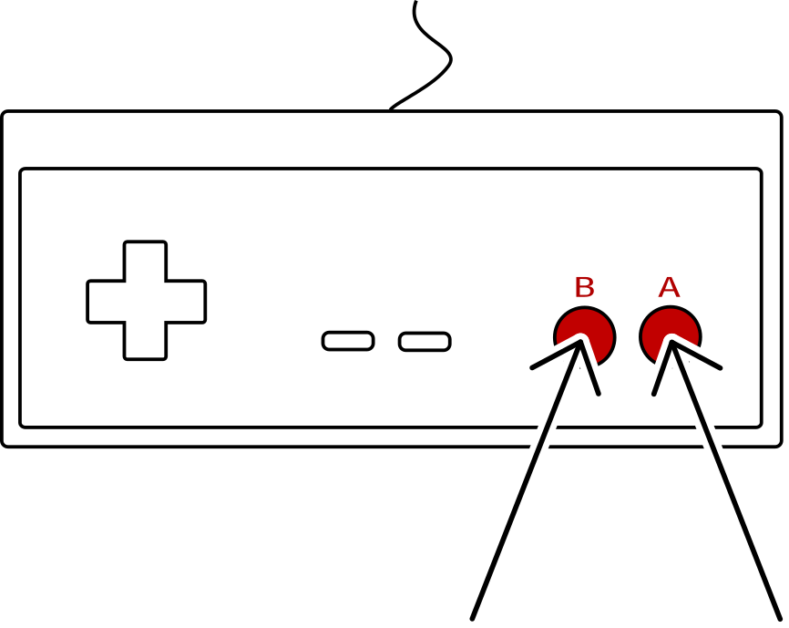
Place your thumbs on the A button and the B button, the experiment will now start

Slide 38
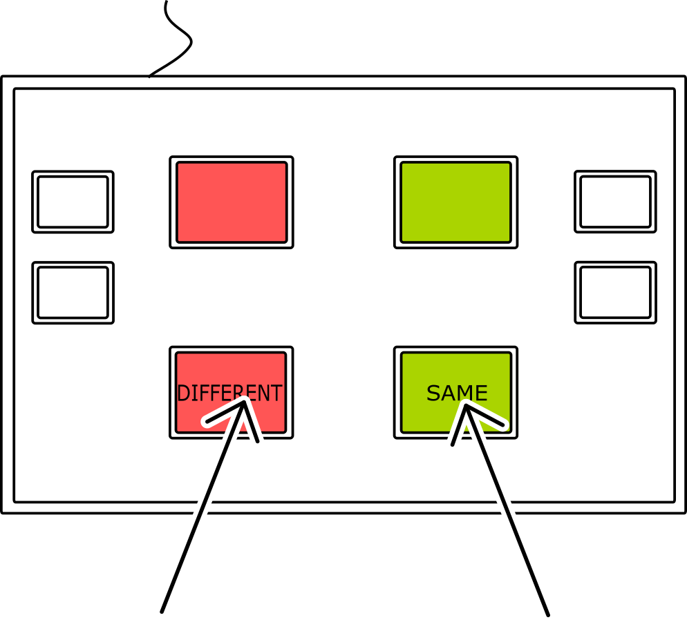
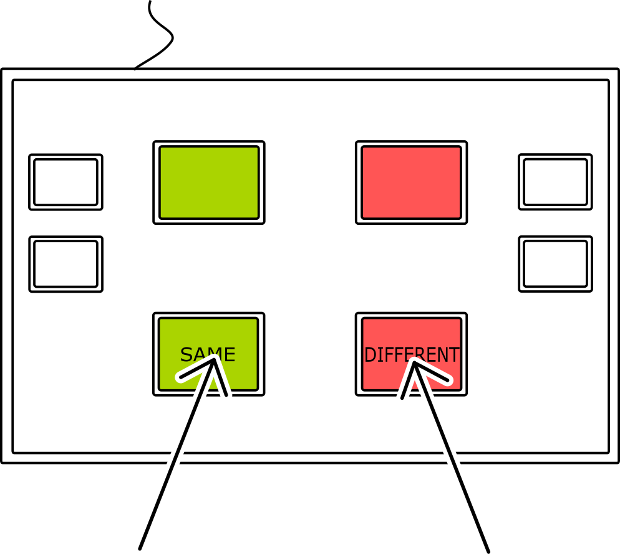
or
Place your fingers on the buttons, the experiment will now start

