Slide 1
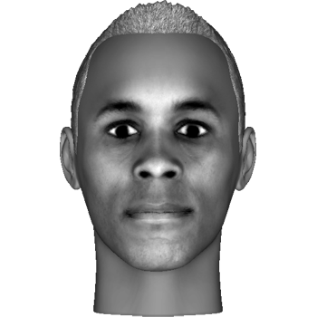
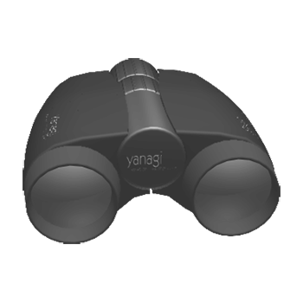


Welcome to the experiment!
You will be presented with a sequence of images. The images are different types of faces, objects, letters or meaningless symbols. Here are some examples:
Press the right arrow key to proceed

Slide 2
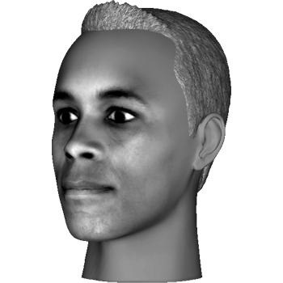
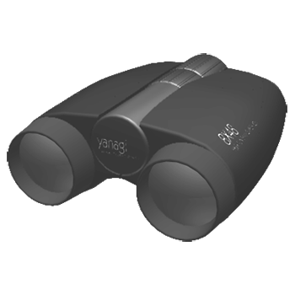


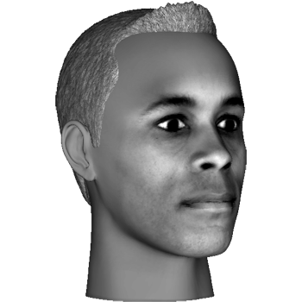
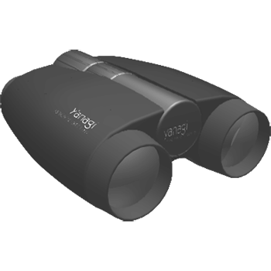


The images can be presented from a front view or side view:
Press the right arrow key to proceed or the left arrow key to
return to the previous slide

Slide 3
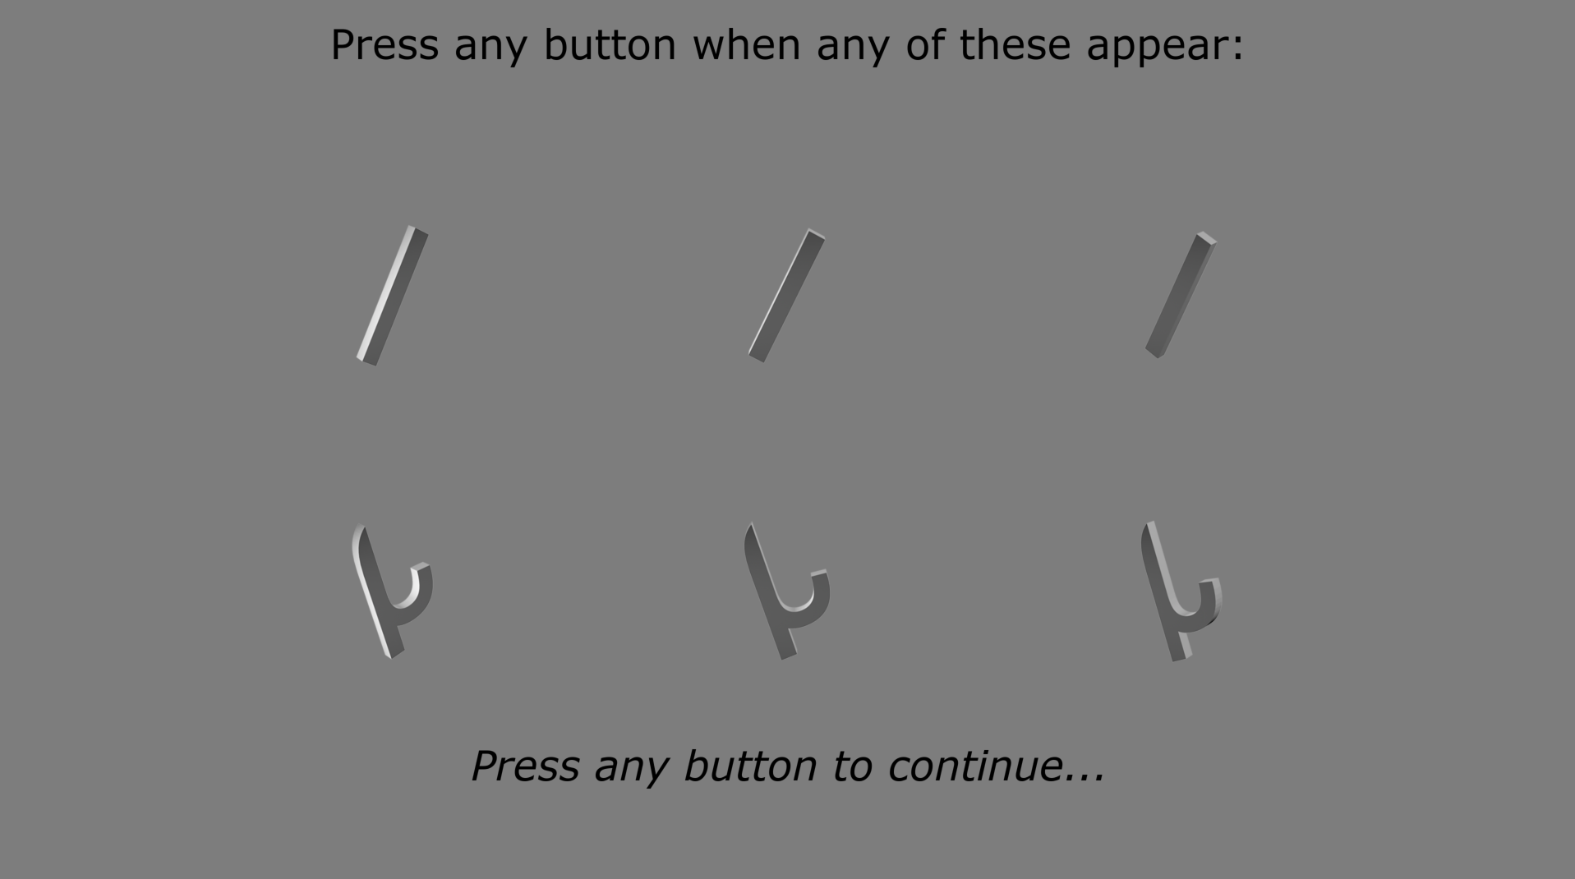
At the beginning of each sequence, we will show you two specific TARGET images that you will need to remember and be on the lookout for during the sequence. For example:
Press the right arrow key to proceed or the left arrow key to
return to the previous slide

Slide 4
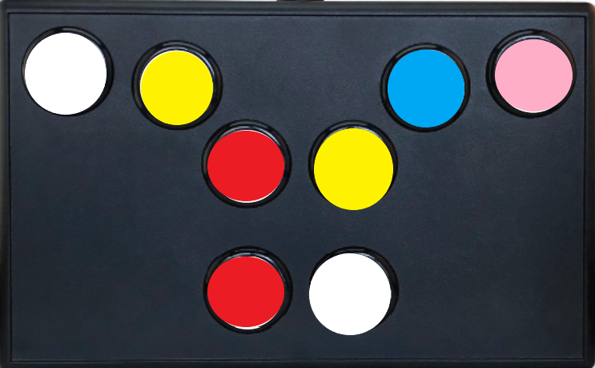
Your main task is to look at each image in the sequence for as long as it’s on the screen and press any of the buttons EXCEPT THE RED ONES with your INDEX finger whenever you see a target image.
Please press the button as quickly and as accurately as possible, whenever you see a target image. Remember, target images can be presented from the front or side views.
Press the right arrow key to proceed or the left arrow key to
return to the previous slide

Slide 5
Each sequence will last about 1min 15sec. The next sequence will only begin after you press the space bar. You will be able to rest between sequences.
Please do your best to remain focused and alert during the experiment.
If you need a break, or have any questions, do not hesitate to ask the experimenter.
Press the right arrow key to proceed or the left arrow key to
return to the previous slide

Slide 6
We will start with a few practice trials, and you will have a chance to ask more questions before starting the main experiment.
Good luck!
Press the right arrow key to proceed or the left arrow key to
return to the previous slide

