Slide 1
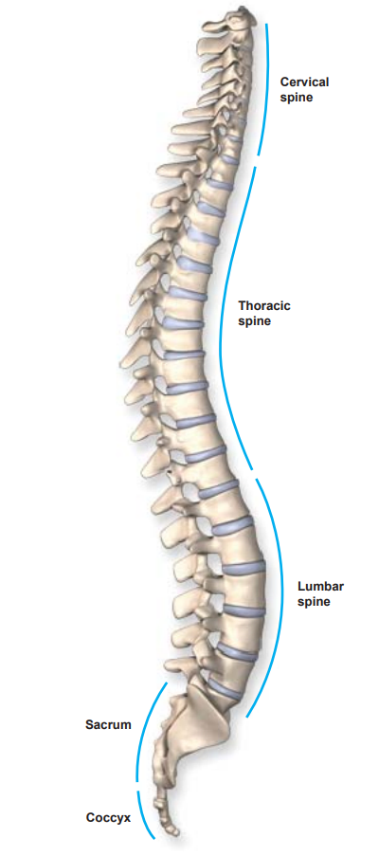
Classification of Lumbar Spine Damages BackPropAgation for Back
Thursday, November 7, 2024
Presented by: Paul Schmelzer

Slide 2
Project goal and motivation
Goal: classify lumbar spine damages using MR images.
Motivation: Facilitate performance of radiologists in diagnosing spine damages.
and
Notes:
my wife has got harniton in the spine. My wife had to leave the hospital due to a lack of severe symptoms."

Slide 3
Dataset
Dataset Origin from Kaggle: collected by RSNA (Radiological Society of North America)
The kind of damage: Classifying five lumbar spine degenerative conditions:
Left Neural Foraminal Narrowing
Right Neural Foraminal Narrowing
Left Subarticular Stenosis
Right Subarticular Stenosis
Spinal Canal Stenosis

Slide 4
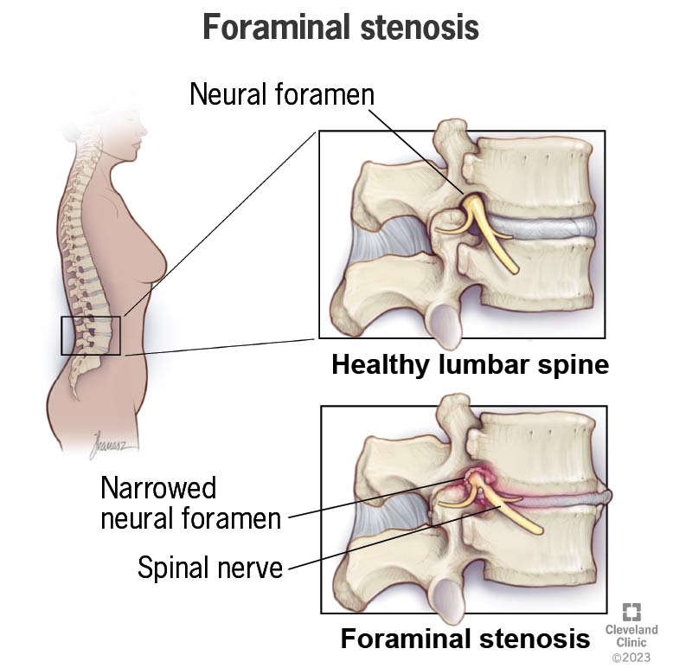
Neural Foraminal Narrowing : Narrowing of the nerve passageways in the spine (right and left)

Slide 5
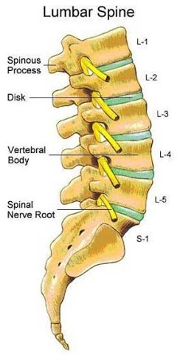
Dataset
Severity Levels: Normal/Mild, Moderate, Severe.
Disc Levels:
L1/L2 - L2/3 - L3/4 - L4/L5 - L5/S1
disc levels

Slide 6
Dataset
Research Focus:
Left Neural Foraminal Narrowing at L5/S1.
Reasoning: resource constraints
Five kind of damages and five levels: result in 25 rows
80 images per person result in 2000 rows
A sample with 2000 persons results in 4 million rows

Slide 7
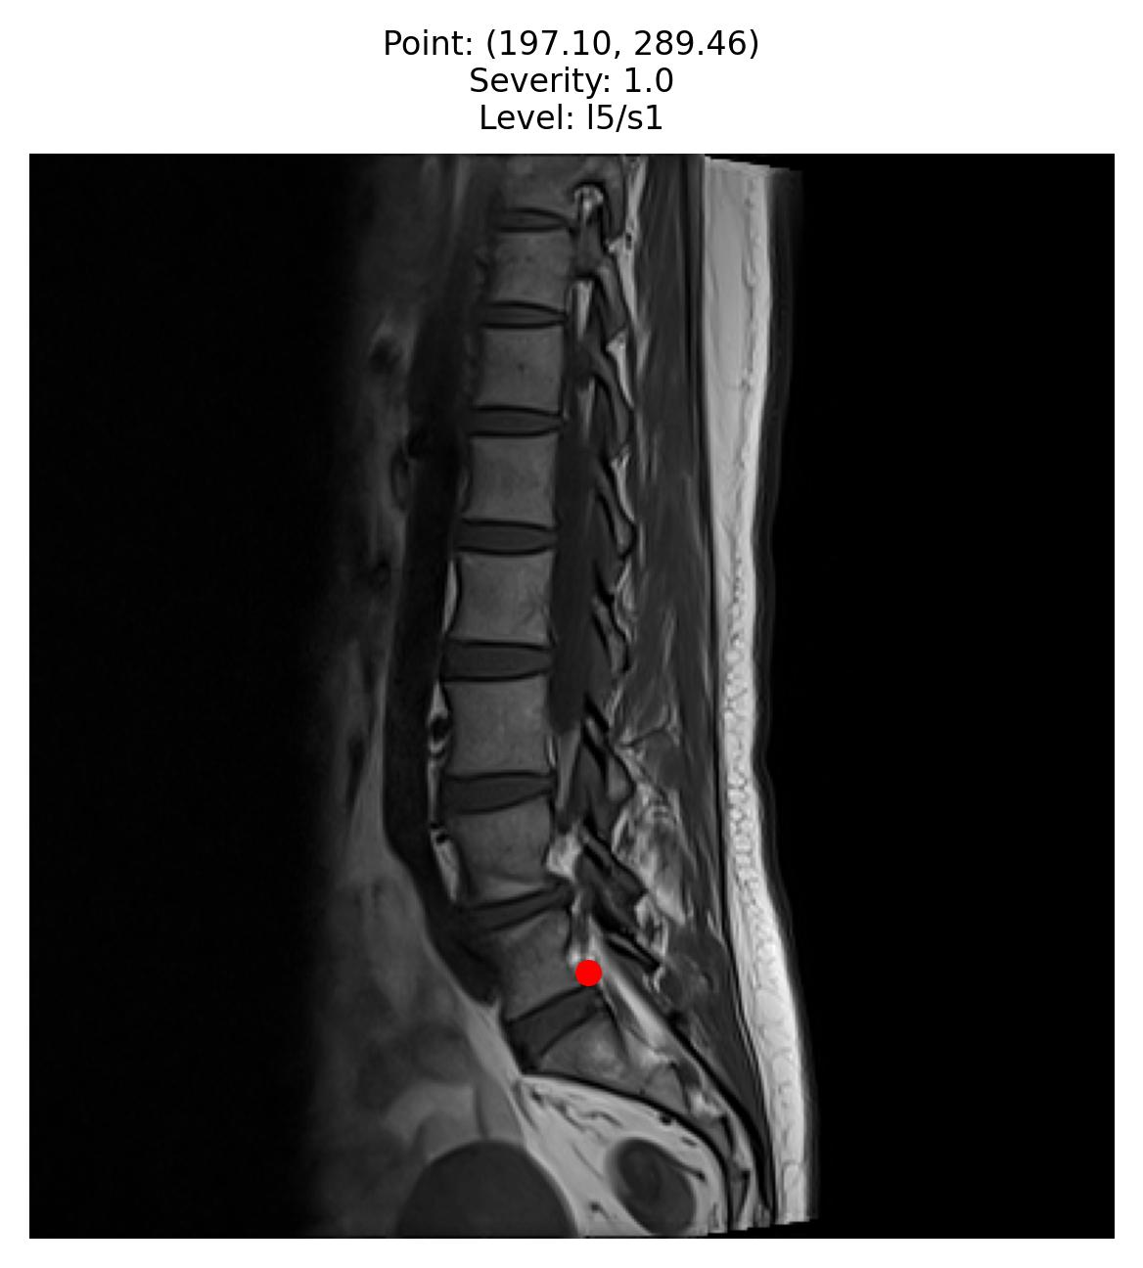
Dataset
Image Categories of MRI
Sagittal T1:
Sagittal T2:
Axial T2
Sagittal Images:
Show the entire spine,
Better for detecting neural foraminal narrowing.

Slide 8
Dataset (sample for L5/S1)
Severity | Normal/mild | Moderate | Severe
N | 1247 | 520 | 206
Number of Persons:
Original sample has about 2000 persons
Average Images per Person:
Each individual has about 40 sagittal images, totaling 80,000 rows.
Random Sampling Strategy:
A random sample of 4,000 images is selected for each severity category.
The sample is balanced by severity but not by person

Slide 9
Dataset (sample for L5/S1)
Train-test split 80% for training and 20% for testing.
Train-validation split 80% for training and 20% for validation.
Calculation time on the training set is approximately one hour per epoch.
Early stopping in 5 -9 epochs.

Slide 10
Prediction Goal
Predictions: on test data for Left Neural Foraminal Narrowing at L5/S1
Predictions: on other positions L1/L2 - L2/3 - L3/4 - L4/L5

Slide 11
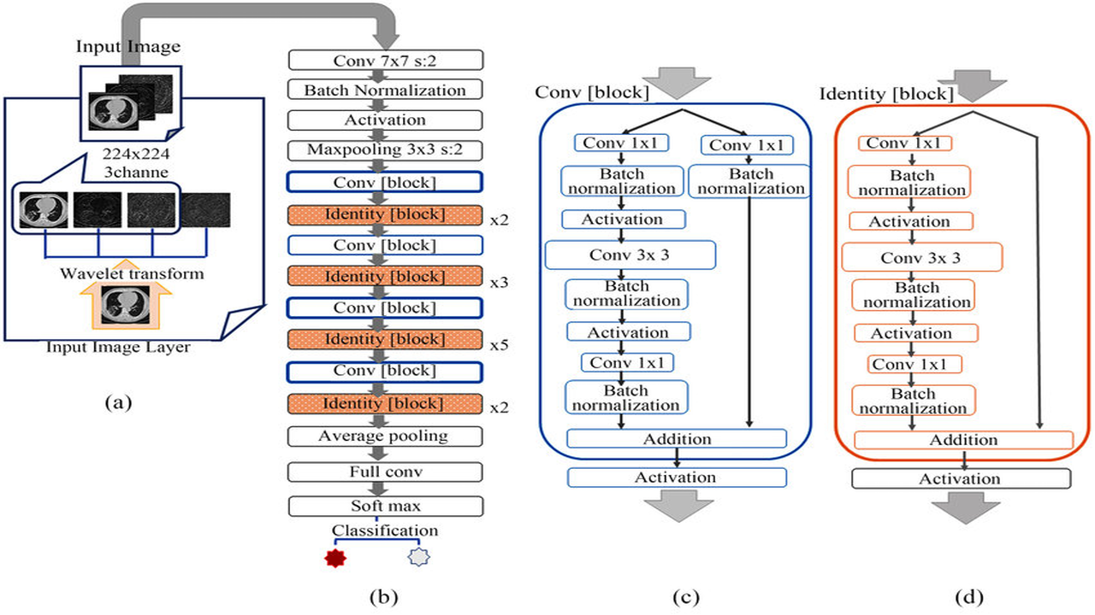
Methods - Transfer Learning with Pretrained ResNet-50
ResNet-50
A deep convolutional neural network with 50 layers
Tackles gradient problem
Operates with pre-trained weights
Trained on ImageNet-1k: contains 1,000 categories and millions of images
Good choice for medical imaging
Introduction of additional layers
Notes:
ResNet-50 is designed to overcome the vanishing gradient problem in deep neural networks. It achieves this through residual learning, where the network learns the differences (residuals) between the input and the output instead of attempting to learn the full mapping. This is implemented using shortcut connections, allowing gradients to flow directly through the network's layers during backpropagation, ensuring effective training even in very deep architectures

Slide 12
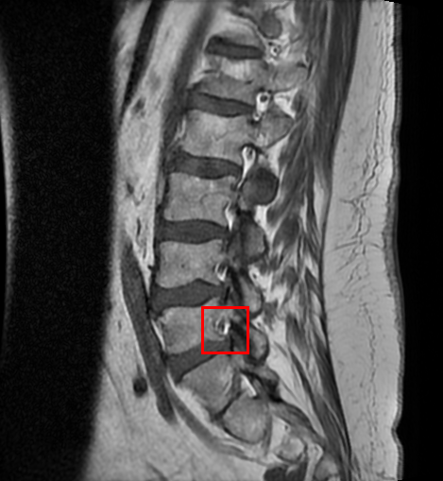
Process of Classification
Training With Bounding Boxes
Provides better accuracy
Training only on L5/S1
Less generalization
Training Without Bounding Boxes
Can be trained on the whole image
all levels of spine damage
Generalization
better predictions for other levels

Slide 13
Results - Accuracy
Baseline Accuracy = Majority Class Sample/​ Total Number of Samples
Base line accuracy 35%
End accuray = TP1 + TP2+TP3/Total number in samples
about 85%
Notes:
Percentage Improvement=Improvement /Baseline Accuracy ​×100

Slide 14
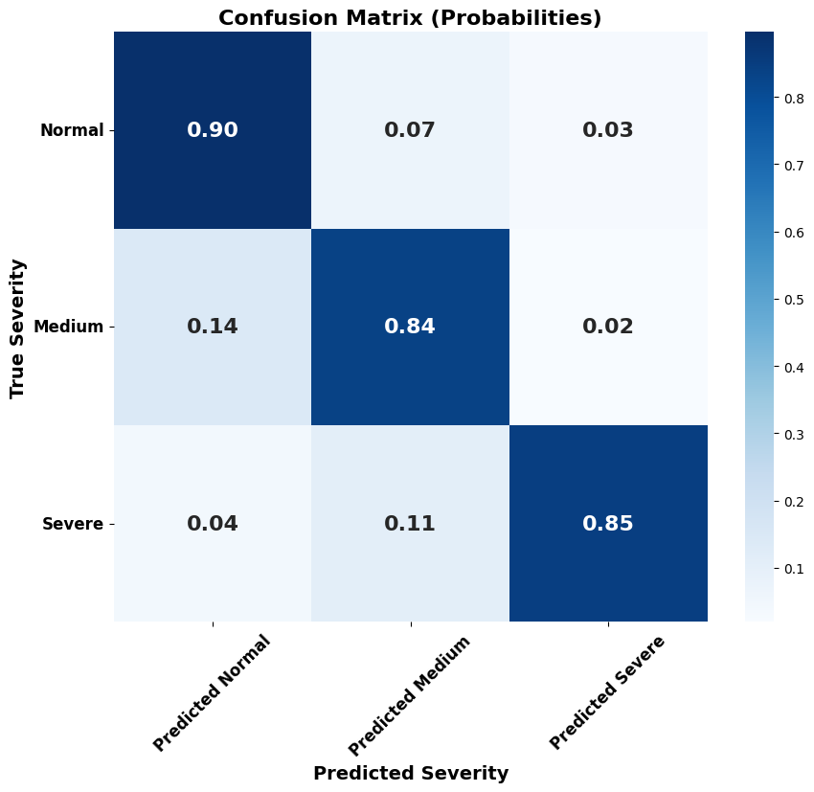
With Bounding Boxes

Slide 15
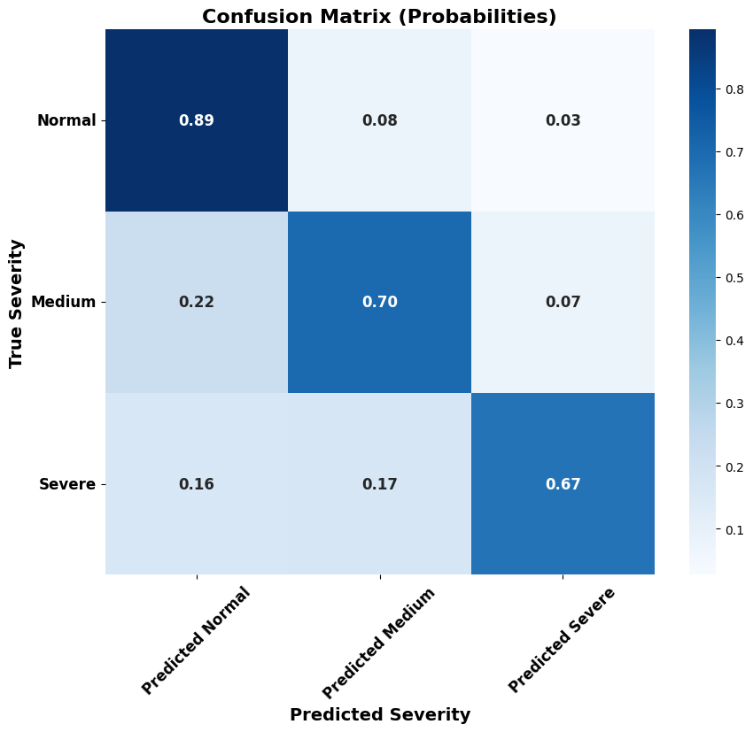
Without Bounding Boxes

Slide 16
Next steps
Nice to have:
Localization of the damage
Comparison between training with and without Bounding Boxes
Predicion on L1/L2 - L2/3 - L3/4 - L4/L5 (left and right side)
Moderate

Slide 17
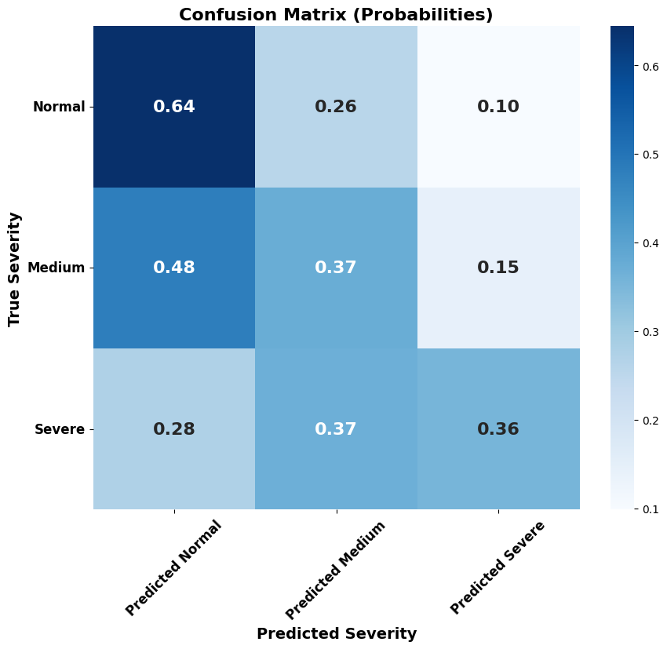
Backups
With Bounding Boxes on
L1/L2 - L2/3 - L3/4 - L4/L5
using coordinates x y

Slide 18
Methods - Transfer Learning with Pretrained Model ResNet-50
Early stopping
Divergence-Based Early Stopping:
Validation loss exceeds training loss by more than a predefined threshold (0.5)
Over a certain number of epochs (5)
Plateau-Based Early Stopping:
Validation loss stops improving for a specified number (5) of epochs
Notes:
ResNet-50 is designed to overcome the vanishing gradient problem in deep neural networks. It achieves this through residual learning, where the network learns the differences (residuals) between the input and the output instead of attempting to learn the full mapping. This is implemented using shortcut connections, allowing gradients to flow directly through the network's layers during backpropagation, ensuring effective training even in very deep architectures

Slide 19
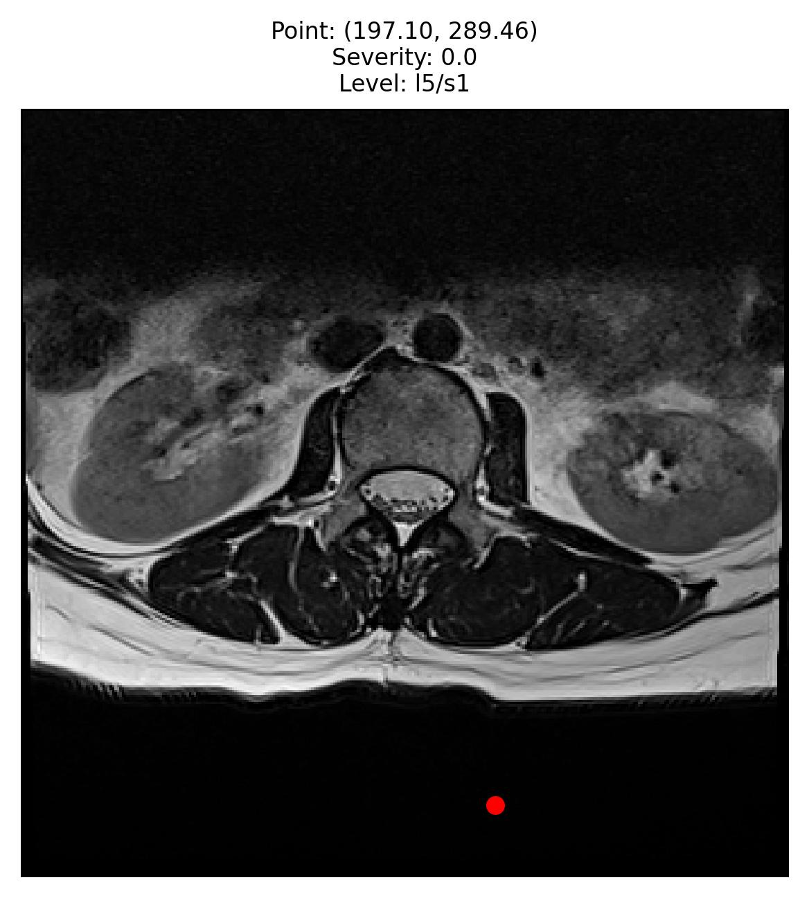
Dataset
Image Categories (stored in folders)
Axial T2
Axial Images:
Axial images show only a cross-sectional "slice" of the spine.
Keeping L5/S1 data few MR Axial images corresponding to L5/S1 "slice"

Slide 20
