Slide 1
Scalable Data Processing and Analytics using Apache Spark
Mining of Massive Datasets (23CSE355) — Assignment 2
Wikimedia editing activity: 10,987,077 revisions through RDDs, DataFrames, Spark SQL and Structured Streaming
Team 22 Project Advisor: Dr Niharika Panda
Sl. No. | Reg. No. | Name of the student
1 | BL.EN.U4CSE23206 | Aman Agarwal
2 | BL.EN.U4CSE23209 | Atharva Wasnik
3 | BL.EN.U4CSE23245 | Pulapa Yaswanth Kumar

Slide 2
Assignment 2: Objectives and Scope
Build a scalable PySpark pipeline that processes, transforms, queries and streams a real-world dataset, exercising all four Spark APIs.
Part | Requirement | Where it is implemented
A | Spark environment: components, driver, cluster manager, executors | src/config.py, slides 3–5
B | RDD creation, map, filter, flatMap, reduceByKey | src/pb_rdd.py
C | DataFrames: schema, cleaning, groupBy, aggregation, Spark SQL | src/p03_prepare.py, src/pc_sql.py
D | Workflow: Input → RDD → DataFrame → Analytical Output | src/run_all.py, slide 6
E | Structured Streaming with per-batch aggregation | src/pe_streaming.py
F | Technical report | reports/Assignment2_Spark_Report.docx (15 pages)
Dataset: Wikimedia MediaWiki History dump, 951 MB bz2, 15,201,370 rows — well above the 10k streaming minimum.

Slide 3
Dataset Description
Item | Details
Source | Wikimedia mediawiki_history dumps, snapshot 2026-10 (CC0)
Wiki / period | simplewiki, complete all-time history (2001–2026)
Download | 951 MB bz2 TSV, 78 tab-separated columns, no header
Raw rows | 15,201,370 (revision 11,023,987, page 2,231,160, user 1,946,223)
Usable after cleaning | 10,987,077 (0.33% removed)
Columns retained | 31 of 78
Labels | bot 23.7% · reverted 14.1%
Streaming source | replay of 200,000 records + live EventStreams (SSE)

Slide 4
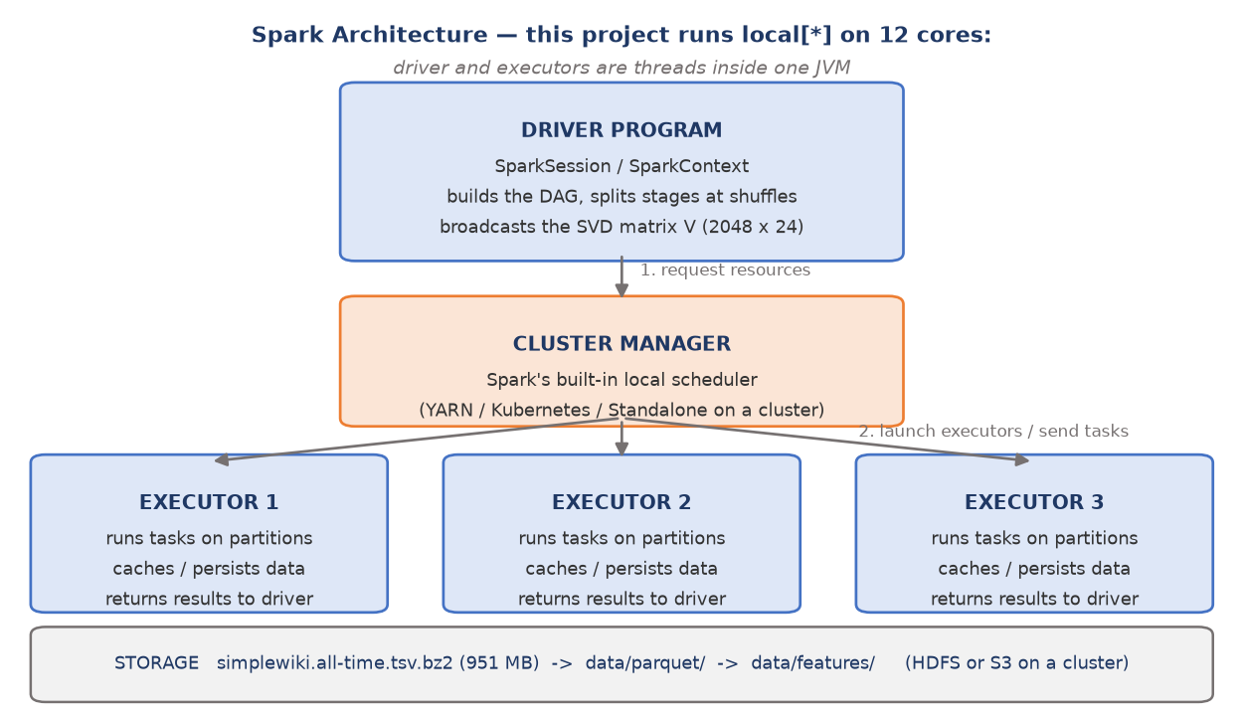
Part A: Spark Architecture
Driver builds the DAG and splits stages at shuffles; the cluster manager allocates executors, which run one task per partition. Under local[*] all three are threads in one JVM.

Slide 5
Part A: Environment and Execution Model
src/config.py
SPARK_CONF = {
"spark.driver.memory": "6g",
"spark.sql.shuffle.partitions": "48", # ~4x cores
"spark.sql.adaptive.enabled": "true",
"spark.sql.adaptive.skewJoin.enabled": "true",
"spark.serializer": "...KryoSerializer",
}
MASTER = "local[*]"
Concept | In this project
Job | one per action (count, collect, write)
Stage | cut at every shuffle boundary
Task | one per partition — 48 after a shuffle
Narrow op | withColumn, filter — no data movement
Wide op | groupBy, window — full shuffle
Partitions | 30 on the raw bz2 read
Lazy evaluation, learned the hard way. Our first ingest called four actions, so Spark replayed the lineage four times and decompressed the 951 MB file four separate times. One grouped aggregate now yields the row total, the entity breakdown and the wiki check together: four passes became two.

Slide 6
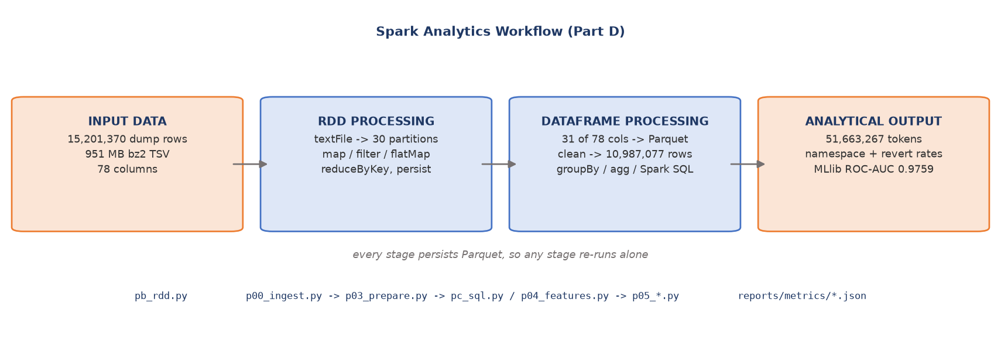
Part D: Spark Analytics Workflow
Every stage persists Parquet, so any stage re-runs alone. The RDD and DataFrame branches read the same source, which is what makes the cross-API validation on the next slides possible.

Slide 7
Part B: RDD Creation and Transformations
The RDD phase runs on the raw compressed dump, not on Parquet — sc.textFile across 30 partitions, because bzip2 is splittable in Hadoop. A gzip dump would have been one task.
src/pb_rdd.py
lines = sc.textFile(str(config.RAW_TSV), minPartitions=24)
parsed = lines.map(parse).filter(lambda r: r is not None)
revs = (parsed.filter(lambda r: r[0] == "revision")
.map(lambda r: r[1:])
.persist(StorageLevel.MEMORY_AND_DISK))
# reduceByKey: edits per namespace
ns = (revs.map(lambda r: (r[0], 1))
.reduceByKey(lambda a, b: a + b)
.takeOrdered(10, key=lambda kv: -kv[1]))
# flatMap: word count over every edit comment
words = (revs.flatMap(lambda r: TOKEN.split(r[6].lower()))
.filter(lambda w: len(w) > 2 and w not in STOP)
.map(lambda w: (w, 1))
.reduceByKey(lambda a, b: a + b))
Operation | Used for
`textFile` | RDD creation, 30 partitions
`map` | parse 78-field TSV line
`filter` | keep revision events
`flatMap` | comment → tokens
`reduceByKey` | namespace, editor, word counts
`takeOrdered` | top-N action
`persist` | share the parse across 5 jobs
Projecting each row to a compact tuple before persisting: full 78-field lists for 11 M rows would not fit in memory.

Slide 8
Part B: Actions, Jobs and Caching
Each action is one Spark job, and each job replays the lineage from source unless an intermediate result is persisted.
Action | Job | Elapsed | Shuffle?
count() — forces the parse | 1 | 61.1 s | no
edits per namespace (reduceByKey) | 2 | 3.1 s | yes
most active editors (reduceByKey) | 3 | 3.8 s | yes
comment word count (flatMap) | 4 | 16.0 s | yes
bot / anonymous aggregates | 5 | 6.9 s | yes
61.1 s, then 3.1 s. The first action pays to decompress and parse 11 M rows; every later action reuses the persisted projection. Without `persist`, jobs 2–5 each repeat that 61-second parse — about five minutes of wasted work.

Slide 9
Part B: RDD Results
Namespace | Edits
`0` | 7,821,994
`3` | 894,246
`14` | 661,036
`2` | 552,165
`10` | 402,717
`4` | 401,355
Top comment token | Count
`robot` | 1,615,801
`adding` | 1,428,633
`talk` | 1,131,878
`category` | 1,069,091
`user` | 824,609
`hotcat` | 765,561
Actor class | Edits | Revert rate
Human | 8,419,962 | 16.04%
Bot | 2,604,025 | 7.69%
Anonymous | 2,044,198 | 36.68%
51,663,267 comment tokens processed by flatMap. The vocabulary is maintenance vocabulary — `robot`, `adding`, `category`, `hotcat` — consistent with 23.7% of edits being automated.
Anonymous contributors are reverted at 36.7% against 7.7% for bots — a factor of 4.8. Automation is the least contested category on the platform.

Slide 10
Part B: Output Validation — RDD vs DataFrame
The same aggregates are recomputed through the DataFrame API and reconciled against the RDD results. The two must not be equal: the DataFrame path drops rows with a null structural key during cleaning, so the RDD figure has to exceed it by exactly that count.
Metric | RDD path | DataFrame path | Delta | Check
revision rows | 11,023,987 | 10,987,077 | 36,910 | PASS
bot edits | 2,604,025 | 2,598,870 | 5,155 | PASS
The 36,910-row gap is exactly the null-key rows Phase 3 discards. An exact match would be the bug — it would mean the cleaning step silently did nothing.
Two independent APIs over the same source, reconciled to a known difference. That is output validation, not a printout.

Slide 11
Part C: Schema, Cleaning and the Null Contract
src/p03_prepare.py
# deleted pages null the current-state columns but keep *_historical
df = (df.withColumn("page_namespace",
F.coalesce("page_namespace", "page_namespace_historical"))
.withColumn("page_title",
F.coalesce("page_title", "page_title_historical")))
df = df.dropDuplicates(["revision_id"])
# NULL == "true" is NULL in SQL -> becomes NaN downstream
for c in BOOL_COLS:
df = df.withColumn(c,
F.coalesce(F.col(c) == F.lit("true"), F.lit(False)))
df = (df.withColumn("label_bot",
(F.length(F.trim("event_user_is_bot_by")) > 0).cast("int"))
.withColumn("label_reverted",
F.col("revision_is_identity_reverted").cast("int")))
Step | Rows
Revision rows in | 11,023,987
Duplicates removed | 0
Null-key rows removed | 36,910
Clean rows | 10,987,077
Bot edits | 2,598,870 (23.7%)
Reverted | 1,550,915 (14.1%)
14.8% of revisions have a null namespace because the page was deleted. Dropping them would bias the revert label, since deleted pages concentrate vandalism. Recovered from *_historical: loss fell from ~15% to 0.33%.

Slide 12
Part C: Spark SQL Queries
src/pc_sql.py
df.createOrReplaceTempView("wikimedia_edits")
# namespace aggregation
spark.sql("""
SELECT page_namespace, COUNT(*) AS edits,
ROUND(AVG(label_bot), 4) AS bot_share
FROM wikimedia_edits
GROUP BY page_namespace
ORDER BY edits DESC LIMIT 10""")
# most frequent comment terms
spark.sql("""
SELECT word, COUNT(*) AS n FROM (
SELECT explode(split(lower(event_comment),
'[^a-z0-9]+')) AS word
FROM wikimedia_edits)
WHERE length(word) > 2
GROUP BY word ORDER BY n DESC LIMIT 15""")
ns | Namespace | Edits | Bot % | Revert %
0 | Article | 7,799,888 | 23.2 | 12.8
3 | User talk | 893,306 | 18.5 | 11.2
14 | Category | 659,831 | 53.5 | 3.7
2 | User | 550,127 | 27.2 | 30.0
10 | Template | 401,997 | 20.1 | 10.2
4 | Project | 401,011 | 7.3 | 45.7
Actor segment | Edits | Revert rate
registered human | 6,357,719 | 9.45%
bot | 2,598,870 | 7.70%
anonymous | 2,030,488 | 36.92%
DataFrame API 1.02s vs Spark SQL 0.66s — identical Catalyst plan. The choice is expression, not performance.

Slide 13
Part C: Analytical Findings
Category space is 53.5% automated against a 23.7% corpus average, and has the lowest revert rate of the major namespaces at 3.7%. Category maintenance is largely machine work and largely uncontested.
Anonymous editors are reverted 4.8x more often than bots — 36.92% against 7.70%, with registered humans between them at 9.45%.
Automated editing peaked and receded. Activity peaked in 2012 with 771,344 edits at 45.3% automation. The busiest recent month, 2025-05, runs at only 6.5%.
Most edited article: `Deaths_in_2020` with 8,538 revisions.
Both APIs answer the term-frequency question and agree on the ordering: robot, adding, talk, category.

Slide 14
Part E: Structured Streaming
src/pe_streaming.py
stream = (spark.readStream
.schema(SCHEMA) # no inference on a stream
.option("maxFilesPerTrigger", 1) # one burst per micro-batch
.json(str(STREAM_IN)))
q1 = (stream.writeStream
.foreachBatch(per_batch)
.option("checkpointLocation", str(CKPT / "q1"))
.trigger(processingTime="2 seconds").start())
# event-time windows with a watermark for late data
windowed = (stream
.withWatermark("event_timestamp", "365 days")
.groupBy(F.window("event_timestamp", "365 days"))
.agg(F.count("*").alias("edits"),
F.avg("label_bot").alias("bot_share")))
Property | Value
Source | file source (JSON)
Trigger | processingTime = 2 s
Bursts | 20 x 10,000
Micro-batches | 20
Records | 200,000
Running bot rate | 44.11%
Event-time windows | 12
A file source was chosen over a socket: a socket source is not fault-tolerant and dies with its producer. The file source checkpoints offsets and is restartable.

Slide 15
Part E: Micro-Batch Output and Interpretation
make streaming
[producer] sampled 200,000 edits (44.1% bot)
BATCH 0: rows=10,000 bot=1,945 (19.4%) | running 19.45%
BATCH 5: rows=10,000 bot=4,014 (40.1%) | running 32.39%
BATCH 10: rows=10,000 bot=5,083 (50.8%) | running 38.57%
BATCH 13: rows=10,000 bot=5,489 (54.9%) | running 41.52%
BATCH 19: rows=10,000 bot=6,404 (64.0%) | running 44.11%
event-time windows produced: 12
2002: 172 edits, bot share 1.7%
2003: 906 edits, bot share 10.7%
2004: 2,647 edits, bot share 14.1%
2005: 9,363 edits, bot share 26.1%
The bot rate climbs 19.4% → 64.0%.
That is not noise. The replay is in event-time order, oldest first, so this is the real growth of automated editing on Wikipedia played back in 90 seconds.
The running rate converges on 44.11%, matching the 44.1% bot share of the sampled replay set measured before streaming began.
Streaming and batch paths agree on the same corpus — the useful cross-check.

Slide 16
Part E: A Partitioning Bug Surfaced by Streaming
Symptom. The first streaming run reported a bot rate of exactly zero in every micro-batch.
Cause. Not in the streaming code. The prepared dataset is written with `partitionBy("label_bot")`, so it is laid out on disk as two directories. A `.limit()` over it reads whole partition directories in order, and `label_bot=0` alone holds more rows than the replay needed — so the sample never reached the bot partition.
Fix. Sample across all partitions, then order by event time.
General lesson. `limit()`, `head()` and `take()` are not random samples. On partitioned data they return whatever the first partitions hold — and if the data is partitioned by the column under measurement, the result is perfectly biased with no error raised.

Slide 17
Results and Discussion
• Scale. 10,987,077 cleaned revisions processed from a 951 MB compressed dump; 51,663,267 comment tokens counted via flatMap.
• Revert rate separates actor classes sharply — anonymous 36.9%, registered human 9.4%, bot 7.7%. Automation is the least contested category on the platform.
• Automation is concentrated by namespace — Category is 53.5% automated against a 23.7% average.
• Streaming reproduces the batch result incrementally — running bot rate converges on 44.11% across 20 micro-batches.
• API choice is expression, not performance — DataFrame 1.02s vs Spark SQL 0.66s on the same question, because both compile to the same Catalyst plan.
• Caching dominates RDD cost — the first action took 61.1 s to parse 11 M rows; the next four took 3–16 s each off the persisted projection.

Slide 18
Scalability Observations
Stage | Parallelisation mechanism
Raw TSV read | bzip2 IS splittable, so the 951 MB file was read by 30 concurrent tasks (gzip would be one)
Column projection | Parquet keeps 31 of 78 columns, so later phases read about a third of the bytes
Feature engineering | row-local withColumn — embarrassingly parallel, no shuffle
Editor aggregation | groupBy + window lag → sort-merge shuffle across 48 partitions; the expensive step
Model training | MLlib broadcasts the model, reduces statistics per partition
Actor skew is the dominant risk at scale. Edits per account follow a heavy power law — `Auntof6` has 335,023 revisions while the median account has one. A naive groupBy sends one enormous partition to a single task, which straggles or OOMs while the other cores idle. Adaptive skew-join handling is enabled; salting the heaviest keys is the next step.
Other limits: small-files problem on write, broadcast ceiling on the SVD matrix if TF-IDF buckets grow, and local[*] only — scalability is argued from observed stage behaviour, not a measured multi-node speed-up.

Slide 19
Reproducing the Results
make help
source env.sh # pins JAVA_HOME and PYSPARK_PYTHON
make smoke # all phases on 49,478 rows, ~1 min
make rdd # Part B: RDD processing ~90 s
make sql # Part C: DataFrame + Spark SQL ~60 s
make streaming # Part E: Structured Streaming ~90 s
make all # the full pipeline ~55 min
make report-a2 # rebuild the 15-page report
make ppt-a2 # rebuild this deck
Every phase persists Parquet, so any phase re-runs alone. Both documents are generated from reports/metrics/*.json, so no number in them is typed by hand.

Slide 20
Conclusion
A complete Spark pipeline over 10,987,077 real Wikimedia revisions, exercising all four programming interfaces on one corpus: RDD transformations on the raw compressed dump, DataFrame cleaning and Spark SQL over Parquet, Structured Streaming with watermarked event-time windows, and distributed MLlib.
Three engineering lessons that generalise:
Published schemas may not match shipped data — the docs say 76 columns, the snapshot ships 78. Verifying column order empirically cost less than debugging a misaligned pipeline would have.
Lazy evaluation means every action replays lineage from source. One `persist` turned five re-parses into seconds.
A metric must be read against its own baseline — and a `.limit()` on partitioned data is not a random sample.
Future scope: multi-node cluster with measured speed-up; connect the live EventStreams collector directly to the streaming consumer; extend to larger wikis where actor skew binds.

Slide 21
THANK YOU

