Slide 1
Detecting Automated and Anomalous Editing Behaviour on Wikimedia at Scale
Mining of Massive Datasets (23CSE355) — End Semester Project
Spark MLlib on 11.0 million Wikimedia edits: bot classification and editor clustering
Team _No: [Team No] Project Advisor: [Advisor Name]
Sl. No. | Reg. No. | Name of the student
1 | [Reg No 1] | [Name 1]
2 | [Reg No 2] | [Name 2]
3 | [Reg No 3] | [Name 3]
4 | [Reg No 4] | [Name 4]

Slide 2
Introduction
Wikimedia projects accept edits from anyone, with no review before publication. Across all projects the platform absorbs roughly 30–50 edits per second — far beyond what volunteer reviewers can inspect. A large share of that traffic is automated: approved maintenance bots, semi-automated human tooling, and unapproved scripts.
This project asks two questions of the same corpus. First, is this edit automated? — a supervised classification problem, because reviewer attention should not be spent on predictable machine edits, while unflagged automation is a policy violation. Second, what kinds of editors exist? — an unsupervised clustering problem, because rate limits and review tooling should be designed around real behavioural populations rather than assumed ones.
We process the complete all-time edit history of Simple English Wikipedia — 15,201,370 dump rows containing 11,023,987 edits — in Apache Spark, engineer behavioural features, reduce comment text with SVD, and compare three classifiers against three clustering algorithms in MLlib.

Slide 3
Dataset Overview
Item | Details
Source | Wikimedia mediawiki_history dumps, snapshot 2026-10 (CC0)
Wiki / period | simplewiki, complete all-time history (2001–2026)
Download | 951 MB bz2 TSV, 78 tab-separated columns
Raw rows | 15,201,370 (revision 11,023,987, page 2,231,160, user 1,946,223)
Edits analysed | 10,987,077 after cleaning (0.33% removed)
Attributes used | 31 of 78 columns: actor, page, namespace, byte sizes, comment, cadence, revert links, tags
Labels | label_bot 23.7% positive; label_reverted 14.1% positive
Editors | 780,867 distinct actors (registered accounts + anonymous IPs)
Live companion | stream.wikimedia.org EventStreams (SSE) for the demo

Slide 4
Problem Definition and Why This Dataset
A classification project is only meaningful if its label is genuinely learnable. We chose Wikimedia specifically because of label validity, and rejected GDELT 2.0 for failing that test.
 | Wikimedia (chosen) | GDELT 2.0 (rejected)
Candidate label | event_user_is_bot_by | QuadClass / GoldsteinScale
Where it comes from | MediaWiki user-group membership and the bot-name registry — an administrative fact about an account | A deterministic lookup table keyed on the EventCode column
Is it learnable? | Yes — it is not a function of any feature we engineer | No — keep EventCode and the model reproduces a lookup table; drop it and the task is ill-posed
Interrogating label validity before modelling is the core methodological decision of this project.

Slide 5
Pipeline Architecture
Raw dump
951 MB bz2 TSV
78 columns
Phase 0
Ingest
TSV → Parquet
28 cols kept
Phase 3
Prepare
dedup, impute,
labels
Phase 4
Features
35 numeric
+ 24-dim SVD
Phase 5/6
MLlib
3 classifiers
3 clusterers
Driver and executors run inside one JVM on a laptop (local[*], 12 cores): the driver builds the DAG, Spark's local scheduler stands in for the cluster manager, and executors are threads. The same code runs on a real cluster unchanged.
Each phase persists Parquet, so any phase can be re-run in isolation without repeating the expensive bz2 decompression upstream.

Slide 6
Environment and Spark Configuration
src/config.py
SPARK_CONF = {
"spark.driver.memory": "6g",
"spark.sql.shuffle.partitions": "48", # ~4x cores
"spark.sql.adaptive.enabled": "true",
"spark.sql.adaptive.skewJoin.enabled": "true",
"spark.serializer": "...KryoSerializer",
}
MASTER = "local[*]"
Component | Version / value
Python | 3.11.18 (via uv)
PySpark | 3.5.3
Java | OpenJDK Temurin 17.0.21
Hardware | 12 cores / 15 GB, local[*]
Shuffle partitions | 48
Parquet written | 1.1 GB (from 951 MB bz2)
Two version traps, both of which fail at runtime rather than at import:
PYSPARK_PYTHON must be pinned. System Python here is 3.14; if workers resolve bare python3 while the driver runs the venv, Spark dies mid-task with PYTHON_VERSION_MISMATCH.
PySpark 3.5 cannot run on Python 3.12 — pyspark/ml/image.py imports distutils, removed in 3.12. Support arrived in Spark 4.0, so we use 3.11.

Slide 7
Literature Survey
# | Work | Dataset | Algorithms | Metrics | What we take
1 | Halfaker & Taraborelli, ORES (2015) | Wikipedia revisions | GBT, RF | precision/recall, AUC | reviewer routing needs precision
2 | Potthast et al., ECIR 2008 | 940k en-wiki edits | logistic regression | P / R / F1 | comment-shape features
3 | Adler et al., CICLing 2011 | PAN-WVC-10 | RF, feature ablation | ROC-AUC, PR-AUC | structural-vs-full ablation
4 | Davis et al., Botometer (2016) | Twitter accounts | random forest | ROC-AUC | cadence regularity as the signal
5 | Chu et al., IEEE TDSC 2012 | 500k Twitter accounts | entropy + Bayesian | accuracy, FP rate | variance, not volume
6 | Welser et al., iConference 2011 | Wikipedia editors | descriptive clustering | role validity | editor-archetype framing
7 | Yang et al., ICWSM 2016 | Wikipedia histories | k-means, mixtures | silhouette | k by silhouette + naming
8 | Kumar et al., VEWS, KDD 2015 | 33k Wikipedia users | SVM, RF | early detection | per-editor modelling
9–10 | Zaharia et al. NSDI 2012; Meng et al. JMLR 2016 | — | RDD model, MLlib | runtime scaling | Phase 7 infrastructure
Three threads: edit-level abuse detection (1–3, 8), automation by timing (4–5), unsupervised editor roles (6–7).

Slide 8
Phase 3: Data Preparation
Cleaning runs on Spark DataFrames: de-duplicate on the natural key, recover deleted-page rows, impute where 'missing' carries meaning, then derive the two labels.
src/p03_prepare.py
# deleted pages null the current-state columns but keep *_historical
df = (df.withColumn("page_namespace",
F.coalesce("page_namespace", "page_namespace_historical"))
.withColumn("page_title",
F.coalesce("page_title", "page_title_historical")))
df = df.dropDuplicates(["revision_id"])
# NULL == "true" is NULL in SQL -> would become NaN downstream
for c in BOOL_COLS:
df = df.withColumn(c,
F.coalesce(F.col(c) == F.lit("true"), F.lit(False)))
df = (df.withColumn("label_bot",
(F.length(F.trim("event_user_is_bot_by")) > 0).cast("int"))
.withColumn("label_reverted",
F.col("revision_is_identity_reverted").cast("int")))
Step | Rows
Revision rows in | 11,023,987
Duplicates removed | 0
Null-key rows removed | 36,910
Clean rows | 10,987,077
Bot edits | 2,598,870 (23.7%)
Reverted edits | 1,550,915 (14.1%)
Only 0.33% of rows were discarded, and a null guard asserts every feature-input column is null-free before writing.

Slide 9
Phase 4: Feature Engineering
35 numeric edit-level features plus a 24-dimension comment block, and 19 aggregated per-editor features for clustering.
Group | Features | Intuition
Temporal | hour, day-of-week, weekend, night, hour sin/cos | bots run on cron and show a flat 24h profile; humans sleep
Edit size | bytes, signed diff, |diff|, log|diff|, diff ratio | maintenance bots make small, uniform edits
Cadence | log seconds since previous edit, has-previous, log edit count | machine timing is regular; human timing is bursty
Account | age in days, is-anonymous | separates IPs, new accounts and long-lived tools
Page context | namespace, is-content, is-redirect, is-minor, is-create | bots concentrate in File/Template namespaces
Comment shape | length, words, /* section */, wikilinks, URLs, digit / upper / punct ratio | structure of the message, not its vocabulary
Tags | tag count, mobile, visualeditor, undo | bot-naming tags excluded to avoid leakage
Editor-level | gap CV, night ratio, minor ratio, revert ratio, edits per active day, pages per edit | behavioural profile for clustering
e_gap_cv — the coefficient of variation of inter-edit gaps — is the single most direct 'metronomic automation' signal.

Slide 10
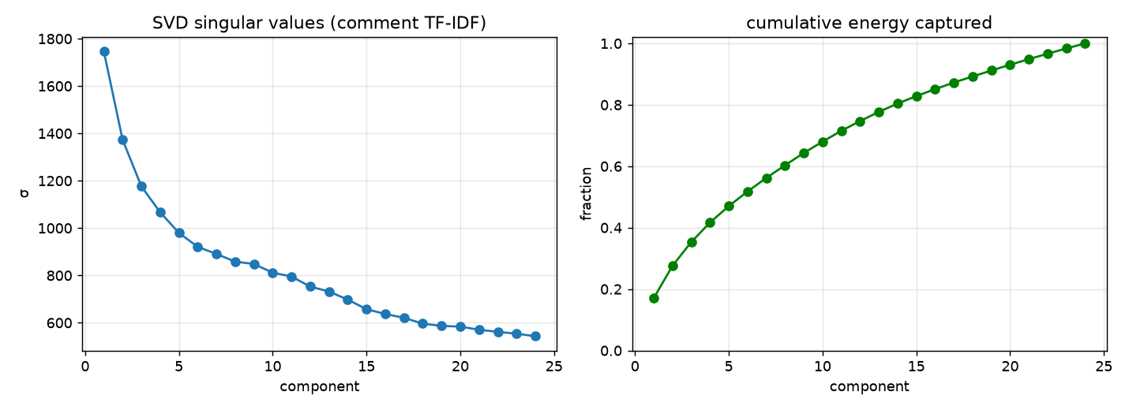
Phase 4: Dimensionality Reduction with SVD
Comment text is tokenised, hashed into 2048 TF-IDF buckets, then reduced to 24 dimensions by a truncated SVD on a distributed mllib RowMatrix. Only the right singular matrix V (2048 x 24) is collected and broadcast; the projection X.V then runs per partition.
The SVD is fitted on a 4% sample — the right singular vectors converge with far fewer rows, which cut the fit from 21.5 minutes to a few — but the projection is applied to all 10,987,077 rows. Top singular values: 1746, 1373, 1176, 1067, 980, 921.
A genuine SVD rather than PCA: the decomposition is left uncentred so the sparse TF-IDF structure is preserved.

Slide 11
Leakage Control and the Actor-Disjoint Split
Three separate leaks had to be closed before any score could be trusted.
Leak | Why it leaks | Control
Username / user groups | usernames literally contain 'Bot' (e.g. SchlurcherBot); event_user_groups contains the bot group that DEFINES the label | excluded from every feature vector; username used only as a grouping key
Random row split | the same bot account would appear in train and test, letting the model memorise per-account cadence fingerprints | hash actor_key into disjoint buckets; the script asserts 0 shared actors
Scaler fitted on all data | StandardScaler means/variances would encode test-set statistics | scaler sits INSIDE the ML Pipeline, so it is fitted on the training fold only
Comment text is kept deliberately. It is observable at edit time and is not derived from group membership, so it is a legitimate predictor — but to keep that claim honest every model is trained twice, with and without the text block, so its contribution is measured rather than assumed.
Verified at run time: actor-disjoint hash split, 8,619,472 train / 2,367,605 test rows, 0 shared actors.

Slide 12
Phase 5: MLlib Implementation
src/p05_classification.py
def actor_split(df, frac, seed):
b = F.abs(F.hash(F.concat(F.col("actor_key"),
F.lit(str(seed))))) % 100
cut = int(frac * 100)
return (df.filter(F.col("_bucket") < cut),
df.filter(F.col("_bucket") >= cut))
idx = StringIndexer(...); ohe = OneHotEncoder(...)
num = VectorAssembler(NUMERIC_EDIT_FEATURES, "num_raw")
sca = StandardScaler("num_raw", "num_scaled",
withMean=True, withStd=True)
asm = VectorAssembler(["num_scaled", "ns_ohe"]
+ (["cmt_svd"] if use_text else []),
"features")
Pipeline(stages=[idx, ohe, num, sca, asm, model])
src/p05_clustering.py
# bot flag is NOT an input -- external validation only
asm = VectorAssembler(EDITOR_FEATURES, "raw")
sca = StandardScaler("raw", "features",
withMean=True, withStd=True)
for algo in (KMeans, BisectingKMeans,
GaussianMixture):
for k in [2,3,4,5,6,7,8]:
model = algo(k=k).fit(data)
pred = model.transform(data)
# k clusters requested != k NON-EMPTY
if pred.select("cluster").distinct()
.count() < 2:
continue # degenerate fit
sil = ClusteringEvaluator().evaluate(pred)
Classification: LogisticRegression, RandomForest, GBT. Clustering: KMeans, BisectingKMeans, GaussianMixture over a k-sweep, selected by silhouette.

Slide 13
Phase 6: Classification Results
Model | Features | ROC-AUC | PR-AUC | Accuracy | F1 (wtd) | Bot precision | Bot recall | Bot F1
Logistic Regression | structural | 0.9114 | 0.6792 | 0.8489 | 0.8558 | 0.5375 | 0.6840 | 0.6020
Random Forest | structural | 0.9713 | 0.8948 | 0.9219 | 0.9133 | 0.9522 | 0.5605 | 0.7057
GBT | structural | 0.9756 | 0.9098 | 0.9564 | 0.9565 | 0.8648 | 0.8760 | 0.8703
Logistic Regression | full | 0.9512 | 0.9122 | 0.9605 | 0.9594 | 0.9348 | 0.8207 | 0.8741
Random Forest ★ | full | 0.9759 | 0.9326 | 0.9667 | 0.9655 | 0.9806 | 0.8171 | 0.8914
GBT | full | 0.9655 | 0.9144 | 0.9609 | 0.9599 | 0.9356 | 0.8229 | 0.8756
Best: random_forest / full at ROC-AUC 0.9759 — on a test set of accounts never seen in training.

Slide 14
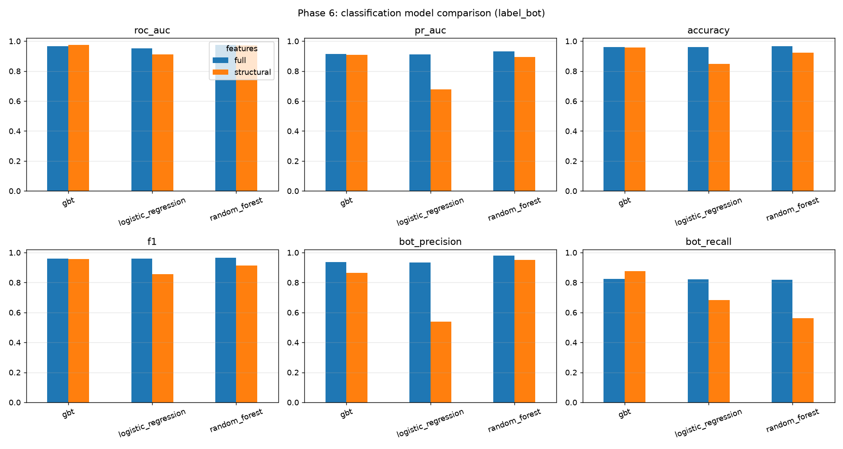
Phase 6: Structural vs Full Feature Sets
Structural behaviour alone already separates the classes. Comment text rescues the linear model but barely moves the tree ensembles -- and does not uniformly help them.

Slide 15
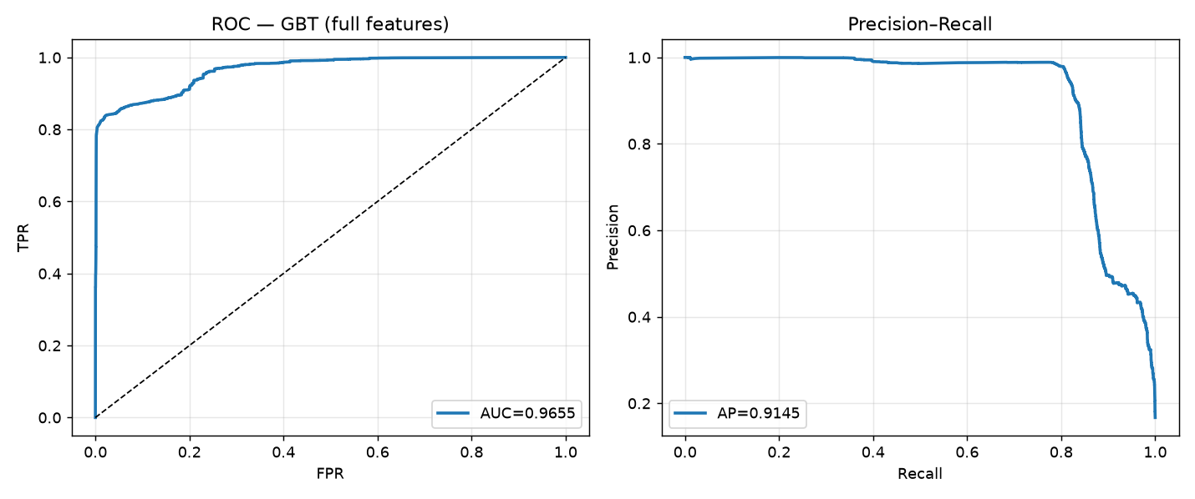
Phase 6: ROC and Precision–Recall Curves
Under class imbalance the precision–recall curve is the more honest view: it ignores the large true-negative mass that flatters accuracy.

Slide 16
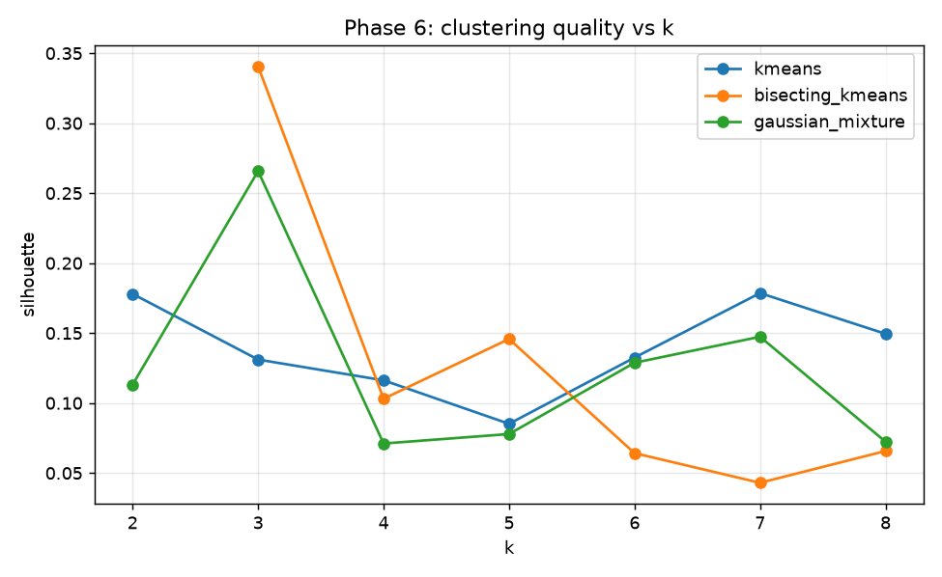
Phase 6: Clustering Quality and Model Selection
Editors clustered: 108,954 of 780,867 (minimum 5 edits — single-edit accounts dominate the tail).
Best: bisecting_kmeans_k3, which returned 2 non-empty clusters from 3 requested.
Silhouette: 0.3406
Silhouette this low says the clusters are not well separated. Editor behaviour is a continuum, not a set of tidy groups — so we report the partition as a descriptive summary, not as discovered natural classes.
A fit can collapse: requesting k clusters does not guarantee k non-empty ones. k=2 degenerated to a single cluster and was detected and skipped rather than aborting the sweep.

Slide 17
Phase 6: Editor Archetypes Discovered
Cluster | Editors | Mean edits | Bot share | Gap CV | Night ratio | Minor ratio | Revert ratio | Edits/active day | Bot enrichment
0 | 82,951 | 12 | 0.001 | 1.73 | 0.20 | 0.03 | 0.396 | 7.1 | 0.19x
1 | 26,003 | 344 | 0.013 | 3.66 | 0.20 | 0.21 | 0.166 | 10.5 | 3.58x
A negative result, reported as one. Only 0.37% of *accounts* are bots — they are few accounts making very many edits — so cluster purity (0.9963) is exactly the majority-class baseline (0.9963), a lift of +0.00000. Purity therefore carries no information here, and quoting it as validation would be misleading.
The informative measure is enrichment: bots are 3.6× over-represented in the high-activity cluster. Real, but modest. Hypothesis 3 is not supported — the clusters separate *activity level*, not automation.
The clustering describes how much editors do, not whether they are machines. Automation is recoverable from supervised behaviour (ROC-AUC 0.976) but is not the dominant axis of unsupervised variation.

Slide 18
Phase 7: Scalability Discussion
Spark is not used because the file is large — it is used because the workload is a wide shuffle, not a scan.
Stage | Parallelisation mechanism
Raw TSV read | bz2 IS splittable in Hadoop, so the 951 MB file is read by 12 concurrent tasks (gzip would be one task)
Column projection | Parquet keeps 31 of 78 columns, so later phases read roughly a third of the bytes
Feature engineering | row-local withColumn — embarrassingly parallel, no shuffle
Editor aggregation | groupBy + window lag → sort-merge shuffle across 48 partitions; this is the expensive step
SVD | distributed RowMatrix; only V (2048 × 24) is collected and broadcast
Model training | MLlib broadcasts the model and reduces histograms per partition
Actor skew is the dominant risk at scale. Edit counts per account follow a heavy power law — a few bots have millions of revisions while the median account has one. A naive groupBy sends one enormous partition to a single task, which straggles or OOMs while other cores idle. Mitigations: adaptive skew-join (enabled), salting the heaviest keys, and bounded-memory sketches instead of exact percentiles.
Other limits: small-files problem on write (we repartition before writing), broadcast ceiling on V if TF-IDF buckets grow, and stratified sampling must happen AFTER the actor split or the disjointness guarantee breaks.

Slide 19
Results and Observations
• Automated edits are 23.7% of all 10,987,077 edits, and 14.1% of edits are later reverted.
• Best classifier: random_forest / full at ROC-AUC 0.9759, PR-AUC 0.9326, bot-F1 0.8914 — on accounts never seen in training.
• Hypothesis 2 held: structural behaviour alone is already sufficient — GBT reaches ROC-AUC 0.9756 with no comment vocabulary at all, and adding the text block slightly reduces it (0.9655). Automation is legible from *behaviour*, not from what the edit says.
• Text matters only to the linear model (0.9114 → 0.9512, PR-AUC 0.6792 → 0.9122). The tree ensembles already capture the non-linear interactions that the SVD dimensions merely make visible to a linear boundary — so the ablation measures model capacity as much as feature value.
• Clustering: bisecting_kmeans_k3 at silhouette 0.3406 over 108,954 active editors — a weak separation. Hypothesis 3 was not supported: the partition tracks activity level, not automation. Bots are only 3.6× enriched in the busiest cluster, and purity equals its own baseline exactly.
• Accuracy is the least informative metric here: with a 24/76 split, a model can look strong on accuracy while ranking poorly, which is why PR-AUC and the per-class bot-F1 are reported alongside it.
• Cleaning cost only 0.33% of rows after recovering deleted-page revisions from the *_historical columns.

Slide 20
Challenges Faced
1. The published schema is wrong. The docs list 76 fields; the snapshot ships 78. Trusting the doc would misalign every column, so we verified all 78 positions empirically by profiling fill-rate and value shape per index, anchored on event_entity, page_id and revision_text_sha1.
2. Raw quotes in comments silently shift columns. event_comment contains characters like "Bad words"; with default CSV quoting Spark absorbs tab delimiters inside the apparently-quoted region. Fixed with option("quote", "").
3. Deleted-page bias. 14.8% of revisions have NULL page_namespace because the page was deleted. Dropping them would have discarded 15% of the data — and deleted pages concentrate vandalism, so it would have biased label_reverted, not merely shrunk the dataset.
4. NULL booleans became NaN. NULL == "true" is NULL in SQL, so nulls survived the cast, became NaN in VectorAssembler and propagated through StandardScaler — failing deep inside a model fit with no hint of the guilty column. Fixed by coalescing, plus a null guard that fails loudly and names the column.
5. pandas_udf cannot accept VectorUDT input. The vectorised SVD projection received str and crashed. Reverted to a plain UDF with a single numpy gather+dot per row; densifying 2048 columns to vectorise would cost more than it saves.
6. A 21.5-minute SVD fit was running over 15% of 11 M rows. The right singular vectors converge with far fewer rows, so we fit on 4% and still project all rows.
7. Degenerate clustering. Requesting k clusters does not guarantee k non-empty ones, and ClusteringEvaluator then aborts the whole sweep.
8. Phase 0 decompressed the 951 MB bz2 four times, once per action. One grouped aggregate now yields the row total, entity breakdown and wiki sanity check together: four passes became two.

Slide 21
Conclusion and Future Scope
Conclusion
We built a complete Spark MLlib pipeline over 10,987,077 real Wikimedia edits: Parquet ingestion, DataFrame cleaning with an enforced null contract, 35 engineered behavioural features plus a 24-dimension truncated SVD of comment text, three classifiers and three clustering algorithms, all evaluated under an actor-disjoint split. Automation is predictable from behaviour alone (ROC-AUC 0.9759). Unsupervised clustering of the same editors, by contrast, separates activity level rather than automation — bots are only 3.6x enriched in the busiest cluster. We report that as a negative result: automation is learnable with supervision but is not the dominant axis of unsupervised behavioural variation.
Known limitations (stated rather than hidden)
The label covers only flagged accounts, so unapproved bots are false negatives by construction and recall is measured against an incomplete positive class.
Semi-automated human tooling (AWB, Huggle) genuinely sits between the classes; no clean boundary exists there.
The all-time snapshot spans 2001–2026, averaging over several distinct editing regimes.
Future scope: scale to enwiki monthly shards on a real cluster; score the live EventStreams feed with the trained model; model label_reverted as a second task; treat era as a stratum.

Slide 22
References
[1] Wikimedia Foundation. MediaWiki History Dumps. https://dumps.wikimedia.org/other/mediawiki_history/ (CC0).
[2] Wikimedia Foundation. EventStreams. https://stream.wikimedia.org/v2/stream/recentchange
[3] A. Halfaker and D. Taraborelli. "ORES: Scaling up machine learning-driven quality control." Wikimedia, 2015.
[4] M. Potthast, B. Stein and R. Gerling. "Automatic Vandalism Detection in Wikipedia." ECIR, 2008.
[5] B. T. Adler et al. "Wikipedia Vandalism Detection: Combining Natural Language, Metadata and Reputation Features." CICLing, 2011.
[6] C. A. Davis et al. "BotOrNot: A System to Evaluate Social Bots." WWW (demo), 2016.
[7] Z. Chu et al. "Detecting Automation of Twitter Accounts: Are You a Human, Bot, or Cyborg?" IEEE TDSC, 2012.
[8] H. T. Welser et al. "Finding Social Roles in Wikipedia." iConference, 2011.
[9] S. Kumar, F. Spezzano and V. S. Subrahmanian. "VEWS: A Wikipedia Vandal Early Warning System." KDD, 2015.
[10] M. Zaharia et al. "Resilient Distributed Datasets: A Fault-Tolerant Abstraction for In-Memory Cluster Computing." NSDI, 2012.
[11] X. Meng et al. "MLlib: Machine Learning in Apache Spark." JMLR 17(34), 2016.
[12] Apache Spark documentation, version 3.5.3. https://spark.apache.org/docs/3.5.3/ml-guide.html

Slide 23
THANK YOU

