Slide 1

Notes:
[Sanad] Step 1 (The logo draws itself, then the title and team appear)
This is Bayan: an Android tool that simplifies hard Arabic where you read, on your phone. Building it was fine. Checking it was the hard part.

Slide 2
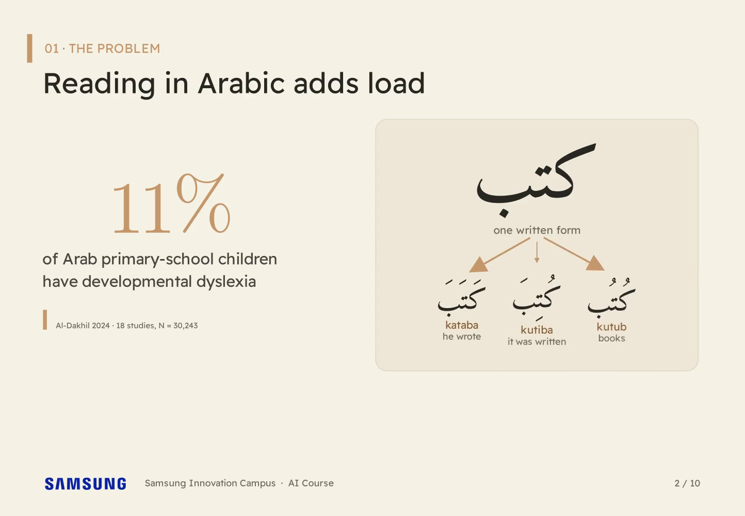
Notes:
[Sanad] Step 1 (11% counts up; كتب splits into kataba, kutiba, kutub)
About eleven percent of Arab primary-school children have dyslexia, and Arabic doesn't help: these letters can be kataba, kutiba or kutub, because short vowels aren't written.

Slide 3
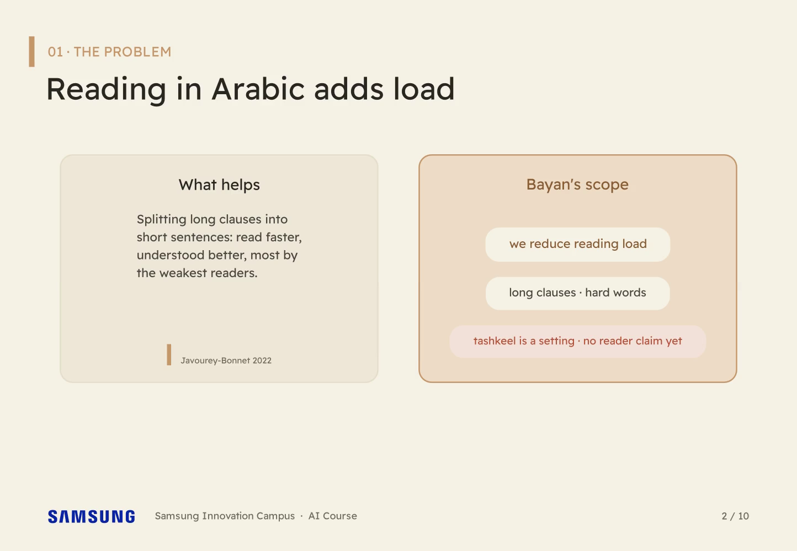
Notes:
Step 2 (Left: shorter clauses help the weakest readers most. Right: our scope)
Shorter clauses help the weakest readers most. So Bayan reduces reading load: long clauses, hard words. Tashkeel is a setting in the app, and we don't yet claim it helps readers with dyslexia.

Slide 4
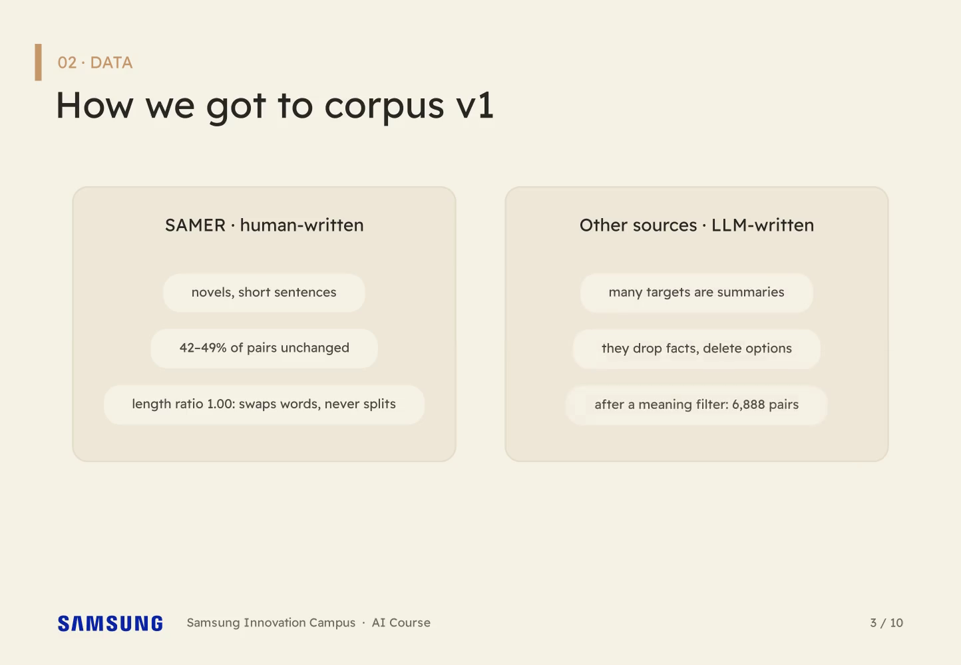
Notes:
[Sanad] Step 1 (Two cards: SAMER (novels, half unchanged, word swaps) and other LLM-written sources (summaries))
We started with what existed. SAMER is novels: half its pairs are unchanged, and it swaps words but never splits sentences. The other sources mostly summarised.

Slide 5
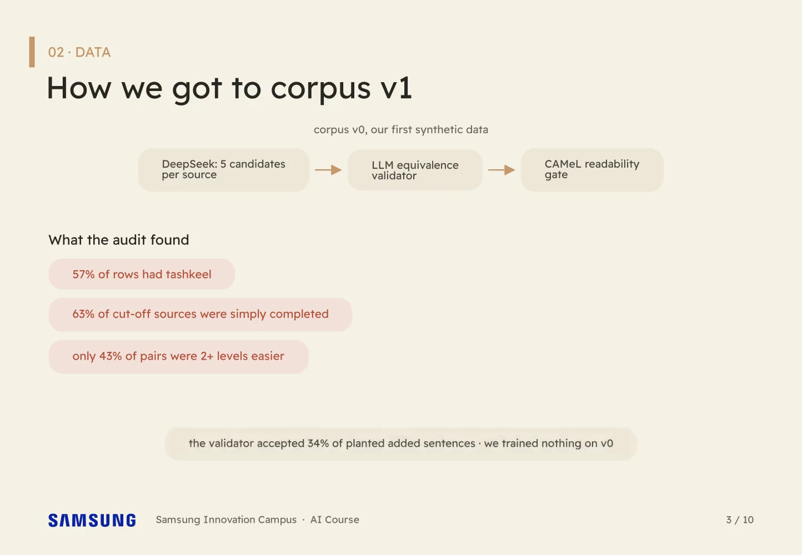
Notes:
Step 2 (Corpus v0: DeepSeek -> validator -> readability gate; three red chips; validator accepted 34% of planted additions)
So we wrote our own with DeepSeek. The audit was humbling: tashkeel in fifty-seven percent of rows, cut-off sentences helpfully completed, a validator that waved through a third of our planted errors. We trained nothing on it.

Slide 6
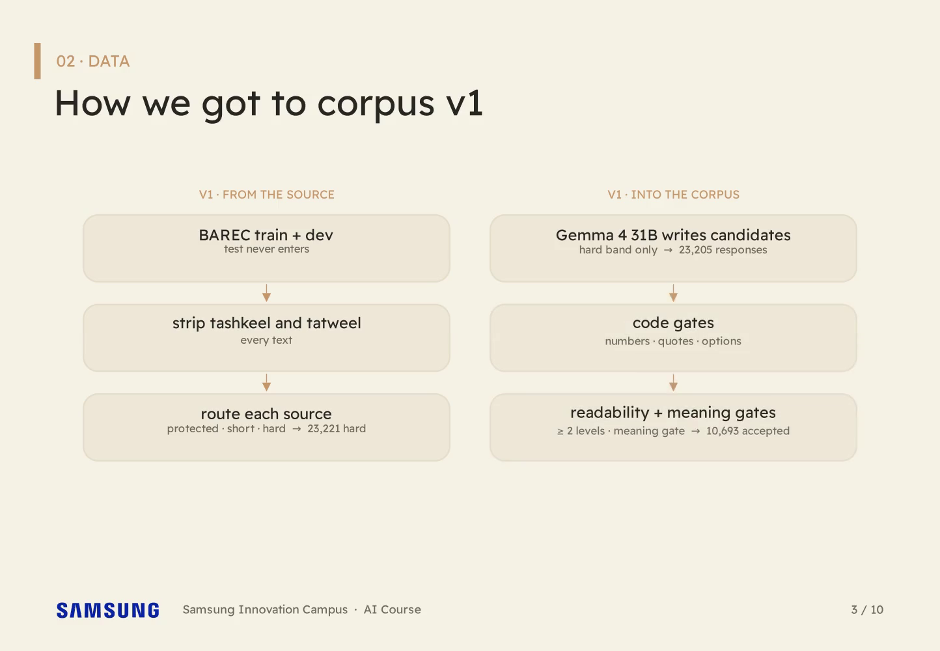
Notes:
Step 3 (Pipeline v1: BAREC -> strip tashkeel -> route -> Gemma 4 31B -> code, readability and meaning gates)
Corpus v1 starts from BAREC, strips tashkeel, sets protected and short text aside, and has Gemma 4 31B rewrite the hard sentences behind three gates.

Slide 7
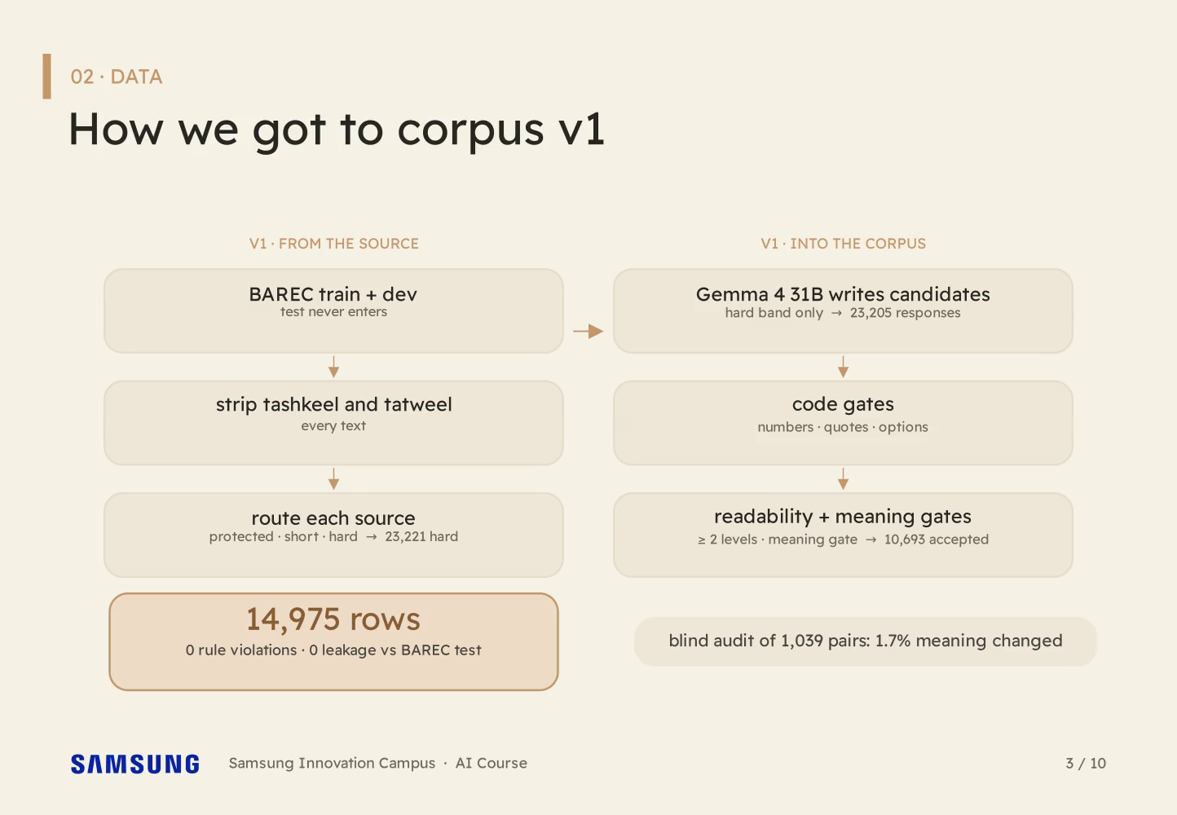
Notes:
Step 4 (14,975 rows lock in; audit badge: 1.7% meaning changed)
Fourteen thousand nine hundred seventy-five pairs survived. A blind audit found one point seven percent with changed meaning. We'll take it.

Slide 8
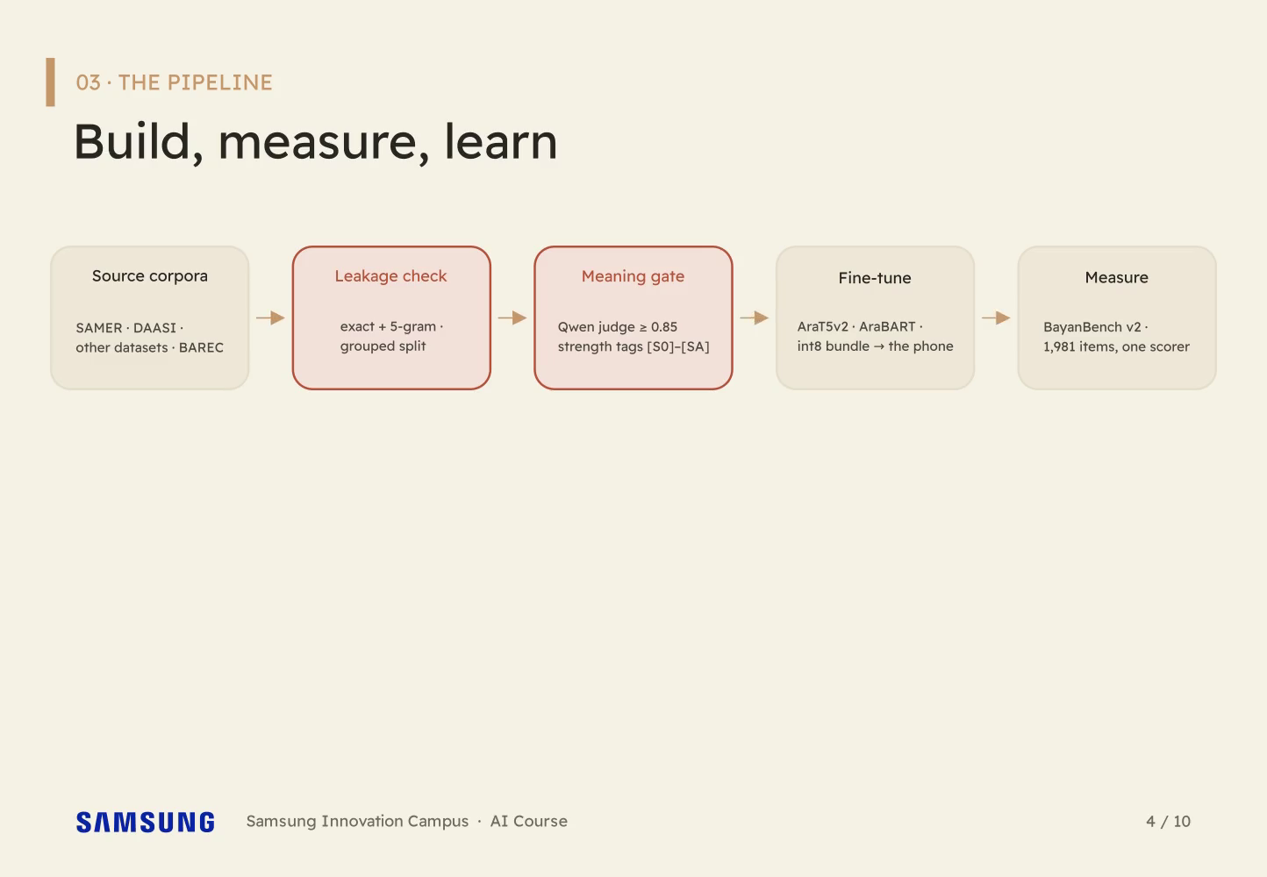
Notes:
[Sanad] Step 1 (Five connected stages: sources, leakage check, meaning gate, fine-tune, measure)
One pipeline carried every version. The sources pass a leakage check, then a meaning gate set at point eight five, then fine-tuning, then measuring on BayanBench.

Slide 9
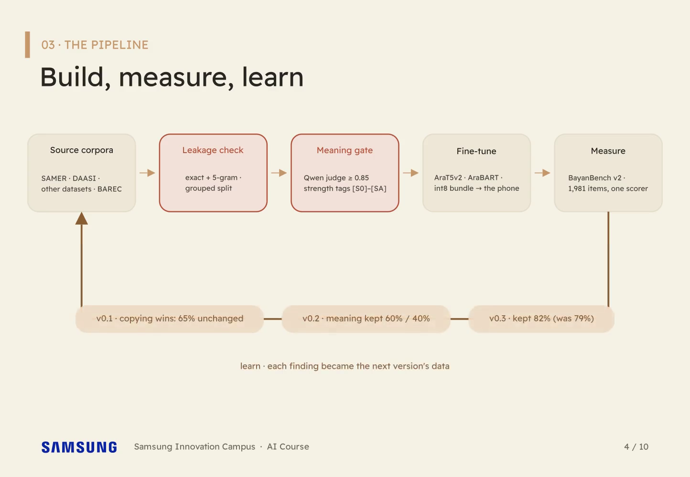
Notes:
Step 2 (A feedback loop closes back on the sources, carrying the three version findings)
And the loop is the point: every measurement came back as the next version's data. v0.1 taught us that copying wins and the model only swaps words. v0.2 taught us that meaning breaks first. v0.3 rebuilt the data around those two findings, and it keeps meaning in eighty-two percent of outputs.

Slide 10
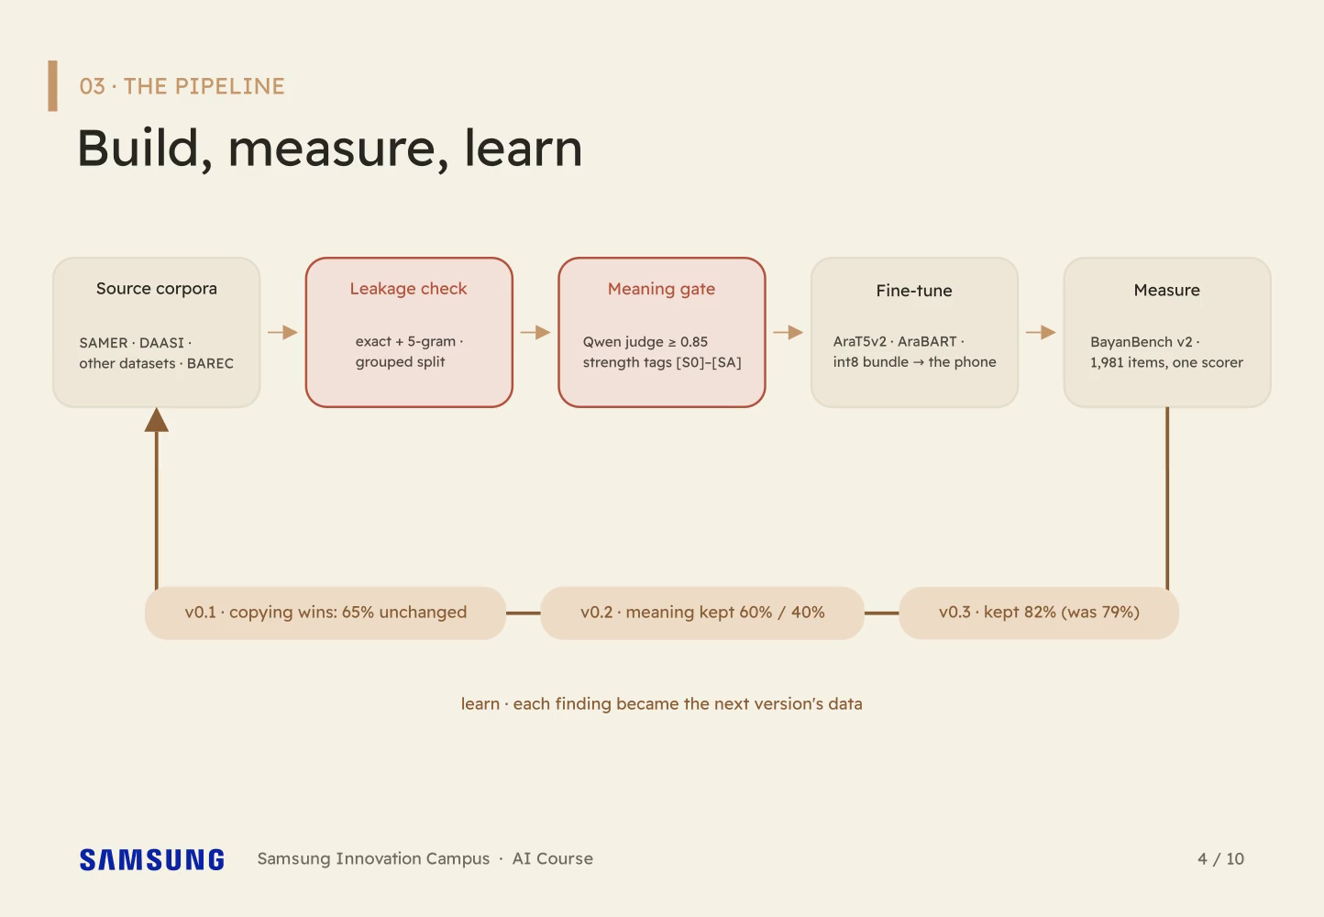
Notes:
Step 3 (A feedback loop closes back on the sources, carrying the three version findings)
And the loop is the point: every measurement came back as the next version's data. v0.1 taught us that copying wins and the model only swaps words. v0.2 taught us that meaning breaks first. v0.3 rebuilt the data around those two findings, and it keeps meaning in eighty-two percent of outputs.

Slide 11
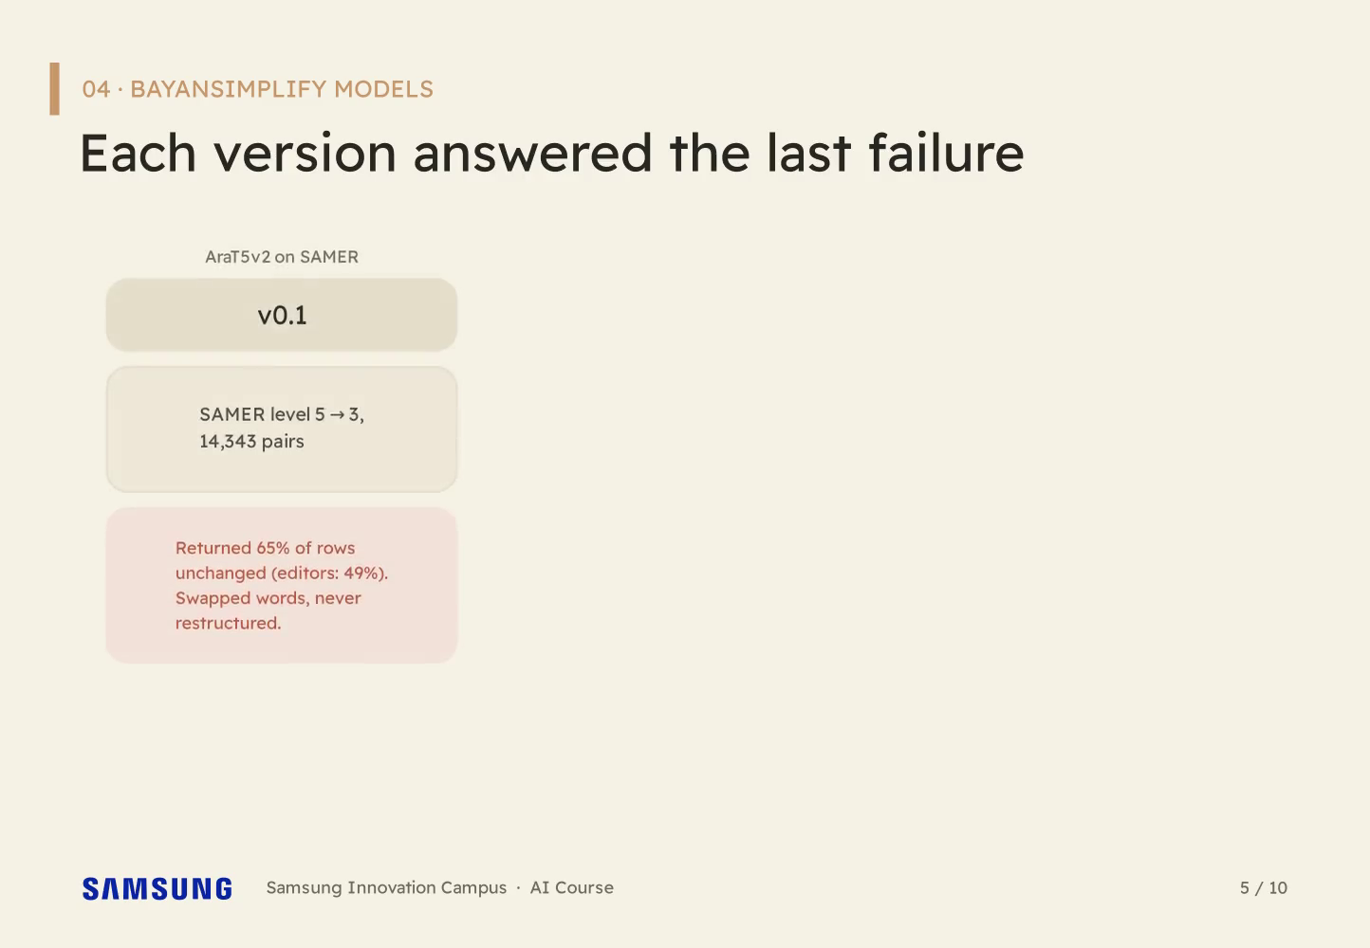
Notes:
[Sanad] Step 1 (Lane v0.1: AraT5v2 on SAMER. Found: returned 65% of rows unchanged, swapped single words)
BayanSimplify v0.1 trained on SAMER. It returned sixty-five percent of sentences untouched, where editors leave forty-nine. Bold strategy: change nothing.

Slide 12
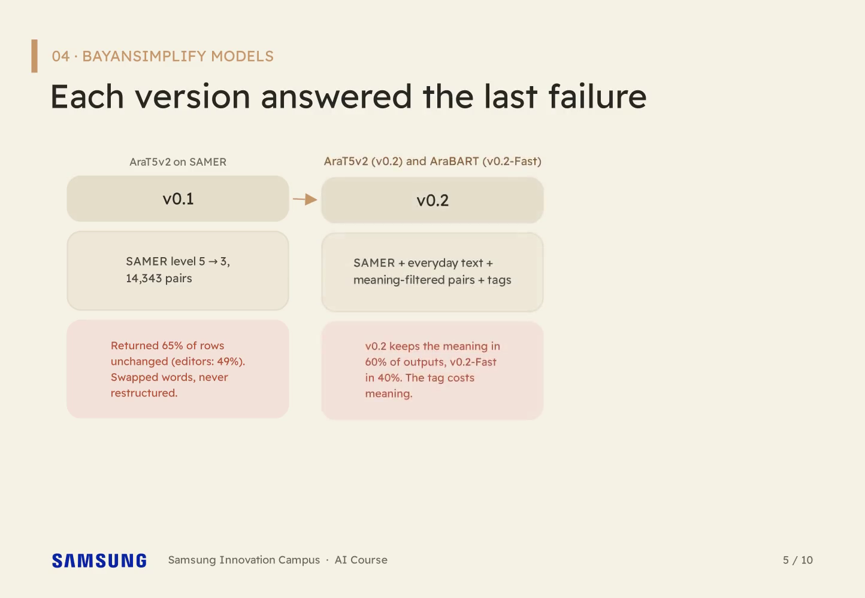
Notes:
Step 2 (Lane v0.2: two models, AraT5v2 (v0.2) and AraBART (v0.2-Fast); meaning kept 60% / 40%; the tag costs meaning)
v0.2 is two models, AraT5v2 and AraBART, trained with everyday text and strength tags. They kept the meaning in sixty and forty percent of outputs. The tag costs meaning, so the app sends none.

Slide 13
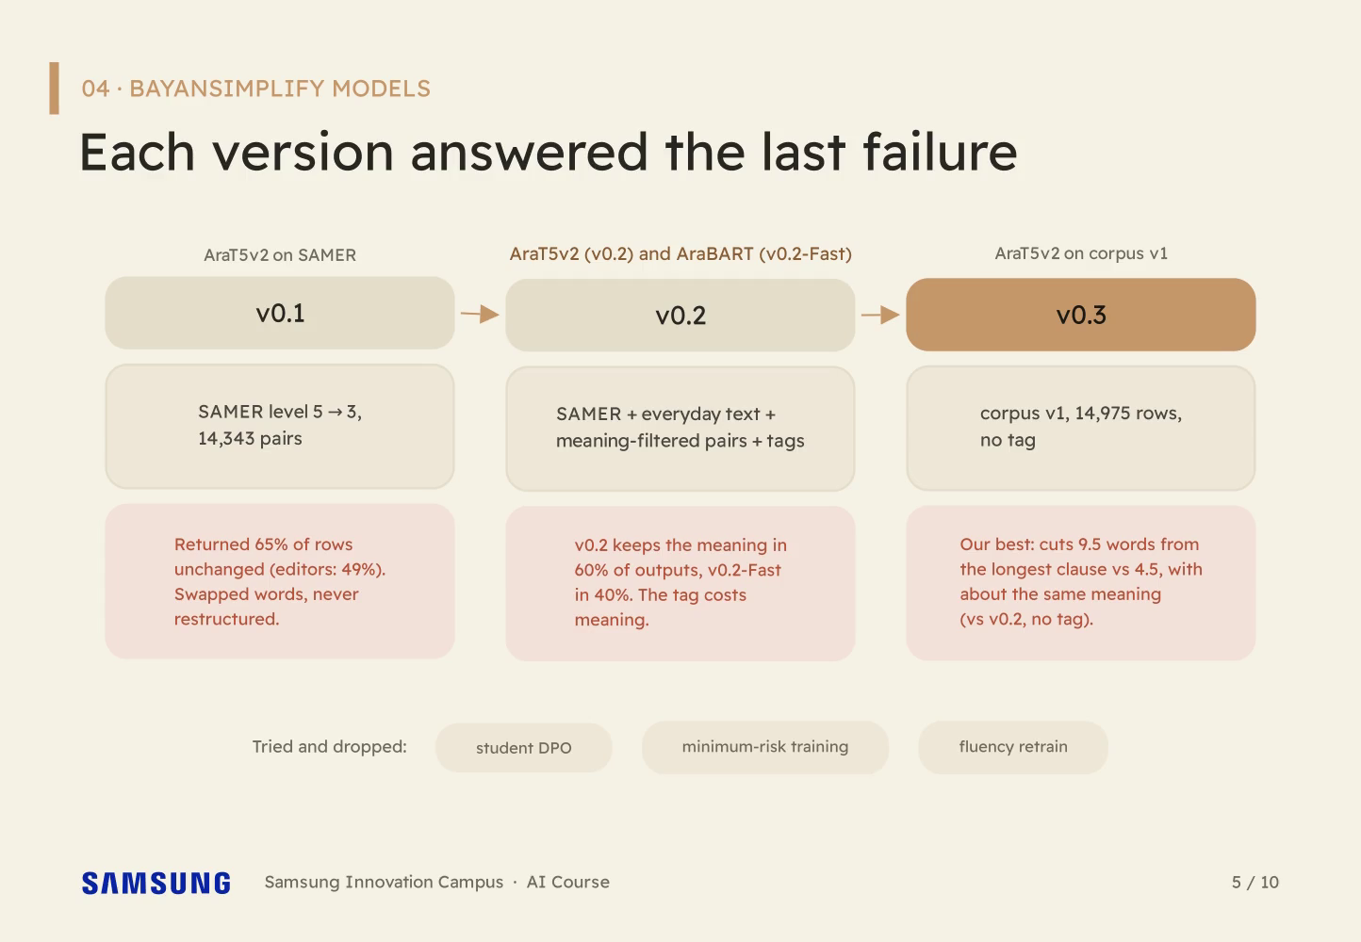
Notes:
Step 3 (Lane v0.3: AraT5v2 on corpus v1, our best: cuts 9.5 words vs 4.5, about the same meaning (vs v0.2, no tag))
v0.3 is AraT5v2 on corpus v1, no tag. As trained, it cuts twice the words of v0.2 and keeps about the same meaning.

Slide 14
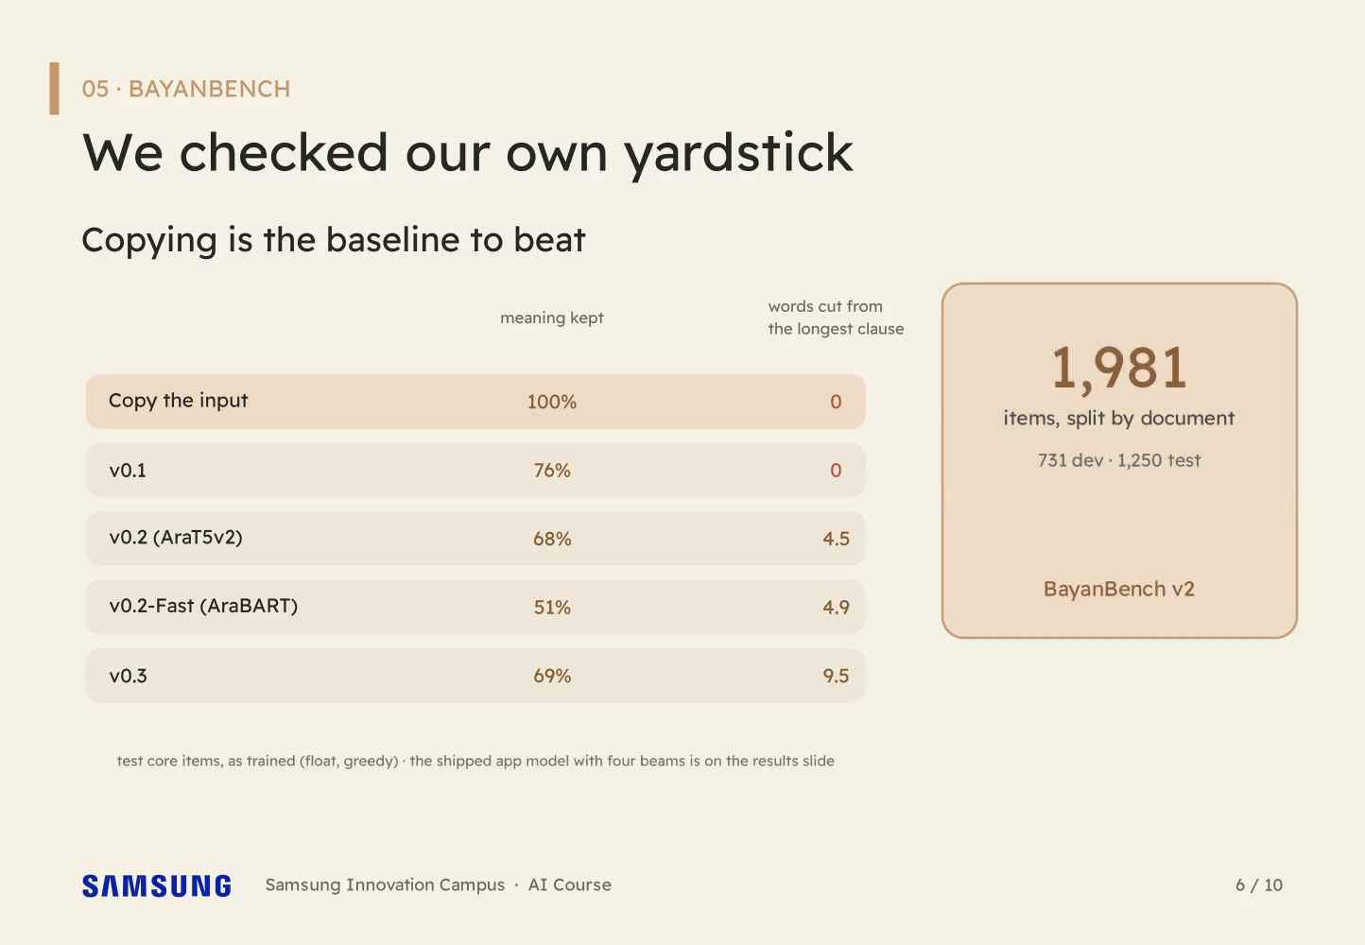
Notes:
[Sanad] Step 1 (Copy baseline table: copy 100% / 0; v0.1 76% / 0; v0.2 68% / 4.5 and v0.2-Fast 51% / 4.9; v0.3 69% / 9.5)
How do we know a rewrite is good? Copying keeps all the meaning and simplifies nothing, which is how a lazy model would win. v0.1 nearly managed it: seventy-six percent kept, no words cut from the longest clause. So we built BayanBench.

Slide 15
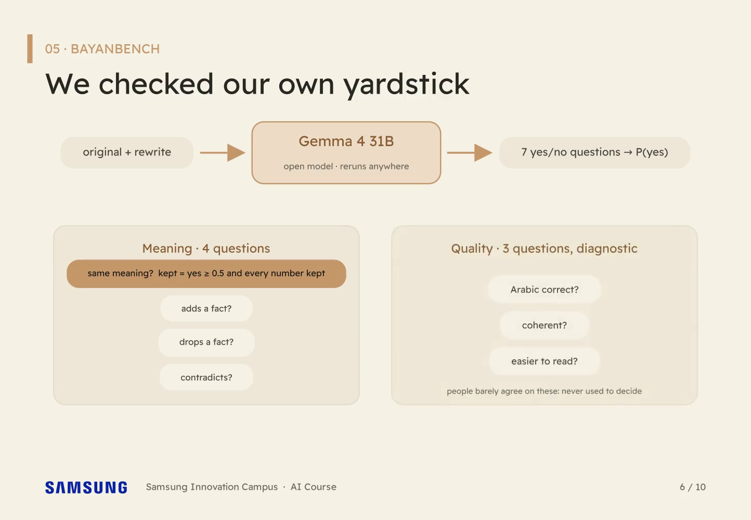
Notes:
Step 2 (Gemma 4 31B reads original + rewrite and answers 7 yes/no questions: 4 on meaning, 3 on quality)
Meaning comes from Gemma 4 31B, an open model. It reads the original and the rewrite and answers seven yes-or-no questions: four about meaning, three about quality.

Slide 16
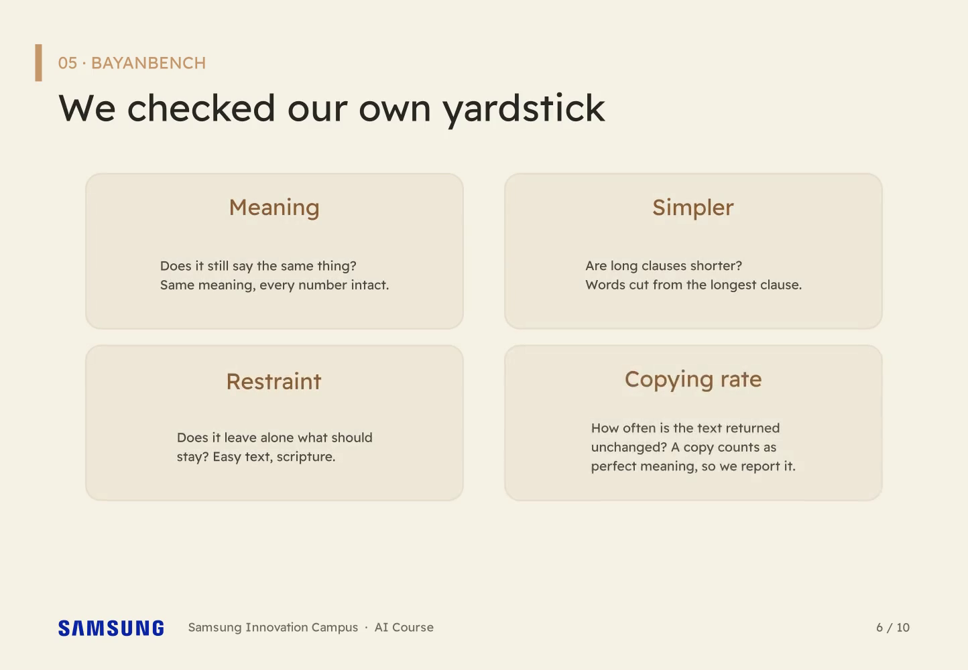
Notes:
Step 3 (Four measures in a square: meaning, simpler, restraint, copying rate)
Four measures, scored separately. Kept means the same meaning and every number intact.

Slide 17
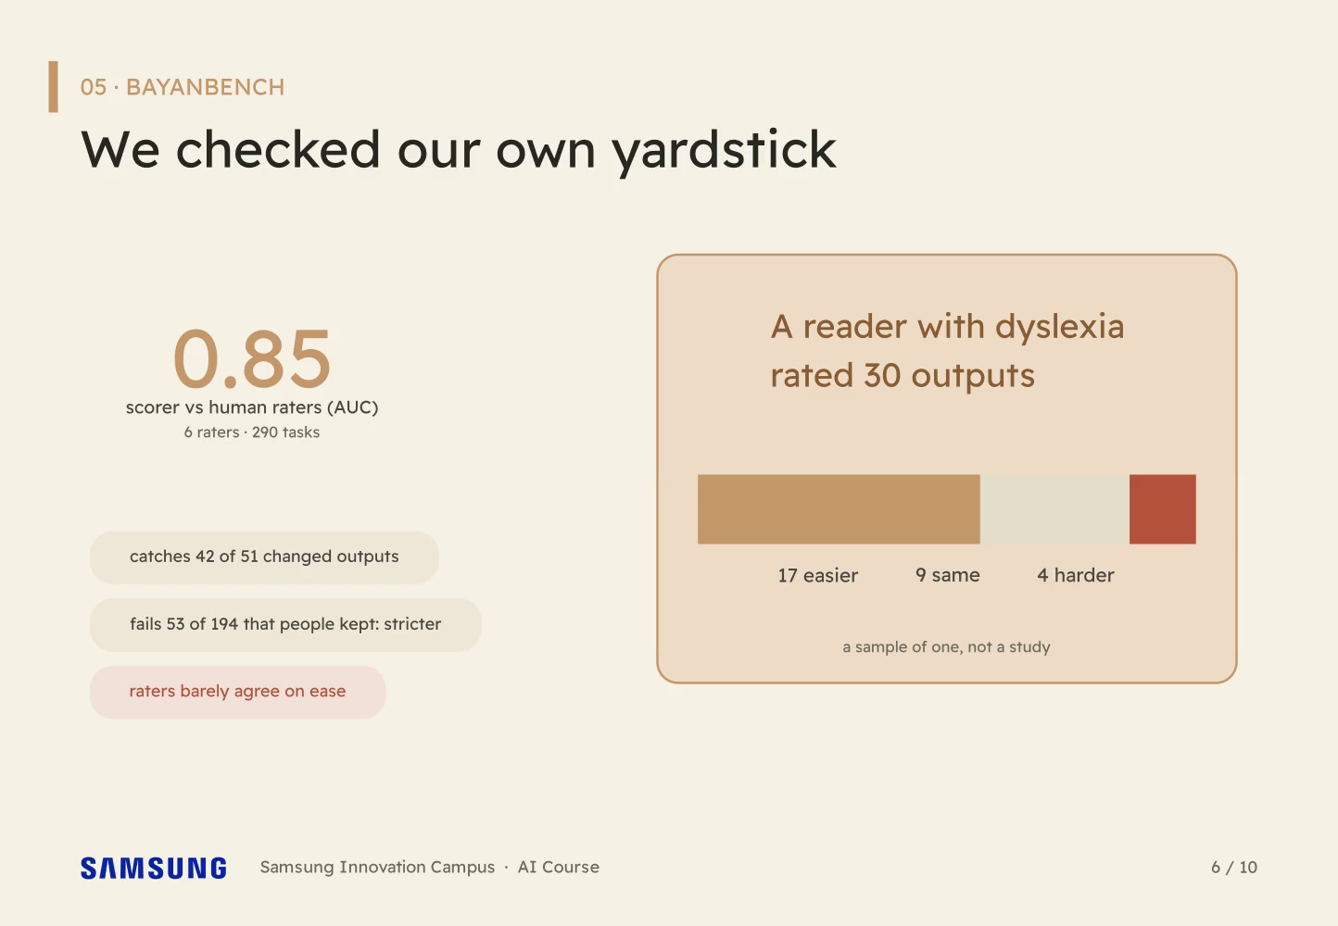
Notes:
Step 4 (People check: one reader with dyslexia rated 30 outputs (17 easier, 9 same, 4 harder); scorer AUC 0.85)
Do people agree with the scorer? Six raters, two hundred ninety tasks: zero point eight five. One reader with dyslexia rated thirty outputs too: seventeen easier, four harder.

Slide 18
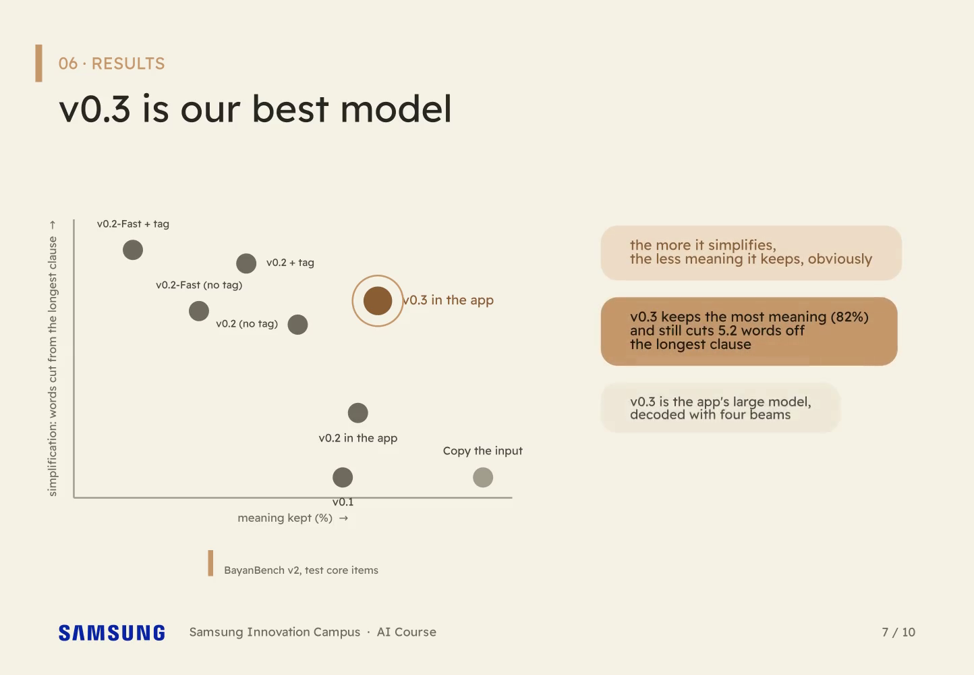
Notes:
[Sanad] Step 1 (Scatter: v0.3 in the app keeps the most meaning (82%) and cuts 5.2 words)
More simplification usually means less meaning. v0.3 breaks the pattern: in the app it keeps the most meaning, eighty-two percent, and still cuts five words off the longest clause.

Slide 19
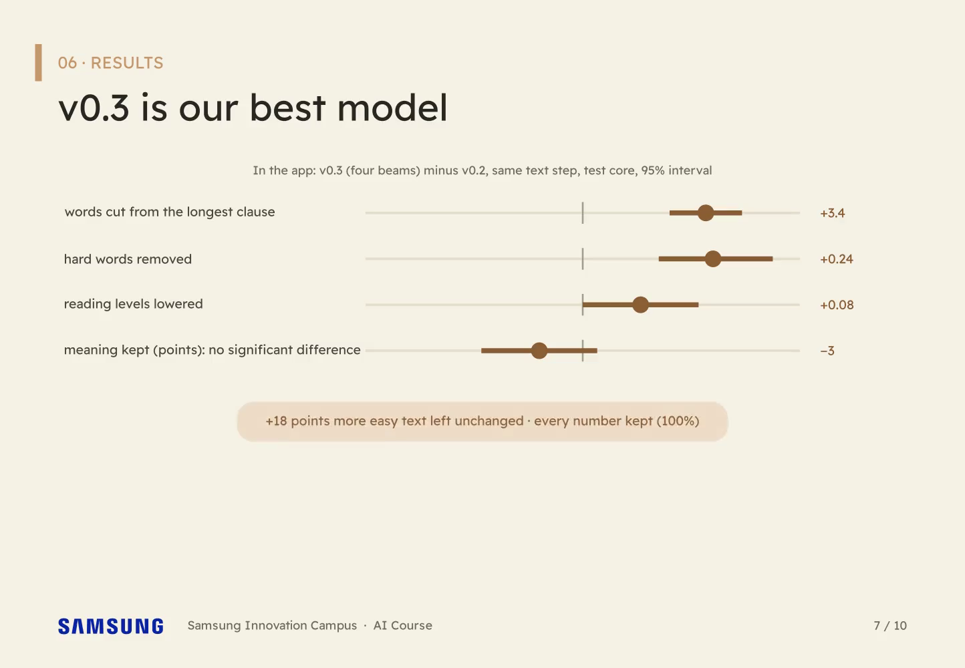
Notes:
Step 2 (In the app: v0.3 minus v0.2 behind the same checks: +3.4 words, harder words out, meaning kept as well (not significant))
Against v0.2 behind the same checks, it cuts three and a half more words off the longest clause, removes more hard words, and keeps the meaning as well. Not significantly different.

Slide 20
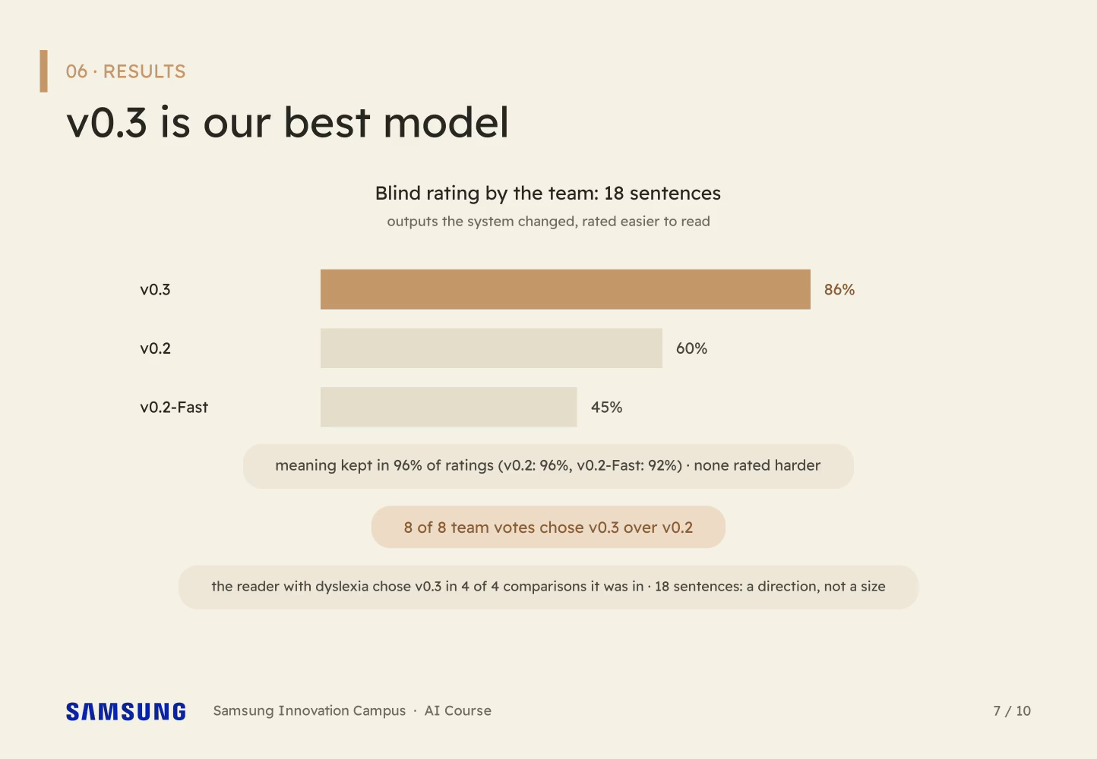
Notes:
Step 3 (Blind rating, 18 sentences: v0.3 easier on 86% of changed outputs vs 60%; 8 of 8 votes)
People agree. In a blind rating, the team found v0.3's changed outputs easier eighty-six percent of the time, against sixty for v0.2, and the reader with dyslexia chose v0.3 in every comparison it was in.

Slide 21
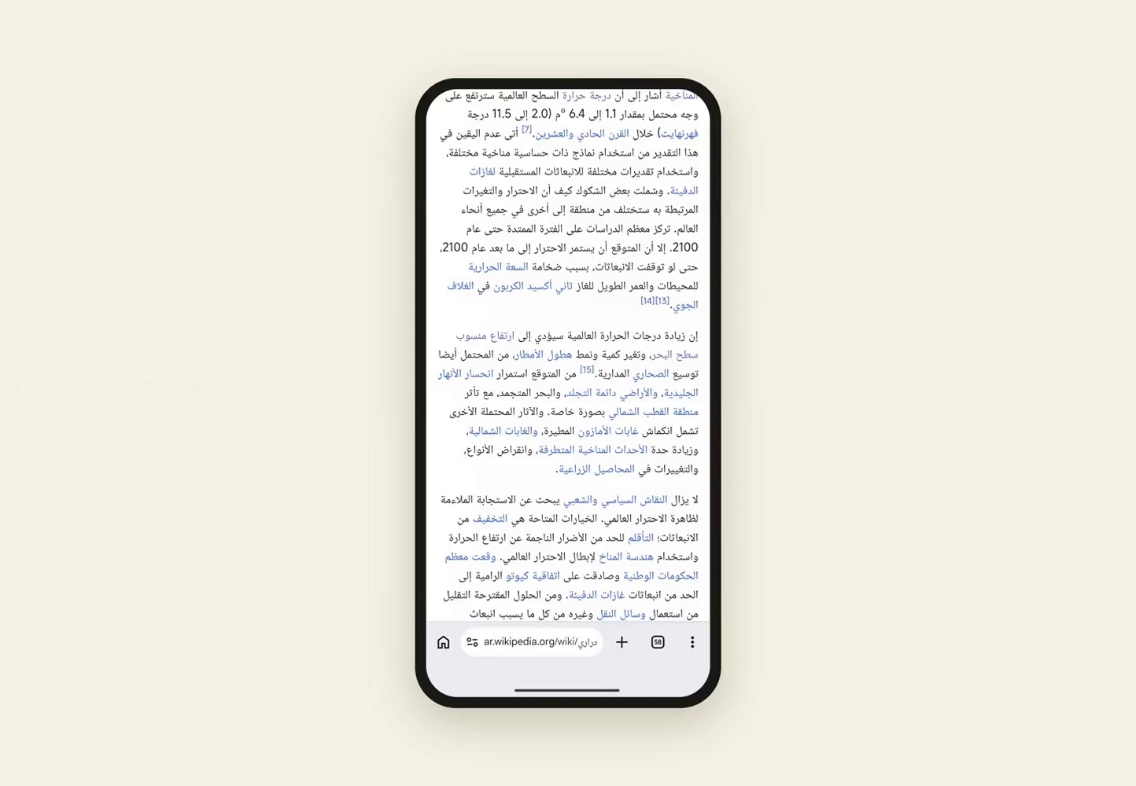
Notes:
[Sanad] Step 1 (Heading 'What the app does' and the video recording under it)
On a phone: select, tap tabseet, and it reads aloud. Scripture never reaches the model, and code checks that numbers survive.

Slide 22
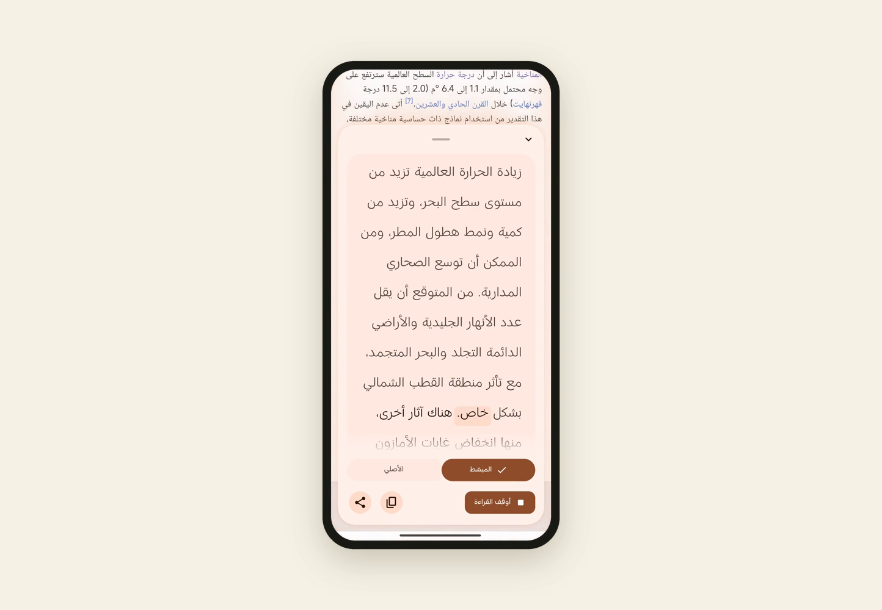
Notes:
Step 2 (Heading 'What the app does' and the video recording under it)
On a phone: select, tap tabseet, and it reads aloud. Scripture never reaches the model, and code checks that numbers survive.

Slide 23
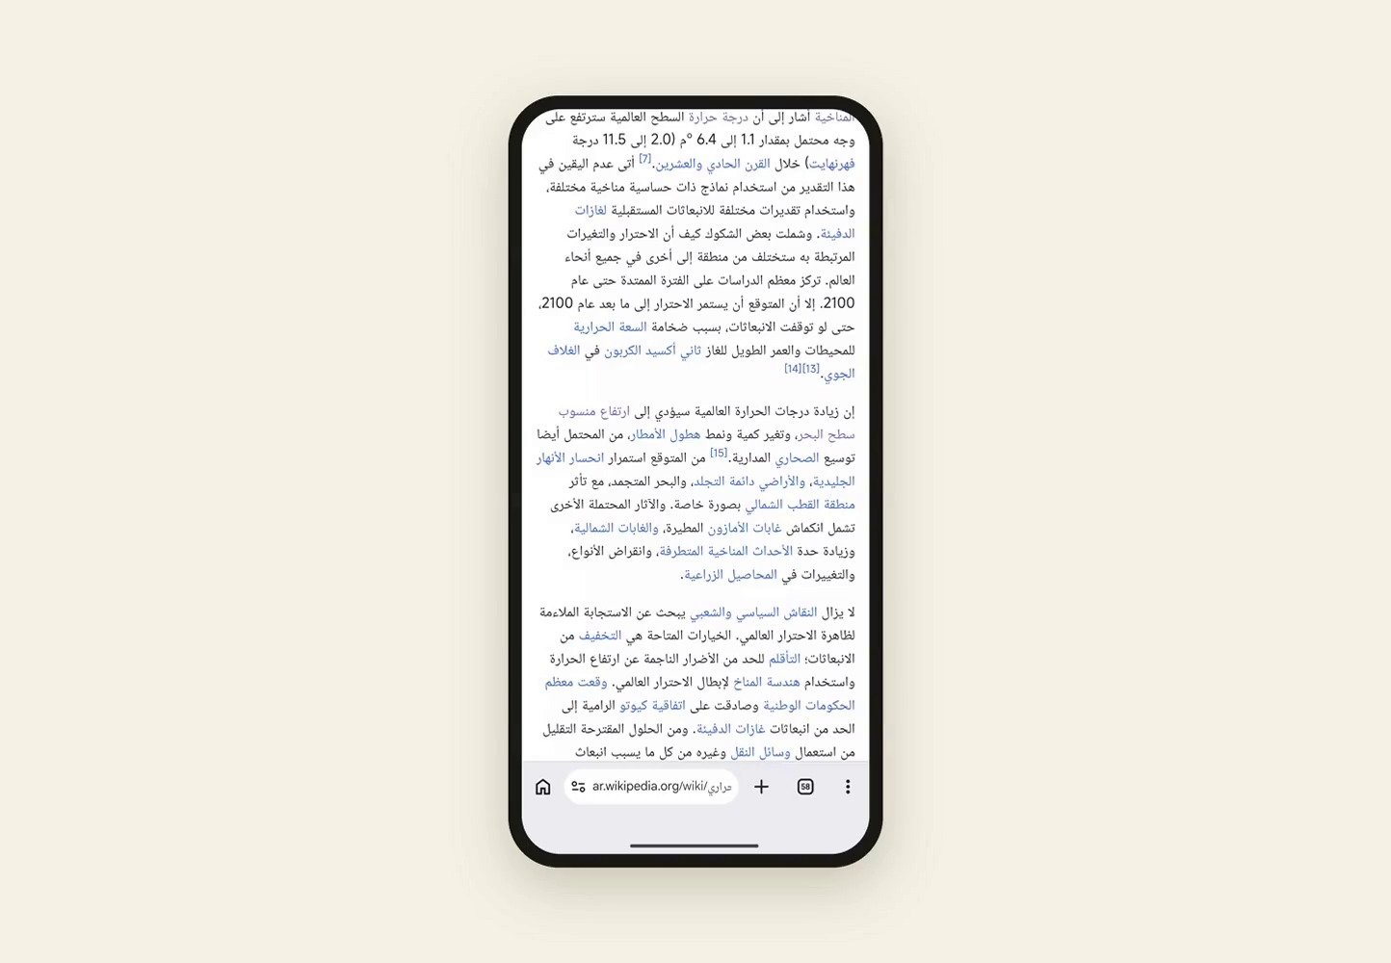
Notes:
Step 3 (Heading 'What the app does' and the video recording under it)
On a phone: select, tap tabseet, and it reads aloud. Scripture never reaches the model, and code checks that numbers survive.

Slide 24

Notes:
[Sanad] Step 1 (Logo and 'Simplify where you read.')
Bayan: simplify where you read.

Slide 25

Notes:
Step 2 (Three limit chips and the next step)
What we can't claim: no reader has used it, our scorer is stricter than people, and our human comparison is eighteen sentences. Next, a reading study. Thank you!

