Slide 1

American Modelica Conference · October 12, 2026
10:00–10:05
Hands-On with Rumoca
James Goppert
Purdue University · School of Aeronautics and
Astronautics
Georgia Tech · 10:00–13:00
github.com/CogniPilot/rumoca_workshop_amc2026
01
PURDUE · AERONAUTICS & ASTRONAUTICS / GEORGIA TECH · AMC 2026
Notes:
10:00–10:05
Welcome to Hands-On with Rumoca. Introduce Purdue University, School of Aeronautics and Astronautics, and the Georgia Tech venue. Point to the QR and ask attendees to keep the participant worksheet open. No aerospace background is required. Allow five minutes for arrivals and orientation; announce the optional app challenge on the next slide.

Slide 2
OPEN APP CHALLENGE · demos + audience vote at 12:50
10:05–10:10
Run the core. Build something extra.
Core: edit a model, fit data,
optimize a trajectory
Apply Rumoca to a problem
you care about
Optional idea: a Three.js
Artemis-style launch
Audience favorite wins a
CogniPilot stocking cap
Enter by 12:40 · up to 5 demos · CHALLENGE.md · APP_PROMPT.md
02
PURDUE · AERONAUTICS & ASTRONAUTICS / GEORGIA TECH · AMC 2026
Notes:
10:05–10:10
Announce the challenge now: “Power users: apply Rumoca to a problem you care about. Use your coding agent during downtime and independent work, put the app on your GitHub, and show one working interaction. The prize is a free CogniPilot stocking cap, chosen by an audience hand vote.” The core Modelica → JAX → CasADi exercises remain the main activity and need no agent or GitHub account. Point to APP_PROMPT.md for creative inspiration: an Artemis-inspired launch experience with Three.js visuals, or a flight lab extending rumoca_fixed_wing. These are optional prompts, not assigned projects; no Artemis app is supplied. Encourage participants to choose their own question and design. Full AD-based fixed-wing MPC is ambitious and optional. Entries close at 12:40: collect GitHub link, problem, agent/tool used and elapsed build time with estimates labeled. Up to five ready apps present at 12:50 for 45 seconds each; if more are ready, use a random draw plus a backup, with order drawn too. Selection is not a quality judgment; share all entry links in a gallery. Announce the selection by 12:45. Each demo names the agent and build time, contribution, working interaction and checked result. Ask for a show of hands for Modelica/JAX/CasADi experience. Today's data are synthetic and the trajectory is open loop.

Slide 3
Why we built Rumoca
10:10–10:15
Make declared physics reusable
A physical model should travel with the question.
Simulation → identification → control → experiment
Open tools and explicit mathematics help us compare
results.
Rumoca connects Modelica to modern computational tools.
03
PURDUE · AERONAUTICS & ASTRONAUTICS / GEORGIA TECH · AMC 2026
Notes:
10:10–10:15
Explain the motivation: carry declared physical equations into simulation, parameter fitting and constrained optimization. Rumoca is an evolving open mathematical compiler; this workshop demonstrates a small tested workflow. OpenModelica, Dymola, Modelon, JuliaHub/Dyad, FMI, JAX and CasADi offer ecosystem and interoperability opportunities.

Slide 4
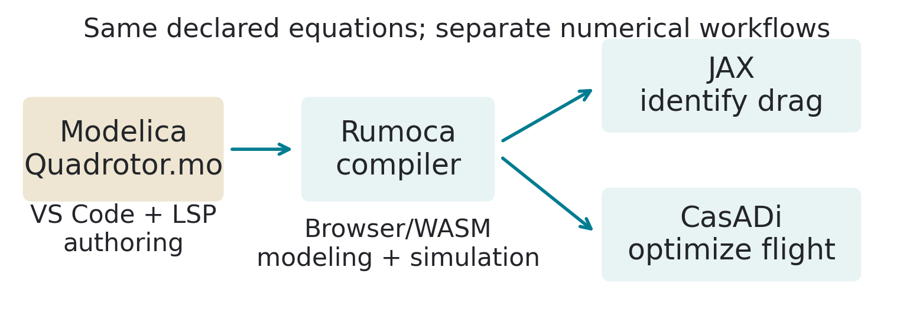
Verified workshop architecture
10:15–10:20
Declare once. Ask different questions.
Same Quadrotor.mo equations, two generated Python representations
Modelica declares physics · Rumoca compiles · backends compute.
04
PURDUE · AERONAUTICS & ASTRONAUTICS / GEORGIA TECH · AMC 2026
Notes:
10:15–10:20
Explain that VS Code is the authoring/LSP path and the playground is browser modeling/simulation. Python 0.10.2 exports JAX and CasADi; deployed browser 0.8.13 is separate. Common Python code performs integration and builds optimization objectives, not another plant. Full language/backends are not certified by this example. Native compiler AD is not today's demonstration.

Slide 5
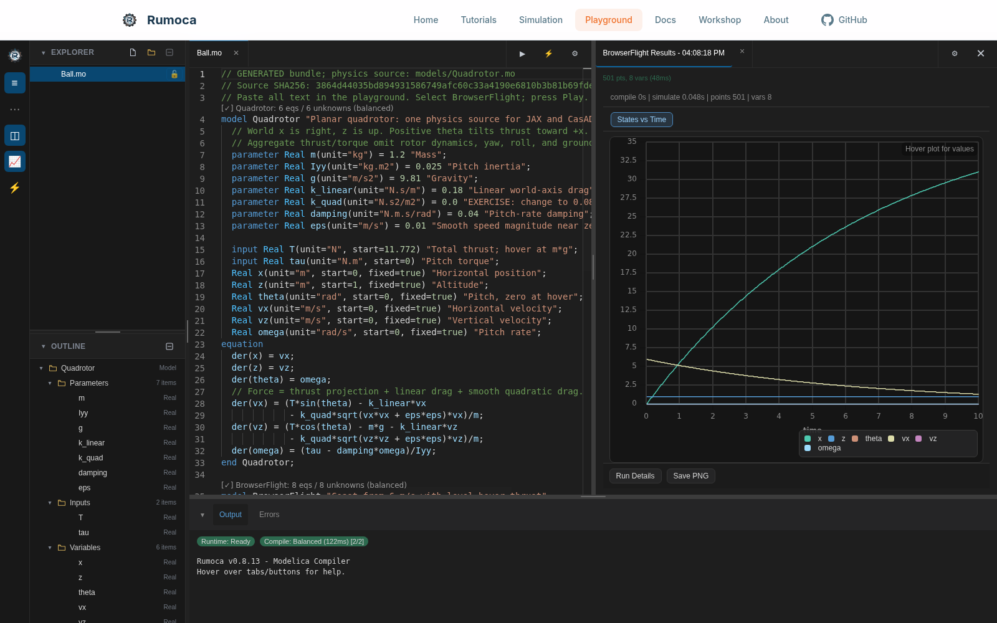
LIVE DEMO · zero-install modeling
10:20–10:25
Everyone gets a browser plot
Open the playground
Paste the complete
browser bundle
Gear → BrowserFlight
→ Play
You should see BrowserFlight Results and a plot.
05
PURDUE · AERONAUTICS & ASTRONAUTICS / GEORGIA TECH · AMC 2026
Notes:
10:20–10:25
Exact URL https://rumoca.cognipilot.org/playground/. Raw source https://github.com/CogniPilot/rumoca_workshop_amc2026/blob/main/browser/Quadrotor_browser.mo. Select all inside editor, paste; gear next to Play opens simulation settings; select BrowserFlight and close settings. Screenshot records a real run. Browser is not Python/JAX/CasADi. If offline, label the screenshot as backup and continue local/demo path. Five-minute guided demo.

Slide 6
Setup decision · worksheet has every link
10:25–10:30
Choose a full-workshop route
Browser: modeling and
predictions; no account
Codespaces: Python + VS
Code; login and allowance
Local uv: Python + VS
Code; pinned CPU packages
Pair or screenshare: keep
working if setup fails
Switch route after ten minutes of setup trouble.
06
PURDUE · AERONAUTICS & ASTRONAUTICS / GEORGIA TECH · AMC 2026
Notes:
10:25–10:30
Codespaces URL https://codespaces.new/CogniPilot/rumoca_workshop_amc2026?quickstart=1. Codespaces requires an account with allowance or billing enabled. Cloud qualification is recorded in VERIFICATION.md; account availability varies. Local: download/extract ZIP, install uv/extension, uv sync --frozen. Python and released editor are qualified on Linux/Windows x64 and macOS Intel/Apple Silicon. The local route uses uv and CPU packages.

Slide 7
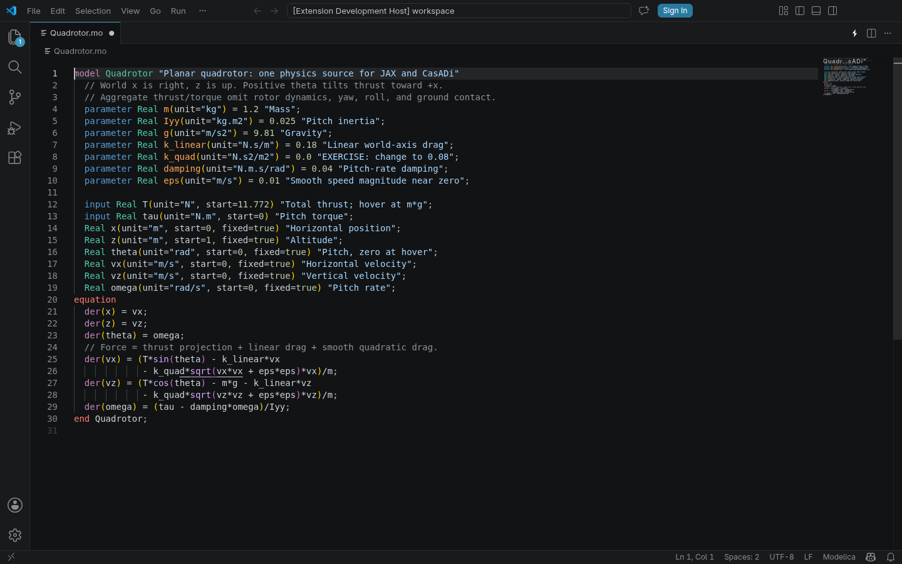
HANDS-ON · released LSP verified on four platforms
10:30–10:40
Edit with feedback. Check the pipeline.
Open
models/Quadrotor.mo
Hover m; try sin
completion
Run the smoke test;
open results/live
uv run --frozen python scripts/smoke_test.py
WORKSHOP PASS · model editor ready
07
PURDUE · AERONAUTICS & ASTRONAUTICS / GEORGIA TECH · AMC 2026
Notes:
10:30–10:40
Give participants most of these ten minutes. Verify extension ID JamesGoppert.rumoca-modelica; choose Modelica language, trust workspace per policy. Show a temporary broken expression then undo for actual syntax diagnostics. Hover, completion and diagnostics passed in real VS Code 1.119.0 hosts on all four supported OS/architecture targets; navigation and Codespaces remote activation are separate checks. Smoke runs all three commands, checks gradient/backend agreement, fits, constraints and outputs. Local measured total about 12 seconds after setup. At 10:40 move to the exercise; use pair or demo recovery if setup is incomplete. App builders can begin their independent challenge once ready.

Slide 8
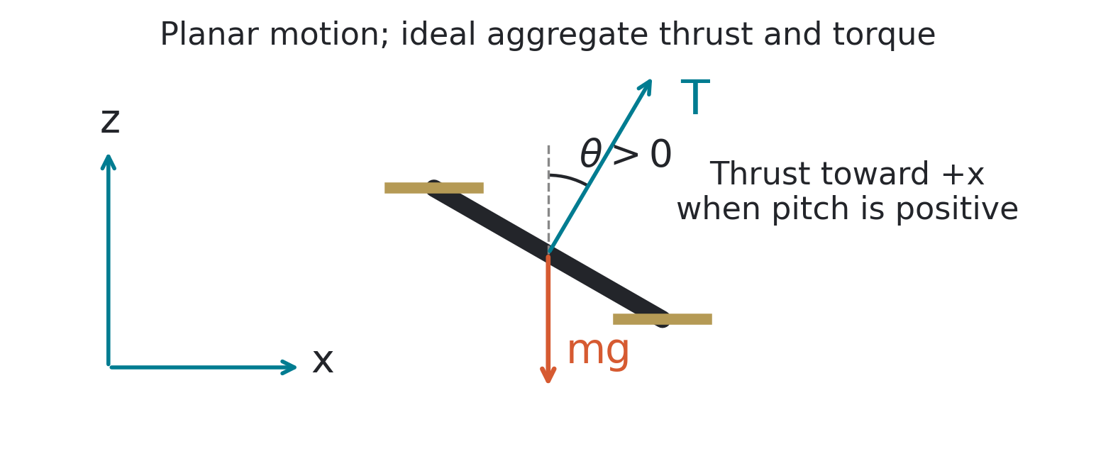
Six states · two aggregate inputs
10:40–10:45
A planar quadrotor we can inspect
World x right; z up
Positive pitch tilts
thrust toward +x
Hover: T = mg =
11.772 N
Find velocities, pitch rate, thrust and torque in the model.
08
PURDUE · AERONAUTICS & ASTRONAUTICS / GEORGIA TECH · AMC 2026
Notes:
10:40–10:45
States x,z,theta,vx,vz,omega; inputs T and tau. m=1.2 kg,Iyy=.025 kg m²,g=9.81. Diagram is generated from our convention, not a borrowed paper figure. Simplified world-axis drag; no roll/yaw/motors/wind/contact. The compact planar example keeps the equations inspectable and the computations short. Introduce pitch as the angle that directs the thrust; specialist aerodynamics is optional.

Slide 9
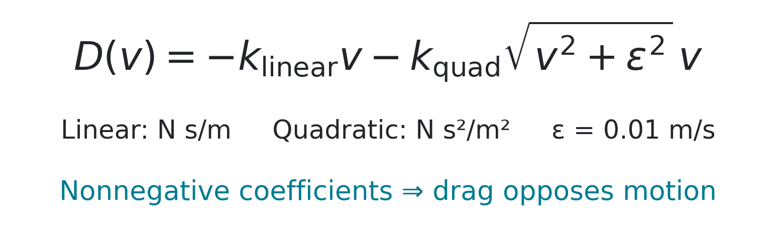
HANDS-ON · predict before running
10:45–10:55
Your first engineering change: drag
Change k_quad = 0.0 to 0.08, save, then simulate.
uv run --frozen python scripts/simulate.py
What changes at high speed? What about negative velocity?
09
PURDUE · AERONAUTICS & ASTRONAUTICS / GEORGIA TECH · AMC 2026
Notes:
10:45–10:55
Explain units kl N s/m,kq N s²/m²,epsilon .01 m/s. Smooth componentwise law approximates |v|v and never adds energy for nonnegative coefficients; Lean proves the signs and smoothing bound. It differs from Faessler et al.'s body-frame rotor-drag model; do not claim their flatness theorem. Allow 7–8 minutes editing/predicting. Browser users make the same coefficient change and Play again. Default parameter changes affect simulation; fitting estimates parameters explicitly.

Slide 10
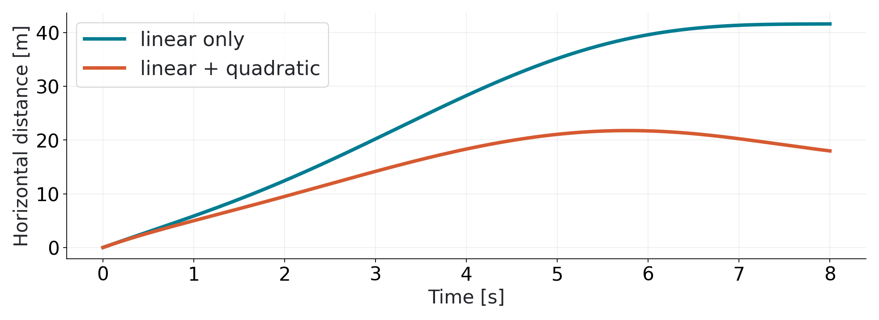
HANDS-ON · same prescribed Python inputs
10:55–11:00
More drag, less distance
Reference at 8 s: 41.60 m → 17.97 m
Compare your current default with the two reference cases.
10
PURDUE · AERONAUTICS & ASTRONAUTICS / GEORGIA TECH · AMC 2026
Notes:
10:55–11:00
Open the actual live plot and ask participants to explain the sign. The slide plot uses emitted JAX equations and reference parameters; not real flight data. Browser wrapper coasts at level hover, so its numbers differ. Optional kl=.30 then restore .18. Instructor solution is an inheritance override, not a second dynamics implementation. Take two questions. End on time for break.

Slide 11
Ten full minutes
11:00–11:10
Break · back at 11:10
Keep your editor and terminal open.
Recovery: results/reference/simulation.png
Next: fit drag from noisy flight data.
Worksheet and commands: WORKSHOP.md · scan the opening QR.
11
PURDUE · AERONAUTICS & ASTRONAUTICS / GEORGIA TECH · AMC 2026
Notes:
11:00–11:10
Actually pause for ten minutes. Help only small recovery questions; avoid turning the break into a lecture. Browser-only attendees can pair for the next exercise. Keep the next command in the worksheet, not a wall of terminal text.

Slide 12
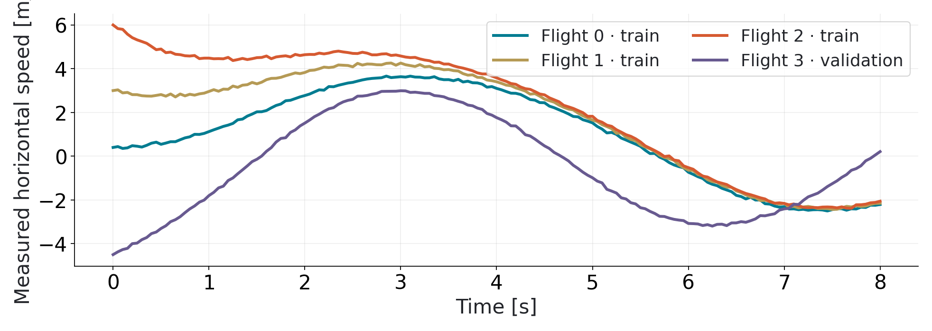
Synthetic data · seed 20261012
11:10–11:20
Known experiment. Unknown coefficients.
Three training flights; one held-out flight. 20 Hz, 8 s each.
Speed variation helps separate linear and quadratic drag.
12
PURDUE · AERONAUTICS & ASTRONAUTICS / GEORGIA TECH · AMC 2026
Notes:
11:10–11:20
Data generated by Rumoca CasADi + independent adaptive DOP853; JAX fit uses RK4. Position noise .025 m; velocity .035 m/s; angles/rates also noisy, but only exact initial angles/rates enter the fit. Commands and initial state assumed known. Holdout has different excitation and negative initial speed. The data are synthetic. Explain how real logs would bring actuator timing, wind and sensor bias. Truth is reporting only.

Slide 13
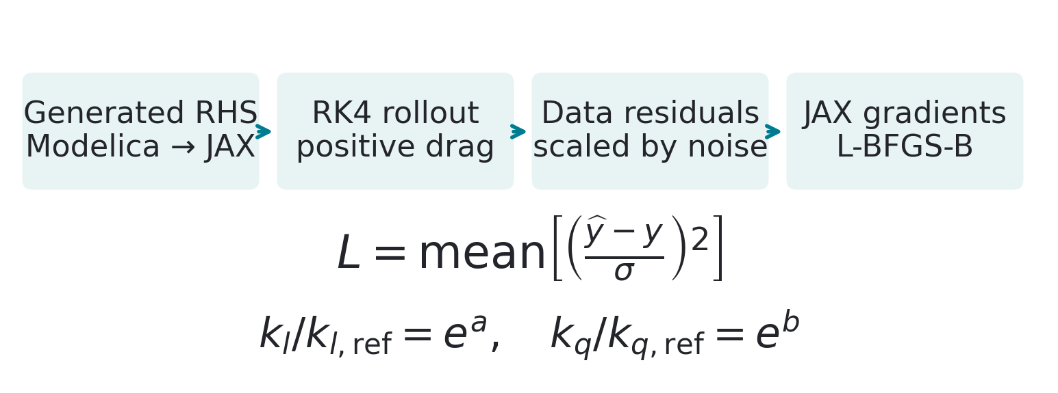
JAX autodiff through generated physics + RK4
11:20–11:30
Differentiate the prediction error
Positive parameters; noise-scaled loss; bounded optimization
JAX provides gradients. SciPy updates the coefficients.
13
PURDUE · AERONAUTICS & ASTRONAUTICS / GEORGIA TECH · AMC 2026
Notes:
11:20–11:30
Show fit script's p_from_log, residual, value_and_grad, minimize. Each coefficient divided by one native SI unit equals exp(log parameter), so the logarithm is dimensionless; fitted bounds .001..2 in native units. Mean residual² divided by known noise variance is dimensionless, over x,z,vx,vz. Avoid differentiating noisy acceleration estimates. JAX derivative is of the implemented discrete rollout; finite differences are checks. The system ID is not an autodiff proof of model correctness. Participants can run the next command and inspect the provided algorithm.

Slide 14
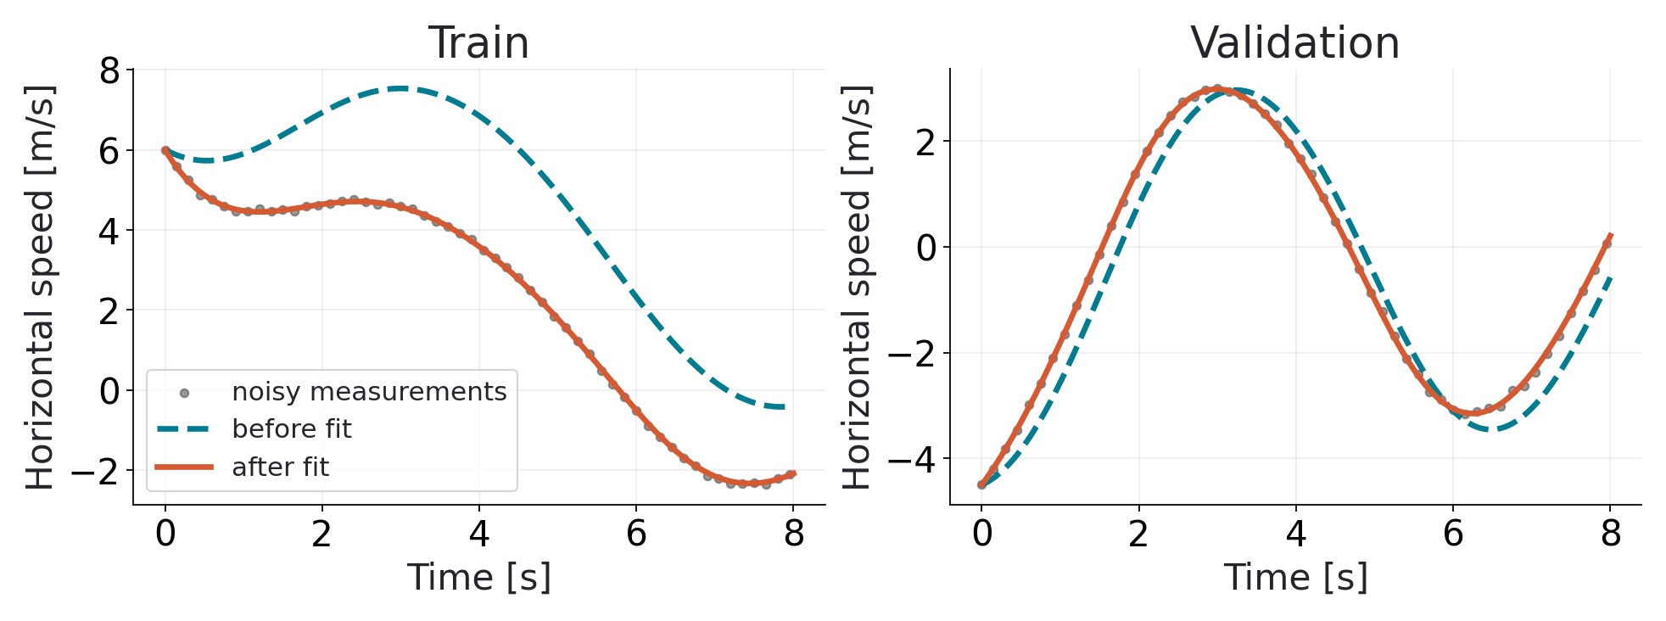
HANDS-ON · estimates ≈ 0.18042 and 0.07991
11:30–11:50
Run the fit. Test the held-out flight.
Open fit_drag.png and fit_drag.json; compare before and after.
uv run --frozen python scripts/fit_drag_jax.py
Two coefficients · lower loss · improved held-out prediction
14
PURDUE · AERONAUTICS & ASTRONAUTICS / GEORGIA TECH · AMC 2026
Notes:
11:30–11:50
Give at least 15 minutes for running the fit, inspecting outputs and individual questions. Participants who finish can return to the app challenge. Reference truth kl=.18 N s/m, kq=.08 N s²/m². Loss roughly 26932→1.073, about 25000×. Read rms_by_state with separate units or noise_scaled_rms; avoid calling mixed-unit legacy RMS metres. Recovery --one-coefficient assumes known kl=.18. Stretch: different initial guess; audit already checks six. Do not use holdout to tune parameters during this exercise. If live fails, label reference plot honestly.

Slide 15
Checkpoint · go deeper at your own pace
11:50–12:00
Check your result. Keep building.
Open your before-and-after
prediction plot
Compare the held-out flight
and fitted values
Stretch: rerun from another
starting guess
App builders: keep your
prototype moving
Fit complete? Continue your app or explore the optional checks.
15
PURDUE · AERONAUTICS & ASTRONAUTICS / GEORGIA TECH · AMC 2026
Notes:
11:50–12:00
Spend two minutes showing where the result files are and eight minutes on independent work and questions. Ask whether the held-out prediction improved; no aerospace background is needed. App builders can continue the open challenge. Offer detailed gradient, excitation and proof discussion only when requested, using MATH_REVIEW.md and Appendix A1–A2. The audit checks six starting guesses, twelve noise seeds, Jacobians, analytic coasting and re-optimized profiles. Lean checks scoped exact-real equation equality and invariants; numerical and statistical claims have separate evidence.

Slide 16
Ten full minutes
12:00–12:10
Break · back at 12:10
Keep results/live/fit_drag.json.
Next: use your coefficients to optimize a flight.
Recovery: results/reference/fit_drag.png
Same Modelica source; now compile to CasADi.
16
PURDUE · AERONAUTICS & ASTRONAUTICS / GEORGIA TECH · AMC 2026
Notes:
12:00–12:10
Ten-minute break. Confirm most pairs have fit outputs. Do not edit the model again after fitting; a source hash will require refitting if it changes. Instructor has successful reference fit and primal trajectory warm start. No Mathlib or extra packages are needed for next exercise.

Slide 17
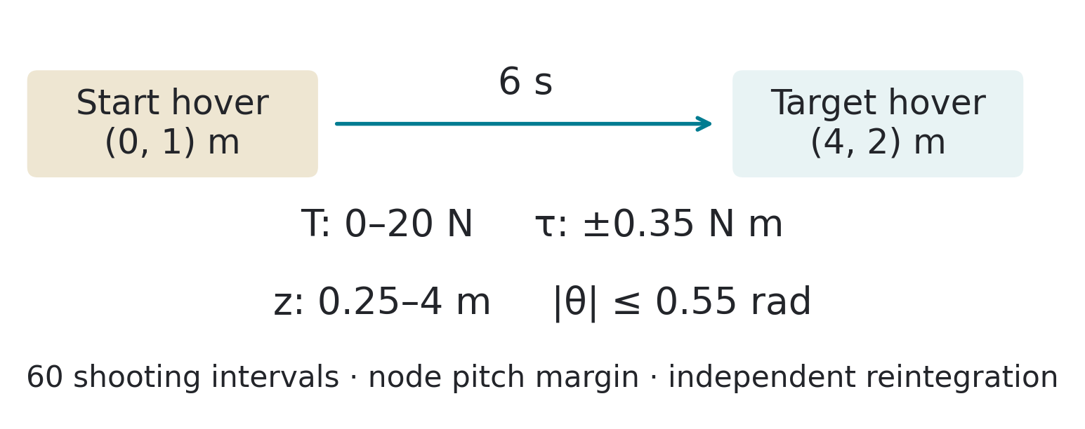
CasADi symbolic dynamics · IPOPT local NLP
12:10–12:20
Move between hovers, respect limits
(0, 1) m → (4, 2) m in
6 s
Track target; limit
effort and control
changes
Bound thrust, torque,
pitch and altitude
Identified drag is an input to this optimization.
17
PURDUE · AERONAUTICS & ASTRONAUTICS / GEORGIA TECH · AMC 2026
Notes:
12:10–12:20
Explain 60 constant-input intervals and RK4 direct multiple shooting: decision states at each node, linked by continuity constraints. Bounds: thrust 0–20 N, torque ±0.35 N m, altitude 0.25–4 m, physical pitch ±0.55 rad, node pitch ±0.54 rad. Illustrative rotor pairs: each 0–10 N, arm 0.2 m. Normalize cost with physical reference scales before choosing weights. A stored successful primal solution warm-starts the default problem. Andersson et al. 2019, section 5.4 supports the transcription; their DAE/IDAS example differs from our ODE/RK4. Local feasible result; no global-optimality, electrical-energy or real-flight claim.

Slide 18
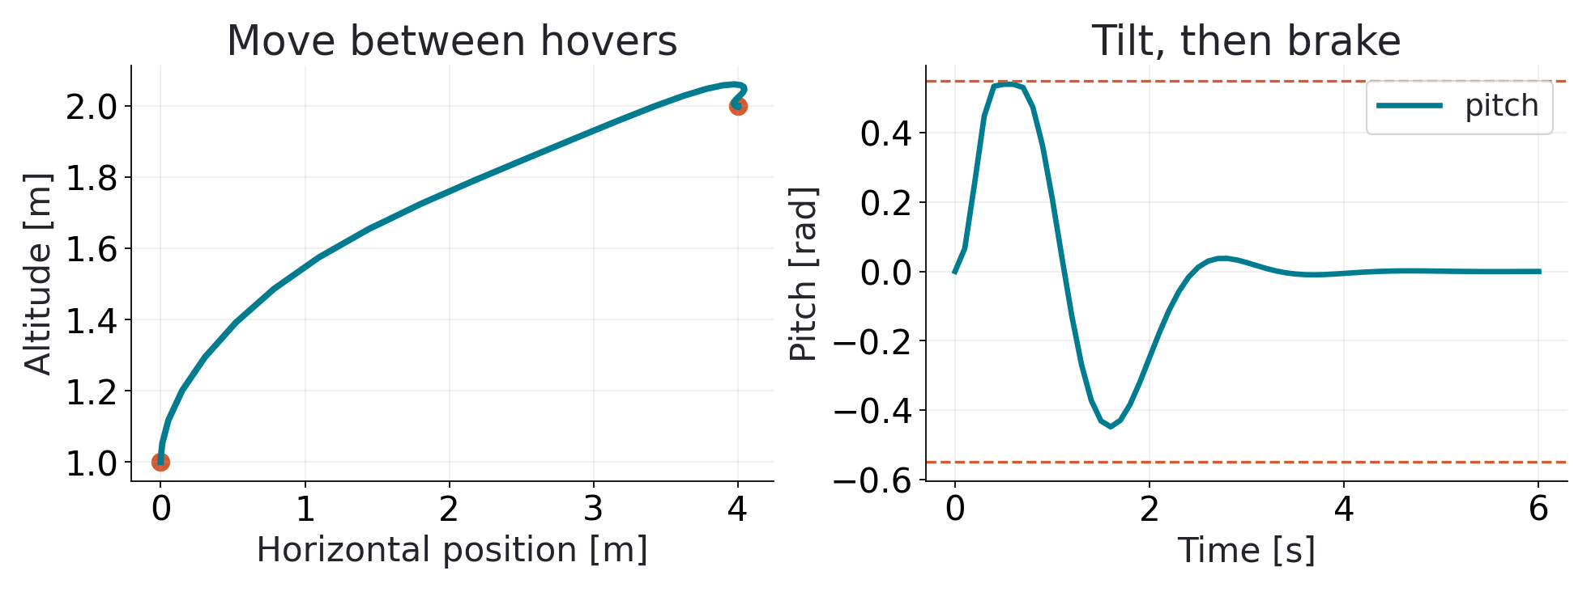
HANDS-ON · fitted physics, constrained trajectory
12:20–12:40
Solve. Inspect. Explain the braking.
Open optimization.png and optimization.json.
uv run --frozen python scripts/optimize_casadi.py
Solve_Succeeded · limits respected · arrive near rest
18
PURDUE · AERONAUTICS & ASTRONAUTICS / GEORGIA TECH · AMC 2026
Notes:
12:20–12:40
Allow about 15 minutes to run and inspect plots/JSON, with the remaining time for questions or app development. Live computation takes about 1–2 seconds locally. Show acceleration tilt and opposite tilt for braking. Confirm drag matches JAX values, defects near 1e−14, exact endpoint constraints at nodes, and about 2 mm altitude error under finer/adaptive integration. Analytic interval pitch extrema are about 0.542 rad, below 0.55. Checks allow 1e−6 numerical tolerance. Explain continuous/discretized differences and the absence of an all-time formal certificate. A source hash requires refitting after edits. Recover with canonical source/reference fit, then a clearly labeled reference figure. Optional --target-x 3 was separately rehearsed; its receipt is in verification/. MPC would repeat optimization online; it is not demonstrated.

Slide 19
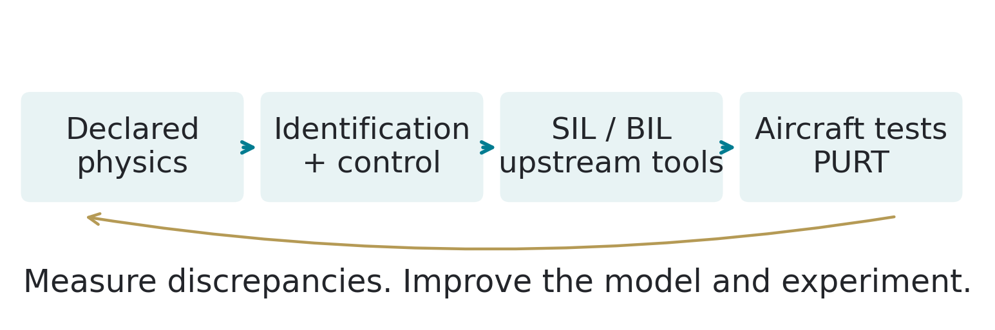
Public Purdue / CogniPilot work · separate from today’s demo
12:40–12:45
Bring the model back to the experiment
PURT: aircraft experiments, racing and security applications
Experimental validation is the next engineering step.
19
PURDUE · AERONAUTICS & ASTRONAUTICS / GEORGIA TECH · AMC 2026
Notes:
12:40–12:45
Official PURT source: https://engineering.purdue.edu/PURT. Public workspace: https://github.com/CogniPilot/cognipilot_workspace documents pure Modelica, host Zephyr SIL and FastDyn/QEMU Cortex-M7 binary-in-the-loop. Documented upstream; not run here. Monte Carlo and reinforcement learning are application directions, not demonstrated results. Avoid unsupported benchmarks and facility superlatives. Synthetic fitting does not establish real-aircraft validity. Briefly connect the model to physical experiments, then introduce the lead fixed-wing app. Leave time for questions and move to app exploration at 12:45.

Slide 20
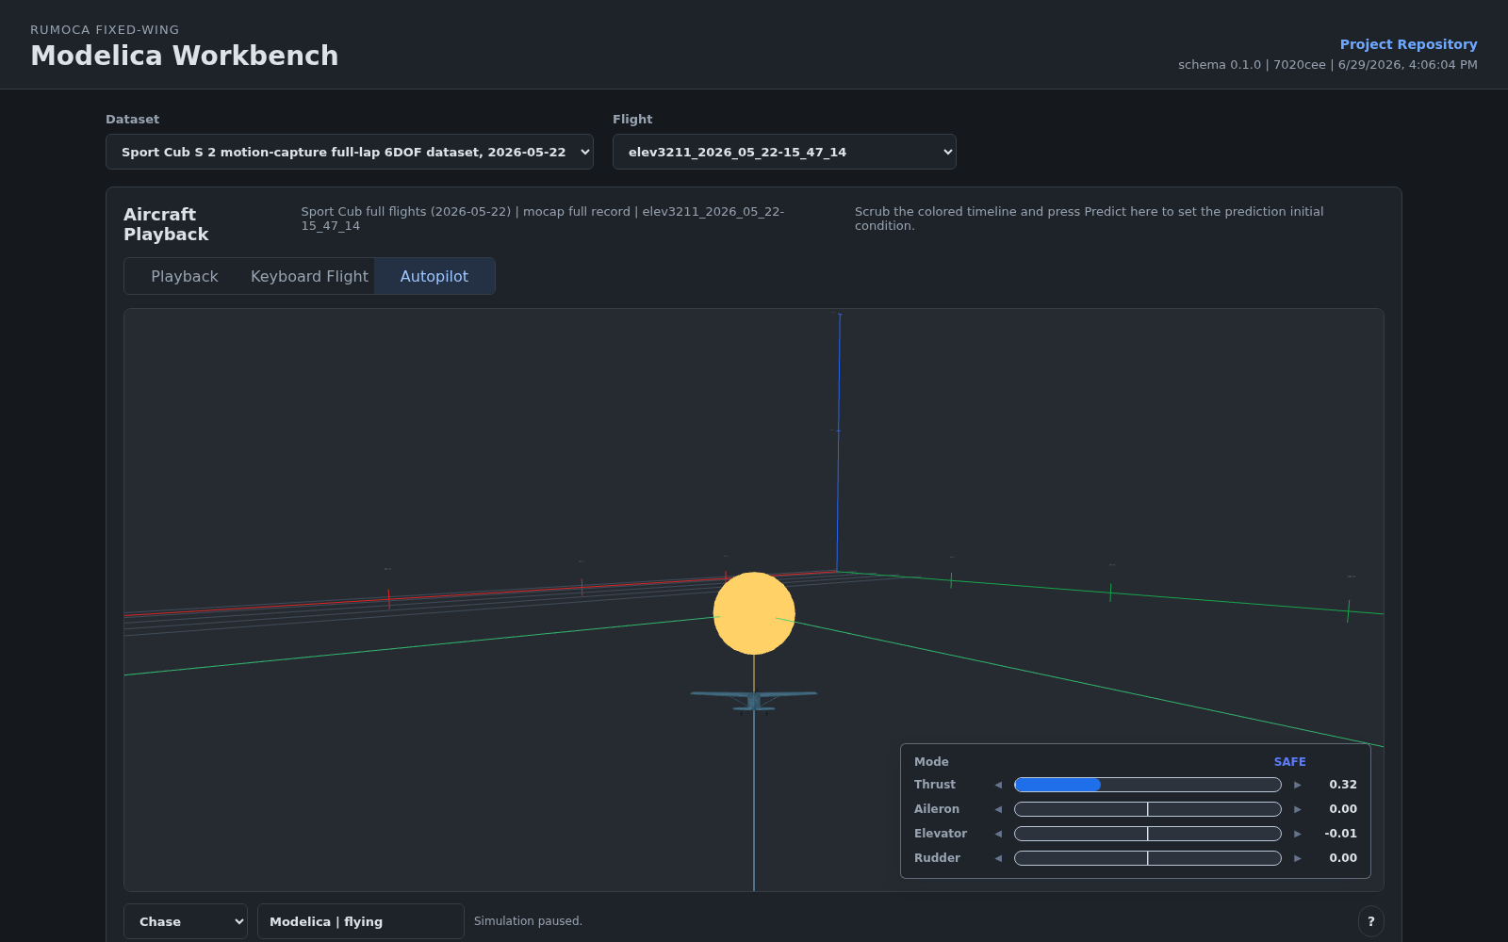
AGENT-BUILT APPS · try fixed-wing or finish your own demo
12:45–12:50
Explore the fixed-wing workbench
Modelica flight
simulation + autopilot
Try 50 Hz → 20 Hz,
restart, then observe
Also: slam_web (in
development),
mocap_sysid
Live links + short experiments: BROWSER_APPS.md
20
PURDUE · AERONAUTICS & ASTRONAUTICS / GEORGIA TECH · AMC 2026
Notes:
12:45–12:50
Lead with rumoca_fixed_wing, the more complete app example. Coding agents helped build the interface and experiments; engineers review models and validate output. Briefly show Autopilot → Start sim, waypoint progress, then 50 to 20 Hz → Start sim again → pause. Invite participants to try that interaction or finish their challenge app. SLAM Lab is an additional example in development; only its inertial baseline and filter variant were rehearsed, not the complete visual-SLAM pipeline. Mocap is a viewer for stored benchmark results, not browser retraining. Fixed-wing and SLAM use WASM; the tested mocap viewer interaction does not. No login, agent account or API key is needed to explore these examples manually. They use different models from the core exercise and are outside its Lean proof scope. Keep the recorded screenshots available for network/graphics recovery. At 12:50 move to participant demos.

Slide 21
OPEN CHALLENGE · short demos · audience show of hands
12:50–12:55
Show your app. Vote for the cap.
Up to 5 demos · 45 seconds each · your GitHub
One checked result · agent used · elapsed build time
Audience favorite wins a free CogniPilot stocking cap
Random draw if more than 5 ready entries → audience hand vote
21
PURDUE · AERONAUTICS & ASTRONAUTICS / GEORGIA TECH · AMC 2026
Notes:
12:50–12:55
Use up to five 45-second demos, selected by the announced readiness check and random draw if needed. Draw order and a backup in advance. Each entrant shows how Rumoca addresses their chosen problem, one working interaction, their GitHub and contribution, a checked result, and the agent/tool used plus elapsed build time. Label estimated times. Have tabs ready and keep the same limit for everyone. Five demos leave 75 seconds for a show-of-hands vote and award. Each attendee votes for one entry; count visibly. If tied, run a quick vote between the tied entries; if still tied, draw among them. Award one stocking cap to the winning entry; a team chooses its recipient. Share all entry links in a gallery, including those not drawn. If there are no entries, invite a brief question about the fixed-wing example and continue to the closing slide. CHALLENGE.md carries the same rules. Keep the core exercise as the workshop's main focus.

Slide 22
Keep the model. Change the question.
12:55–13:00
Questions + your next
problem
Bring a modeling, identification or optimization
problem
Share a reproducible model and a measurable
result
Collaborate with Purdue and the open-source
community
github.com/CogniPilot/rumoca_workshop_amc2026
22
PURDUE · AERONAUTICS & ASTRONAUTICS / GEORGIA TECH · AMC 2026
Notes:
12:55–13:00
Invite collaboration: “Bring a hard modeling, identification, optimization or cyber-physical testing problem. We are developing open-source tools and validating ideas on real systems at Purdue. Let us find a useful research question together.” Point to the repository, worksheet, math review and contribution links. Welcome ecosystem partners. Answer final questions and stop at 13:00. Appendix A3 covers research directions if asked.

Slide 23
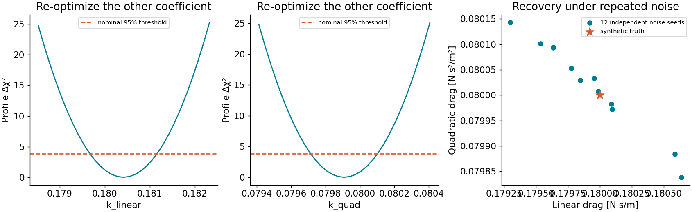
Scope matters · MATH_REVIEW.md
Appendix
Exact-real proofs and numerical evidence
Lean: equation
equality and
invariants
Audit: gradients,
profiles, integration
Papers: model and
method choices
None of these certify arbitrary edits or real flight.
A1
PURDUE · AERONAUTICS & ASTRONAUTICS / GEORGIA TECH · AMC 2026
Notes:
Appendix
Lean 4.29.1 and public Mathlib v4.29.1 are pinned. The proof representation comes from the actual Solve operation program. No admissions or custom axioms; standard propext, Classical.choice and Quot.sound only. The compiler/template/translator and real-arithmetic interpretation remain trusted. Assumptions: nonnegative coefficients, positive smoothing, nonzero mass/inertia for energy algebra. The profile threshold is asymptotic Gaussian; a finite grid does not guarantee confidence coverage.

Slide 24
Full citations and checked equations: MATH_REVIEW.md
Appendix
Primary papers behind the approach
Faessler et al., RA-L 2018: rotor-drag physics and
excitation
Andersson et al., 2019: CasADi AD and multiple
shooting
Raue 2009; Wieland 2021: practical identifiability and
profiles
World-axis teaching drag differs from body-axis rotor aerodynamics.
A2
PURDUE · AERONAUTICS & ASTRONAUTICS / GEORGIA TECH · AMC 2026
Notes:
Appendix
Faessler DOI 10.1109/LRA.2017.2776353, equation 2: mass-normalized body-frame R D Rᵀ drag; we do not invoke their flatness theorem. CasADi DOI 10.1007/s12532-018-0139-4, sections 2.6 and 5.4: AD and multiple shooting. Journal: Mathematical Programming Computation. Raue DOI 10.1093/bioinformatics/btp358, primary abstract; Wieland arXiv 2102.05100, equation 6/full method checked. No paper figures or extensive quotations are reproduced.

Slide 25
FUTURE WORK · beyond the tested app experiments
Appendix
Research questions worth exploring
Vision + SLAM + estimation
+ physics in one declared
system
Richer browser / FMI /
WebAssembly workflows
Compiler differentiation and
larger symbolic systems
Partition work across CPU,
GPU and embedded
hardware
Bring a falsifiable question and a measurable benchmark.
A3
PURDUE · AERONAUTICS & ASTRONAUTICS / GEORGIA TECH · AMC 2026
Notes:
Appendix
The app gallery demonstrates selected browser interactions; it does not establish complete SLAM, deployable SLAM FMUs, automatic hardware partitioning or million-variable scaling. Agent-assisted development does not supply mathematical validation by itself. Use this appendix for roadmap questions only; no extra scheduled time. Recovery instructions remain in TROUBLESHOOTING.md and REHEARSAL.md.

Slide 26
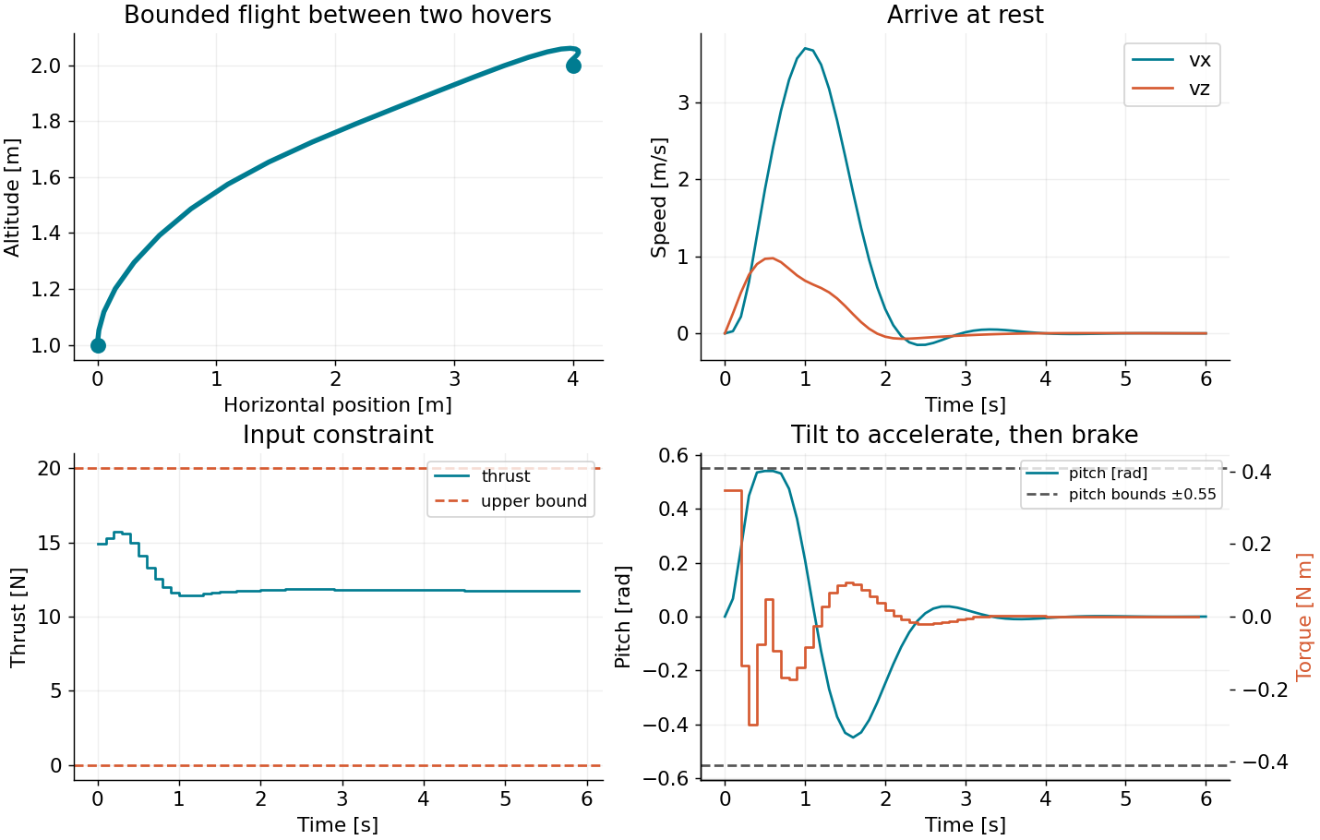
Node solution ≠ exact continuous-time flight
Appendix
Numerical constraints need validation
Reintegrate the inputs independently; inspect errors by physical unit.
Small defects, pitch margin and fine rollout are separate checks.
A4
PURDUE · AERONAUTICS & ASTRONAUTICS / GEORGIA TECH · AMC 2026
Notes:
Appendix
Default physical constraints: T 0–20 N, torque ±0.35 N m, pitch ±0.55 rad (nodes ±0.54), altitude 0.25–4 m, rotor pairs 0–10 N. Finer/adaptive peak pitch is about 0.542 rad. No interval-bound certificate, actuator dynamics or feedback is provided. IPOPT solves a local NLP. Active bounds can differ by about 1e−8 from floating-point solver tolerance; checks allow 1e−6. RK4 verification uses dt=0.025 s; DOP853 output samples are 0.01 s. These numerical checks are separate from exact-real Lean proofs.

