Slide 1



ENTERPRISE AI CONTROL PLANE
One platform to centrally control, build, operate and optimize enterprise AI workloads.
Console
Agent SDK
Agent Server
Open source foundation · Enterprise service model · Full infrastructure control
Notes:
Opening frame: cognipeer is positioned as an enterprise AI control plane, not another AI tool. Console, Agent SDK and Agent Server are one platform. 10-15 minutes of architecture story, then straight into the live demo.

Slide 2






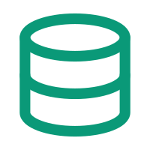




01 · CONTEXT
Enterprise AI Is Becoming an Infrastructure Layer
AI workloads spread across models, agents, applications, teams, data and infrastructure.
TODAY'S ENTERPRISE AI FOOTPRINT
THE QUESTION
Models & Providers
AI Agents
How do you centrally manage enterprise AI workloads?
OpenAI, Anthropic, Bedrock, vLLM
Per team, per use case
Business Applications
Teams & Business Units
Embedded AI features
Parallel adoption
Enterprise Data
APIs & Tools
Documents, systems, knowledge
Internal and external calls
Models, agents, data, access, policies and cost need one place where they are decided, enforced and observed.
Security & Policies
Usage & Cost
Applied inconsistently
Growing, hard to attribute
02 / 13
Notes:
Every enterprise reaches the same point: AI stops being a project and becomes an infrastructure layer. Each team picks its own models, agents and data paths. Nothing is centrally governed, measured or attributable — which is an infrastructure problem, not a model problem.

Slide 3





02 · ARCHITECTURE
The Enterprise AI Control Plane
One platform to centrally control, build, operate and optimize enterprise AI workloads.
CONSUMERS
Applications · Teams · Business Units · Products
COGNIPEER · ENTERPRISE AI CONTROL PLANE
Console · Agent SDK · Agent Server
Control & Sovereignty
Build & Run
Observe & Govern
FinOps & Optimization
Models, data, access,
policies, deployment
Sandbox, SDK, runtime,
serving, versioning
Traces, guardrails,
approvals, runtime policy
Usage, cost, budgets,
routing, fallback
FOUNDATION
Models · Agents · Data · Tools · Infrastructure
03 / 13
Notes:
The key architecture slide. Consumers on top, foundation at the bottom, and one control plane in between with four capability areas: control and sovereignty, build and run, observe and govern, FinOps. Everything after this slide is a zoom into one of those four.

Slide 4



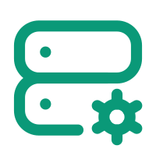
03 · CONTROL & SOVEREIGNTY
Control & Sovereignty
Maintain control over your enterprise AI infrastructure.
cognipeer Control Plane
ONE POINT OF CONTROL
THE ORGANIZATION DECIDES
Which models can be used
Where AI workloads run
Who can access them
Models
Data
Access
Policies
Infrastructure
Providers,
routing, limits
Residency,
retention, RAG
Projects, roles,
API tokens
Guardrails,
quotas, PII
Self-hosted,
on-premise
Which policies apply
Where enterprise data remains
Self-hosted
On-premise
Multi-tenant isolation
No vendor lock-in
How AI infrastructure is governed
The platform runs where your data, policies and security requirements say it must.
04 / 13
Notes:
Sovereignty is the entry condition for enterprise AI: which models are allowed, where workloads run, who can access them, which policies apply and where data stays. Self-hosted and on-premise deployment keep that decision with the organization, not with a vendor.

Slide 5



04 · OPERATING MODEL
Open Source + Service Model
Full control without the operational burden.
Open Source
FOUNDATION
Enterprise Service Model
OPERATIONS
Transparency
Deployment
Enterprise support
Extensibility
Integration
Architecture services
No vendor lock-in
Code-level control
Customization
Operational assistance
Infrastructure independence
Platform upgrades
Continuous evolution
Self-hosted architecture
Open Source Foundation + Enterprise Services = Enterprise-Ready AI Infrastructure
Own the platform. Keep the flexibility. Let us operate and evolve it with you.
05 / 13
Notes:
Open source here is not a pricing argument, it is a sovereignty argument: transparency, extensibility, code-level control, no lock-in. The service model is what makes it enterprise-ready — deployment, integration, customization, upgrades and support stay with us.

Slide 6






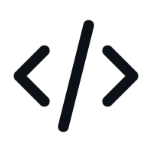

05 · BUILD & RUN
Build & Run AI Workloads
From experimentation to production — on one runtime path.
01
02
03
04
Build
Test
Deploy
Run
Agent Sandbox
Agent Runtime
Publish & Version
Agent Server
Agent SDK
Traces & Replay
Authentication
Streaming
RAG & Files
Guardrails
APIs
Production Deployment
Console
Agent SDK
Agent Server
Manages the AI environment and the infrastructure layer.
Controls agent execution and runtime behaviour.
Publishes, versions and serves production agents.
MODELS · PROJECTS · POLICIES · COST
RUNTIME · GUARDRAILS · HUMAN-IN-THE-LOOP
REST · SSE · AUTH · VERSIONING
06 / 13
Notes:
The same platform carries a workload from sandbox experiment to production service: build in the sandbox with the SDK, test against traces and guardrails, publish a version, serve it over authenticated APIs with streaming. No rewrite between prototype and production.

Slide 7



06 · OBSERVE & GOVERN
Observe & Govern
Know and control what every AI workload is doing.
Observe
Understand
Control
An AI operations and governance layer — not another monitoring dashboard.
What happened?
Why did it happen?
Can we control it?
Tracing and observability across every run.
Execution history, model requests, tool interactions.
Guardrails, approvals, interruption, runtime policy.
Detailed tracing
Agent execution traces
Guardrails
LLM request tracking
Model requests & responses
Human-in-the-loop
Tool call visibility
Tool interactions
Interrupt · Pause · Continue
Session & thread view
Token & latency breakdown
Runtime policies & alerts
07 / 13
Notes:
Three questions, in order: what happened, why did it happen, can we control it. Tracing answers the first two down to the model request and tool call. Guardrails, human-in-the-loop, interrupt and runtime policies answer the third. This is an operations layer, not a dashboard.

Slide 8




07 · FINOPS
FinOps & Optimization
Measure, control and optimize AI consumption.
Usage
Cost
Control
Optimization
Tokens, requests and
calls per workload
Attribution by project,
team and application
Budgets, quotas,
rate limits, alerts
Model routing and
provider fallback
QUESTIONS THE PLATFORM ANSWERS
AI consumption should be measurable, attributable and controllable.
Which teams consume AI resources?
Which applications generate the highest cost?
Which models are being used, and where?
BUDGETS · QUOTAS · RATE LIMITS · COST ALERTS
Where can workloads be routed more efficiently?
08 / 13
Notes:
AI cost behaves like cloud cost did ten years ago: it grows before anyone can attribute it. Usage is tracked per project and team, cost is attributed, budgets and quotas enforce limits, and routing plus provider fallback optimize what is left.

Slide 9

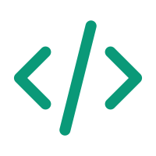

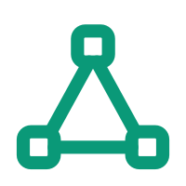



08 · SERVICES
Key Services
Core services for enterprise AI infrastructure.
LLM Gateway
Agent Sandbox
Agent SDK
RAG & Files Pipeline
Unified access to multiple models and providers.
Controlled environment to develop and test agents.
Runtime layer for controlled, production-grade agents.
Enterprise document ingestion and knowledge grounding.
Vector Orchestration
Agent Server
Tracing & Observability
Chat UI
Unified management of vector infrastructure.
Publishing, versioning and serving through secure APIs.
Central visibility into model and agent execution.
Production-ready conversational interface for the enterprise.
09 / 13
Notes:
The service surface behind the four capability areas. Each of these is a production service in the platform today — the demo will move through the gateway, sandbox, tracing and serving paths.

Slide 10
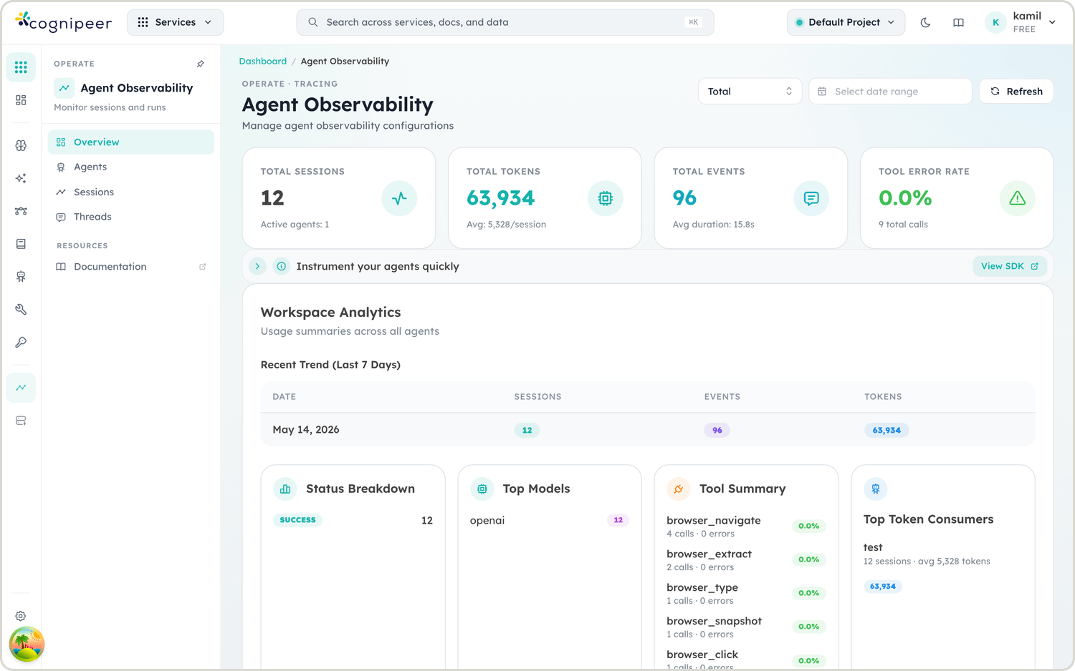
09 · DEMO
Live Demo
From control plane to running AI workload.
01 Configure
02 Build
03 Run
04 Observe
05 Control
06 Optimize
One platform — configure the infrastructure, build the workload, run it, and see exactly what it did and what it cost.
CONSOLE · AGENT OBSERVABILITY
10 / 13
Notes:
Transition slide. Move into the product: configure a provider and model, build an agent in the sandbox, run it, watch the trace, apply a guardrail or interrupt, then show usage and cost attribution.

Slide 11



10 · DISCUSSION
Architecture & Deployment Discussion
How does this fit into your AI architecture?
Existing AI workloads
Models & providers
Cloud / on-premise
Security requirements
Enterprise data sources
Integration points
Teams & projects
Governance & policy
AI cost management
Initial pilot scope
STARTING POINT
Pilot scope
Integration points
Deployment model
Which AI workloads would make the best starting point for a centralized control plane?
11 / 13
Notes:
Stop pitching here. Walk through the discussion areas with the team, map their current workloads and constraints, and land on a first pilot scope that is narrow enough to deliver and representative enough to prove the control plane.

Slide 12
APPENDIX · A1
Platform Capability Overview
Detail behind the four control-plane capability areas.
Console
Agent SDK
Agent Server
Chat UI
LLM Gateway
Message-first runtime
Multi-agent registry
Full chat
RAG & Knowledge Engine
Pause / continue
REST API
Streaming UI
Tracing
Human-in-the-loop
SSE streaming
Tool cards
Files pipeline
Structured tracking
Swagger
File attachments
Vector orchestration
Interrupt
Authentication
Themes
Cost & budget control
Summarisation
Publish & version
Hooks API
Multi-tenant isolation
Guardrails
Storage
Memory management
Planning
File upload
Alerting
Multi-agent orchestration
12 / 13
Notes:
Appendix. Use only if the audience asks for capability-level detail.

Slide 13
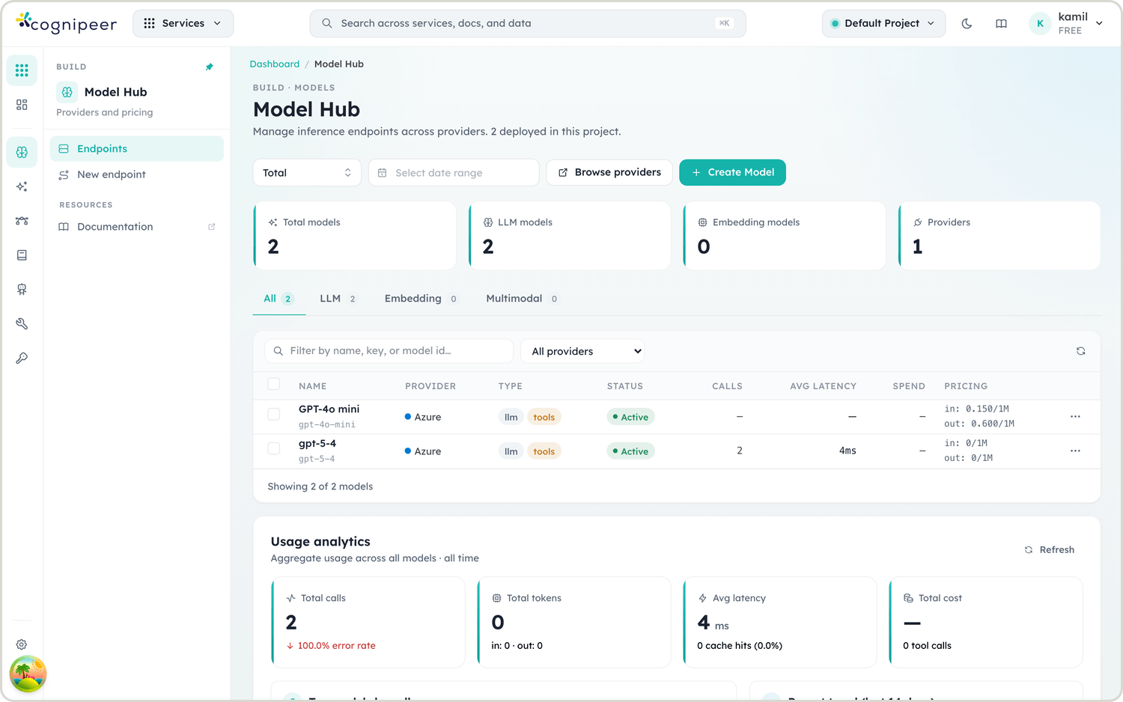
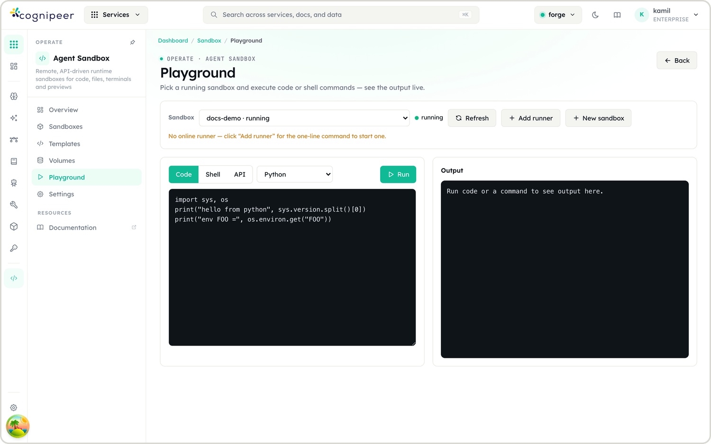
APPENDIX · A2
Console in Action
The surfaces the live demo moves through.
MODEL HUB
AGENT OBSERVABILITY
AGENT SANDBOX
Providers, models and routing under one catalogue.
Sessions, traces, tool calls and token usage.
Build and test agents before they reach production.
The full walkthrough happens live — configure, build, run, observe, control, optimize.
13 / 13
Notes:
Appendix. Backup screenshots in case the live environment is unavailable.

