Slide 1
PRODUCT SHOWCASE · BUILT WITH DEVIN
AT A GLANCE
NAS Capacity Pulse
Volume Anomaly Detection & Storage Forecaster
Full-stack app FastAPI · SQLite · Chart.js
~15,000 lines of code
8-page gradient dashboard
67 automated tests
Enterprise NAS storage intelligence with sub-application level granularity — purge insight, cost forecasting and capacity planning that server-level tools like Grafana cannot deliver.
POSIX shell agents, zero deps
Demo video narrated walkthrough
~1 hr
to first MVP
21 days
to full product
10
iterative phases

Slide 2
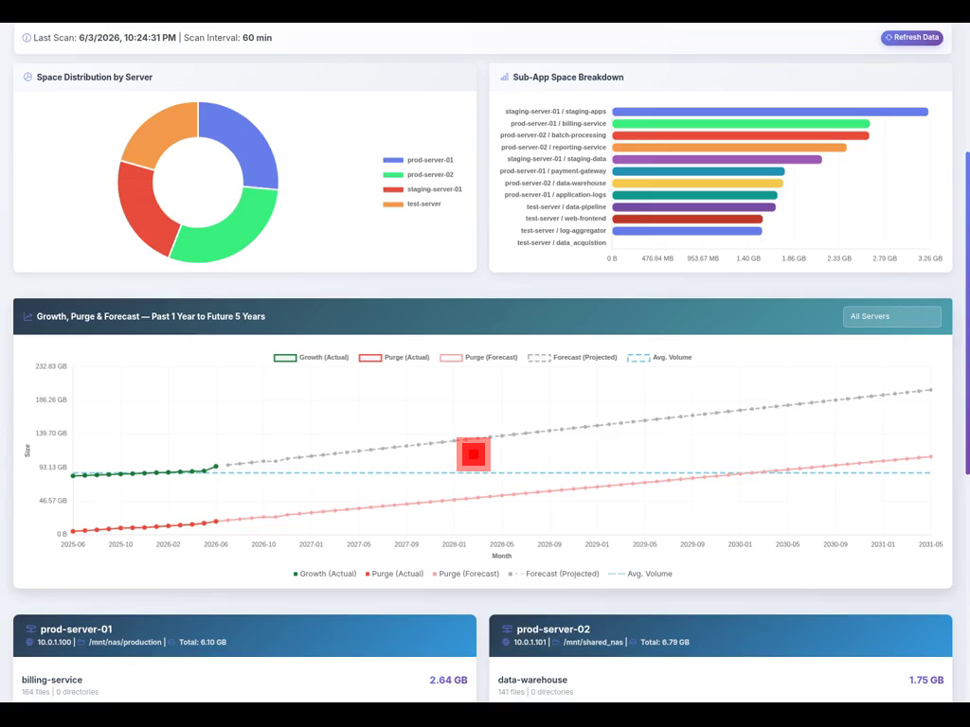
The Product Designed
Sub-app level NAS storage monitoring, forecasting & controlled cleanup
Sub-App Granularity
Space usage per team/service, not just per server or filesystem.
Growth & Cost Forecast
Regression on historical snapshots projects size & $ from 1 week to 5 years.
Purge & Archive Workflow
Archive-before-delete with confirmation; surfaces largest, oldest files first.
Capacity Planning + Alerts
Per-team allocation with 80% threshold email alerts and consumption plans.
Zero-Dependency Agents
POSIX shell agents (du/find/stat/curl) — no Python or Java on monitored hosts.
Live dashboard — space distribution, sub-app breakdown & 5-year forecast

Slide 3
Why Devin — Impact & Effort
A production-grade, iteratively-refined product delivered at a fraction of traditional effort
226
ACU of agent compute
19
commits · 10 phases
~15K
lines of code
67
tests, all passing
TIME TO BUILD — DEVIN vs. 2 ENGINEERS
KEY BENEFITS REALIZED
Milestone
Devin
2-Engineer Team*
Speed to value — From idea to demo-ready product in days, not months.
Working full-stack MVP
< 1 hour
1–2 weeks
Iterative partnership — 10 feedback-driven phases — UI, forecasting, auth, alerts.
Feature-complete product
~21 calendar days**
~6–8 weeks
Full-stack breadth — Backend, DB, dashboard, shell agents & docs in one flow.
Active build effort
~226 ACU
~480 person-hours
Built-in quality — 67 tests, security hardening, Devin Review bug fixes.
Docs + tests + demo video
Included
+1–2 weeks
Deliverables beyond code — Narrated demo video, technical design docs, gap analysis.
*Estimate for 2 mid-level full-stack engineers building the same scope from scratch. **Mostly stakeholder feedback/idle time; hands-on agent work was a small fraction.

Slide 4
Key Takeaways
What NAS Capacity Pulse — and the way it was built — demonstrates
1
Solves a real gap
2
Delivered fast
Sub-application storage visibility, purge insight and cost forecasting that traditional server-level tools (Grafana, Zabbix) simply do not provide.
A working full-stack MVP in under an hour and a feature-complete, tested product across ~21 days — a fraction of a traditional 2-engineer timeline.
3
Enterprise-ready
4
More than code
Zero-dependency shell agents, auth, archive-before-delete controls, 80% allocation alerts, and CSV audit trails built for scale (10 TB+ servers).
Tests, security hardening, technical design docs, gap analysis and a narrated demo video — all produced within the same Devin engagement.
NAS Capacity Pulse · Designed & built with Devin

