Slide 1
Design for Humans
not Devices

Slide 2
Desktop Web
Often overlooked in favor of mobile browsers
Here to stay
Established user base
Growth in mobile complements desktop
Specific use cases

Slide 3
Modern Desktop Web
Lots of scrolling
Single column layouts
Unnecessarily large elements (hero images, header text)
Scanning is hard - information arranged in grids rather than tables with rows and columns
Navigation is hidden

Slide 4
Well, how did we get here?
Increasing uncertainty in screen size/resolution
screens ranging phones to televisions
high resolution (retina) displays
Media queries
CSS frameworks and grid systems
CSS – easy to learn, hard to master

Slide 5
How did we get here?
New design terminology
Mobile first design
Adaptive design
Responsive design

Slide 6
How did we get here?
New design terminology
Mobile first design
Adaptive design
Responsive design

Slide 7
User focused design has not changed

Slide 8
Pitfall
Displaying same content to everyone
Solution
Consider separate mobile version

Slide 9
Pitfall
Single Column Layout
Solution
To hide a sidebar use:
display: none;

Slide 10
Pitfall
Setting breakpoints to target screen resolutions
Solution
Let your content determine breakpoints

Slide 11
Pitfall
Unnecessarily large elements ex: hero images, headers

Slide 12
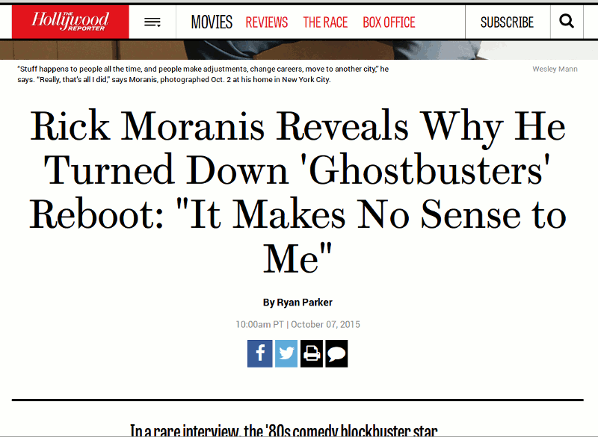

Slide 13
Pitfall
Unnecessarily large elements ex: hero images, headers
Solution
Maintain consistent size ratio based on hierarchy

Slide 14
Pitfall
Information in grid format is hard to scan

Slide 15


Slide 16
Pitfall
Information in grid format is hard to scan
Solution
Use fluid width tables instead of collapsible grids

Slide 17
Pitfall
Content occupies entire width of screen

Slide 18
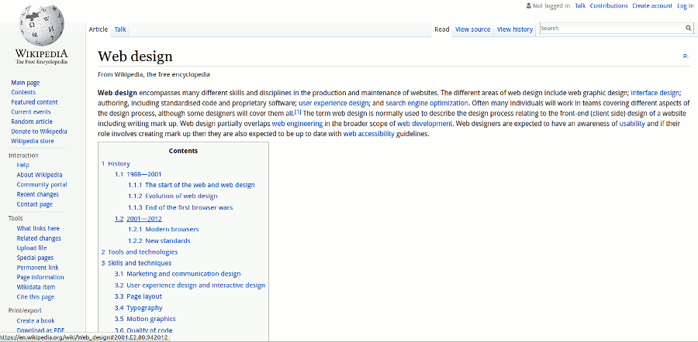

Slide 19
Pitfall
Content occupies entire width of screen
Solution
Set max-width property on wrapper, limit text to 60 characters per line

Slide 20
Pitfall
Hidden navigation on large screens
Solution
Display navigation on large screens, hide on small screens and use 'menu' label

Slide 21
Things that you can do

Slide 22
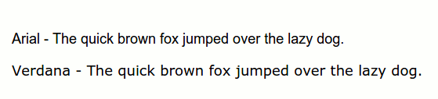
Use Scalable Fonts
Adequate spacing between letters
Large x-height
Well defined bowls
Visible ascenders and descenders

Slide 23
Learn CSS
Not as bad as you think
Browser support – better than ever
Learn to code layouts from scratch
Retrofit an old website to be usable on all screens
Learn basic principles of design and typography
Give a hug to CSS devs on your team

Slide 24
Test your layout on ridiculously large screens

Slide 25

@PatrickMcSweeny

