Slide 1
Find Your Inner Bounded Context
A case study of breaking up a large monolithic application

Slide 2
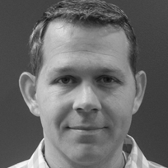
Jim Everett
Developer, Architect, Software Enthusiast
Experience
HMBer
Married father of 2
Software Enthusiast
15 years of .NET Experience
Enterprise Architect
Developer
Scrum Master
Life Learner
 https://twitter.com/CognitiveBurden
 https://github.com/cognitiveburden
 cognitiveburden@gmail.com

Slide 3
Outline
What are we doing today?
1
3
Problem
Takeaways
What problem are we trying to solve?
Review of practical ideas to be learned from case study
Bounded Context
A Developer’s Journey
Definition of bounded context and why it is important
Case study
2
4

Slide 4
1
Bounded Context
Notes:
When discussing topic of talk found
I had a hard time concisely expressing what a bounded context was
People were unsure what it was

Slide 5
Boundary
Definiton
A real or imagined point or limit that indicates where two things become different.
Notes:
a point or limit that indicates where two things become different
A boundary is a border and it can be
physical, such as a fence between two properties
abstract, such as a moral boundary that society decides it is wrong to cross
A boundary is basically what limits us.

Slide 6

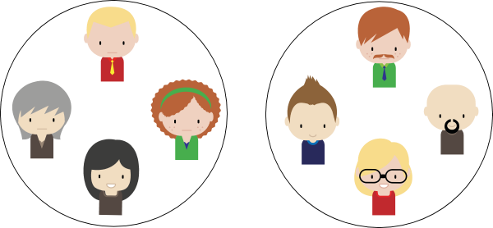

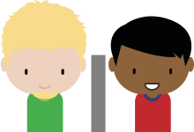
Boundary Examples
Real or Imagined
Accounting
Technology
Ocean
Cubicle Wall
Mountains
Departments
Notes:
Ocean
Mountain
Cubicle Wall
Department – Use Different Terminology and Perform Different Functions and there have different DRIVERS
Accounting
Information Technology

Slide 7
Context
Definition
Background, environment, framework, setting, or situation surrounding an event or occurrence, which helps explain its full meaning.
Notes:
Think about how you use pronouns like he, she, it…we require some Context (background to know which person or thing you are talking about.
Information surrounding idea which Clarifies meaning

Slide 8


Context Example
Tim concentrated and contorted his face while he created a tweet.
Twitter
Musical
Context
Context
We were all amazed at how insightful and concise his tweet was.
We were all amazed by the sound coming from his face.

Slide 9
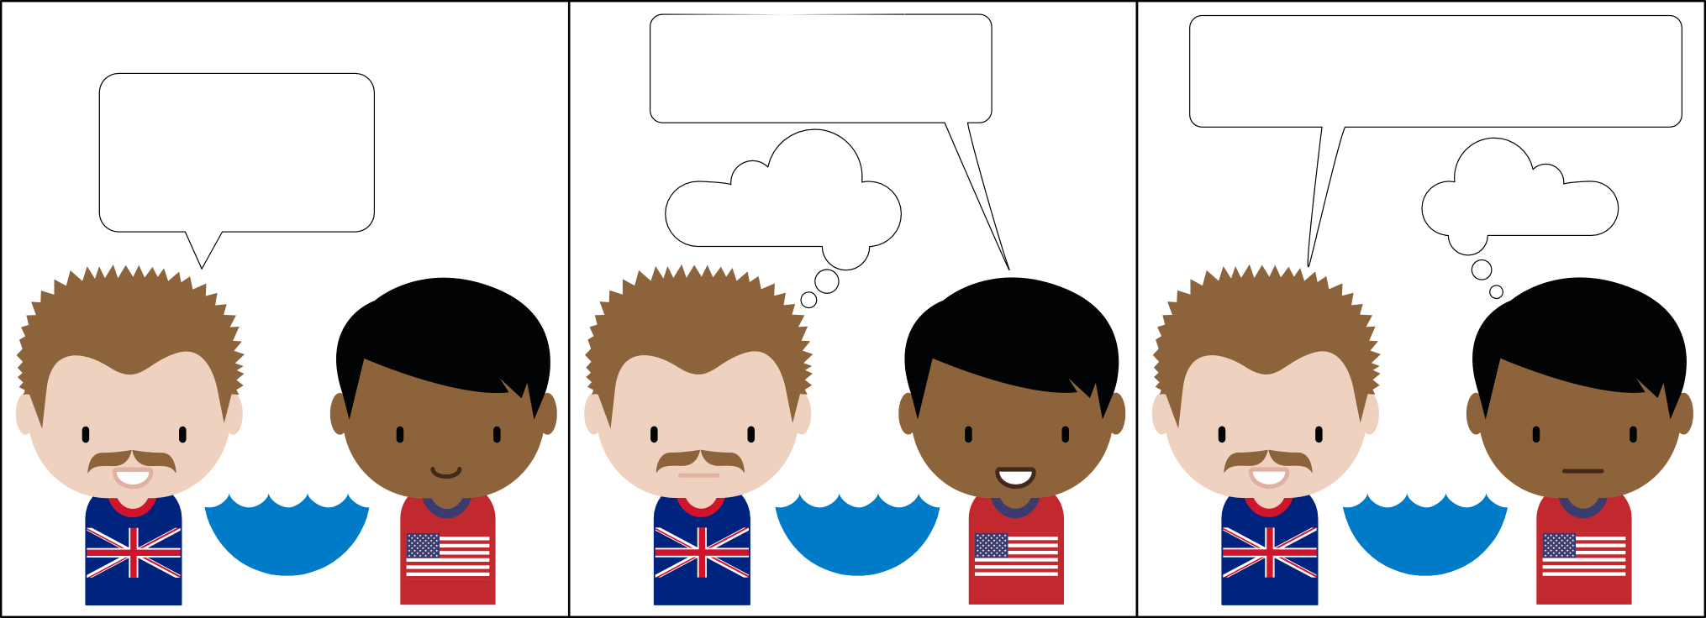
A Boundary Without Context
United Kingdom & United States
Yeah…I will wear my lucky buckeye pants!
Ok…I will bring a pencil, paper, and a large rubber, to keep score!
Would you like to go to a football match?
??Pants??
??Rubber??
Notes:
There is a boundary between UK and US – Ocean
The different cultures have specialized their language due to shared experiences
To someone from UK
Soccer is called football
Underwear is called pants
A pencil eraser is a rubber
Accident and Emergency: commonly referred to as “A&E”

Slide 10
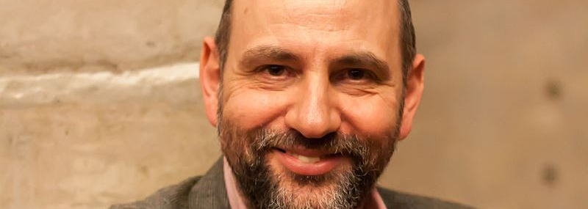
Domain-Driven Design Bounded Context
Definition
“DDD deals with large models by dividing them into different Bounded Contexts and being explicit about their interrelationships.” – Martin Fowler
Notes:
Martin Fowler – International Speaker and Author (Patterns of Enterprise Application Architecture, Refactoring)
Bounded Context is a central pattern in Domain-Driven Design (DDD).
It is the focus of DDD's Strategic Design Section which is all about dealing with large models and teams.

Slide 11
DDD Context
Definition
The setting in which a word or a statement appears that determines its meaning.
Notes:
This almost identical to our dictionary definition of Context

Slide 12
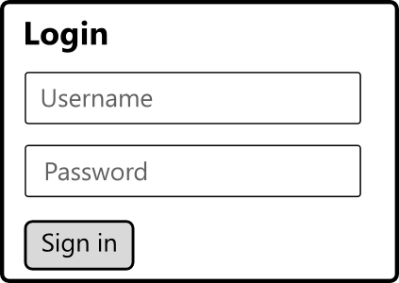

DDD Unbounded Context Example
Personal Finance Application
Account - Credentials
Account - Money
Notes:
Example…A personal finance program…
An Account could mean:
user credentials to log into the program
a container of money
These 2 ideas should not be joined in software
the awkwardness of this model is feedback on a break in the model and a need for a boundary

Slide 13
Apply Context To Software
Models
The maximum extent a model can be stretched without compromising its conceptual integrity is called a context.
Notes:
The Models are where we apply context
How can we keep them consistent?
So the real crux here is to keep the MODEL consistent
Therefore the meaning of the MODEL CANNOT be stretched too or it will become polluted.

Slide 14
Ubiquitous Language
DDD – Common, Rigorous, Shared Language
Special condition where every term has a single unambiguous definition.
Notes:
Single unambiguous definition does not scale with a system.
The more enlarged a system gets, the more ambiguity creeps in.
If you want unambiguous models you need explicit boundaries
Therefore can only exist within a BOUNDARY

Slide 15
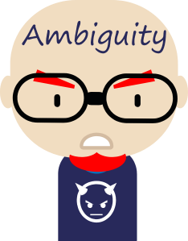
Ambiguity
Super Villain of Ubiquitous Language!
Notes:
Ambiguity is the super villain of the Ubiquitous Language
Must destroy Ambiguity in Ubiquitous Language and Model
To Keep Conceptual Integrity of Model must destroy Ambiguity

Slide 16
DDD Boundary
Explicit
Keeps the knowledge inside consistent whilst ignoring the noise from the outside world
Formalize interactions between different contexts
Notes:
Explicit
Different Projects, Namespaces, Services?
Up to you on how you make it explicit (I always mentor developers that with ultimate discipline we can have all the software grouped together, but this is a higher cognitive burden and not POKA-YOKE)
Different Contexts
Often reflect relationships of teams which work in same domain
Simplifies what the developer and business need to understand to make the system work Cognitive Burden
Conceptual Integrity

Slide 17
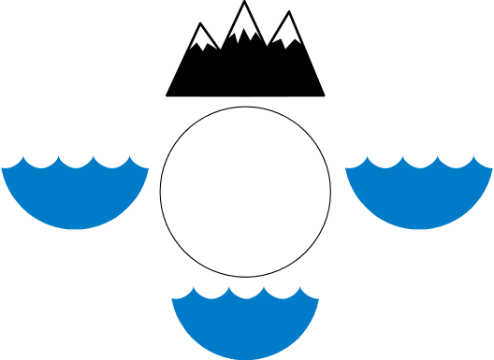
DDD Bounded Context
Bounded Contexts are models with explicit boundaries, where the model is unambiguous within the boundary.
Model
Notes:
To have a Bounded Context you need a model, and an explicit boundary around it.
Many data-driven application with shared database lack a boundary

Slide 18
Bounded Context == Language
Defining Bounded Contexts is an exploration of language
Notes:
How do you find a bounded context?
Our Case Study will help explain the steps.
But as with many things in software it is NOT a technological endeavor
Exploration of Terminology

Slide 19
2
Problem

Slide 20
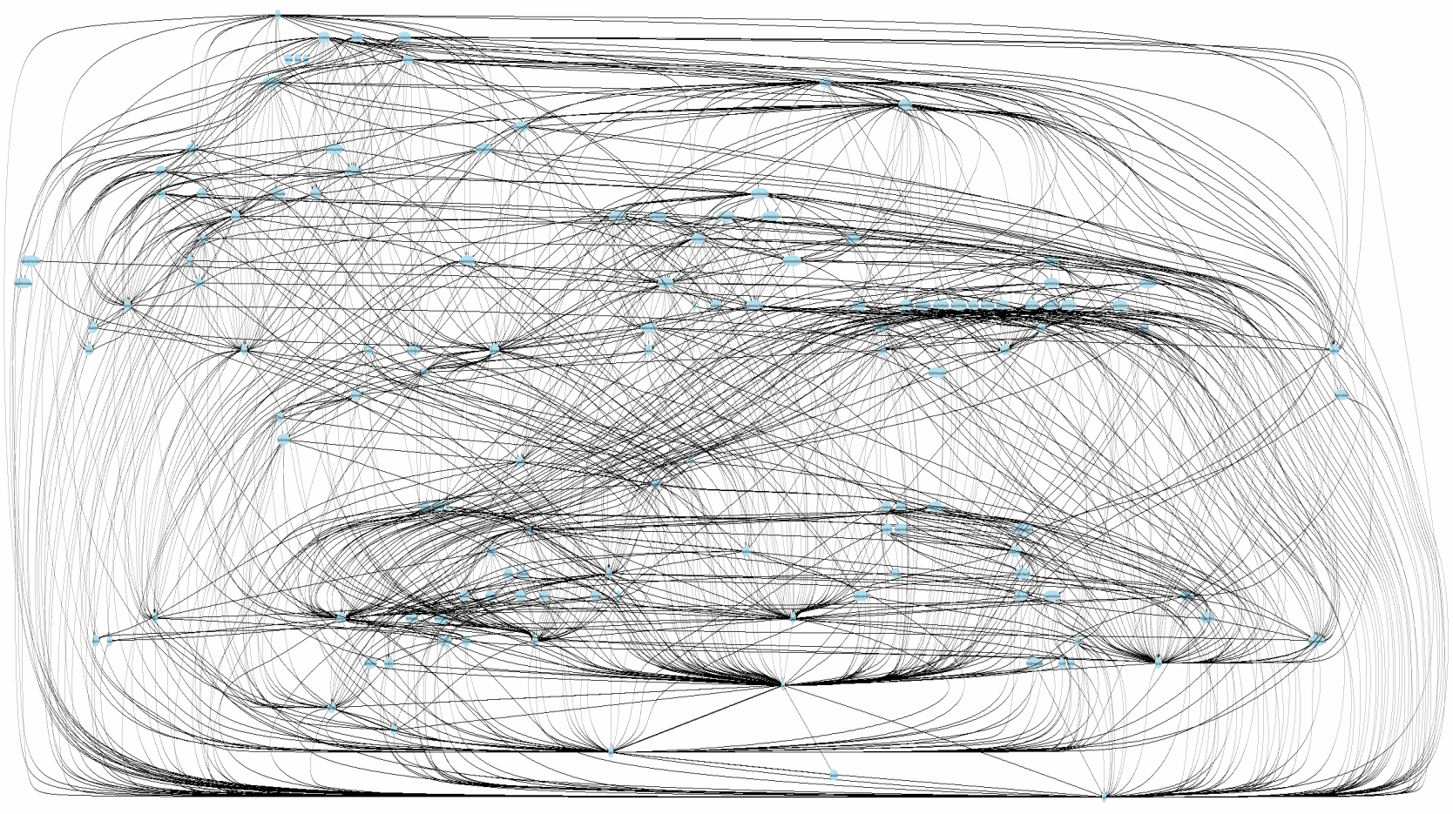
Is this yours?
Coupled Dependency Graph
Notes:
Is this what your application dependency graph looks like?

Slide 21
So What?
Difficult to change
Difficult to test
Difficult to reason about
Notes:
Why would a dependency graph that looks like that be bad?

Slide 22
How did we get here?
Small changes over time
Most systems have a stage when they are small
As they grow, they become more complex and difficult to understand
Notes:
How did my system get this way?

Slide 23
Cognitive Burden
Developers are the limiting factor
Humans are the limiting factor
Tools
Functions
Classes
Abstractions
Interfaces
SOLID
Domain-Driven Design
Service-Oriented Architecture

Slide 24
Essential Complexity is the Model
Accidental vs Essential Complexity
Essential Complexity is in the business domain itself
Often our issues are not technical hurdles
Domain – a sphere of knowledge, influence, or activity
Notes:
In Fred Brooks seminal paper “No Silver Bullet – Essence and Accidents of Software Engineering”
Accidental Complexity – Complexity introduced by developers and can be solved by developers
Essential Complexity – is caused by problem domain and nothing can remove it.
Argues most accidental complexity is solved or decreased … think IDE…new language features, TPL
Order of magnitude improvement in efficiency can only be achieved by tackling Essential Complexity
Bounded Context is a tool to help with Essential Complexity.
When I talk with clients often we discuss the technology stack we will use and not very much around the problem space we are developing.
If the developer’s do not understand the domain…if they don’t have a mental model…the software will not solve the problem well. AKA lots of bugs will be introduced.

Slide 25
Importance
Bounded Context helps to solve Essential Complexity
Smaller, more focused model allows for better architecture
Over time we recognized that “total unification of the domain model for a large system will not be feasible or cost-effective” (Eric Evans)
Notes:
Cognitive Burden
Bounded Context contain unambiguous model(s) which talk to other Bounded Contexts through well known and defined boundaries based on their relationships.

Slide 26
Application
Decomposition of problem
Service-Oriented Architecture (SOA)
What use cases should be grouped together? Bounded Context.
A service should not cross a bounded context.
Micro Services
How to define what is included in a micro service? Bounded Context.
Command Query Responsibility Segregation (CQRS)
What entities should share code? Bounded Context.
RestFul Services
Which resources should be grouped together? Bounded Context.
Data Access
How do I create a data access layer without a one to one relationship with the database? Bounded Context.
Notes:
Ultimately this is a tool to decompose a problem for design into software
Used to discover the appropriate architecture
So we need boundaries (Projects, classes, services,) to allow for precise and consistent definitions of words (Ubiquitous Language) where the boundary provides the context to allow us to determine those definitions.

Slide 27
Cost of Bounded Contexts
Identifying Bounded Contexts requires significant effort, so focus on your core business
Many large business applications would derive value from utilizing Bounded Contexts

Slide 28
3
A Developer’s Journey
Notes:
Illustrating how bounded contexts are identified
Discover how a developer became aware of them and how it impacted the development of a large piece of software

Slide 29
A long time ago in A far away place.

Slide 30

Colorado

Slide 31
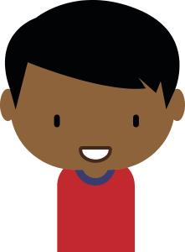
Developer
Tim
Notes:
Tim NOT JIM

Slide 32

Tim is Reasonably Bright

Slide 33
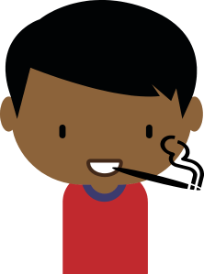

Marijuana is Not Legal

Slide 34

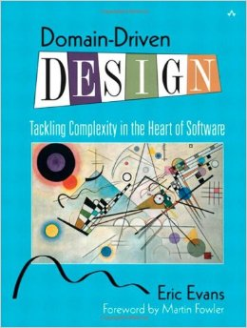
2009
Yes Tim can Read
Domain Driven Design
But only read Chapters 1 - 11
Notes:
He got through the first eleven chapters
(aggregate root, entity, value object, repository pattern, ubiquitous language)
Tim tried to apply concepts but kept ending up with monolithic application
Eric Evans has stated that one of his regrets was not putting more emphasis on
Context Mapping and Core Domain…concepts in chapters 14 and 15.

Slide 35
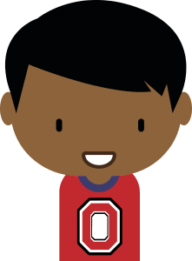

New Opportunity
Notes:
Tim received an opportunity to work for a large healthcare company.

Slide 36
Consultant

Colorado
Working for local government
☑
Healthcare. Inc.
Ohio
.Net Developer for health insurance provider
Notes:
So he loaded up the truck and moved to OHIO
Healthcare. Inc. is a health insurance provider

Slide 37

Tool On Boarding
Notes:
Tim joined Healthcare Inc. on a Monday
The lead developer gave Tim a list of software tools to install on his computer and a hand shake
Tim spent some time, downloading visual studio, installing sql server, and installing the other tools the developers used
This was a tool on boarding

Slide 38
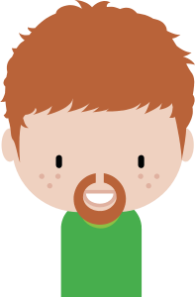
Technical On Boarding
Notes:
Webforms project
.Net 3.5
Ajax Control Toolkit
Architecture of deployment items (file processor and website)
3 Layered Architecture
How Data Access worked
Technical on boarding – dealing with the Accidental Complexity issues.

Slide 39

Application On Boarding
Notes:
Five Business Analysts (BAs) gave Tim a tour of the application they were assigned to
Describing how the BA would perform regression testing
Click this button and check that this value has changed.
After the fire hose of information Tim did NOT have an understanding of how the different applications help to solve business problems
Or What the Business did

Slide 40

Cerberus
Notes:
Developers Expensive
Flagship product
Next Tim was tasked with performance enhancements to a core search page for Cerberus.
The Page was described as the way the business found new work.

Slide 41
Tim’s Mental Model 1
Cerberus
File Processor
Web Application
Find Work
Do Work
Receive Information
Done
Notes:
Simply information is loaded via a console app which read csv data.
Then Business Users search for work, do work and then done.
So what are the boundaries here?
File Processor – deployment item a console.exe which parses csv files
The Web Application –
Finding Work
Do Work
Tim realized these were technical boundaries and did not have anything to do with how the business was shaped.

Slide 42
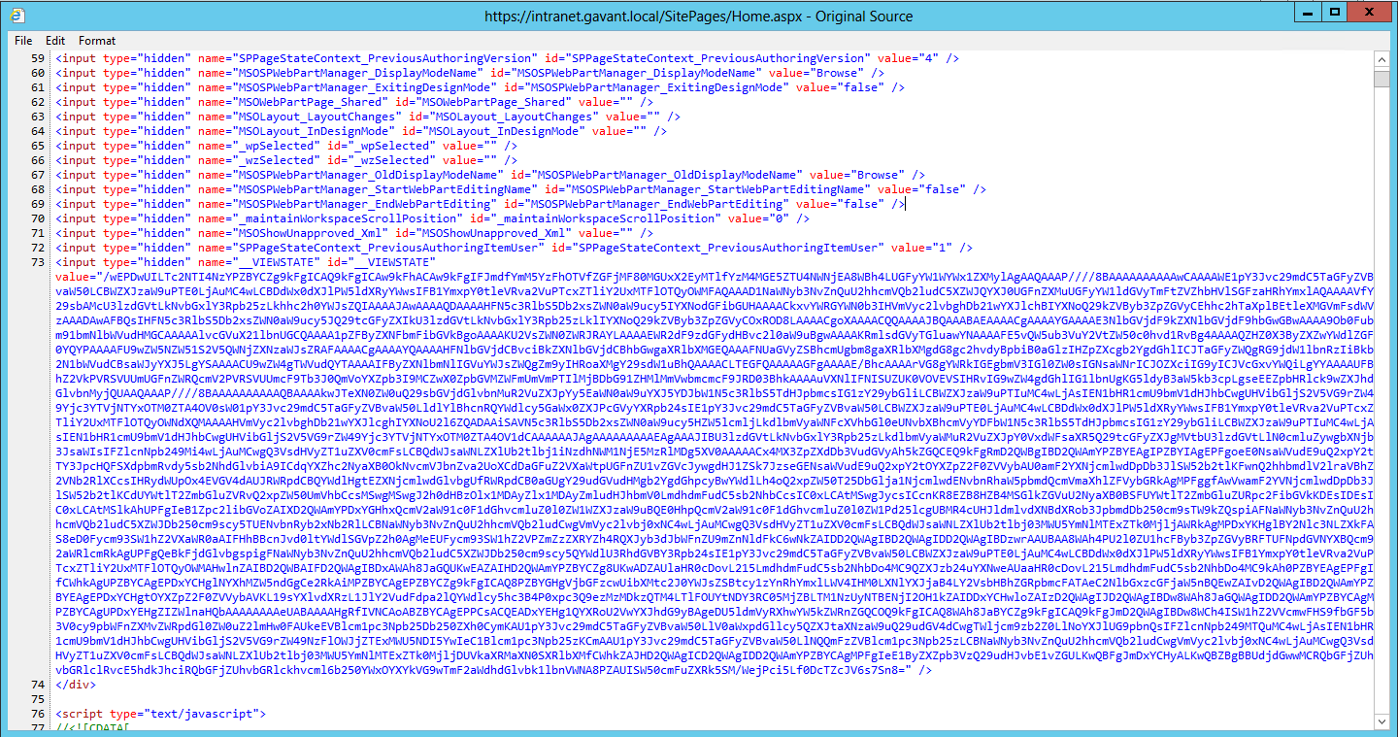
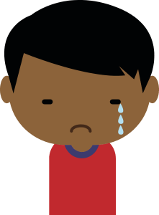
The Code
Notes:
So Tim started his work
The page was a web-form and the markup was 5000 lines…and the code behind was 5000 lines.
There were several tabs jammed onto one page and some interesting convention driven development.
Magic would happen if your control started with dr vs dn
Tim spent some time untangling the page. But Tim wanted to understand why the page was written the way it was.
Tim asked around and the other developers and business analysts gave him much needed information about overpayment processing

Slide 43
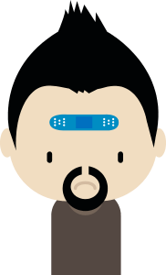

Medical Event
Notes:
It starts with a medical event
A person gets an injury, which maybe requires a bandage and x-ray
The result is a medical claim
The Hospital or Physician will submit a medical claim to the insurance company (Healthcare Inc)

Slide 44


Timer Started
Notes:
Once the medical claim is submitted a timer starts
Health Insurance Companies are federally and state mandated to pay claims in a fixed period of time…think 30 – 60 days
If the Health Insurance Company can not find any issues with the medical claim they pay the claim

Slide 45


Overpayment
Notes:
coding error and instead of a bandage and x-ray they coded as HEAD REATTACHMENT
Costly
Well the federal government and states allow period of time to go after overpaid claims…think 2 years.
So how much money…Tim was told hundreds upon hundred of millions of dollars were recovered every year.
Cerberus was the software Healthcare. Inc. used to manage the overpayments.
Tim found this information very useful, but it did not explain how the business used the search page to find work.

Slide 46
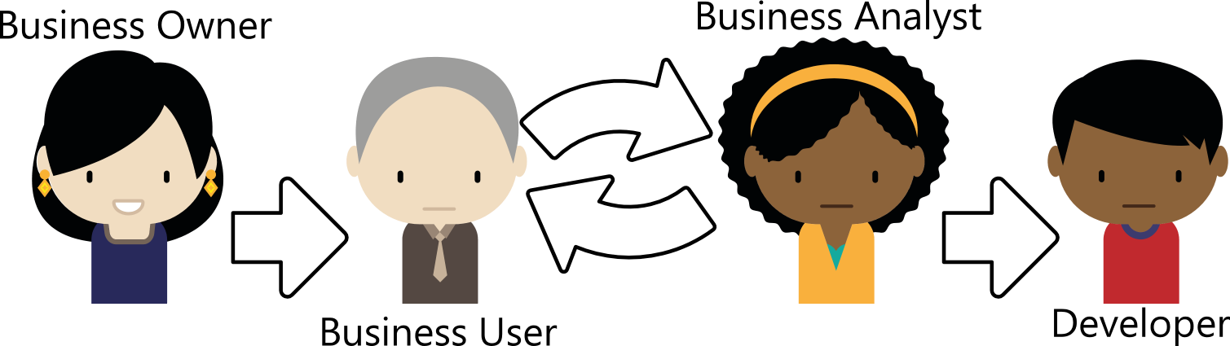
Communication Pattern
Notes:
Tim asked the manager of his group to speak to a “business user”, but was informed of the policy stating developers were not allowed to talk to “business users” directly.
The Management approved communication plan was:
Business Owner - finds money for project.
Business User – is delegated responsibility of delivery on the capital allocated for the project
Business analyst works with business user to gather requirements then translate into technical specification
Developers create software based on technical specifications.

Slide 47
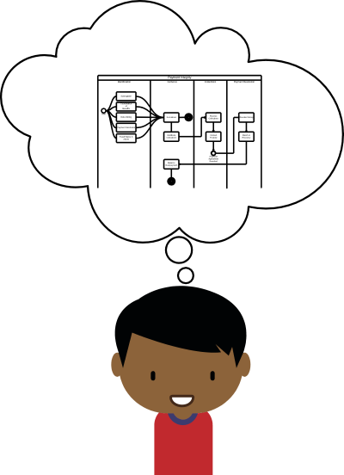
Mental Model Is Context
Notes:
Problem for TIM without a Mental Model he could not:
create a well designed, performant, extensible product
Developers must be able to talk to business to understand the drivers of a feature.

Slide 48
New Project
New
Features
Notes:
Tim finished his page and showed the final result with new timings to his boss. Tim’s boss was impressed.
Next Tim was given the opportunity for a new project with new features.

Slide 49
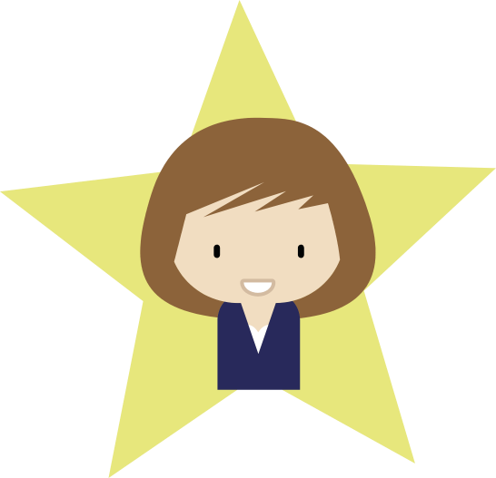
The Oracle
Attributes
Access to Business Users
Understanding of Business Process
Rough understanding of technology
Wants to discuss how business works and how technology is being applied to solve problems
Notes:
The Oracle was the Business Analyst for the project
An Oracle has all the hidden truths of the business
Tim’s Oracle would
talk to the development team about business drivers
listen to development concerns about how requirements were impacting code quality

Slide 50
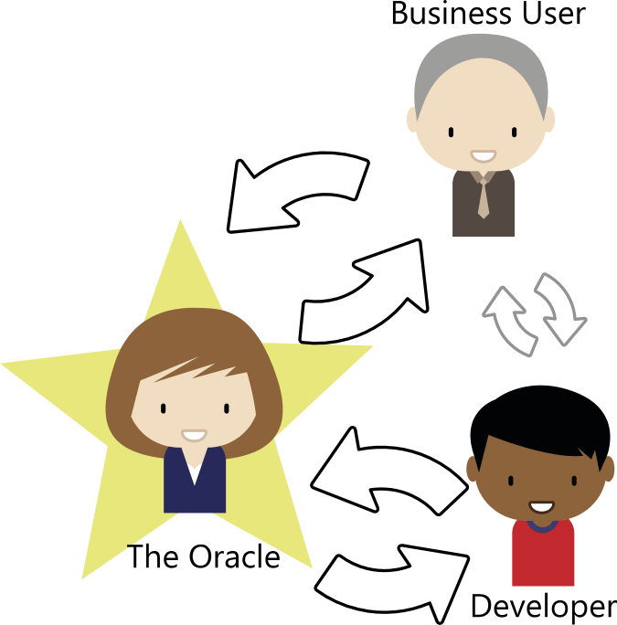
Oracle, Developer, Business
Notes:
As Tim and The Oracle worked long hours, and as he gained trust he got unprecedented access to the business stakeholders.

Slide 51
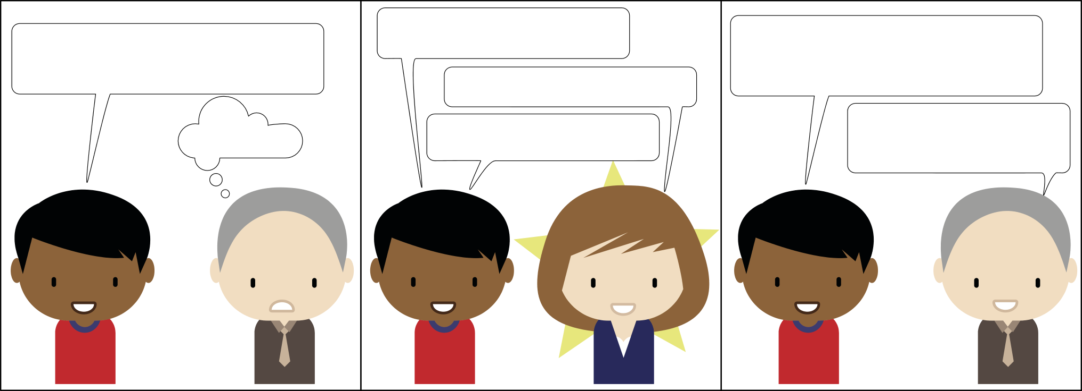
Learning a new Language
Why? Why? Why?
Why? Why? Why?
What are the business drivers for this project? What is the expected ROI?
Business Drivers and ROI
???
Oh…those are nice words!
Great questions! Let me explain…
Notes:
The Oracle taught to shape questions of “Why”, so that the stakeholder would not shut him down with “Because I told you so and I am writing the checks”.
Understand the ROI specific to the project.
Tim found that business analysts and business users were taught to use technical terms…
Example: I need a sortable grid on this page and a hyperlink to this other page where I need filtered search box.
These are they how(s) I need to know the problem statement!

Slide 52

Success
Notes:
With some small bumps in the road Tim, The Oracle, and other developers successfully release the software.
The Oracle PROMOTED to Business Analysis for multiple divisions of the company.
Tim was made an architect.

Slide 53
Tim’s Mental Model 2
Payment Integrity
Overpayment Discovery
Cerberus
Payment Resolution
Analyst Verify Overpayment found
Find Work
Run Algorithm
Do Work
Receive Money
Gather Identified Overpayments
Balance Overpayment
Match to Recovery
Send
To
Cerberus
CLAIM
CLAIM
CLAIM
Done
Notes:
DARK BLUE IS NEW
Oracle’s help discovered a business unit identify the overpayments
Discussions on Drivers and expected ROI revealed
So the boundaries are: (Overpayment Discovery, Overpayment Management, Payment Resolution)
contexts separating…
Overpayment Discovery details of a medical claim as they looked for overpayments
A claim in Cerberus was a balance
Payment Resolution focused on money received and a claim was just a reference for accounting checks and balances.
CLAIM

Slide 54
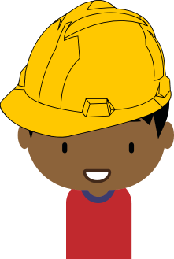
Tim the Architect

Slide 55
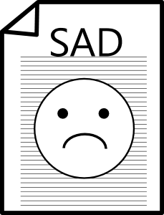
Solution Architecture Document
Notes:
New types of work…like SAD. Very specific diagrams from a business context diagram -> deployment diagram.
Different perspectives on Cerberus was enlightening
Time most valuable

Slide 56

The Guru
Attributes
Highly technical
A sounding board for ideas
Interested in tackling Essential Complexity
Life long learner
Notes:
Another architect assigned to Cerberus
Attributes technical, sounding board, tackling Essential Complexity, Life Long Learner
Tim’s Guru was also uncompromising in his desire for business process and software to make sense.

Slide 57

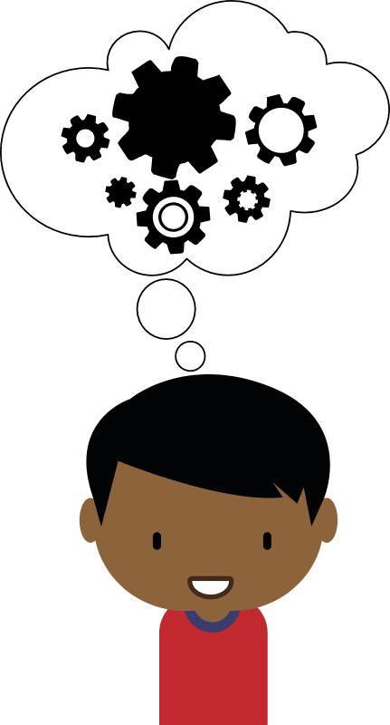
Collaboration
Notes:
Layered In each other’s experiences with the products and business domain knowledge.
Reached out to The Oracle or to business people he had relationships with.
Long timers (developers) who would give him historical context.
Other Analogies to the problem domain
Is this like a used sales man
Is this like an accounting system
What are the Accounting words we could use?

Slide 58
Tim’s Mental Model 3
Payment Integrity
Identification
Cerberus
Collections
Payment Resolution
Analyst Verify Overpayment Found
Run
Algorithm
Done
No
Receive and Validate Overpayments
Yes
Distribute Collections
Receive Collections
Contact Provider
Gather Identified Overpayments
Valid?
Receive Money
Check Progress of Recovery
Report Collections Progress
Payment
Agreement
Reached
Send
To
Cerberus
Balance Overpayment
Done
Match Money to Recovery
CLAIM
CLAIM
CLAIM
CLAIM
Done
Notes:
DARK BLUE IS NEW
CLAIM
Validation of Overpayments (< 2 years old, not duplicate, had required info)
Collections (manage the communications with Hospitals and Physicians)
contract out some collections work
Tim could see more boundaries being identified Different Definitions of CLAIM.
In each boundary the definition and meaning of CLAIM had a slightly different meaning and each boundary had its own terms which were most important to it

Slide 59

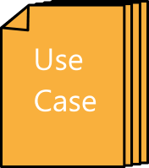
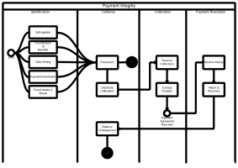
Validate Model
Notes:
Validated the new model via USE CASES.
Integrity check on the evolution of the model.

Slide 60
New Integration
New
Integration
Notes:
New Integration for Cerberus
Difficulty understanding how the new integration was trying to USE Cerberus.
Many business units
Each business unit had different responsibilities and therefore different drivers.
PRODUCERS & CONSUMERS
SIMPLIFIED model

Slide 61
Tim’s Mental Model 4
Payment Integrity
Identification
Cerberus
Collections
Payment Resolution
Department 1
Department 2
Exclusions
Receive Collections
Contact Provider
Department 3
Start
Done
Department 4
Department 5
Distribute Collections
Receive Money
Payment
Agreement
Reached
Balance Overpayment
Match Money to Recovery
CLAIM
CLAIM
CLAIM
CLAIM
Done
Notes:
DARK BLUE IS NEW
CLAIM
Boundaries:
Identification (Each business group had a different specialty for identifying overpayments)
Exclusions (ask Cerberus if the overpayment is valid)
Distribution of collections (good overpayment internal)
Collections (track communications to agree on money)
Payment Resolution (get money)
Balance of the overpayment (Accounting)
Each distinct boundary had its own notion of a CLAIM
Separating each boundary simplified the models in the boundary ultimately identifying the bounded contexts.

Slide 62
Result
Notes:
The result was an elegant solution to the integration project
The Guru and Tim created abstractions (interfaces) to represent the firm boundaries and separated the new features from the general code base
They did not REWRITE Cerberus…but future features would move the solution closer to the simplified model

Slide 63
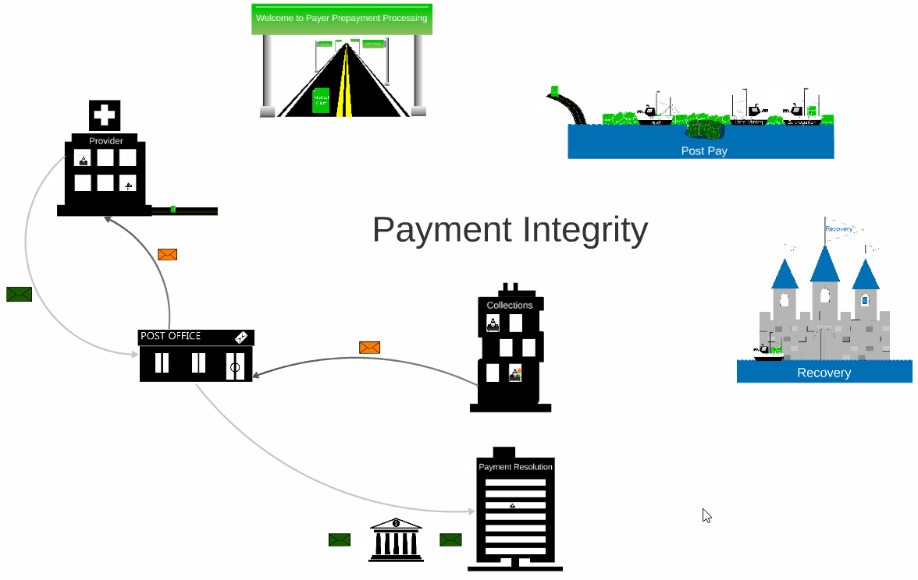
Prezi
http://prezi.com/vioimegmepr1/?utm_campaign=share&utm_medium=copy&rc=ex0share
Notes:
After 4.5 years Tim had reached an understanding of how the business worked.

Slide 64

What Could Have Been
Notes:
If Tim had understood what a bounded context was
He could have purposely searched out and pushed for an understand of the business
If On Boarding had been focused on the Essential Complexity of the health insurance domain
Or if he had met the Oracle earlier and learned how to talk to business and had access to them
Or if had met the Guru earlier and spent time analyzing the problem domain
He could have formed his mental model faster
He could have broken up the monolithic application sooner
He could have NOT introduced more technical debt to Cerberus
He could have given better estimates on new features
He could have made Cerberus more TESTABLE
He could have SIMPLIFIED Cerberus

Slide 65
4
Takeaways

Slide 66
Takeaways
Bounded Context
Model
Bounded Contexts are models with explicit boundaries, where the model is unambiguous within the boundary
Bounded Contexts are useful in many different architectural styles
Identifying Bounded Contexts requires significant effort, so focus on your core business
Many large business applications would derive value from utilizing Bounded Contexts

Slide 67
Takeaways
On Boarding
Focus on the essential complexity, the domain
It takes time for humans to digest new information
A person will not gain deep knowledge without asking questions
Notes:
Focus ESSENTIAL COMPLEXITY is in the domain NOT technology.
REVISIT domain and bounded contexts – It takes time

Slide 68
Takeaways
The Oracle
Identify an Oracle and/or business users to help refine the model
Learn how to shape questions in business terms
Software design is a collaborative process and requires open communication between business users and developers

Slide 69

Takeaways
The Guru
Stitch together other peoples’ experience to create a larger model
Identify a Guru to use as a sounding board
Use relationships with gray beards to establish context of decisions
Utilize Use Cases to continually validate the model
Take time to analyze the problem domain
Notes:
Soil Core Sample (Gray Beards)
Analyzing the problem domain is very important because it allows the developer to create a mental model of the interacting models.
Without a mental model there is no way to find discrepancies/ambiguity in definitions which identify the existence of boundaries and therefore bounded contexts.

Slide 70
Takeaways
New Integration
New
Integration
Identify all upstream and downstream business users
Learn about how the business units who interact with your system are divided and what their responsibilities are
Notes:
Business Units are divided and what their responsibilities are.
Wrap it up here…before references

Slide 71
References
Greg Young CQRS/DDD talks extensively about bounded context
https://youtu.be/KXqrBySgX-s
Udi Dahan - CQRS and DDD
https://youtu.be/EkEz3pcLdgY
A good discussion of Bounded Context
http://programmers.stackexchange.com/questions/237513/what-in-reference-to-ddd-is-a-bounded-context
Eric Evans - Domain Driven Design
http://www.infoq.com/presentations/model-to-work-evans
Bounded Context Discussion
http://culttt.com/2014/11/19/bounded-contexts-context-maps-domain-driven-design/
Eric Evans - 5 Years after DDD pushed
http://dddcommunity.org/library/evans_2009_1/
Discussion of importance of bounded context
http://eventuallyconsistent.net/2012/05/14/why-bounded-context-really-matters/
Definition of Context
http://www.urbandictionary.com/define.php?term=context
Bounded Context Defintion
http://martinfowler.com/bliki/BoundedContext.html
Context and Context Mappings in DDD
http://www.infoq.com/articles/ddd-contextmapping

