Slide 1


Modular Design
Developing, Maintaining, and Extending Component-Based CSS
Erin Depew
January 7th 2016

Slide 2
The Current State of CSS
BEM
SMACSS
OOCSS
Utility Classes

Slide 3
Methodology - Hierarchy
Globals
Simplified Pattern Lab model
One to one relationships
Unidirectional Hierarchy

Slide 4
Our File Structure
|-- CSS |-- atoms
|-- _button.scss… |-- molecules
|-- _bitlink-item.scss… |-- templates
|-- _layout.scss… |-- globals |-- _colors.scss |-- _fonts.scss |-- _reset.scss…

Slide 5
Methodology - Components
Parts of a component:
Name
Children
Nested Components
Aspect

Slide 6

Our Component

Slide 7
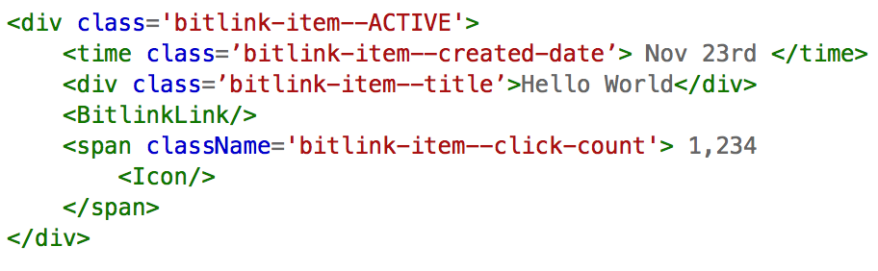
Our Component

Slide 8
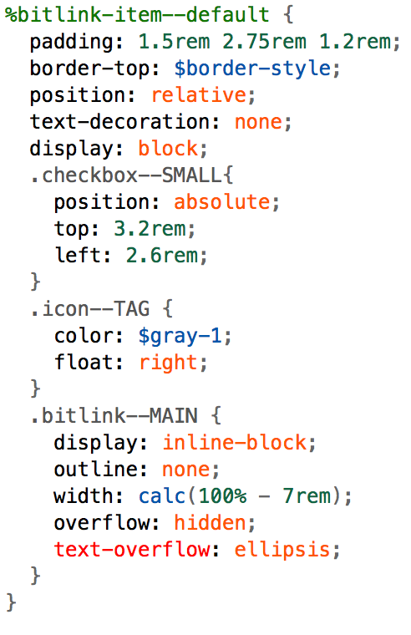
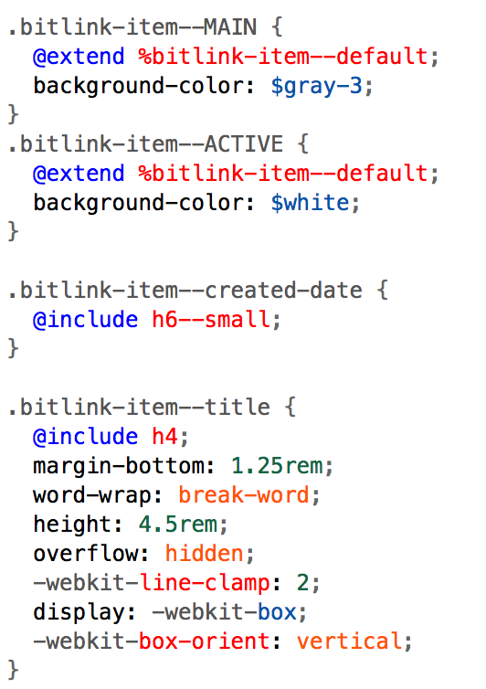
Our Sass

Slide 9
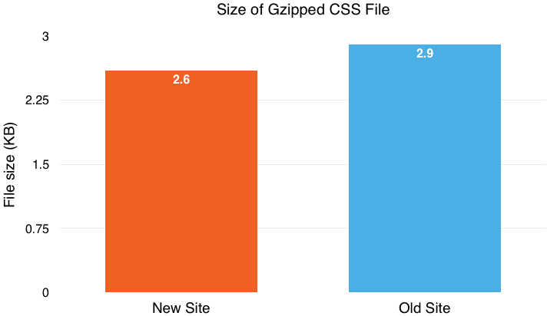
The Stats

Slide 10
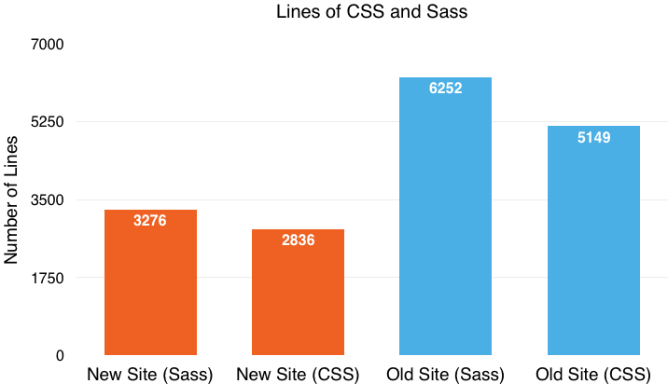
The Stats

Slide 11
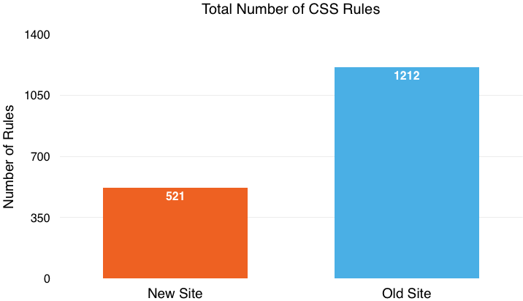
The Stats

Slide 12
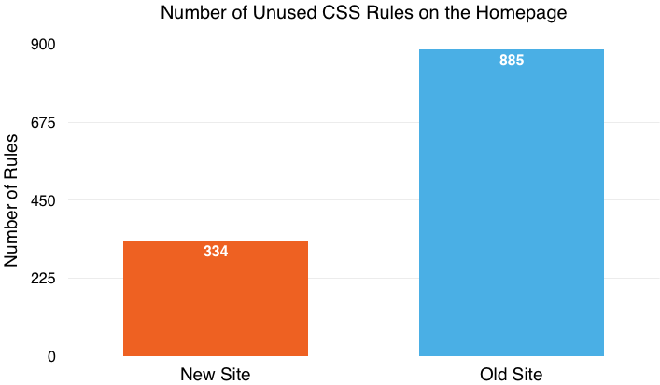
The Stats
Notes:
new site: 64% of total, old site: 73% of total

Slide 13
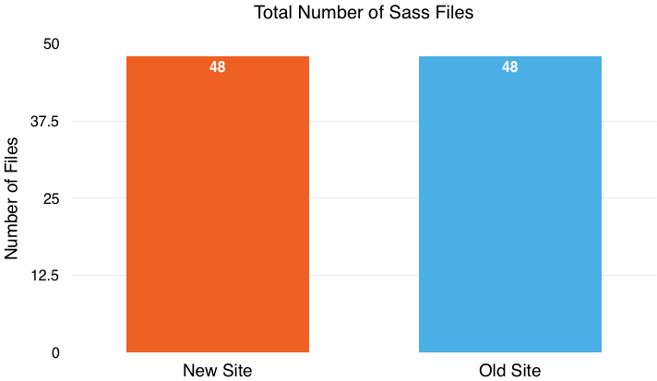
The Stats

Slide 14
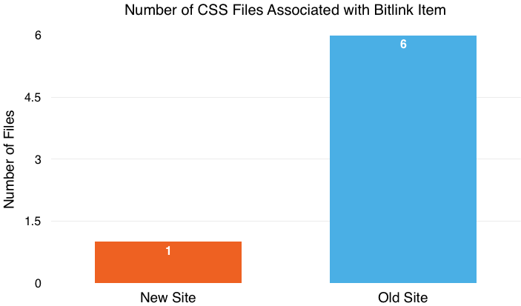
The Stats

Slide 15
What About React Inline Styles?
Netscape’s JSSS
Separation of concerns
DOM weight
High-specificity
CSS solutions for dynamic styling
Alternative solutions for cascading issues

Slide 16
What’s the Catch?
Requires discipline and restraint
Requires a CSS preprocessing language
Naming stuff is hard
Not particularly DRY

Slide 17
Benefits
Simplified hierarchy
Reduce nested selectors
1:1 relationships and no element styles
Readable HTML
Smaller CSS files
(Relatively) stress-free maintenance and refactoring!

