Slide 1
Python Koans: An Introduction to Python
David Stanek • CodeMash 2016
Notes:
Make introductions; Pirnat fairly new to Django, have learned a lot about it from Mike and Dave over the course of preparing the tutorial

Slide 2
Today
Lean about Koans and the Koans process
Learn a little about Python to set the tone
Iterate through hands-on self-paced exercises and discussion
I’ll be walking around the room to help you get through issues
We can also do some exercises together
Notes:
Here's what we're going to be doing today

Slide 3
koan defined
a paradox to be meditated upon that is used to train Zen Buddhist monks to abandon ultimate dependence on reason and to force them into gaining sudden intuitive enlightenment
source: http://www.merriam-webster.com/dictionary/koan

Slide 4
Python Koans
“Learn Python through TDD”
305 exercises divided into 37 lessons aimed at teaching Python step-by-step (and growing)
Exercises are executed using a test suite
Run the suite and you will get an error because something is broke
TDD-like because RED->GREEN(->REFACTOR)
Notes:
Here's what we're going to be doing today

Slide 5
Requirements
Your favorite text editor
Python 3.5 (other versions may also work)
A clone of https://github.com/dstanek/python_koans
( A zip is also available from http://prereqs.codemash.org/Files/python_koans-master.zip )
Notes:
Here's what we're going to be doing today

Slide 6
Getting Started
Open up a terminal window
Change directory into the directory containing your Python Koans clone
Change directory into the python3 subdirectory
Execute the test suite
Notes:
Here's what we're going to be doing today

Slide 7
Let’s Do The First One Together
off to the terminal → (╯°□°）╯︵ ┻━┻)
Notes:
Mac? Linux? Windows? Python experience? Web dev? Django? Rails? etc? Pairing?

Slide 8
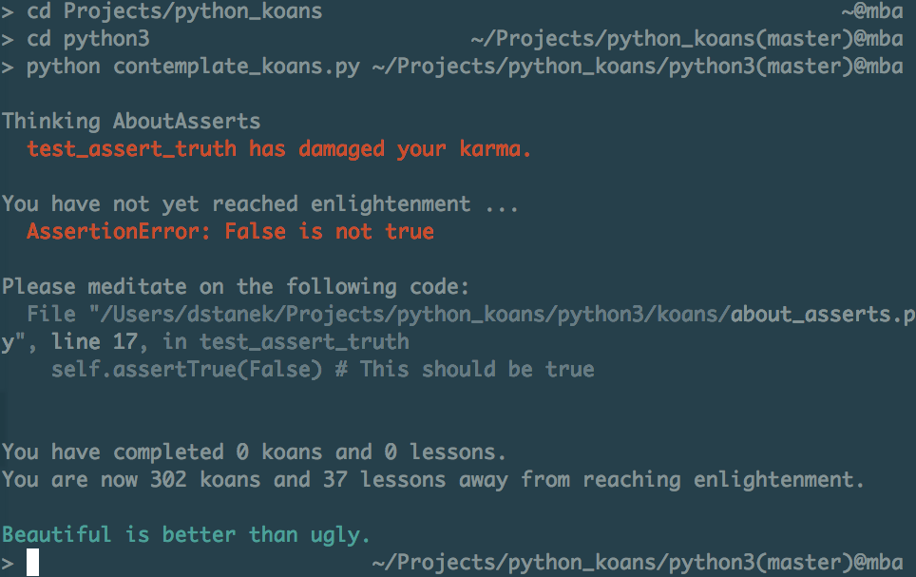

Slide 9
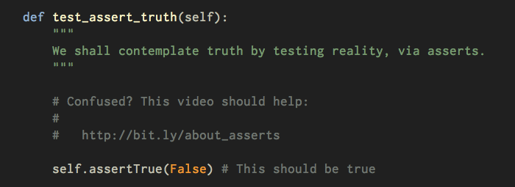

Slide 10
SUPER helpful hints
Read the name of the test as it tells you what the koan is trying to teach
Follow the links in the comments to read the supporting materials
Read the entire body of the test method and not just the line where the error occurred
Notes:
Here's what we're going to be doing today

Slide 11
Quick Notes
Some tests will require you to open interactive Python to do some experimenting -or- writing code in temporary scripts
Using help is NOT cheating
help() in the interactive interpreter
https://docs.python.org/3.5/tutorial/
Internets
Notes:
Here's what we're going to be doing today

Slide 12
Links
Some tests will require you to open interactive Python to do some experimenting -or- writing code in temporary scripts
Using help is NOT cheating
help() in the interactive interpreter
https://docs.python.org/3.5/tutorial/
Internets
Notes:
Here's what we're going to be doing today

Slide 13
On your marks,
Get set,
GO
Notes:
Mac? Linux? Windows? Python experience? Web dev? Django? Rails? etc? Pairing?

Slide 14
Nothing to see here. You should be working!
Notes:
Mac? Linux? Windows? Python experience? Web dev? Django? Rails? etc? Pairing?

Slide 15
What did you learn?
What surprised you?

Slide 16
About Us
David Stanek
Rackspace
http://traceback.org
@dstanek
dstanek@dstanek.com
Mike Pirnat
American Greetings
http://mike.pirnat.com
@mpirnat
mpirnat@gmail.com

