Slide 1


Architecture Patterns
Adding Tools to the Toolbox

Slide 2

Jim Everett
Developer, Architect, Software Enthusiast
Experience
HMBer
Married father of 2
Software Enthusiast
16 years of .NET Experience
Enterprise Architect
Developer
Scrum Master
Life Learner
 https://twitter.com/CognitiveBurden
 https://github.com/cognitiveburden
 cognitiveburden@gmail.com

Slide 3

What is your favorite Architecture?

Slide 4
Introduction
Architecture Patterns
Layered
Microservices
Most common architectural style, N-Layered.
There are many variations of passages but the majority have suffered alteration in some form by injected.
Event-Driven
Space-Based
There are many variations of passages but the majority have suffered alteration in some form by injected.
There are many variations of passages but the majority have suffered alteration in some form by injected.
Microkernel
There are many variations of passages but the majority have suffered alteration in some form by injected.
Discuss several well known architectural patterns with their pros and cons. The goal is for the listener to have an understanding of the patterns and be more informed on the types of architecture when faced with architectural decisions.

Slide 5
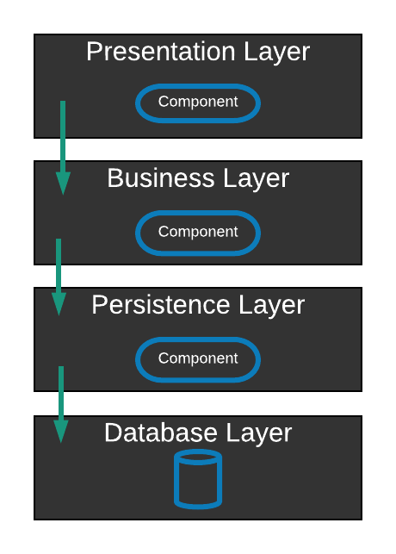

Layered Architecture
MMM…Tastes so good.
Typically:
Presentation
Business
Persistence
Database
Notes:
Typically 4 layers
Each with a specific role and responsibility
Describe each role
Separation of concerns – logic only pertains to code in that layer
Easy to develop, test, govern, and maintain applications due to well-defined component interfaces.
Closed layers means you must pass through them, open means you can skip layers.
Walk through an example of getting a user information and work list

Slide 6

Pros & Cons
Layered Architecture
Pros
General Purpose Pattern
Starter Arch for new application
Cons
Sinkhole anti-pattern
Best for Monolithic applications
Notes:
Sinkhole anti-pattern
Requests flow through layers which are a pass through (no logic)
Think 80/20 rule with sink-hole (having only 20% of calls be pass through and 80% having some business logic)
If 80 % is pass through consider opening up your layers so they can skip a layer.
Best suited for Monolithic applications

Slide 7
Pattern Analysis
Layered Architecture


Agility
Performance
Changes can be isolated to a layer, it is time-consuming to make changes due to Monolithic nature.
Pattern does not lend it self to performance because every request must go through multiple layers.


Ease of Deployment
Scalability
One small change can result in redeploying the entire application.
Due to tightly coupled monolithic design is difficult to scale. Large granularity of layers makes expensive to scale.


Testability
Ease of Development
Because components belong to specific layer, other layers can be faked, making it easy to test.
Pattern is well known and not overly complex. Matches well with companies communication patterns, Conway’s Law.

Slide 8



Event-Driven Architecture
What’s Going On
Mediator
Distributed Async Pattern
Composed of highly decoupled, single purpose event processing components that asynchronously receive and process events.
Broker
Notes:
Lack of atomic transactions for single business process.
Which events can run independently and which can’t.
Difficultly in creating, maintaining, and governing of the event-processor component contracts.

Slide 9
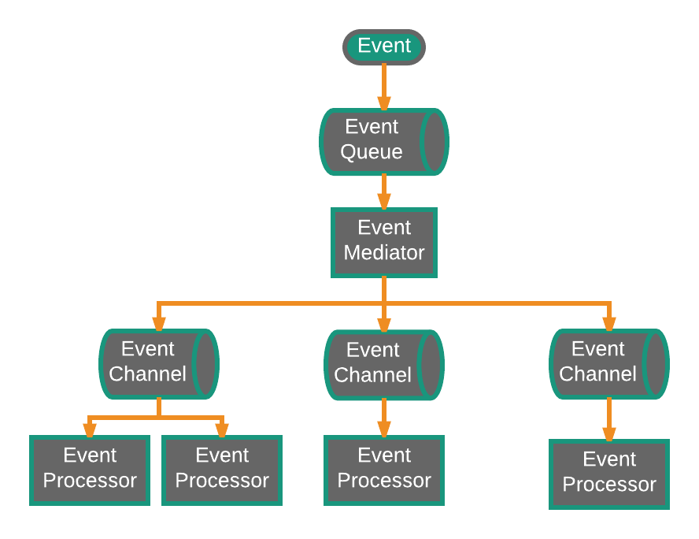
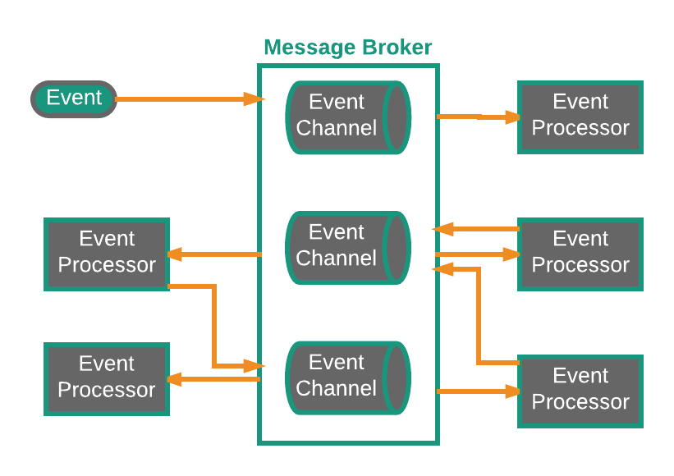
Mediator vs Broker
Mediator
Broker
Notes:
Mediator used when steps need to happen in order and therefore need orchestration.
Think Spring Integration, MULE ESB
Logic in the middle of your infrastructure
No Business logic in Event Mediator
2 types of events…Initial & Processing
Broker
For Simple workflow not orchestration needed
ActiveMq, RabbitMQ
Each event processor emits a new processing event

Slide 10
Pattern Analysis
Event-Driven Architecture


Agility
Performance
Able to respond quickly to constantly changing environment. Since event-processor components are single purpose and decoupled, changes are isolated and quickly change without impacting others.
Possible that will not perform well with all the messaging infrastructure, asynchronous capabilities, decoupled parallel execution outweighs cost.


Ease of Deployment
Scalability
Relatively easy to deploy because decoupled. Broker easier to deploy than mediator.
Naturally achieved through highly independent and decoupled event processors.


Testability
Ease of Development
Unit testing not difficult, but testing is complicated by async nature of pattern.
Development and can be complicated due to async nature of the pattern. Advanced error handling, unresponsive event processors, and failed brokers are complicated problems.
Notes:
In General this is type of pattern you need to put in ideas of correlation id to track

Slide 11
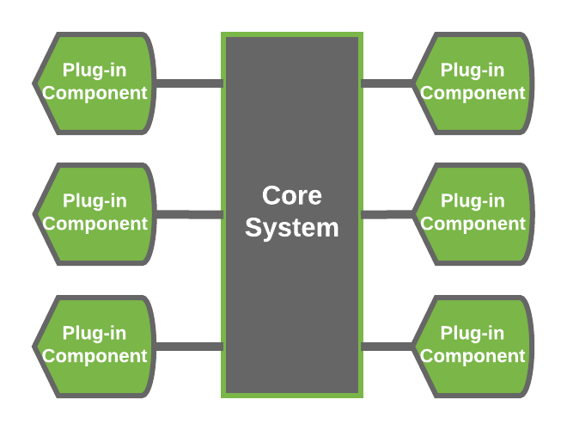
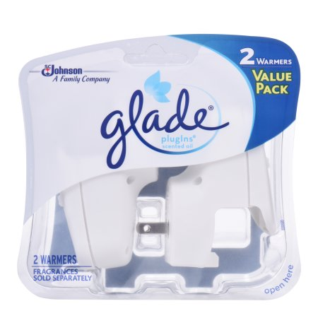
Microkernel Architecture
Plug it in, plug it in
Great for Products
Add features as plug-ins
Extensible
Feature Separation
Feature Isolation
Notes:
Known as plug-in architecture
Packaged and made available for download software internal or external
Application logic is divided between independent plug-in modules and the basic core system, providing extensibility, flexibility, and isolation of application features and custom processing logic
provides great support for evolutionary design and incremental development

Slide 12


Core vs Plugin
Microkernel

Core

Plug-in

Minimal viable business logic to make application valuable
Implements a plug-in registry
Connected via OSGi, messaging, web services, point-to-point
Remain independent of other plug-ins
Notes:
Remember to implement versioning strategy
Eclipse and modern browsers are examples of microkernel
Can nest architectural patterns, could use Microkernel within even-driven

Slide 13
Pattern Analysis
Microkernel Architecture


Agility
Performance
Able to respond quickly to constantly changing environment. Changes isolated and implemented quickly through loose coupled plug-in modules.
Not naturally high performance, often perform well because only include features you need.


Ease of Deployment
Scalability
Plug-ins can be added dynamically (hot-deploy).
Core is often smaller in size and deployed as one unit, making it hard to scale.


Testability
Ease of Development
Plug-ins can be tested in isolation and easily mocked by core system.
Requires thoughtful design and contract governance. Contract versioning, plug-in registry, plug-in granularity, and wide array of connectivity choices make complex.
Notes:
Core usually becomes stable quickly
What is core of your system?

Slide 14
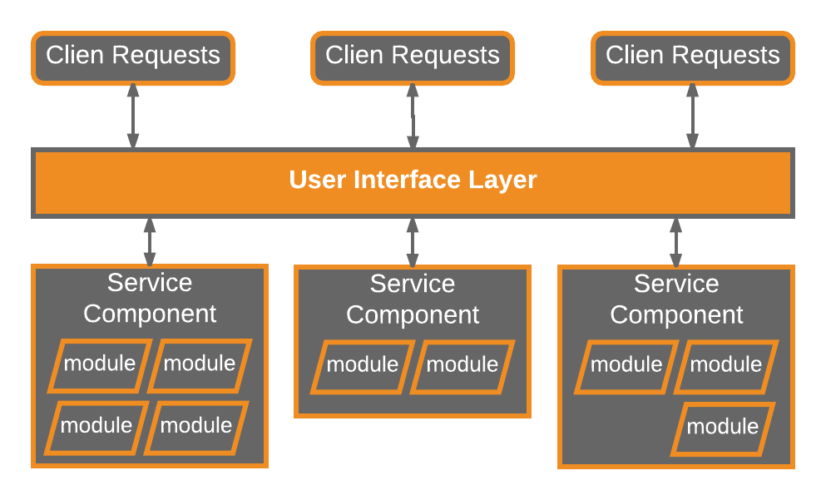
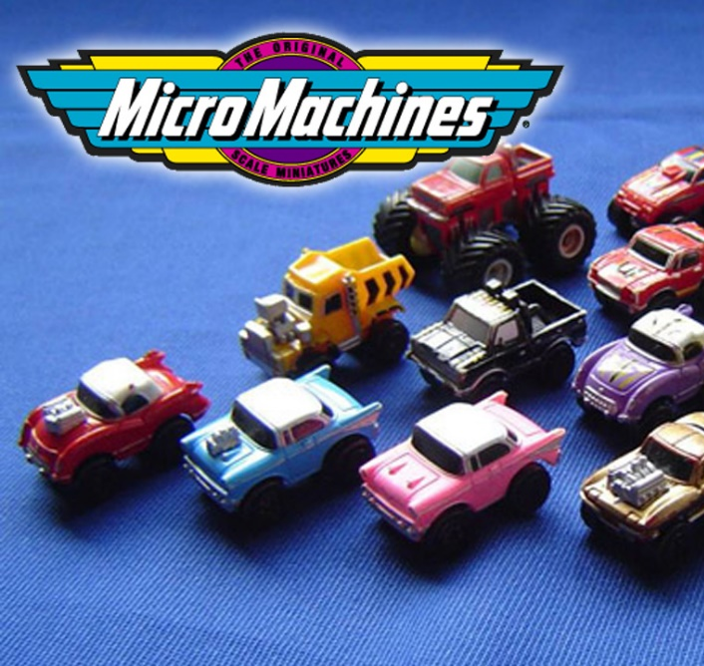
Microservices
Collect them all
Separately deployed units
Distributed Architecture
Easier deployment due to isolation
Microservice as a service component
Microservice has a single purpose
Evolution of monolithic and SOA
Notes:
Distributed architecture
All components are fully decoupled and accessed through remote access protocol (JMS, AMQP,REST,SOAP,RMI, etc)

Slide 15
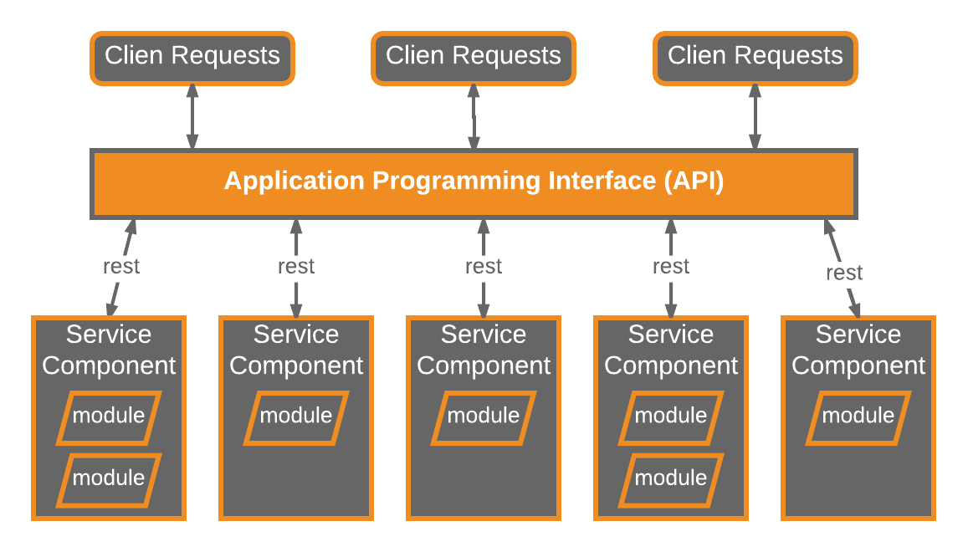
API REST-base Topology
Microservices
Useful for websites
Fine-grained services
REST-based interface
Notes:
Examples of this topology include some of the common single-purpose cloud-based RESTful web services found by Yahoo, Google, and Amazon.

Slide 16
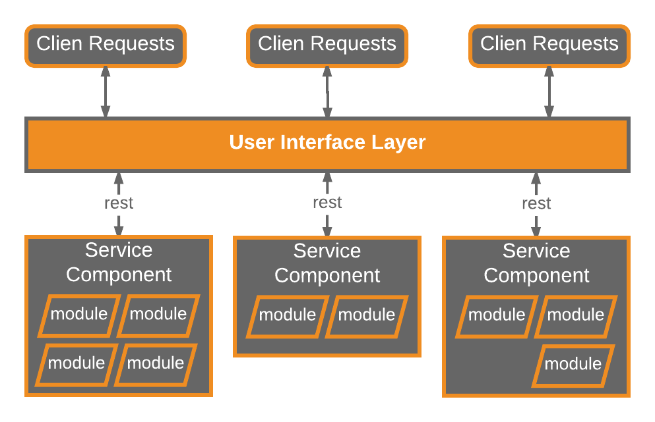
REST-base Topology
Microservices
Useful for fat-client apps
Through screen not API
Coarse-grained components
REST-based interface
Notes:
This topology is common for small to medium-sized business applications that have a relatively low degree of complexity.
Represent small portion of the business rather than fined-grained, single-action services

Slide 17
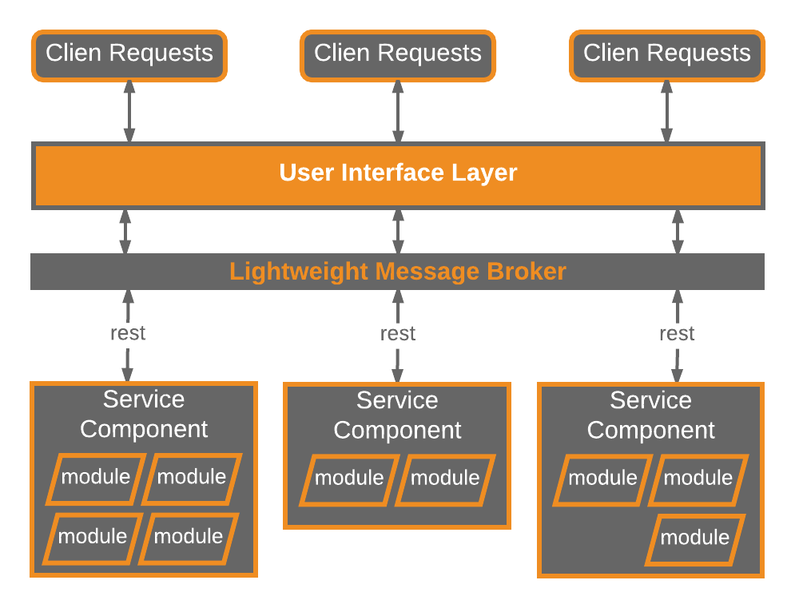
Centralized Messaging Topology
Microservices
Remote Access via Message Broker
NOT SOA-Lite
Coarse-grained components
REST-based interface
Notes:
lightweight centralized message broker (e.g., ActiveMQ, HornetQ, etc.).
larger business applications
requiring more sophisticated control over the transport layer between the user interface and the service components
benefits over the simple REST-based topology
advanced queuing mechanisms,
asynchronous messaging,
monitoring,
error handling,
better overall load balancing and scalability

Slide 18

Granularity of Service Components
Avoid Dependencies and Orchestration
L
Too Coarse
May not realize benefits of deployment, scalability, testability, & loose coupling.
S
Too Fine
Leads to service orchestration, which turns lean microservices into heavy SOA, with complexity, confusion, expense, & cruft.
M
Just Right
Get all of the agility, deploy-ability, testability, scalability, & develop-ability
Notes:
if you find you need to perform inter-service communication between service components to process a single request, chances are your service components are either too fine-grained or they are not partitioned correctly from a business functionality standpoint
Violate DRY to keep services independent

Slide 19
Pattern Analysis
Microservices Architecture


Agility
Performance
Able to respond quickly to constantly changing environment. Separate deployed units, changes limited to single service component.
Possible to create performant solution, but pattern does not lend itself to performance, due to distributed nature of pattern.


Ease of Deployment
Scalability
Easy to deploy due to the decoupled nature of event-processing components.
Because app is split into separate deployment unit, each service can be scaled.


Testability
Ease of Development
Isolation of business functionality into independent applications makes easy to test. Regression a particular service is possible.
Due to isolation of distinct service components , development is focused on smaller scope. Less chance a developer’s changes will impact other service components.
Notes:
Core usually becomes stable quickly
What is core of your system?

Slide 20
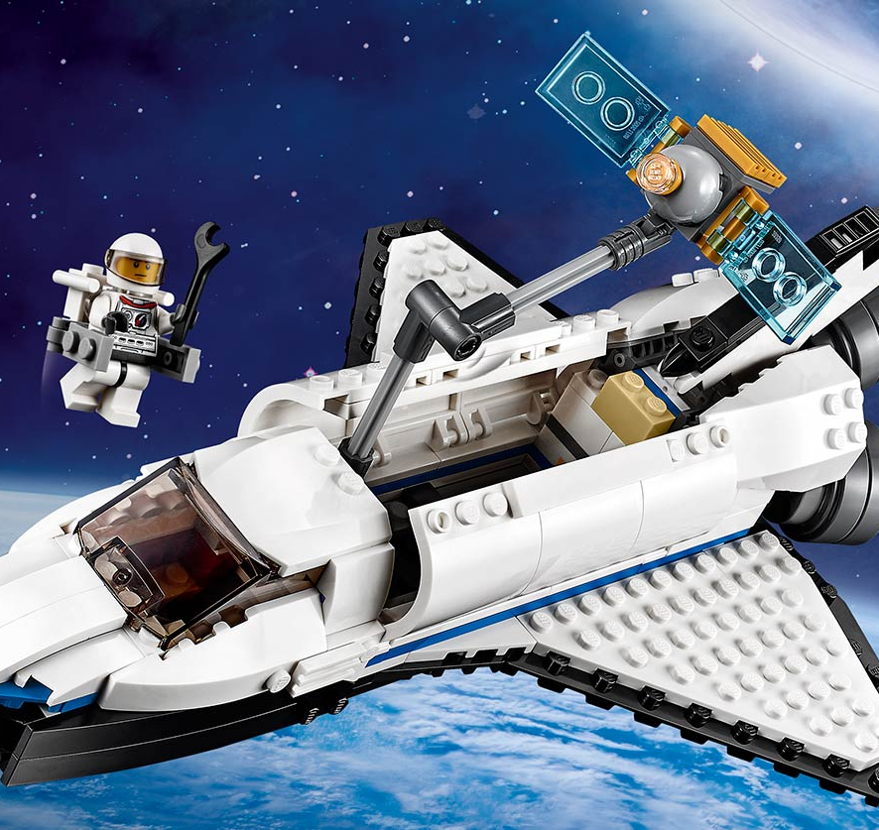
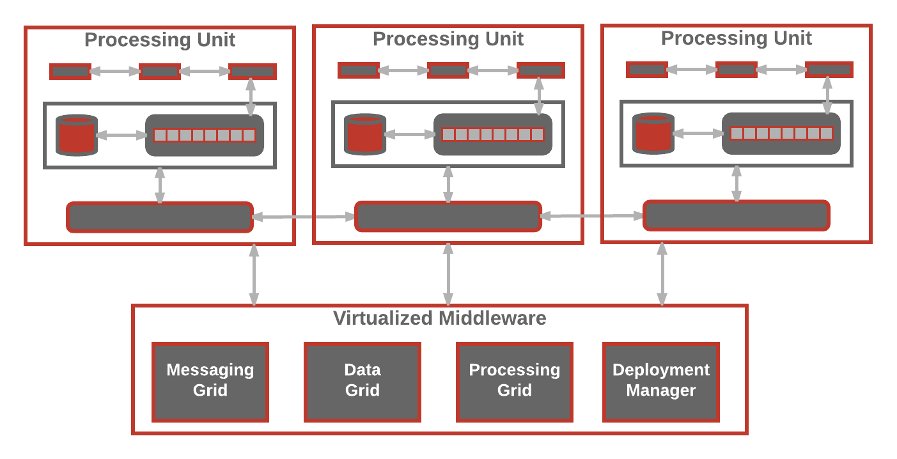
Space-Based Architecture
Build it
Solve Scalability issues
Address concurrency issues
For high concurrent user volumes
Aka the cloud architecture pattern
Remove central DB
Use replicated in memory data grids
Complex & Expensive
Notes:
name from the concept of tuple space, the idea of distributed shared memory
providing near-infinite scalability within the application.

Slide 21
Space-Based
Overview
Notes:
The contents of the processing unit varies based on the type of application—smaller web-based applications would likely be deployed into a single processing unit, whereas larger applications may split the application functionality into multiple processing units based on the functional areas of the application.
The virtualized-middleware component handles housekeeping and communications

Slide 22
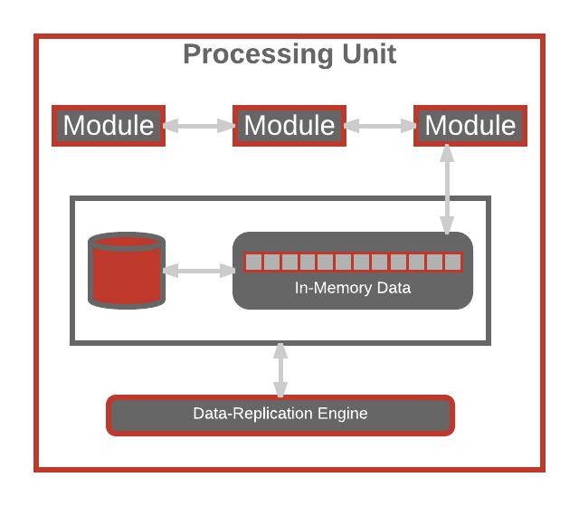
Processing Unit
Space-Based Architecture
Application logic in modules
In-memory data grid
Optional async persistence store
Data Replication Engine

Slide 23
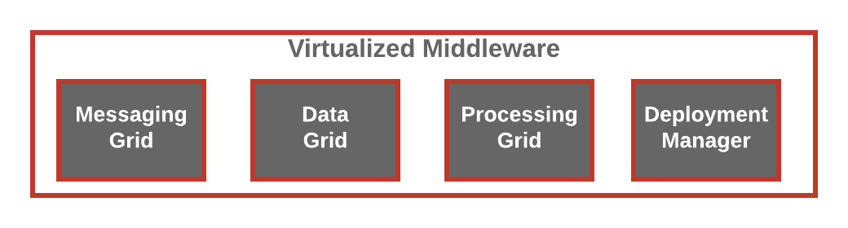
Virtualized Middleware
Space-Based Architecture
Message Grid
Data Grid
Processing Grid
Deployment Manager
Manage input requests
Manage Session
Determine which active processing unit to use
Scale of complexity
Manages data replication
Talks to each replicator
Replication in parallel async
Optional component
Manages distributed requests
Coordinates processing units
Orchestrates
Manages startup/shutdown of processing units
Monitors response times & user loads
If load increases start new processing unit

Slide 24
Pattern Analysis
Space-Based Architecture


Agility
Performance
Because processing units can be brought up/down quickly.
Achieved by in-memory data access and caching build into pattern.


Ease of Deployment
Scalability
While not decoupled or distributed, sophisticated cloud-based tools allow for easy push button deploy.
Achieved by not depending on centralized database, which is often the limiting bottleneck.


Testability
Ease of Development
Expensive and difficult to create user load to test architecture.
Complex caching and in-memory data grids make it difficult to develop. In addition, need to be diligent watchers of performance issues being introduced.

