Slide 1



The LIDA model’s hypotheses on the cognitive cycle, high-level cognitive processes, and brain rhythms
Stan Franklin
Notes:
Who”s IDA

Slide 2
Cognitive Architecture
Attempts to mirror the structure of cognitive systems (e.g. humans)
So as to produce behaviors mirroring those of cognitive systems
Can be conceptual or computational or both
LIDA is a cognitive architecture
October 19, 2007
Univ of Memphis — Computer Science Department

Slide 3
LIDA based on Cognitive Science
LIDA implements central ideas from Global Workspace Theory (Baars 1988)
LIDA also implements central ideas from other cognitive theories
  Embodied cognition (Glenberg & Robertson 2000)
  Perceptual symbol systems (Barsalou 1999)
  Long-term working memory (Ericsson & Kintsch 1995)
  Transient episodic memory (Conway 2001)
October 19, 2007
Univ of Memphis — Computer Science Department

Slide 4
LIDA Cognitive Architecture
Basic assumptions
  Every autonomous agent operates by frequent iteration of sense-process-act cycles
  A LIDA controlled agent functions via a continual cascade of cognitive cycles
  High-level cognitive processes are produced by sequences of these cognitive cycles
October 19, 2007
Univ of Memphis — Computer Science Department

Slide 5
Functions of a Cognitive Cycle
Sense the environment (internal or external)
Understand the current situation
Decide what part to attend to
Select an appropriate action to take
Execute the action (internal or external)

Slide 6
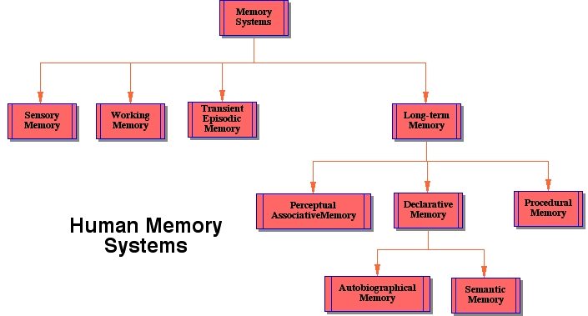

Slide 7
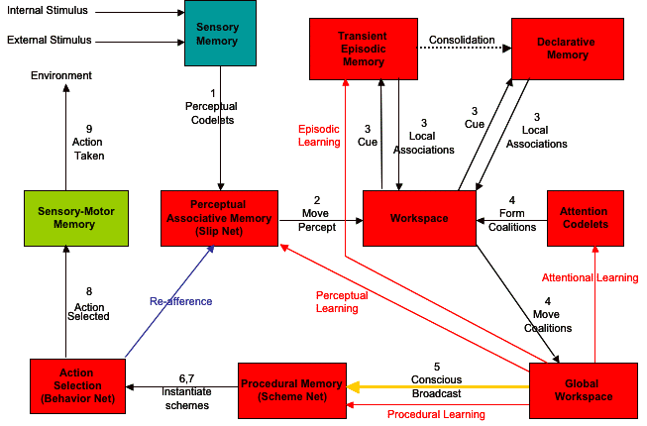
LIDA Cognitive Cycle

Slide 8
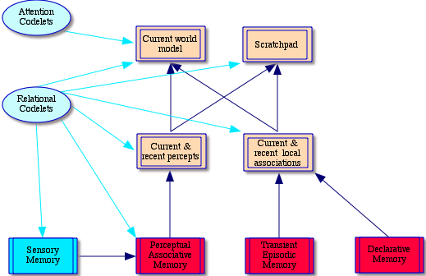
LIDA’s Workspace
Workspace

Slide 9
Human Cognitive Cycle Processing
Hypothesis— Human cognitive processing is via a continuing iteration of Cognitive Cycles
Duration— Each cognitive cycle takes roughly 200 ms
Cascading— Several cycles may have parts running simultaneously in parallel
Seriality— Consciousness maintains serial order and the illusion of continuity
Cycle— The cognitive cycle corresponds to the action/perception cycle

Slide 10
Feelings & Emotions
Feelings – thirst, pain, anxiety, boredom
Emotions – fear, shame, confusion
  Emotions = feelings with cognitive content
Feelings (including emotions) serve to
  Implement motivations
  Modulate learning
  Bias sensory-motor actions

Slide 11
Learning in LIDA
Learning takes place during each cycle
Learning is a function of attention and of arousal level
Feelings and emotions modulate learning
Modes of learning
  Perceptual
  Episodic
  Procedural

Slide 12
Selectionist & Instructionalist Learning
Selectionist Learning
  selected for reinforcement from a redundant repertoire
Instructionalist Learning
  new representations constructed
LIDA learns by both methods

Slide 13
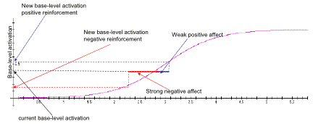
Modifying Base-level Activation

Slide 14
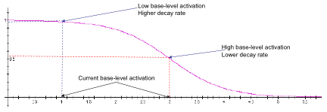
Decay Curve
Low base-level activation — rapid decay
Saturated base-level activation — almost no decay

Slide 15
High-level Cognitive Processes
Requires multiple cognitive cycles
Examples
  Volitional decision making
  Planning
  Scheduling
  Problem solving
  Imagination
  Theory of mind
  Metacognition

Slide 16
High-level Cognitive Process Hypothesis
Each such high-level process operates via a sequence of cognitive cycles
Each is implement by a collection of behavior streams – partially ordered sets of behaviors
October 19, 2007
Univ of Memphis — Computer Science Department

Slide 17
High-level, broad, integrative, cognitive models
Include processes from sensation to action, including learning
Empirically grounded in cognitive science and neuroscience
Provide hypotheses to guide research
October 19, 2007
Univ of Memphis — Computer Science Department

Slide 18
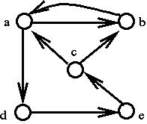

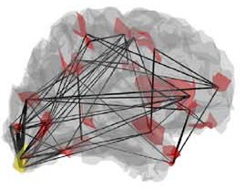
Cognitive Model Level
(Cognitive Science)
Attractor Landscape Level
(Non-linear Dynamics)
Cell Assembly Level
(Neuroscience)

Slide 19
Neural Correlates of LIDA Components
Available online at
http://ccrg.cs.memphis.edu/tutorial/correlates.html
October 19, 2007
Univ of Memphis — Computer Science Department

Slide 20
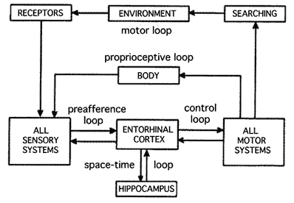
Action-Perception Cycle (Intentional Arc)
Freeman, W J. 1995. Societies of brains. Hillsdale NJ: Lawrence Erlbaum.

Slide 21
Theta-Gamma Coupling
Jensen, O & LL Colgin. 2007. Cross-frequency coupling between neuronal
oscillations. TRENDS in Cognitive Sciences 11, no. 7: 267-269.
Canolty et al. 2006. High gamma power is phase-locked to theta oscillations
in human neocortex. Science 313: 1626–1628.

Slide 22
Dreaming Rhythms Hypothesis
Dreaming occurs during REM and NREM sleep
Hypothesis: Dreaming is characterized by theta coupled with gamma AM modulation (somewhere ?)

Slide 23
Email and Web Addresses
Stan Franklin
  franklin@memphis.edu
  www.cs.memphis.edu/~franklin
Cognitive Computing Research Group
  http://ccrg.cs.memphis.edu/
October 19, 2007
Univ of Memphis — Computer Science Department

