Slide 1
Infra-slow oscillations & consciousness

Slide 2
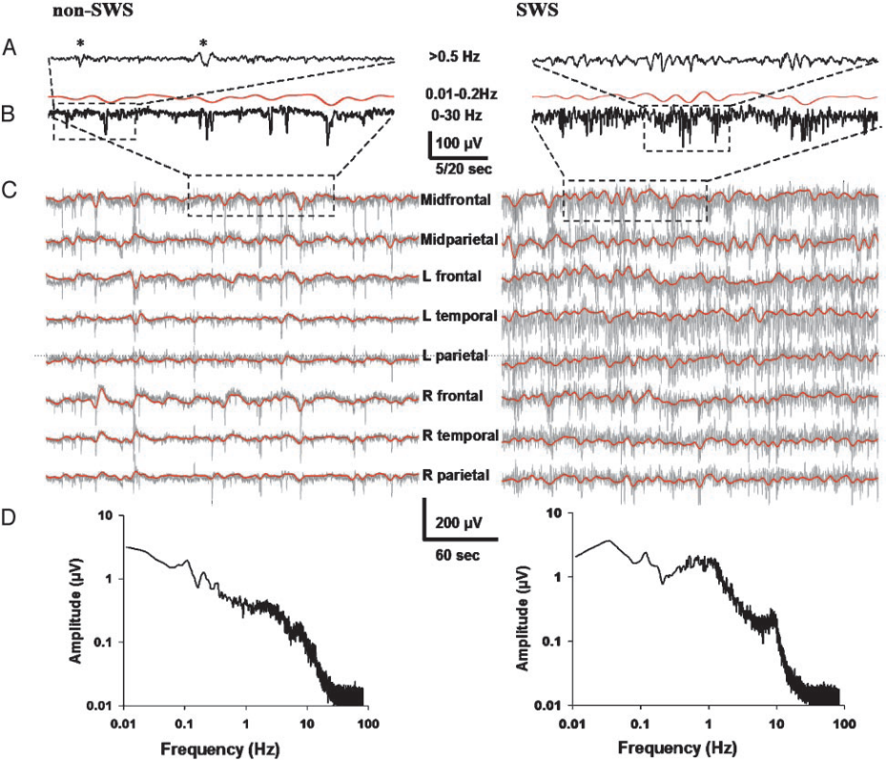
Infra-slow oscillations
Slow fluctuations in the frequency range of
0.01Hz -0.1 Hz
Prominent during sleep
Present in awake brain?
Infra-slow activity fluctuations in fMRI BOLD signal
  Task specific / Resting state networks
Vanhatalo, Palva et al., PNAS 2004

Slide 3
Somatosensory detection task
8 subjects
Weak, constant-current electrical stimuli at the threshold of detection
ISI 3-6 s
TASK: indicate detected stimuli with thumb twitch
Detection rate ~40 %
Direct current (DC) electrodes
EMG to detect thumb switches

Slide 4
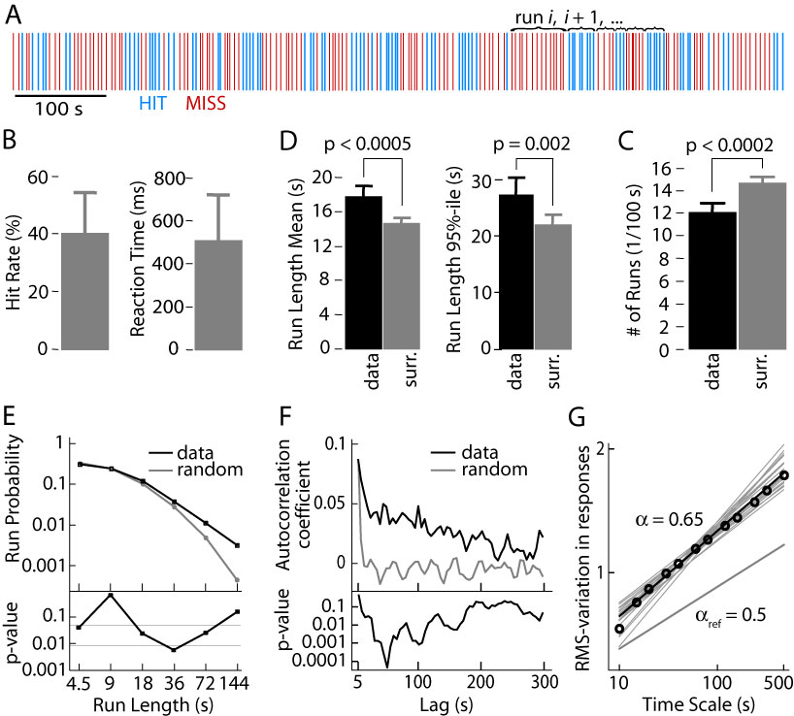
The clustering of Hit probability
The clustering of HITs and MISSES

Slide 5
The clustering of Hit probability
Non-random performance
Detections are clustered
Detection ”runs” between 18-72 seconds more prominent than expected

Slide 6
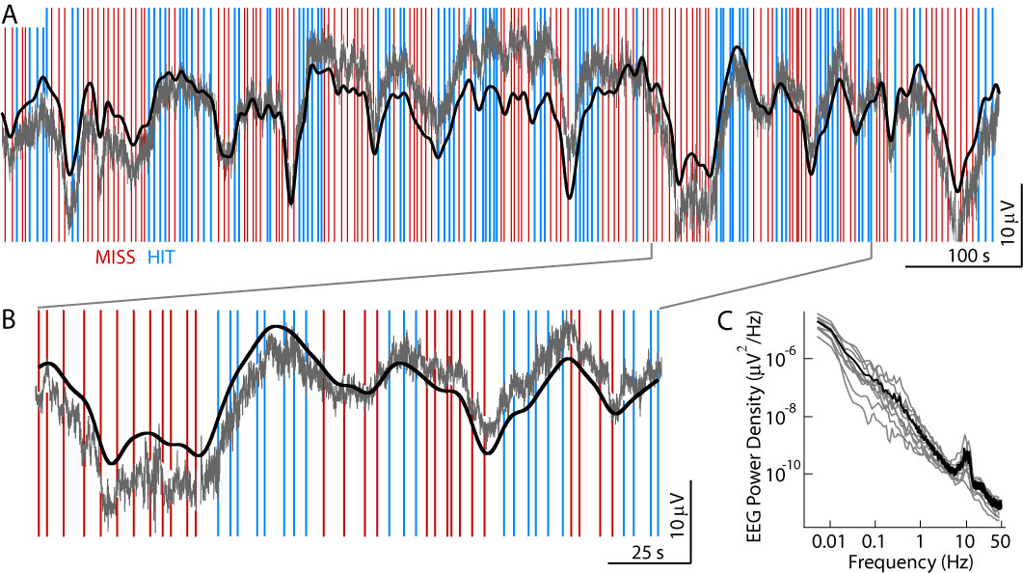
The correlation of infra-slow oscillations & behaviour

Slide 7
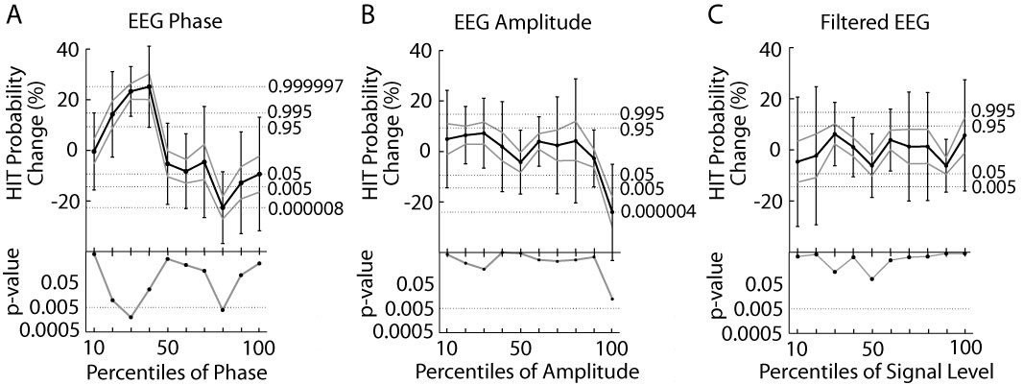
Hit probability is correlated with the phase of infra-slow oscillations
Detection is more probable in the rising than falling phases of infra-slow oscillations
Detection is not depended on the amplitude nor on the real part of the infra-slow oscillations

Slide 8
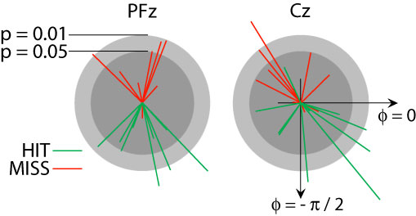
Phase-locking of infra-slow oscillations in individual subjects
In every subject, the detection is more probale in the rising than in the falling phase
The presence of alternating task-specific and resting state networks?

Slide 9
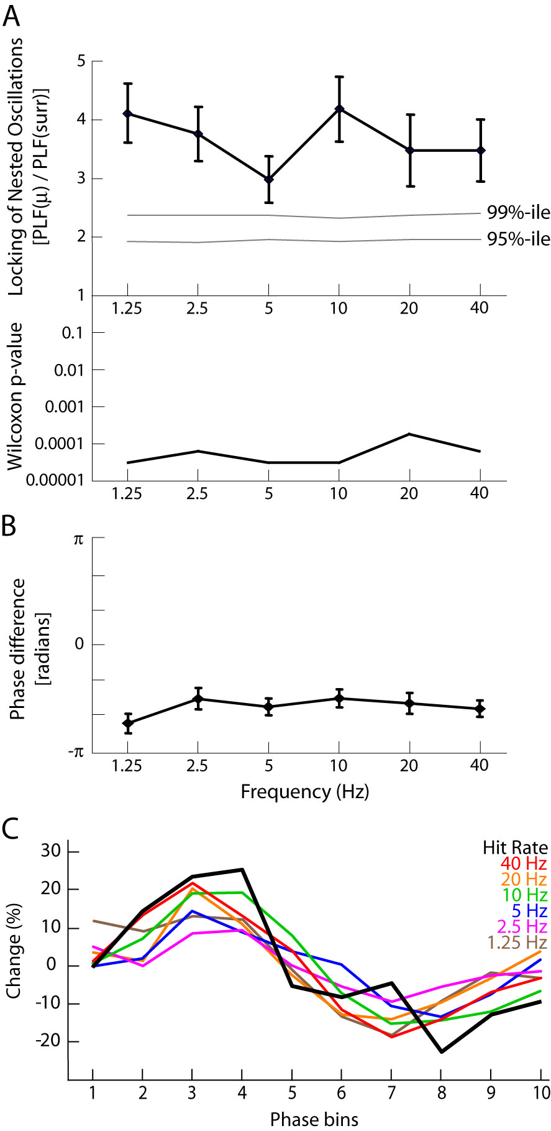
Correlation of higher frequencies with the infra-slow oscillations
All frequencies from 1.25 Hz to 40 Hz are nested with the infra-slow oscillations
Amplitude is high during the rising phase of infra-slow oscillation

Slide 10
Results and Implications
The phase of infra-slow oscillations correlates with the detection of weak threshold level somatosensory stimuli
→ The alternation between task-specific and resting state networks determine the fate of the stimulus
Amplitude does not correlate with detection
→ No gross excitability changes
Higher frequencies are nested into infra-slow oscillations
→ Co-operation between all frequencies facilitate detection,
Network excitability

Slide 11


Acknowledgements
Systems Neuroscience and Informatics Group @ Neuroscience Center, University of Helsinki
J. Matias Palva
Tomi Maila
Simo Monto
Shrikanth Kulashekhar
Santeri Rouhinen

