Slide 1
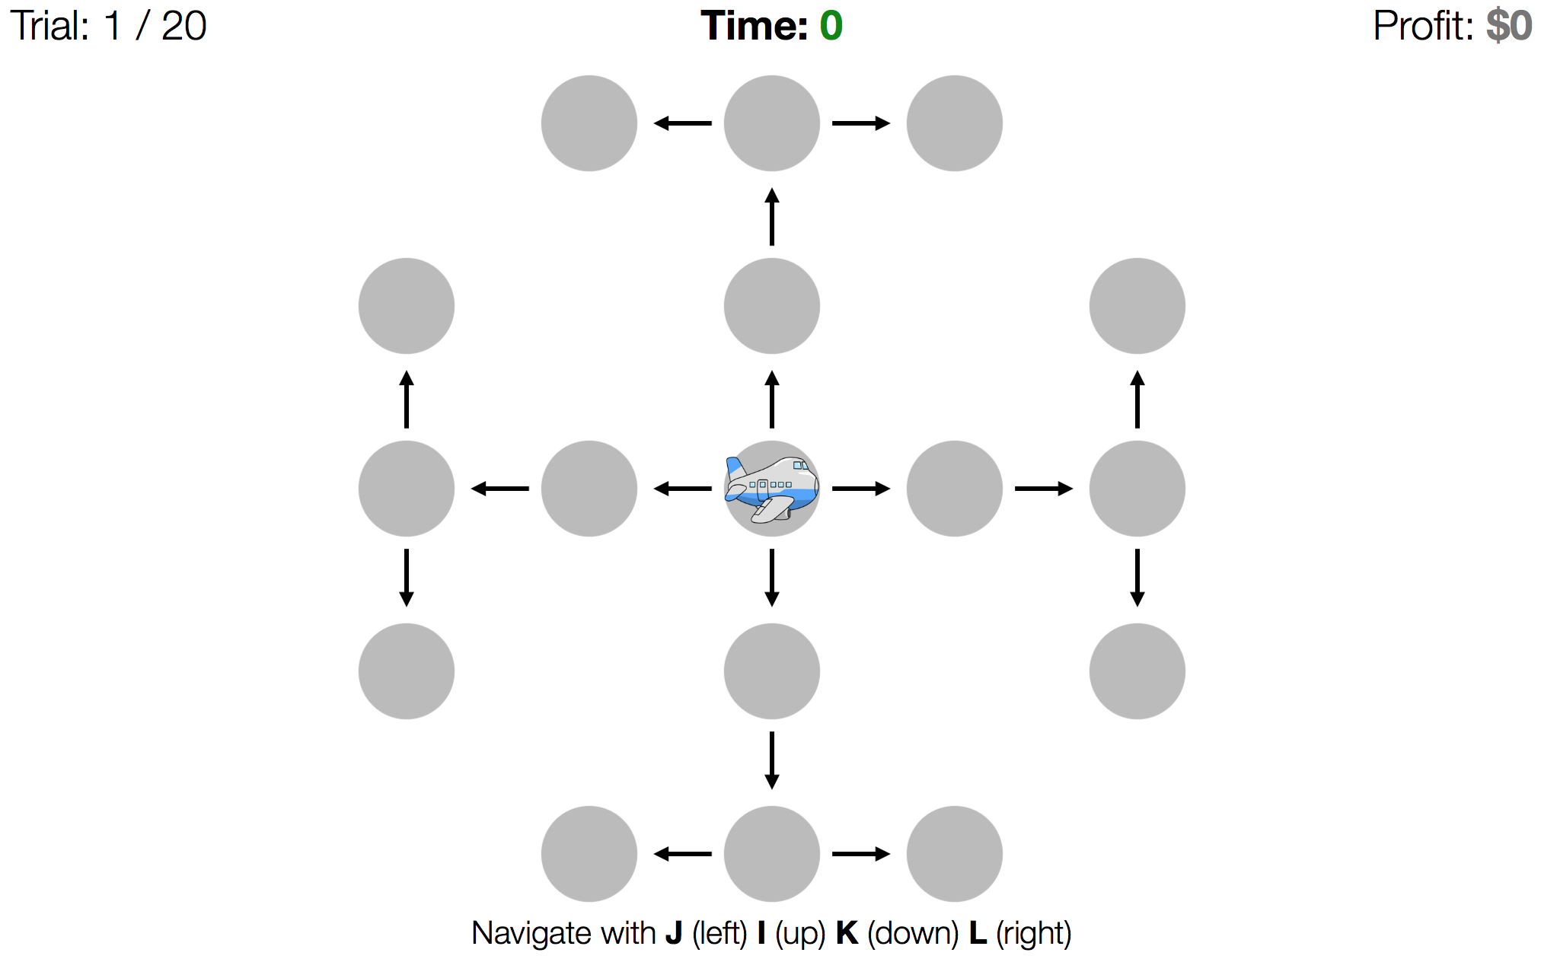


1
2
8
3
7
4
6
5

Slide 2
Round: 1 / 12
Profit: $-0.16
$6
$13
$10
$15
$-9
$11
$9
$2
$-17
$18
$-1
$-7
$-4
$16
$-3
$9

Slide 3
Round: 1 / 12
Time: 45
Profit: $0

Slide 4
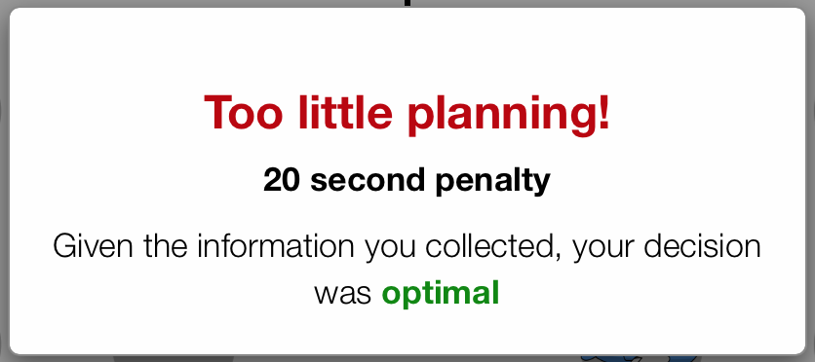
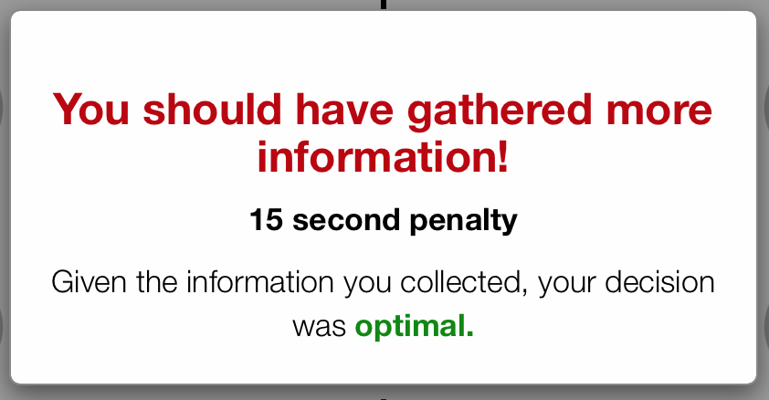
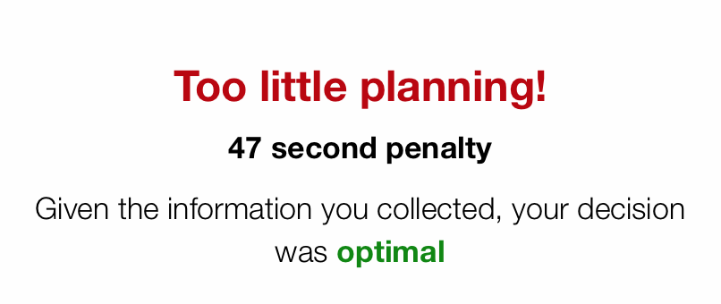
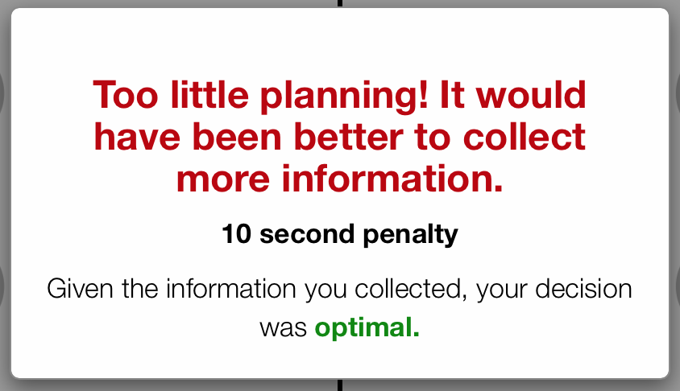
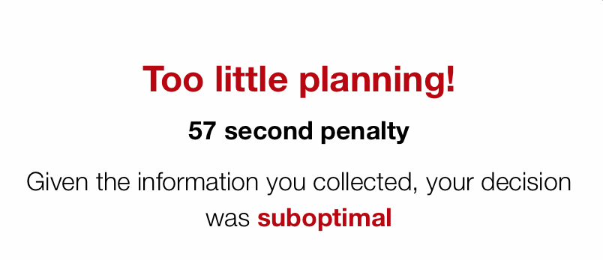
Round: 1 / 12
Time: 0
BaB
You should have gathered
more/less information!

Slide 5
Round: 1 / 12
Time: 0
BaB
Bad move! You should have moved down.

Slide 6
Round: 1 / 12
Time: 0
BaB
BaB

Slide 7
Round: 1 / 12
Time: 0
BaB
You should have gathered
more/less information!
BaB

Slide 8
Round: 1 / 12
Time: 0
BaB
Poor planning!
BaB

