Slide 1
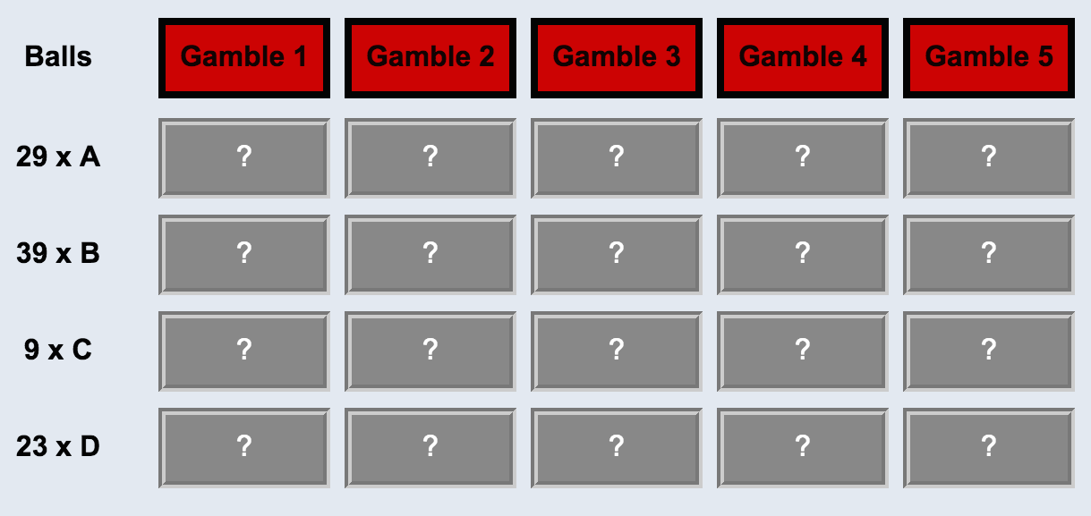
4
12 YELLOW
38 BROWN
$0.11
$0.05
$0.20
1
2
3
28 BLUE
22 PURPLE

