Slide 1
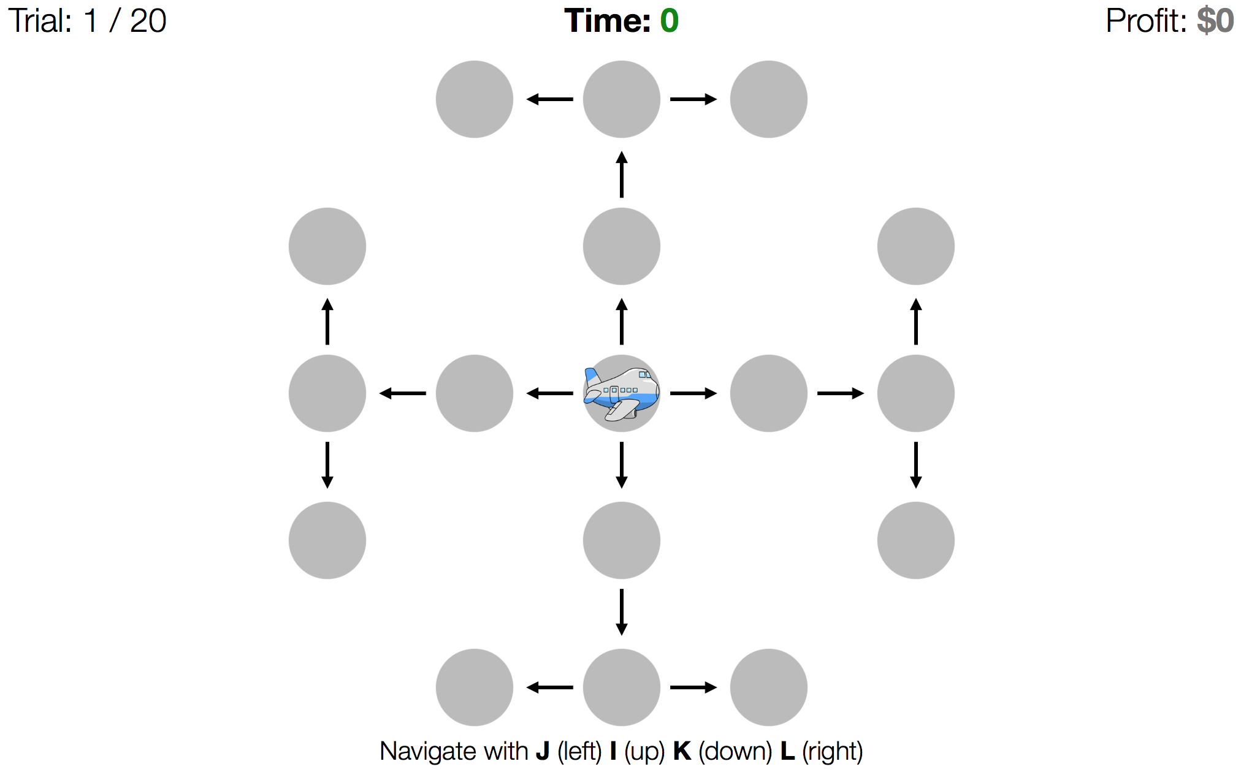


1
2
8
3
7
4
6
5

Slide 2

1 / 8
$-1.60
$6
$13
$10
$15
$-9
$11
$9
$2
$-17
$18
$-1
$-7
$-4
$16
$-3
$9

Slide 3
1 / 8
45

Slide 4
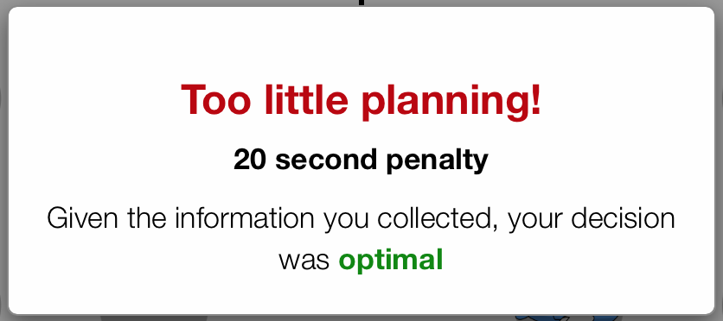
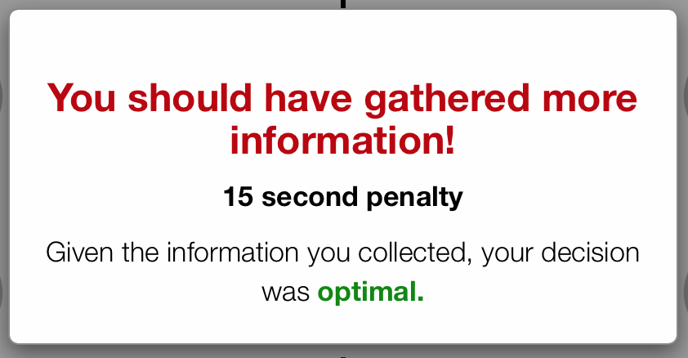
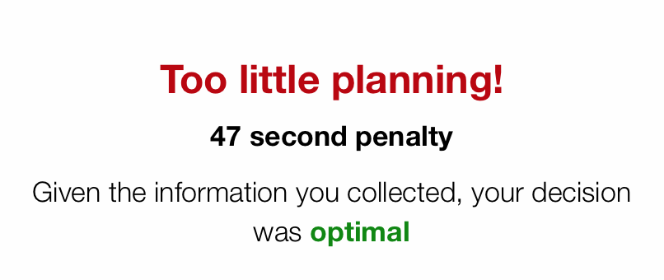
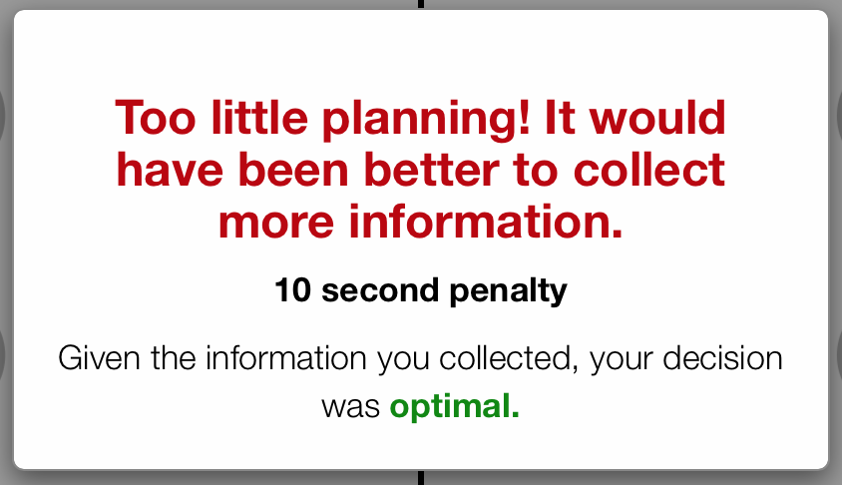
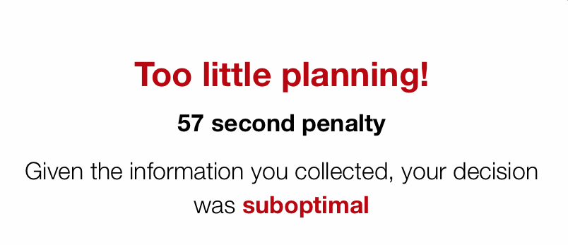
1 / 8
0

Slide 5
1 / 8
0
Poor planning:

Slide 6
1 / 8
0
Please wait 3.18 seconds

Slide 7
45

