Slide 1
Ethereum Blockchain
Layout the foundation of Blockchain Technology
How Ethereum Works
Geth Ethereum Client
Building a front end (Web 3)
Learn Solidity
Put altogether as a DAPP

Slide 2


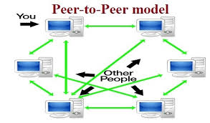


Evolution Of Blockchain
www (world wide web) 1989
All the web applications developed in client – server mode
Point to point exchange of data between two computer
Old peer-to-peer
New peer-to-peer

Slide 3

Bitcoin
Bitcoin Evolution
A open source Peer-to-peer application network that supports exchange of digital currency know as Bitcoin.
It does not represent any currency since its digital. It does not print any currency symbol like $ , € etc.
It was developed and lunched in 2009. The currency lives in Bitcoin network as bit and bytes as file system on the peers network.
Each Coin has the identity and owner
Owner can only spend the coin
There is no central authority like Government who can control the Bitcoin
Bitcoin community who developed the Bitcoin are controlling Bitcoin but whatever the control
Algorithm and Mathematics define Protocols/Rules How a bit coin gets generated , use by the owner and how the transaction is being validated

Slide 4

Bitcoin Evolution
Public Ledger: all Bitcoin transactions are visible to everyone
Bitcoin network is public
Anyone can create a pair of public and private key pain and participate in the blockchain transaction.
All transactions are inherently secure because the user is not passing any personal information in the transaction such as PIN , Credit Card etc.
User is identified by its Public Key(Address)
Transfer/Send of any coin is required a little fee
Private Key is kept by the user
Miner who rewarded with that fee for the validation of the transaction
The network is very much transparent and how it works

Slide 5

Bitcoin Evolution
SATOSHI NAKAMOTO was designed and conceptualized the Bitcoin
No one knows Satoshi is real person or a group of people , this is a mystery till date.
In 2008 Satoshi Published a yellow paper “Peer to Peer Electronic Cash System
Satoshi used the term block chain in his paper , since that day block chain was coined.
Bitcoin is the first blockchain application in the world.
Wanted: SATOSHI NAKAMOTO

Slide 6
What is Blockchain?
Decentralized system for the exchange of value.
Blockchain Uses
A shared and
Distributed
ledger system to keep the transaction record
Transactions in the block are normally immutable , immutability can be achieved by the way of blocks and chaining them
Uses public and private key cryptography for the TRUST , ACCOUNTABILITY and SECURITY
Blockchain Leverages Consensus mechanism for the validation of the transactions and validators are call Minors. A small amount of fee would be paid to validators

Slide 7
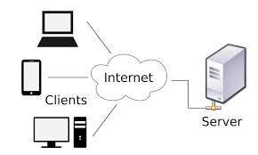
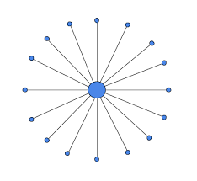
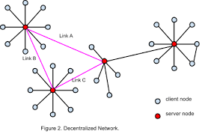
Centralized Network app
Decentralized Network app
All nodes are connected to a central node
Peer to Peer network
Single Point of Failure
All nodes are equal
Scaling inefficiency
Any node fails , can be recovered the transactions.

Slide 8

Value
Bitcoin blockchain allows bitcoin as a value to exchange within peers digitally.
But general blockchain system such as Ethereum , Dash etc. allow any asset to be managed as long as they are available digitally.
Ethereum Blockchain exchange any asset with its value to exchange between peers.
For the exchange of other values user must be paid a transaction fee with the blockchain designated value ( Ethers in case of ethereum)

Slide 9






Value
For example a Vehicle manufacturer after manufacturing the vehicle , it transfers the asset to Dealers and Dealers after sales done transfer the asset ownership to Customers.
Registers
Tx Asset Created
Who owns the car
Transfer Ownership
Tx Asset Transferred to dealership
Transfer Ownership
Tx Asset Transferred to Customer
History of the car
Ethereum

Slide 10

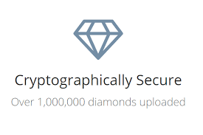
Value
Everledger is a start up which manages the diamond in the blockchain application , they already have 1M diamonds registered in the blockchain system.
https://www.everledger.io

Slide 11
Ledger
Traditional Ledger
Vs.
Distributed Ledger
Ledger
Ledger
Ledger
BANK
Ledger
Ledger
Ledger
Ledger

Slide 12
Value
Traditional Ledger
Vs.
Distributed Ledger
In a centralized system transactions are maintained in centralized ledger , which is managed and protected by a central authority. For example a Bank , the bank has a ledger which is not visible to the outside world. The ledger gets updated when customer carry out transactions
In the distributed ledger peers in the network have copy of the ledger. Peers can use copy of the ledger for reading of the transactions and initiate new transaction. The distributed ledger technology keeps data consistent across the network. Nodes in the network can independently validate the data in the ledger. Node does not need to trust any outside entity to validate the transactions authority

Slide 13

Distributed Ledger
Institution B
Ledger
Reconciliation
Intermediaries
Processes
Institution A
Ledger
Ledger
Institution C

Slide 14

R3 Consortium
Corda: Designed for Commerce , Engineered for Deployment
http://www.r3cev.com

Slide 15
Blocks & Chaining
Tradition Transaction has CRUD Operations
Create
Retrieve
Update
Delete
In Blockchain Transactional Data Added to the Ledger CANNOT be Updated or Delete
Genesis Block
Index:1
Index:2
Index:3
Index:0
Timestamp:..
Timestamp:…
Timestamp:…
Timestamp:…
Hash:Hash#
Hash:Hash#
Hash:Hash-3
…..
Hash:Block0
PreviousHash: Hash#- 1
PreviousHash: Hash#- 1
PreviousHash: Hash#- 1
Txn…
Txn…
Txn…
PreviousHash:0
Txn…
Txn…
Txn…
Data:….
Txn…
Txn…
Txn…
Block #:0
Block #:1
Block #:2
Block #:n

Slide 16
Blocks & Chaining
First Block of the blockchain is called Genesis block. It’s a special block in the chain
There are some basic properties defined for every block.
Index – is the block number its sequential , start with zero.
Time Stamp - Time of the block creation
Hash# : SHA256 bit value
Previous Hash# : SHA256 bit Hash value of previous block
Block Data : Transaction Data
In Block 1 Previous hash property point to the hash value of the previous block as Block0 , Block2 point to Block1 so on and so forth.
This backward reference is how the blocks are chained together, that is why we called blockchain.

Slide 17
Immutability
1001
1002
1003
1004
Index:1001
Index:1002
Index:1003
Index:1004
Timestamp:..
Timestamp:…
Timestamp:…
Timestamp:…
Hash:Hash#
Hash:Hash#
Hash:Hash#
Hash:Hash#
PreviousHash:hash # -1
PreviousHash: hash-1
PreviousHash: hash-1
PreviousHash: hash-1
Txn…
Txn…
Txn…
Txn…
Txn…
Txn…
Txn…
Txn…
Txn…
Txn…
Txn…
Txn…

Slide 18
Immutability
Immutability can be achieved by calculating hash values
Anyone has the access to the ledger can check whether the ledger has been tampered with , in other word any transaction in any block has been changed.
This can be validated by calculating the Hash Value property of the block data and comparing the value with the hash value of the previous block data
Consider the latest block created with # 1004 , its Prev. Hash value = Hash value of Block # 1003 , Prev. Hash value of block # 1003 = Hash value of Block # 1002 so on and so forth till we get zero block #.
Let’s assume that transaction data of any block is Changed/Deleted by a Hacker , let say block # 1002 , this would lead to a change the calculated hash value of Block #1002 , in that case the link between Block # 1001 and # 1002 will break. Thus leading to the failure of validation and rejection of the chain data by all nodes. Same thing will happen if Hackers will insert any data in any of the block.

Slide 19
Immutability
Chain is Tampered
Prev Hash # 1004=hash1003
Calculate # 1003
Prev Hash#=hash#1002
Calculate # 1003
Prev Hash # 1004=#1001
Validate
Calculate # 1004
1001
1002
1003
1004
Index:1
Index:2
Index:3
Index:0
Timestamp:…
Timestamp:…
Timestamp:…
Timestamp:..
Hash:Hash#
Hash:Hash#
Hash:Hash#
Hash:Block0
PrevHash:Hash# block1001
PrevHash:Hash# block1002
PrevHash:Hash# block1003
HashChange
Txn…
Txn…
PreviousHash:0
Change
Txn…
Txn…
Data:….
Txn…
Txn…
Txn…

Slide 20
Distributed Ledger = Distributed Database
Consensus
How do you ensure that data is consistent across the network?
Consensus = Protocol by which peers agree on state of Ledger
It ensures all peers in the network has the same copy of ledger. Data in the ledger is same across the nodes.
Fraudulent transactions are kept outside of the Ledger
It Guarantees to record transactions in chronological order
Consensus Protocols
Proof of Work
Proof of Stake
Tendermint
Bitcoin and Ethereum were using POW consensus protocol. In May 2018 Ethereum started using POS (Jasper Protocol) for security reasons

Slide 21



Cryptography
Participant have a public/private key pair
Transaction is signed by the owner of the asset with private key.
Anyone can validate the transaction with owner’s public key
Owner of the asset (Seller) initiate a transaction called transfer the ownership of the asset to the buyer.
Owner generates hash for the Tnx and signs with the private key , That degenerates the encrypted hash value. Encrypted hash decrypted by public key of the owner.
Hash is checked against the calculated Tnx hash of the owner , if the hash is matched then authenticity of the Txn is proved and ownership of the asset would be transferred.
HASH
SHA256
Txn Data
HASH
Seller
Buyer

Slide 22
Ethereum 101
Ethereum
Objective:
Introduction to ethereum
Introduction to smart contract

Slide 23
Ethereum?
Permission less public Blockchain network like Bitcoin.
Major difference with Bitcoin
Bitcoin is a Distributed Data Storage
whereas Ethereum is a Distributed Data
Storage + Computing i.e it executes the code that deployed by the participants in the network

Slide 24
History of Ethereum
2013
Vitalik Buterin argued in favor of scripting on Bitcoin
No one supported him , so he decided to setup a new platform
White Paper was published
A Next - Gen Smart Contract and Decentralized Application Platform
2014
Vatlik with Dr. Gavin Wood co-founded Ethereum
Dr.Gavin publish Yellow Paper
A secure , decentralized , generalized transaction ledger
2015
Frontier Version(Beta version ) of Ethereum Released on July 30.

Slide 25
Ethereum Version
May 2015
Olympic(Testnet)
July 2015
Frontier(Beta)
Mar 2016
Homestead
2017
Metropolis
Byzantine
Constantinople
Privacy improvement
POS and Sharding
2019
Serenity

Slide 26
Bitcoin and Ethereum Comparison
Value Token:
Bitcoin(BTC)
Ether(ETH)
Block Time
10 Mins
14 Seconds
Block Size:
1 MB Maximum
Depends ( ~ 2KB Min)
Scripting:
Limited , Loop is not supported
Smart Contract
More:

Slide 27

Computer code ,written in multiple languages
Smart Contract?
Contract lives in the network
Enforces rules
Perform negotiated actions
1.Sends Ethers
3. Widget Shipped
4.Widget Received
2. Holds Ethers in escrow
5.Release Funds to Seller
Seller
Buyer

Slide 28
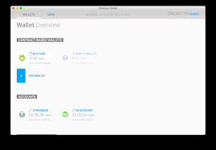
How does it work?
Wallet for managing Ethers
Smart Contracts
Decentralize APP(DAPP)
Interact with Contracts on network
Execution is not free
DAPP
Network

Slide 29
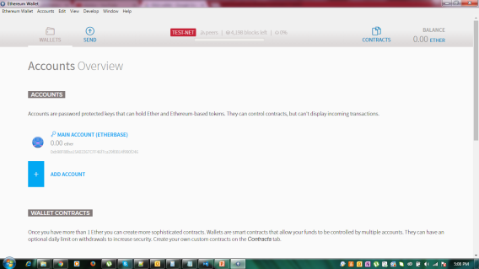


Where to get Ethers?
Become a Miner
Trade with other currencies
Ether Faucets
Get some from friends and family

Slide 30
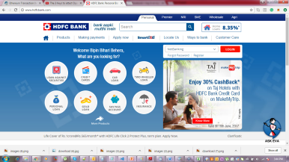
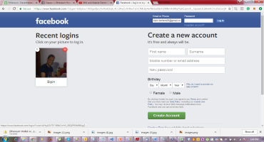



Introduction to Decentralized Application
Learning Objective
Working of Decentralized Application
Architecture of Decentralized Application
WEB APP Vs. DAPP
Centralized Resources Owned by the organizations
Front End Apps

Slide 31

DAPP Continue
Decentralized Resources Public Domain
C
Data

Slide 32

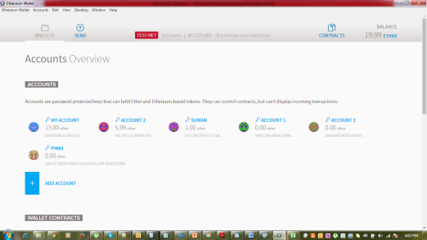
Working Of DAPP
Invoke Contract
App Users pay gas/fees
Miners Collect
Txn Validated /Mined
Recorded in Ledger
C
Data
Managed Funds
Invoke Contracts

Slide 33


DAPP Example
Seller Application
Ship Good
Event : BidReceived()
Event : WithdrawFunds()
Buyer Application
C
Data
Bid()

Slide 34





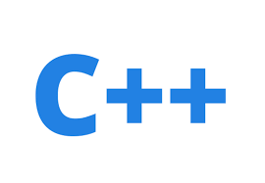


DAPP Technology Stack
Serpent

Slide 35
Ethers , Gas & EVM
Ethereum(ETH) : Value Token (Ethers )
Denominations :

Slide 36
Ethers Supply
Ether Creation
Contract Invocation – users pay ethers
Incentive for miners
Presale (2014) : 60 Million
12 Million created to fund development
Sometimes 2-3 Ethers for non-wining miners (Uncle Rewards)
3 Ethers created as reward for every block ; roughly ~ 14 seconds

Slide 37
EVM
A software that can execute Ethereum Bytecode
Follows the EVM specifications (Ethereum Protocol)
Runs as a process on a computer /server
EVM implemented in multiple languages C++, Python , Java , Javascripts and Go. Go is widely used EVM language.
EVM
Memory Area
Stack
Execution Engine

Slide 38

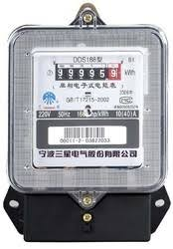
Gas
User invoking the transaction pays for the execution
Gas is the unit in which EVM resources usage is measured.
Measures: Gallons of water used
Measures: KWH used

Slide 39

Gas Calculations
Instructions
ADD
MUL
JMP
…….
Transaction
Execution
Storage
Fee paid by originator
Type/Number of instructions
Amount of storage

Slide 40
Fee Calculation
gasUsed = Instructions Executed (Summed up gas)
gasPrice = User Specified in the transaction
Miners decides the minimal acceptable price.
Transaction Fee = gasUsed*gasPrice

Slide 41
Transaction Fee Parameters
Transaction
…….
…….
Start Gas
(Unit)
Gas Price
(µ Ethers)
Max unit of gas originator will spend
Per unit gas price that originator willing to pay

Slide 42

Fee Calculation
Transaction
…….
…….
Start Gas
(Unit)
Gas Price
(µ Ethers)
Escrow:
StartGas*gasPrice
Fee Paid:
gasUsed*gasPrice
Fee Paid :
startGas*gasPrice
Refund :
(startGas – gasUsed)*gasPrice
Out of gas Exception No changes made

Slide 43
Ethereum Network
Live Network
Network Id = 1
Test-Net
Network Id = 2 Morden Retired
Network Id = 3 Ropsten (by default) Current
Network Id = 4 RINKEBY Current
KOVAN used for specific Network client
Private Network
Network Id = Assigned
Test-Net
Ropsten (Id = 3 )
RINKEBY (Id = 4 )
Mining OK
Mining not allowed

Slide 44


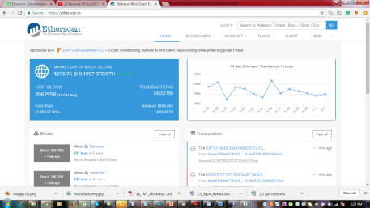
Interactions
Live Network
Wallet Mist
Test Net
Private Network
DAPP
Block Explorer

Slide 45
Private Network
Data Privacy
As a distributed database
Consortium
Industry Verticals
Permissioned
Internal transactions and contracts

Slide 46

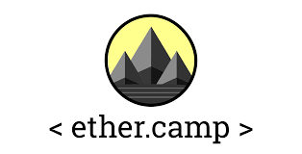
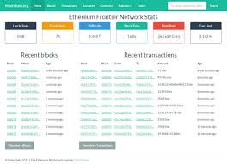
Blockchain Explorer
Websites ( or webapps) that show information on.
Transactions
Blocks
Accounts
https://etherscan.io/
https://live.ether.camp/
https://etherchain.org/

Slide 47


Ethereum Client Architecture
Client Or
Node
5.Deploy Contracts
Wallet Or DAAP
6. Execute Contracts
1.Receives Blocks
Client Or
Node
4. Transactions
3.Send Blocks
Client Or
Node
8. Explore History
2.Validate Blocks
7.Mining

Slide 48
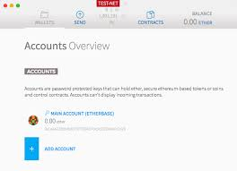

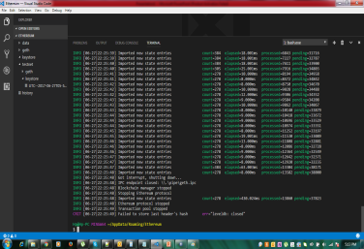
Working for client
http://localhost:8545
[Port No:30303]
JSON-RPC
DEV P2P
Client Or
Node
IPC-RPC
WEB3
Fast Key-Value Storage
> JS API Console
Put/Get/Delete

Slide 49
Go Ethereum Client
GoLang Ethereum Client:
Learning Objectives :
Installation
Commands
Option overview
Geth Version 1.6.5

Slide 51
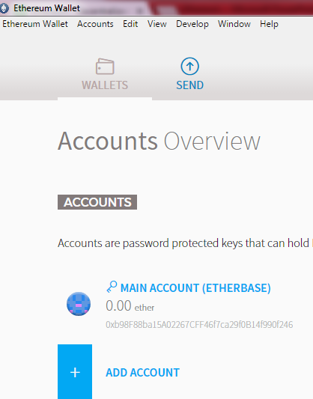
Installation Ethereum Client
Windows :
Geth Binaries: %APPDATA%\Mist\Binaries\geth
Windows:
%APPDATA%\Roaming\Ethereum Wallet\ binaries\geth
Run PS command as
$ ps –e |grep geth
Add geth to PATH to execute anywhere.

Slide 52
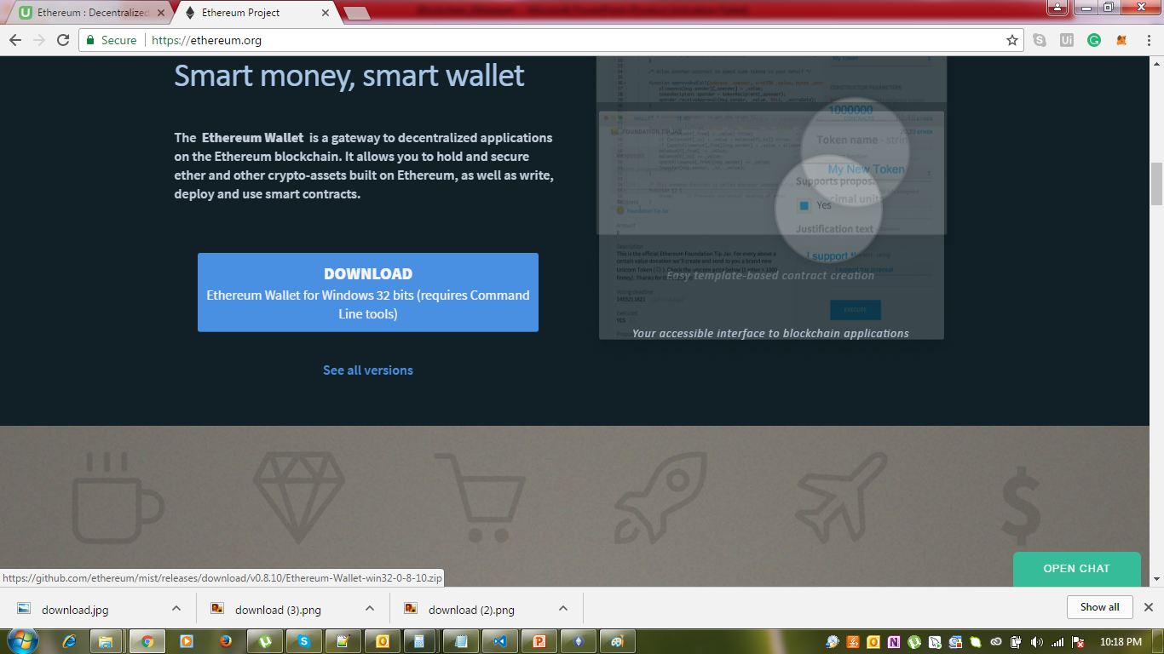

Slide 53
Blockchain Roles
APP
Web,Mobile,HTML,CSS,Node.js, Angular Js, Client
APP1
APP2
APP3
API Layer
Chain Code(Smart Contract)
Solidity
Smart Contract
Cryptographic Protocols
Network
Validate Blocks , Mines
Consensus Algorithm
Fabric
Contribute to Ethereum Community
Shared Replicated Ledger

Slide 54
Geth CLI
Ethereum Geth Command
>_ geth [Options] command [Options] [args…]
Ethereum
Account
Performance Tuning
Developer Chain
Gas & Tnx Pool
Virtual Machine
API & Console
Miner
Networking
Logging & Debugging
Misc
Experimental Options

Slide 55

Geth CLI - Setting Up RPC for geth Client
Ethereum Command IPC-RPC
Objective
Configure the IPC for geth
Configure the RPC for JSON & Web Socket
Geth [Options] command [Options] [args…]
Configuration
API & Console
Misc.
IPC-RPC by Default
Client Or
Node
Admin,eth,web3,personal,net,miner,debug,shh,txpool
Wallet
--ipcdisable enabled by default
--ipcvalue all enabled by default
>JS API Console
--ipcpath “geth.ipc”

Slide 56
Geth CLI - Setting Up RPC for geth Client
Ethereum Command IPC-RPC
Objective
Configure the IPC for geth
Configure the RPC for JSON & Web Socket
Geth [Options] command [Options] [args…]
Configuration
API & Console
Misc.
IPC-RPC by Default
Client Or
Node
Admin,eth,web3,personal,net,miner,debug,shh,txpool
Wallet
--ipcdisable enabled by default
--ipcvalue all enabled by default
>JS API Console
--ipcpath “geth.ipc”

Slide 57
Geth CLI - Setting Up RPC for geth Client
Ethereum Command IPC-RPC
Objective
Configure the IPC for geth
Configure the RPC for JSON & Web Socket
Geth [Options] command [Options] [args…]
Configuration
API & Console
Misc.
IPC-RPC by Default
Client Or
Node
Admin,eth,web3,personal,net,miner,debug,shh,txpool
Wallet
--ipcdisable enabled by default
--ipcvalue all enabled by default
>JS API Console
--ipcpath “geth.ipc”

Slide 58
Geth CLI - Setting Up RPC for geth Client
Ethereum Command IPC-RPC
Objective
Configure the IPC for geth
Configure the RPC for JSON & Web Socket
Geth [Options] command [Options] [args…]
Configuration
API & Console
Misc.
IPC-RPC by Default
Client Or
Node
Admin,eth,web3,personal,net,miner,debug,shh,txpool
Wallet
--ipcdisable enabled by default
--ipcvalue all enabled by default
>JS API Console
--ipcpath “geth.ipc”

Slide 59

Ethereum Command JSON-RPC
Geth [Options] command [Options] [args…]
Configuration
API & Console
Misc.
JSON-RPC
Client Or
Node
Wallet
WS-RPC
eth,web3,net
>JS API Console

Slide 60
Geth [Options] command [Options] [args…]
Configuration
API & Console
Misc.
JSON-RPC [HTTP 8545
--rpc Enable JSON-RPC
--rpcapi Default = eth , web3 , net
--rpcaddr = “host” localhost
--rpcport = “port” 8545
--rpccrossdomain = “domains, . ,” or “*” 8545

Slide 61
Geth [Options] command [Options] [args…]
Configuration
API & Console
Misc.
WS-RPC [HTTP 8546
--ws Enable WS-RPC
--wsapi Default = eth , web3 , net
--wsaddr = “host” localhost
--wsport = “port” 8546

