Slide 1
Ethereum Definition
Layout the foundation of Blockchain Technology
How Ethereum Works
Geth Ethereum Client
Building a front end (Web 3)
Learn Solidity
Put altogether as a DAPP

Slide 2


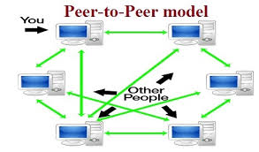

Evolution Of Blockchain
www (world wide web) 1989
All the web applications developed in client –server mode

Slide 3

Bitcoin
Bitcoin Evolution
A open source Peer-to-peer application network that supports exchange of digital currency know as Bitcoin.
It does not represent any currency since its digital. It does not print any currency symbol like $ , € etc.
It was developed and lunched in 2009. The currency lives in Bitcoin network as bit and bytes as file system on the peers network.
Each Coin has the identity and owner
Owner can only spend the coin
There is no central authority like Government who can control the Bitcoin
Bitcoin community who developed the Bitcoin are controlling Bitcoin but whatever the control
Algorithm and Mathematics define Protocols/Rules How a bit coin gets generated , use by the owner and how the transaction is being validated

Slide 4
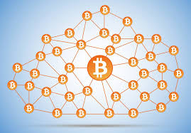
Bitcoin Evolution
Bitcoin network is public
Public Ledger: all Bitcoin transactions are visible to everyone
Anyone can create a pair of public and private key pain and participate in the blockchain transaction.
All transactions are inherently secure because the user is not passing any personal information in the transaction such as PIN , Credit Card etc.
User is identified by its Public Key(Address)
Transfer/Send of any coin is required a little fee
Miner who rewarded with that fee for the validation of the transaction
Private Key is kept by the user
The network is very much transparent and how it works

Slide 5

Bitcoin Evolution
SATOSHI NAKAMOTO was designed and conceptualized the Bitcoin
No one knows Satoshi is real person or a group of people , this is a mystery till date.
In 2008 Satoshi Published a yellow paper “Peer to Peer Electronic Cash System
Satoshi used the term block chain in his paper , since that day block chain was coined.
Bitcoin is the first blockchain application in the world.
Wanted: SATOSHI NAKAMOTO

Slide 6
What is Blockchain?
Decentralized system for the exchange of value.
Uses a shared distributed ledger
Transactions are immutable , immutability is achieved by the way of Blocks and chaining.
Leverages Consensus mechanism for the validation of the transactions
Uses cryptography for the TRUST , ACCOUNTABILITY and SECURITY

Slide 7
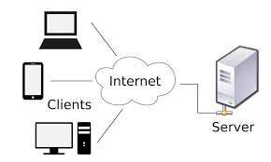
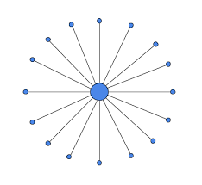
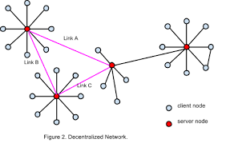
Centralized Network app
Decentralized Network app
All nodes are connected to a central node
Is a Peer to Peer network
Single Point of Failure
All nodes are equal
Scaling inefficiency
Any node fails , can be recovered the transactions.

Slide 8







Value
Buy/Sale Bit coin in Exchanges of Dollar
Bitcoin blockchain represents bitcoin as value in bitcoin network
Registers
Tx Asset Created
Who owns the car
Transfer Ownership
Tx Asset Transferred to dealership
Transfer Ownership
Tx Asset Transferred to Customer
History of the car
Ethereum

Slide 9
Ledger
Traditional Ledger
Vs.
Distributed Ledger
Ledger
Ledger
Ledger
BANK
Ledger
Ledger
Ledger
Ledger

Slide 10

Distributed Ledger
Institution B
Ledger
Ledger
Reconciliation
Intermediaries
Processes
Institution A
Ledger
Institution C

Slide 11

Consortium
Corda: Designed for Commerce , Engineered for Deployment
http://www.r3cev.com

Slide 12
Blocks & Chaining
Tradition Transaction has CRUD Operations
Create
Retrieve
Update
Delete
Blockchain Tradition Data Added to the Ledger CANNOT be Updated or Delete
Index:1
Index:2
Index:3
Index:0
Timestamp:..
Timestamp:…
Timestamp:…
Timestamp:…
Hash:Hash-1
Hash:Hash-2
Hash:Hash-3
Hash:Block0
PreviousHash:
PreviousHash:
PreviousHash:
Txn…
Txn…
Txn…
PreviousHash:0
Txn…
Txn…
Txn…
Data:….
Txn…
Txn…
Txn…
Block #:0
Block #:1
Block #:2
Block #:n

Slide 13
Immutability
Previous Hash#=1002
Previous Hash#=1001
Calculate # 1003
Calculate # 1002
Validate
1001
1002
1003
1004
Index:1
Index:2
Index:3
Index:0
Timestamp:…
Timestamp:…
Timestamp:…
Timestamp:..
Hash:Hash-1
Hash:Hash-2
Hash:Hash-3
Hash:Block0
PreviousHash:
PreviousHash:
PreviousHash:
HashChange
Txn…
Txn…
PreviousHash:0
Txn…
Change
Txn…
Txn…
Txn…
Data:….
Txn…
Txn…
Txn…
Block #:0
Block #:1
Block #:2
Block #:n

Slide 14
Distributed Ledger = Distributed Database
Consensus
How do you ensure that data is consistent across the network
Consensus = Protocol by which peers agree on state of Ledger
How do you ensure that data is consistent across the network
Fraudulent transactions are kept outside of the Ledger
Guarantees to record transactions in chronological order
Proof of Work
Proof of Sate
Tendermint

Slide 15



Cryptography
Participant have a public/private key pair
Transaction is signed by the owner of the asset with private key.
Anyone can validate the transaction with owner’s public key
HASH
Txn Data
HASH
Seller
Buyer

Slide 16
Ethereum 101
Ethereum
Objective:
Introduction to ethereum
Introduction to smart contract

Slide 17
Ethereum?
Permission less public Blockchain network like Bitcoin.
Major difference with Bitcoin
Bitcoin is a Distributed Data Stroage
Ethereum is also a Distributed Data
Storage + Computing

Slide 18
History of Ethereum
2013
Vitalik Buterin argued in favor of scripting on Bitcoin
No one supported him , so he decided to setup a new platform
White Paper was published
A Next - Gen Smart Contract and Decentralized Application Platform
2014
Vatlik with Dr. Gavin Wood co-founded Ethereum
Dr.Gavin publish Yellow Paper
A secure , decentralized , generalized transaction ledger
2015
Frontier Version of Ethereum Released on July 30.

Slide 19
Ethereum Version
May 2015
Olympic(Testnet)
July 2015
Frontier(Beta)
Mar 2016
Homestead
2017
Metropolis
Serenity

Slide 20
Bitcoin and Ethereum Comparison
Value Token:
Bitcoin(BTC)
Ether(ETH)
Block Time
10 Mins
14 Seconds
Block Size:
1 MB Maximum
Depends ( ~ 2KB Min)
Scripting:
None
Smart Contract
More:

Slide 21

Computer code ,written in multiple languages
Smart Contract?
Contract lives in the network
Enforces rules
Perform negotiated actions
1.Sends Ethers
3. Widget Shipped
4.Widget Received
2. Holds Ethers in escrow
5.Release Funds to Seller Received

Slide 22
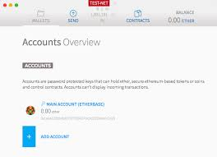
How does it work?
Wallet for managing Ethers
Smart Contracts
Decentralize APP(DAPP)
Interact with Contracts on network
DAPP
Execution is not free
Network

Slide 23
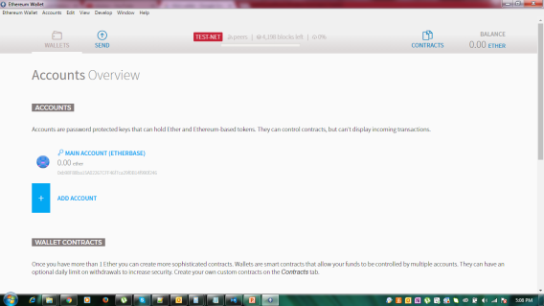


Where to get Etheres?
Become a Miner
Trade with other currencies
Ether Faucets
Get some from friends and family

Slide 24
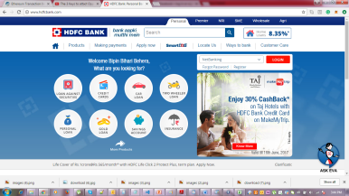
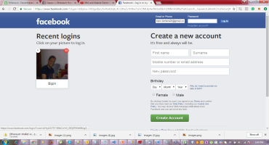

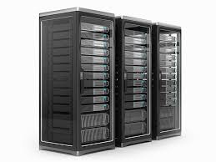

Introduction to Decentralized Application
Learning Objective
Working of Decentralized Application
Architecture of Decentralized Application
WEB APP Vs. DAPP
Centralized Resources Owned by the organizations
Front End Apps

Slide 25

DAPP Continue
Decentralized Resources Public Domain
C
Data

Slide 26

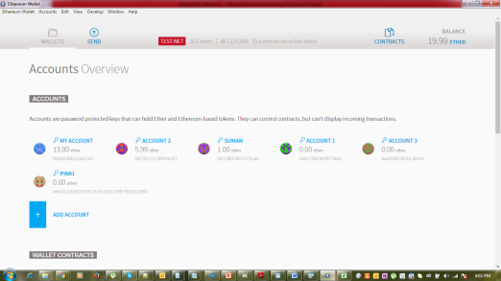
Working Of DAPP
App Users pay gas/fees
Miners Collects
Txn Validated /Mined
Recorded in Ledger
C
Data
Managed Funds
Invoke Contracts

Slide 27


DAPP Example
Seller Application
Ship Good
Event : BidReceived()
Event : WithdrawFunds()
Buyer Application
C
Data
Bid()

Slide 28





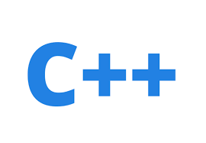


DAPP Technology Stack
Serpent

Slide 29
Ethers , Gas & EVM
Ethereum(ETH) : Value Token (Ethers )
Denominations :

Slide 30
Ethers Supply
Ether Creation
Contract Invocation – users pay ethers
Incentive for miners
Presale (2014) : 60 Million
12 Million created to fund development
5 Ethers created as reward for every block ; roughly 14 seconds
Sometimes 2-3 Ethers for non-wining miners (Uncle Rewards)

Slide 31
EVM
A software that can execute Ethereum Bytecode
Follows the EVM specifications (Ethereum Protocol)
Runs as a process on a computer /server
EVM implemented in multiple languages C++, Python , Java , Javascripts and Go. Go is widely used EVM language.
EVM
Memory Area
Stack
Execution Engine

Slide 32
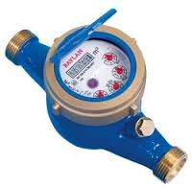
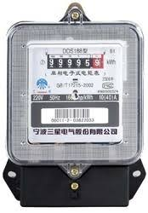
Gas
User invoking the transaction pays for the execution
Gas is the unit in which EVM resources usage is measured.
Measures: Gallons of water used
Measures: KWH used

Slide 33

Gas Calculations
Instructions
ADD
MUL
JMP
…….
Transaction
Execution
Storage
Fee paid by originator
Type/Number of instructions
Amount of storage

Slide 34
Fee Calculation
gasUsed = Instructions Executed (Summed up gas)
gasPrice = User Specified in the transaction
Miners decides the minimal acceptable price.
Transaction Fee = gasUsed*gasPrice

Slide 35
Transaction Fee Paramers
Transaction
…….
…….
Start Gas
(Unit)
Gas Price
(µ Ethers)
Max unit of gas originator will spend
Per unit gas price that originator willing to pay

Slide 36

Fee Calculation
Transaction
…….
…….
Start Gas
(Unit)
Gas Price
(µ Ethers)
Escrow:
StartGas*gasPrice
Fee Paid:
gasUsed*gasPrice
Fee Paid :
startGas*gasPrice
Refund :
(startGas – gasUsed)*gasPrice
Out of gas Exception No changes made

Slide 37
Ethereum Network
Live Network
Network Id = 1
Test-Net
Network Id = 2 Morden Retired
Network Id = 3 Ropsten Current
KOVAN RINKEBY
Private Network
Network Id = Assigned

Slide 38


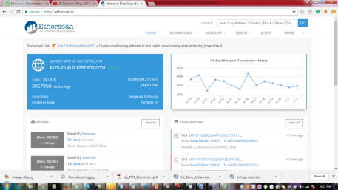
Interactions
Live Network
Wallet Mist
Test Net
Private Network
DAPP

Slide 39
Private Network
Data Privacy
As a distributed database
Consortium
Industry Verticals
Permissioned
Internal transactions and contracts

Slide 40

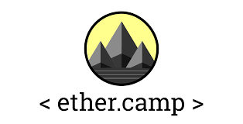
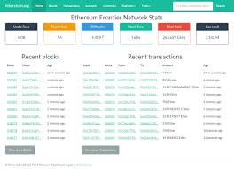
Blockchain Explorer
Websites ( or webapps) that show information on.
Transactions
Blocks
Accounts
https://etherscan.io/
https://live.ether.camp/
https://etherchain.org/

Slide 41


Ethereum Client Architecture
Client Or
Node
5.Deploy Contracts
Wallet Or DAAP
6. Execute Contracts
1.Receives Blocks
Client Or
Node
4. Transactions
3.Send Blocks
Client Or
Node
8. Explore History
2.Validate Blocks
7.Mining

Slide 42

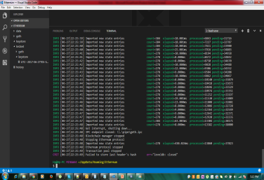
Working for client
http://localhost:8545
[Port No:30303]
JSON-RPC
DEV P2P
Client Or
Node
IPC-RPC
WEB3
Fast Key-Value Storage
> JS API Console
Put/Get/Delete

Slide 43
Go Ethereum Client
GoLang Ethereum Client:
Learning Objectives :
Installation
Commands
Option overview
Geth Version 1.6.5

Slide 45
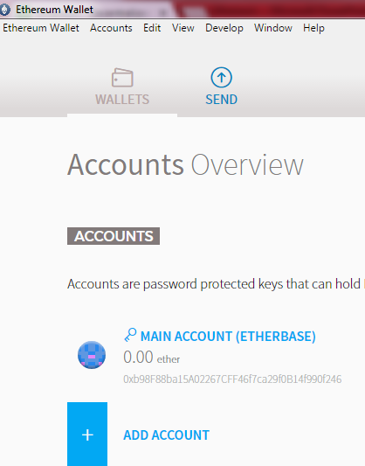
Installation Ethereum Client
Windows :
Geth Binaries: %APPDATA%\Mist\Binaries\geth
Windows:
%APPDATA%\Roaming\Ethereum Wallet\ binaries\geth
Run PS command as
$ ps –e |grep geth
Add geth to PATH to execute anywhere.

Slide 46
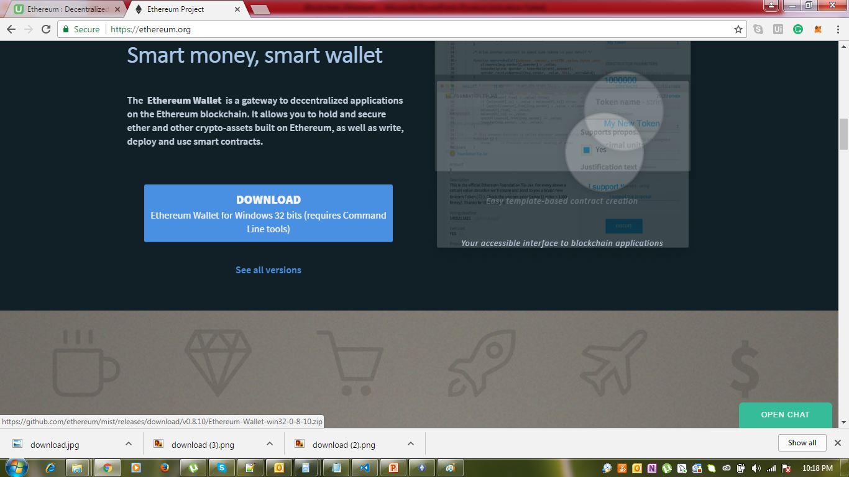

Slide 47
Blockchain Roles
APP
Web,Mobile,HTML,CSS,Node.js, Angular Js, Client
APP1
APP2
APP3
API Layer
Chain Code(Smart Contract)
Solidity
Smart Contract
Cryptographic Protocols
Network
Validate Blocks , Mines
Consensus Algorithm
Fabric
Contribute to Ethereum Community
Shared Replicated Ledger

Slide 48

Geth CLI - Setting Up RPC for geth Client
Ethereum Command IPC-RPC
Objective
Configure the IPC for geth
Configure the RPC for JSON & Web Socket
Geth [Options] command [Options] [args…]
Configuration
API & Console
Misc.
IPC-RPC by Default
Client Or
Node
Admin,eth,web3,personal,net,miner,debug,shh,txpool
Wallet
--ipcdisable enabled by default
--ipcvalue all enabled by default
>JS API Console
--ipcpath “geth.ipc”

Slide 49

Ethereum Command JSON-RPC
Geth [Options] command [Options] [args…]
Configuration
API & Console
Misc.
JSON-RPC
Client Or
Node
Wallet
WS-RPC
eth,web3,net
>JS API Console

Slide 50
Geth [Options] command [Options] [args…]
Configuration
API & Console
Misc.
JSON-RPC [HTTP 8545
--rpc Enable JSON-RPC
--rpcapi Default = eth , web3 , net
--rpcaddr = “host” localhost
--rpcport = “port” 8545
--rpccrossdomain = “domains, . ,” or “*” 8545

Slide 51
Geth [Options] command [Options] [args…]
Configuration
API & Console
Misc.
WS-RPC [HTTP 8546
--ws Enable WS-RPC
--wsapi Default = eth , web3 , net
--wsaddr = “host” localhost
--wsport = “port” 8546

