Slide 1

Cognitive Neuroscience Unit 251, 254 and 257 Areas Floor plan and desk assignment

Slide 2
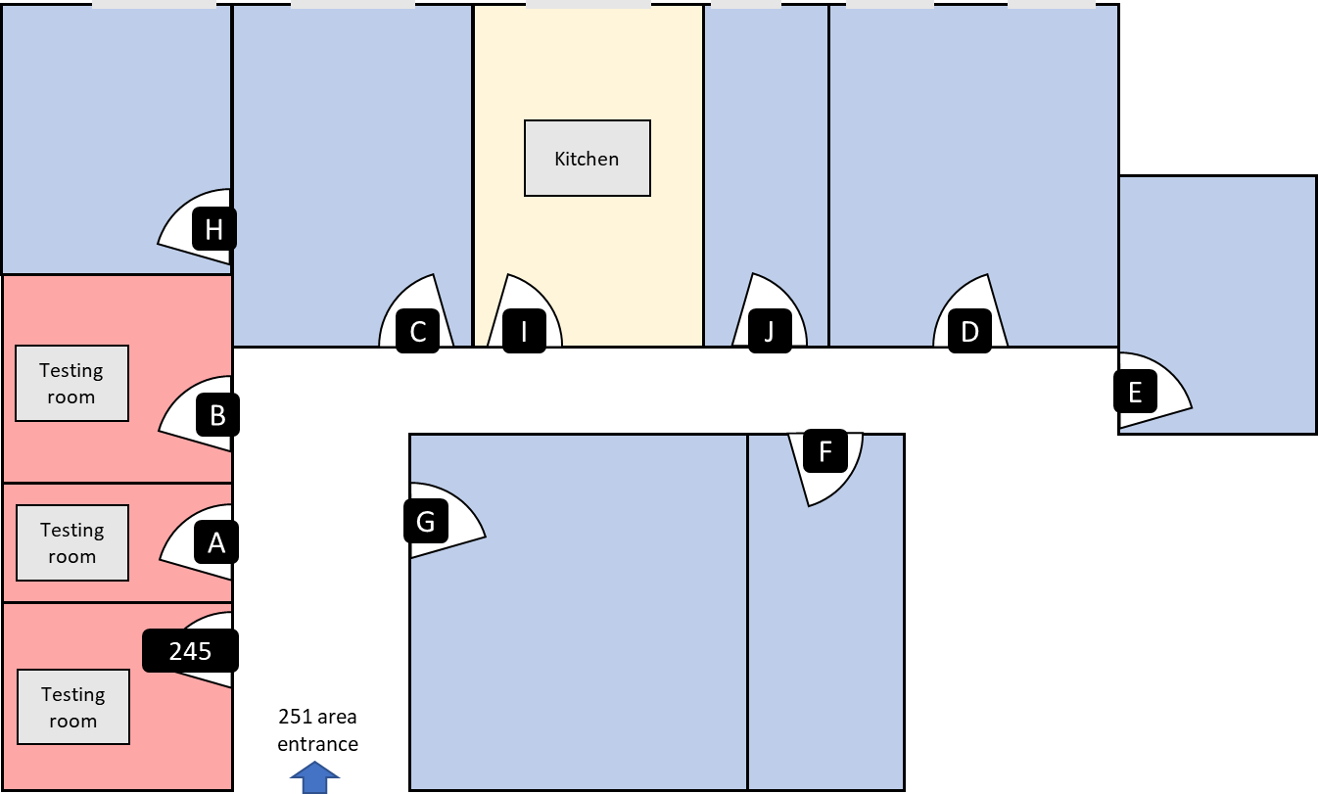
251 Area
Gabriel Pelletier (R. Asso. LF)
Sophie Sun (MSc. MS)
Stephanie Deschamps (PhD. DK)
Alix Noly (Grad. RZ & MG)
Larissa Chiu (Grad. MG)
Maiya Geddes (PI)
Kaija Sander (PhD. DK)
Lyla Hawari (MSc. MS)
Adrian Noriega (PostDoc. MG)
Alexander Bailey (MSc. MS)
Naga Thovinaker (MSc. MG)
Caitlin Walker (Grad. MG)
Jen-Kai Chen (R. Asso. DK & AP)
Kep Kee Loh (PostDoc. MP)
Kristi Drudik (Grad. MP)
Erika Nolan (Grad. ?)
FREE
Trisanna Sprung (R. Asso. MP)
Soraya Lahlou (PhD. MS)
Tommy Kin (MSc. MS)
Ekatarina Lunkova (PhD. AP)

Slide 3
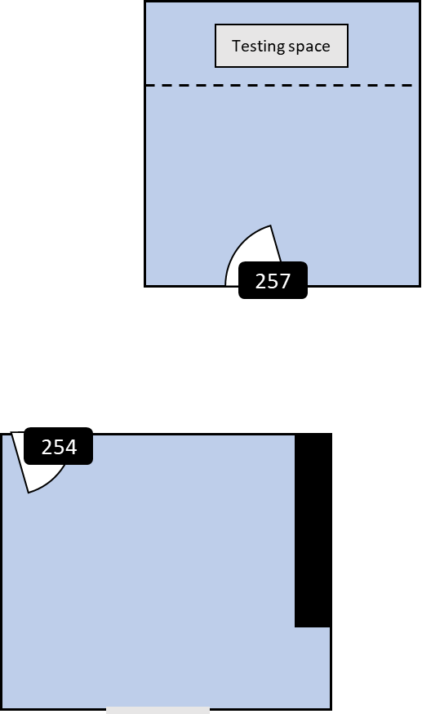
257 & 254 Areas
Yilin Zhang (RA. MS)
Elsie Yan (RA. MS)
MUHC spot
Dimitri Palidis (PostDoc. LF
FREE
Float / Undergrad
Juliette Ryan-L MSc. LF
FREE
BIC (dennis)

Slide 4
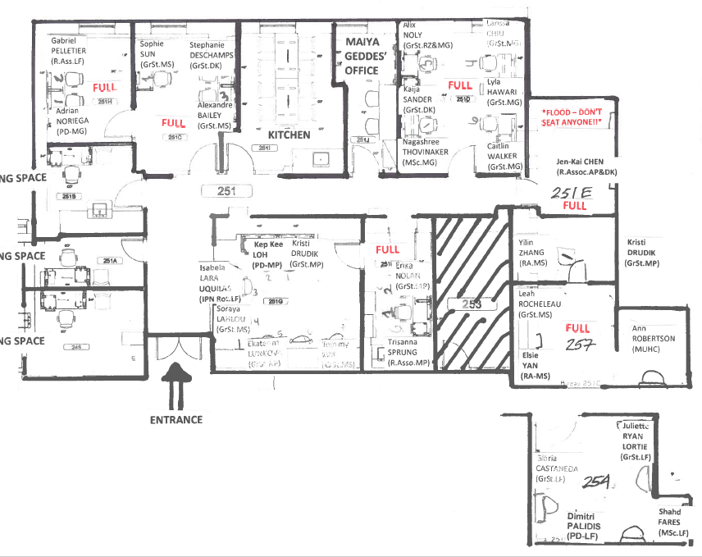

Slide 5
257 & 254 Areas
Testing space
257
254

Slide 6
251 Area
Kitchen
H
C
I
J
D
Testing room
E
B
F
Testing room
A
G
245
Testing room
251 area entrance

