Slide 1
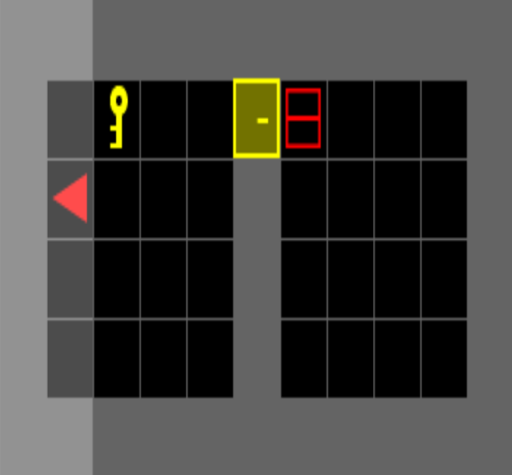


</>
pddl domain
$${skill}_{1}$$
$${skill}_{2}$$
$${skill}_{3}$$
$$⋮$$
$${skill}_{H}$$
predicates
actions
demonstration
exploration
planning
initial natural language descriptions
LLMS
</>
pddl problems
prompt
initial
goal
execution
correction language descriptions
P | V
$$p_{1}$$ | 0
$$p_{2}$$ | 0
$$p_{3}$$ | 1
$$⋮$$
$$p_{N}$$ | 1
common sense vocabulary

Slide 2
















</>
pddl domain
alignment
alignment
predicates
actions
$${parameters}^{t}$$
$$d^{t+1}$$
$$d^{t}$$
$${parameters}^{t+1}$$
action effects
action effects
action effects
action effects
$$\hat{p^{t}}$$
$$\hat{p^{t+1}}$$
$$\hat{p^{t+2}}$$
$$p^{t}$$
$$p^{t+1}$$
$$p^{t+2}$$
$${reflextion}^{t}$$
$${reflextion}^{t+1}$$
${reflextion}^{t}$+2
dec2pred
dec2pred
dec2pred
$$d^{t}$$
$$d^{t+1}$$
$$d^{t+2}$$

Slide 3























$$error$$
$$attribution$$
$$error$$
$$attribution$$
PDDL Step
&
Environment Step
PDDL Step
&
Environment Step
$$env$$
$$pddl$$
$$env$$
$$×$$
$$√$$
$$×$$
$$√$$
$$×$$
$$√$$
$$pddl$$
$$pddl$$
$$env$$
$$env$$
$$pddl$$
$$pddl$$
$$×$$
$$√$$
$$×$$
$$√$$
$$×$$
$$√$$
$$×$$
$$√$$
$$×$$
$$√$$
$$×$$
$$√$$
$$action$$
$$action$$
rollback to previous step
and resample action
error
attribution
possible effect or precondition error

Slide 4
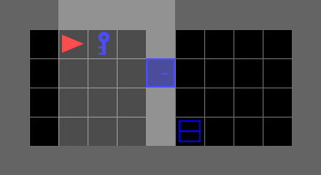
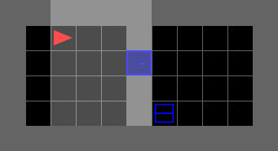
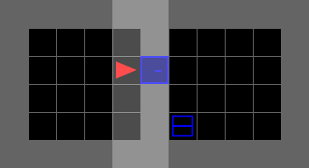
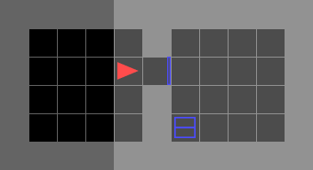
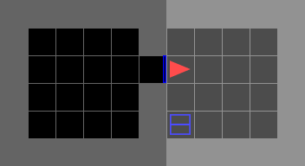
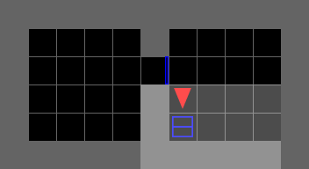
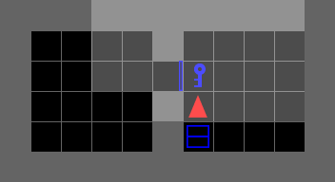
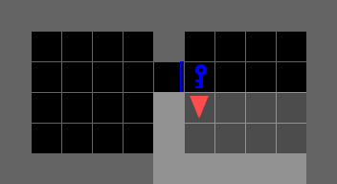

Slide 5






$$action$$
$$state image$$
repeating
CNN
boundary
Encoder
encoder-output
$$state embedding$$
$$encoded output$$
repeated
skill extraction
sampling
repeating
sampling
baoundary
skill-embedding
decoder
transition model
sampled
$$action$$
$$reconstruction$$
$$skill$$
transition

Slide 6















$$action$$
$$state image$$
CNN
Encoder
$$differentiable$$
$$state$$
$$embedding$$
non-$differentiable$
skill head
$$encoded$$
$$representation$$
Gumbel
argmax
segment
codebook
$$onehot$$
$$skill index$$
$$onehot$$
grad
nograd
repeating
sampling
$$boundary$$
$$skill$$
$$embedding$$
transition
$$corpus$$
$$repeated$$
decoder
+
Loss
$$prediction$$
$$action recon$$

Slide 7

repeating
boundary
encoder-output
repeated
sampling
baoundary
skill-embedding
sampled

