Slide 1

Unified Data Concepts
Unified AI Data Lake
Presented by [Presenter Name]

Slide 2
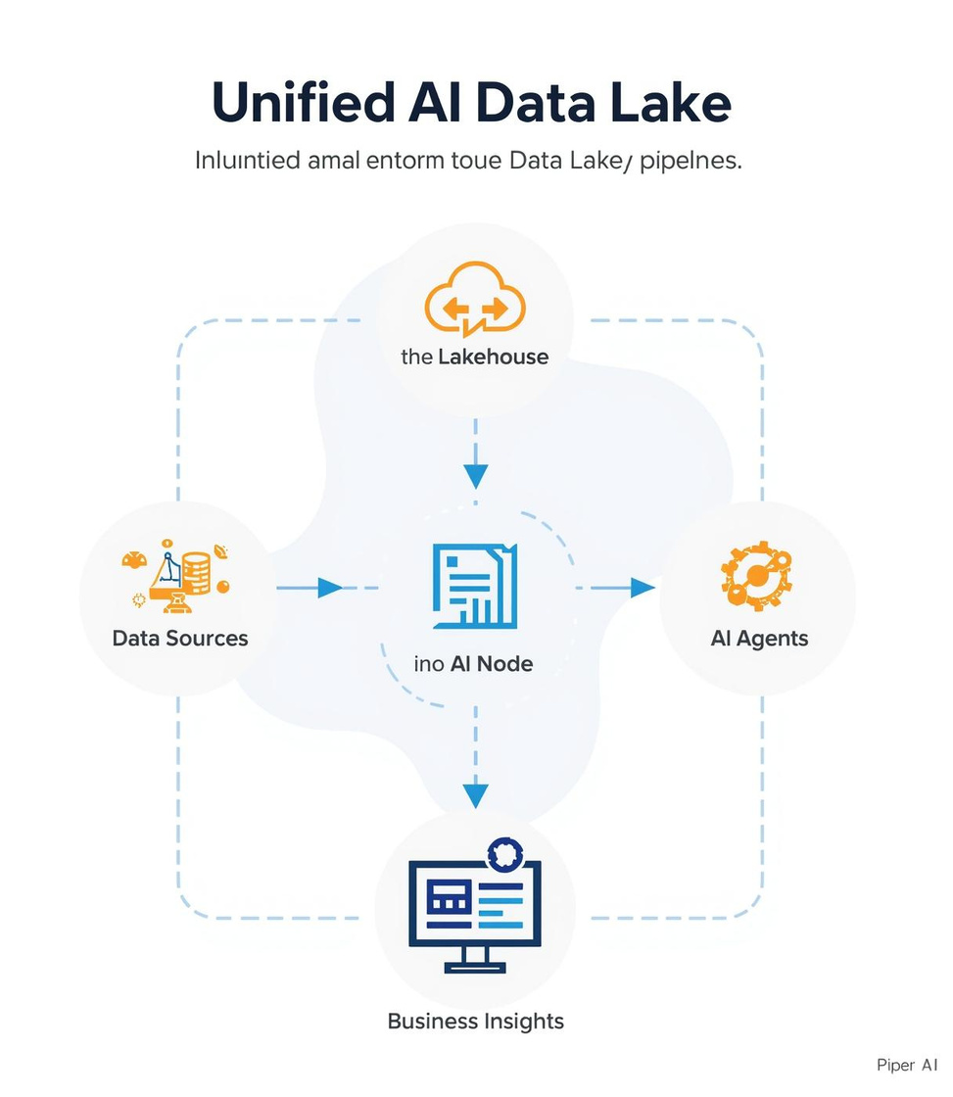

Unified AI Data Lake Pipeline
Data Sources
Lakehouse
Diverse inputs feeding the data lake ecosystem.
Integrating Knowledge Graphs and multimodal data types.
NOTES
EXPLANATION OF KEY PIPELINE STAGES.
2

Slide 3
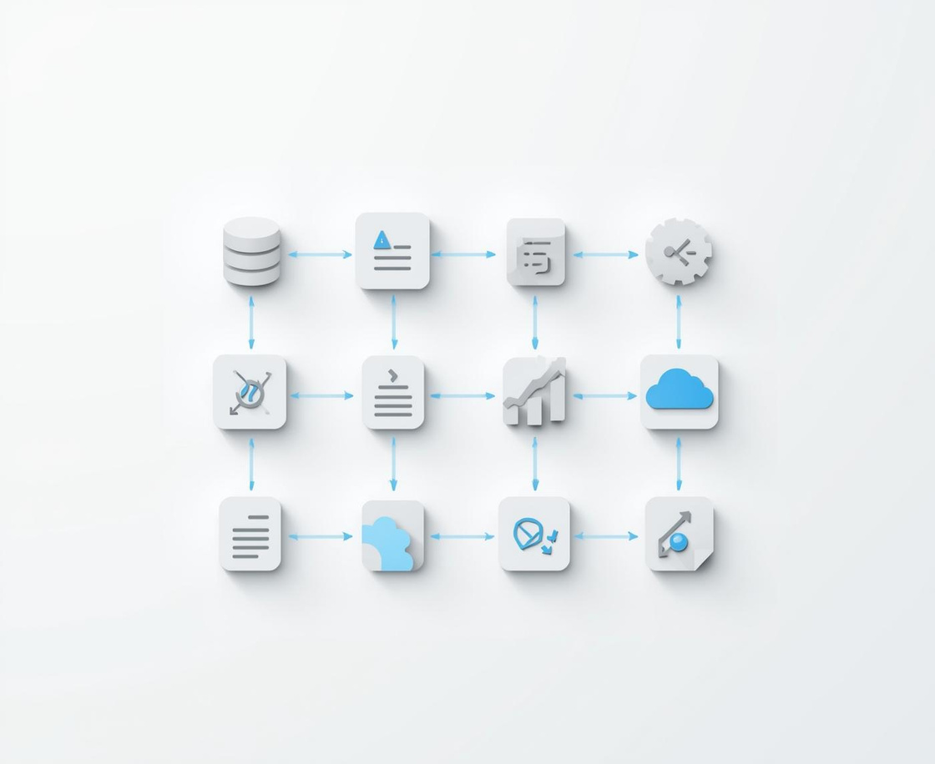


Pipeline Elements
Data Sources
Lakehouse
AI Agents
Diverse inputs like databases and documents fuel insights.
Knowledge Graph combines data types for richer context.
Intelligent automation drives actionable insights from data.
FURTHER NOTES
3

Slide 4
Business Benefits of AI Data Lake
Faster Discovery
Enhanced algorithms enable quicker access to valuable insights.
Reduction in Duplicates
Centralized data minimizes redundancy across all sources.
Greater Accuracy
Improved models yield more reliable and actionable predictions.
THANK YOU FOR YOUR ATTENTION
4

Slide 5
Contact Information
Stay in Touch
Phone
123-456-7890
Email
hello@reallygreatsite.com
Website
www.reallygreatsite.com

