Slide 1


Unified AI Solutions
AI Data Lake
Connecting Every Decision to a Trusted Source
PRESENTED BY
Jane Doe

Slide 2

Fragmented Data
Fragmented data leads to inconsistent insights across organizations, hindering effective decision-making and preventing teams from leveraging critical information efficiently.

Slide 3
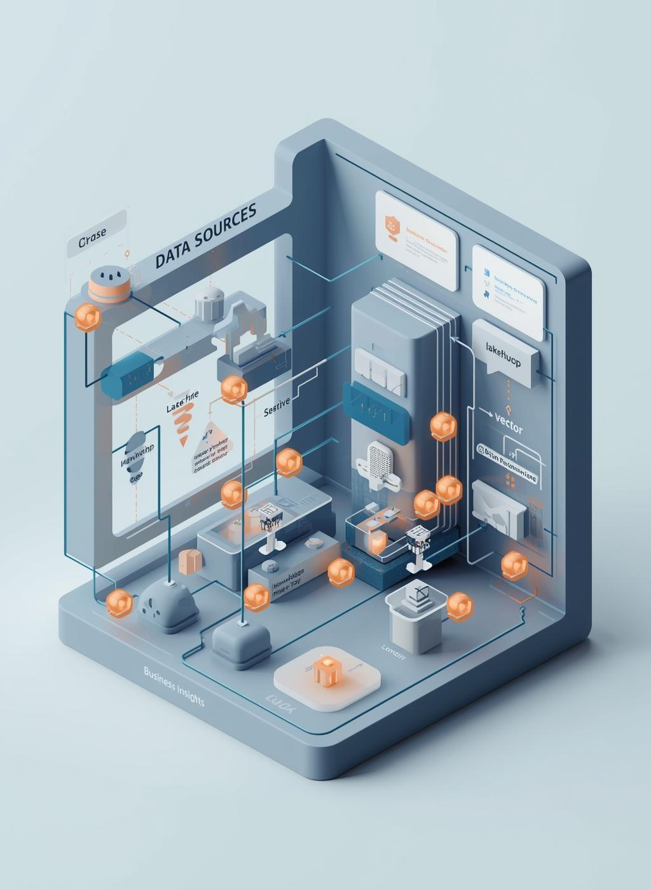
The Vision
This section illustrates the unified data flow and AI integration, showcasing how various data sources connect through a Lakehouse to deliver actionable business insights.

Slide 4
Core Components
VECTOR SEARCH + RAG
KNOWLEDGE GRAPH
Vector Search combined with Retrieval-Augmented Generation (RAG) enables precise data retrieval, enhancing the efficiency of information access and improving the accuracy of insights generated for decision-makers.
The Knowledge Graph enhances data relationships, allowing for a comprehensive understanding of interconnected information, leading to improved insights and informed decision-making across the organization.
MULTIMODAL STORAGE
GOVERNED SCHEMAS
Multimodal Storage supports diverse data types, including PDFs, tables, and images, ensuring seamless access and integration, thereby enriching data analysis and enabling deeper insights for businesses.
Governed Schemas ensure data traceability and compliance, establishing a solid framework for data governance that promotes accountability and trust across all business functions and processes.

Slide 5

Business Outcomes
Achieving a unified AI data lake leads to enhanced decision-making, consistent insights, improved accuracy, and reduced costs, providing organizations with a competitive edge in today's data-driven landscape.

Slide 6

Contact Us
[COMPANY NAME]
@reallygreatsite
OFFICE LOCATION
(12) 3456-7890
SUPPORT TEAM
hello@reallygreatsite

