Slide 1

Projects Overview
TUM Chair of IT Security
Computer Science Department
Huang Xiao (I20)
xiao@sec.in.tum.de

Slide 2
Overview
BMBF Project: ARAMiS
Anomaly Detection with Machine Learning

Slide 3

ARAMiS
ARAMiS stands for Automotive, Railway and Avionics Multicore Systems.
Goal: Multicore adaption of current existing embedded systems to increase system security, safety and efficiency in automotive, railway and avionics domains.
Importance: Fundament of networking embedded systems and Cyber Physical Systems.
Funded by BMBF for three years.
Project consortium includes the most influential partners in both industry and academy. E.g., BMW, EADS, Siemens, Infienon, TUM, Fraunhofer (32 Partners overall)
Results: Realization of MC-OS (Multicore Operating System) for various mobility domains, project documents, Scientific publications, books, articles, organization of speicial sessions (e.g., workshops).
TUM Chair of IT Security: Security components in ARAMiS MC-OS.

Slide 4
ARAMiS (Cont.)
System architecture (via PikeOS)
TUM INSEC OBJECTIVES
SECURITY ARCHITECTURE
HW/SW security partitioning
Algorithms and protocols
Hypervisor functions
Threat analysis
SOFTWARE
System architecture for MC-OS
Development of security monitor
Verification and test of system
DEMOSTRATOR
High integration demonstration on BMW automotive platform.

Slide 5
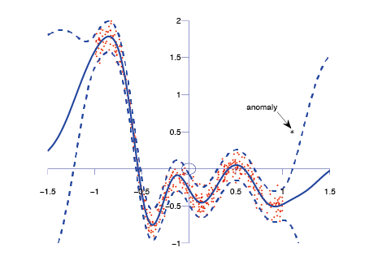
Anomaly Detection
Machine learning based anomaly detection
Classification based
Neural networks, Bayesian networks, SVMs¹
Nearest neighbor based
K^{th} nearest neighbor, relative density
Clustering based
EM² algorithm, Local outlier factor
Statistical anomaly detection
Gaussian model based, regression model, kernel function based
Information theoretic based
Geometric entropy minimization (GEM)
Spectral based
Compact matrix decomposition, robust PCA

Slide 6
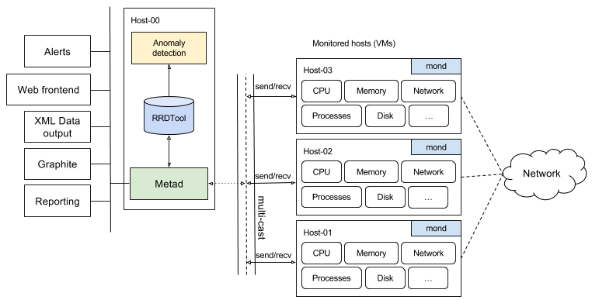
Smart Security Monitor (Architecture)
Embedded anomaly detection module
Catch the anomalies in real time!
NoDatabase: RoundRobinTools for Time series Data

Slide 7
Anomaly Detection (Cont.)
Selected publications
Xiao, Huang, and Claudia Eckert. Indicative Support Vector Clustering with its Application on Anomaly Detection. In IEEE 12th International Conference on Machine Learning and Applications (ICMLA'13), Miami, Florida, December 2013
Xiao, Han, Huang Xiao, and Claudia Eckert. Learning from Multiple Observers with Unknown Expertise. In Proceedings of 17th Pacific-Asia Conference on Knowledge Discovery and Data Mining, Gold Coast, Australia, April 2013. Springer.
Xiao, Huang, Han Xiao, and Claudia Eckert. OPARS: Objective Photo Aesthetics Ranking System. In 34th European Conference on Information Retrieval (ECIR'13), Moscow, Russia, March 2013
Xiao, Han, Huang Xiao, and Claudia Eckert. Adversarial Label Flips Attack on Support Vector Machines. In 20th European Conference on Artificial Intelligence (ECAI), Montepellier, France, August 2012.

