Slide 1
Selected Topics for IT Security Adversarial Learning: AI as a New Security Target
Lecturer
Huang Xiao
xiaohu (at) in (dot) tum (dot) de
Chair for IT Security (I20), Prof. Dr. Claudia Eckert
Technische Universität München

Slide 2
Outline
Introduction & Motivation
Machine Learning for Security
Research Subfields
Challenges & Discussion
References

Slide 3
Introduction
Machine Learning is not a panacea
Data stationary assumption is usually too strict
Learning-as-a-Service is a trend
Cyber Security is using learning-based solutions
AI system itself can be a threat (intrinsic algorithmic deficiency)
Endless war between adversaries and defenders
Therefore: adversarial and secure machine learning

Slide 4
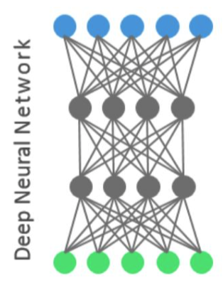
Motivation
To mislead the DNN to give wrong decisions
“It turns out some DNNs only focus on discriminative features in images.”
Nguyen A, Yosinski J, Clune J. Deep Neural Networks are Easily Fooled: High Confidence Predictions for Unrecognizable Images. In Computer Vision and Pattern Recognition (CVPR '15), IEEE, 2015.

Slide 5
Motivation
To bypass the spamfilter by good words attack.
Learning to violate security goals, e.g.,
Integrity is violated, since a positive sample evades being detected.

