Slide 1
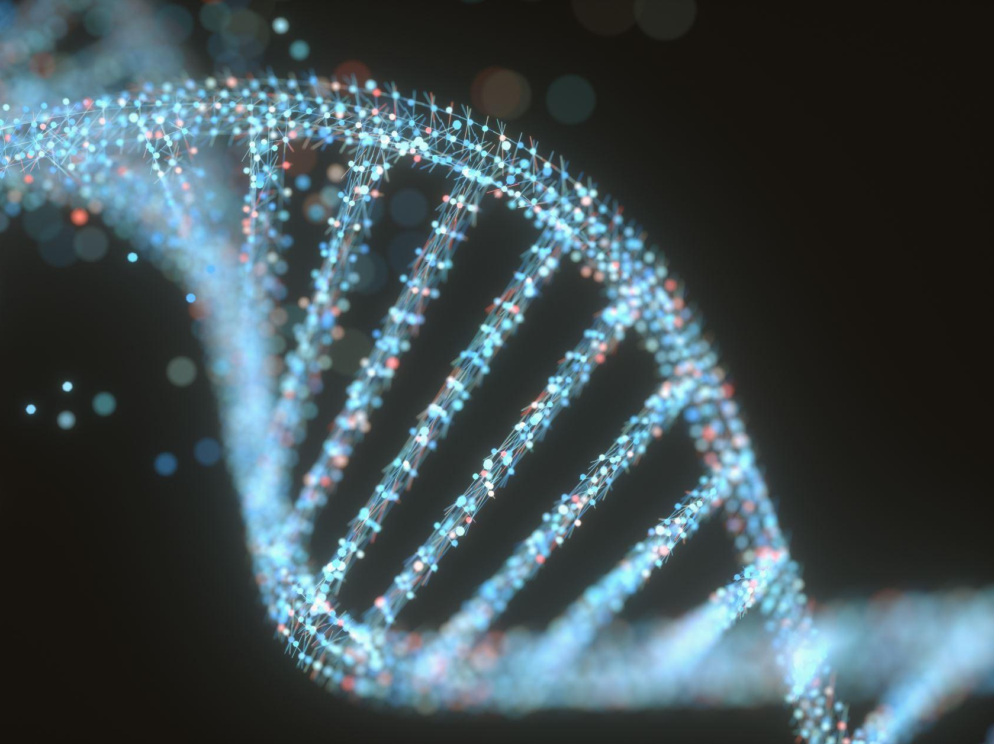
Precision Cancer Medicine on Meningioma Tumors
Group 9 - Natalie Heywood, Avi Mayron, Cohen Adkins
11/22/2022

Slide 2
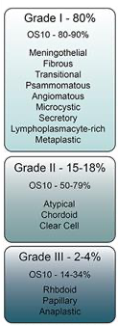
Introduction
WHO Histology Grade:
Approach #1:
Differential Expression Analysis
Results:
Correctly classified subtypes
  Grade 3
  Not Classified
Identified small group of outliers
Impact:
Proper diagnosis of prominent deadly disease
Optimal precision medicine
Focus on treatment research
Data:
~23,000 Genes
X
102 Patient Samples
Approach #2:
Predictive Clustering Models

Slide 3
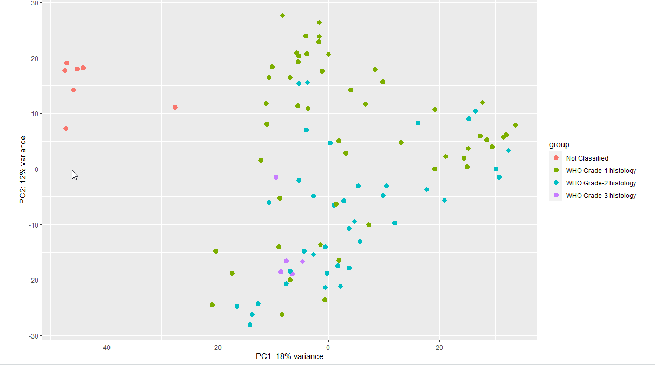
Introduction
PCA Plot:

Slide 4





Hypothesis
Question: What is the impact of precision cancer medicine used to treat meningioma tumors, based on their grade (1, 2, or 3), on surrounding genes?
Hypothesis: If we analyze various patterns of overexpressed genes amongst patients with meningioma tumors, then we will uncover a strong correlation with their tumor histology grade – a metric fundamental to precision medicine efficacy.

Slide 5
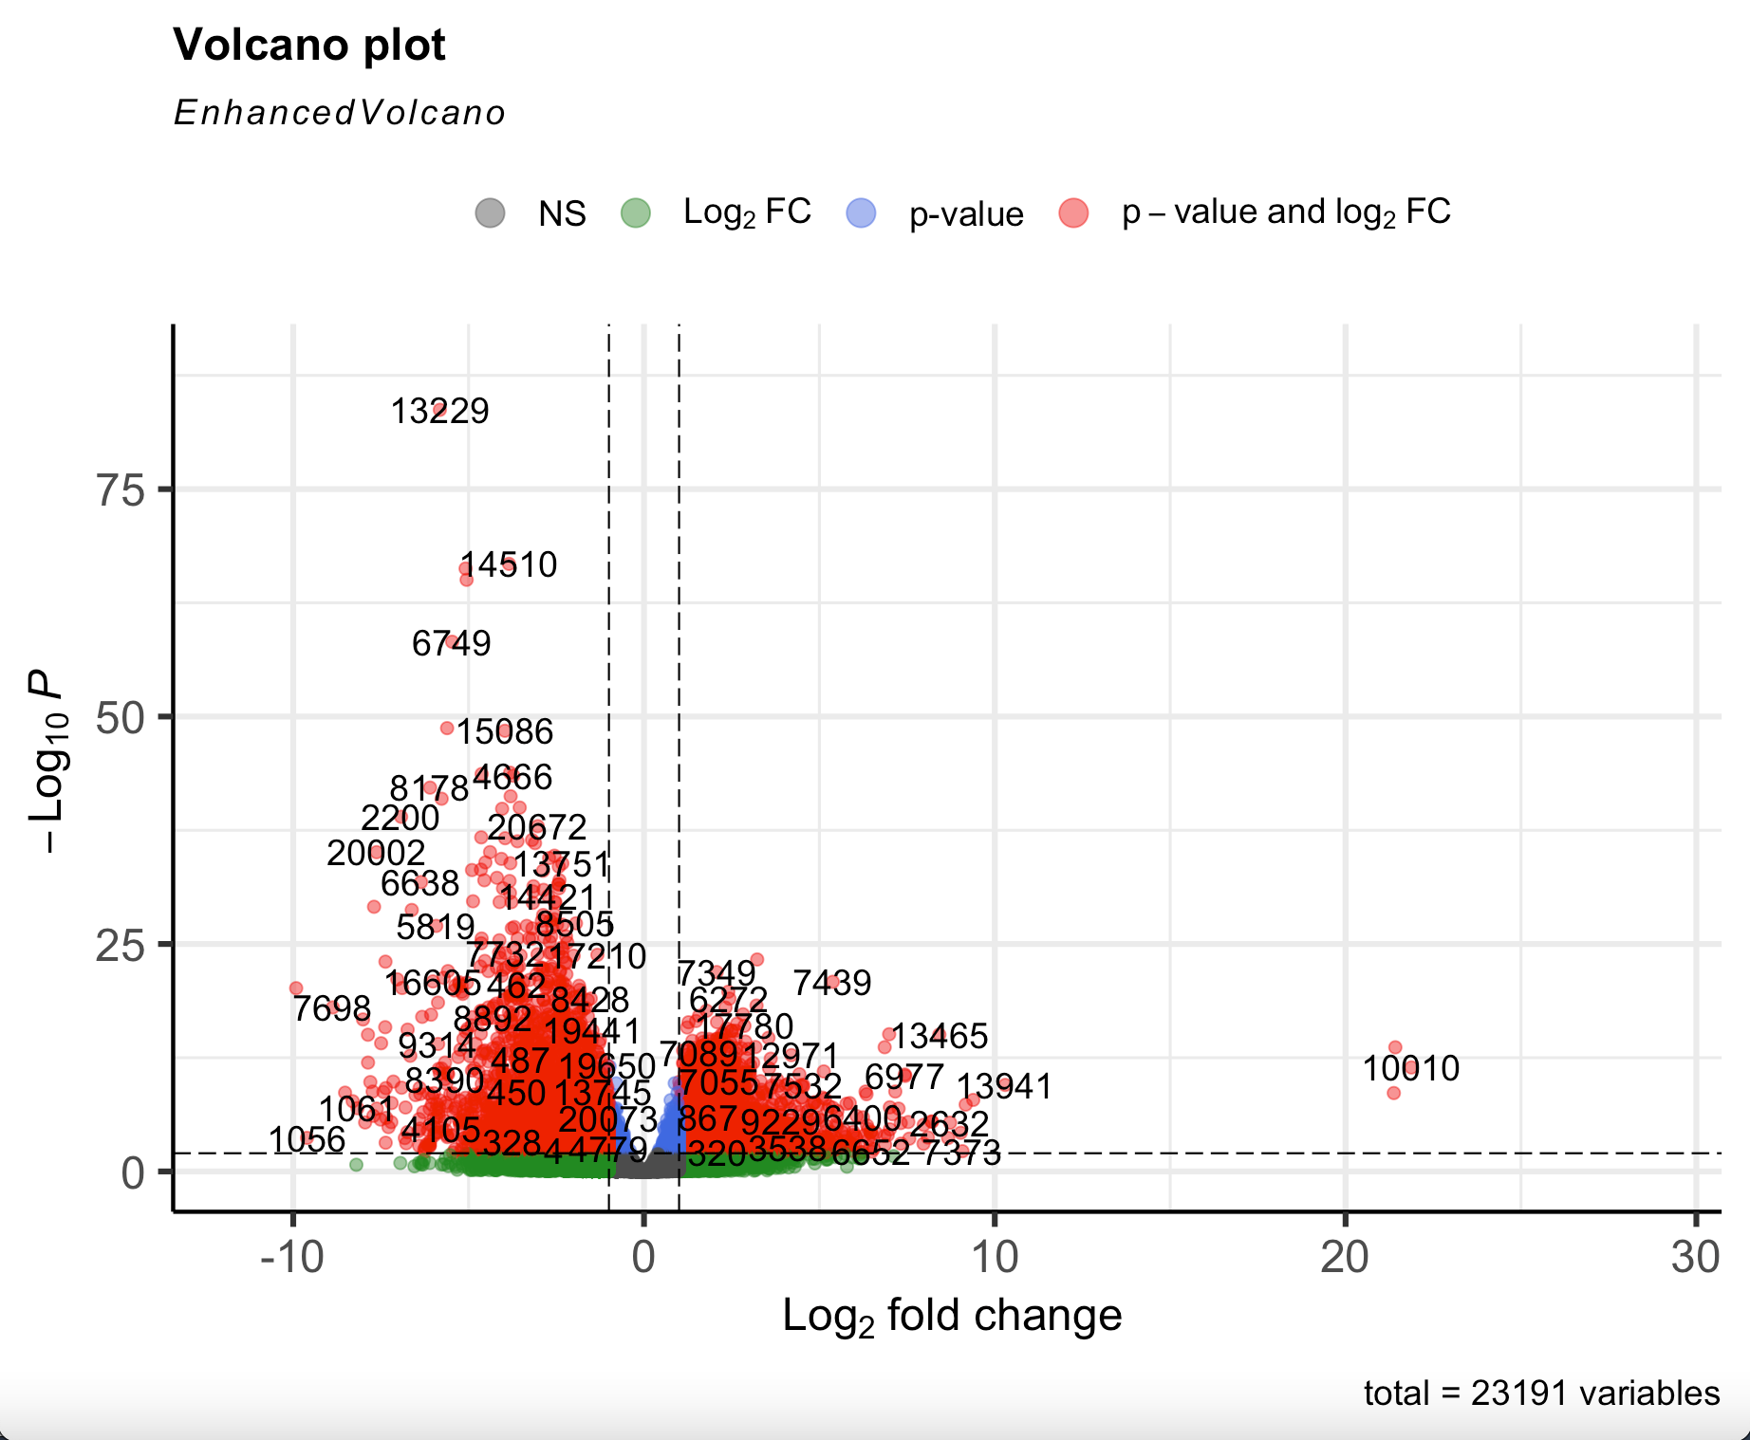
Differential Expression and Enrichment Analysis
Visualization of genes that display large magnitude of changes that are significant
Outliers along the x and y axis
Highlights significant genes

Slide 6
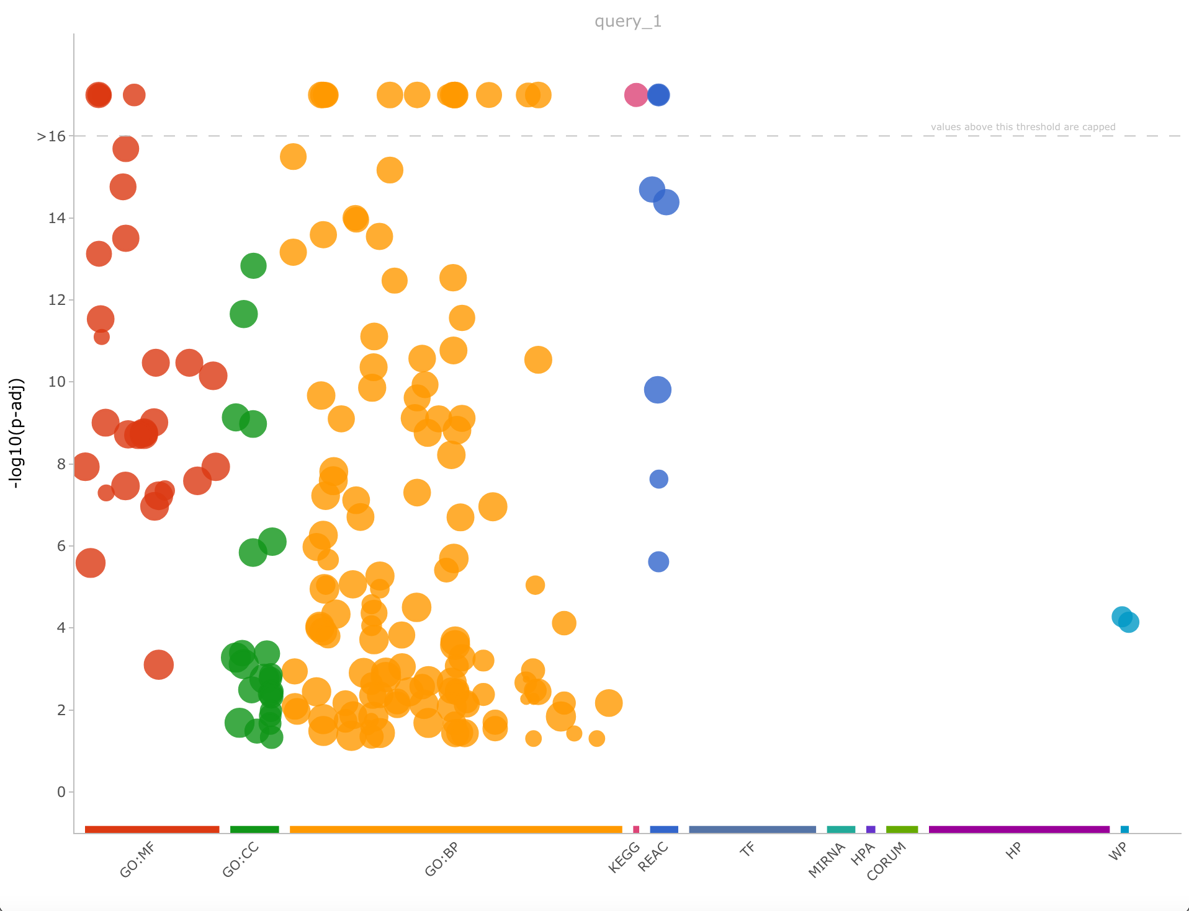
Differential Expression and Enrichment Analysis
Displays significant SNP’s
(GO:BP) Relationship between proteins
(GO:MF) Catalytic binding activities
(GO:CC) Locations of subcellular structures

Slide 7
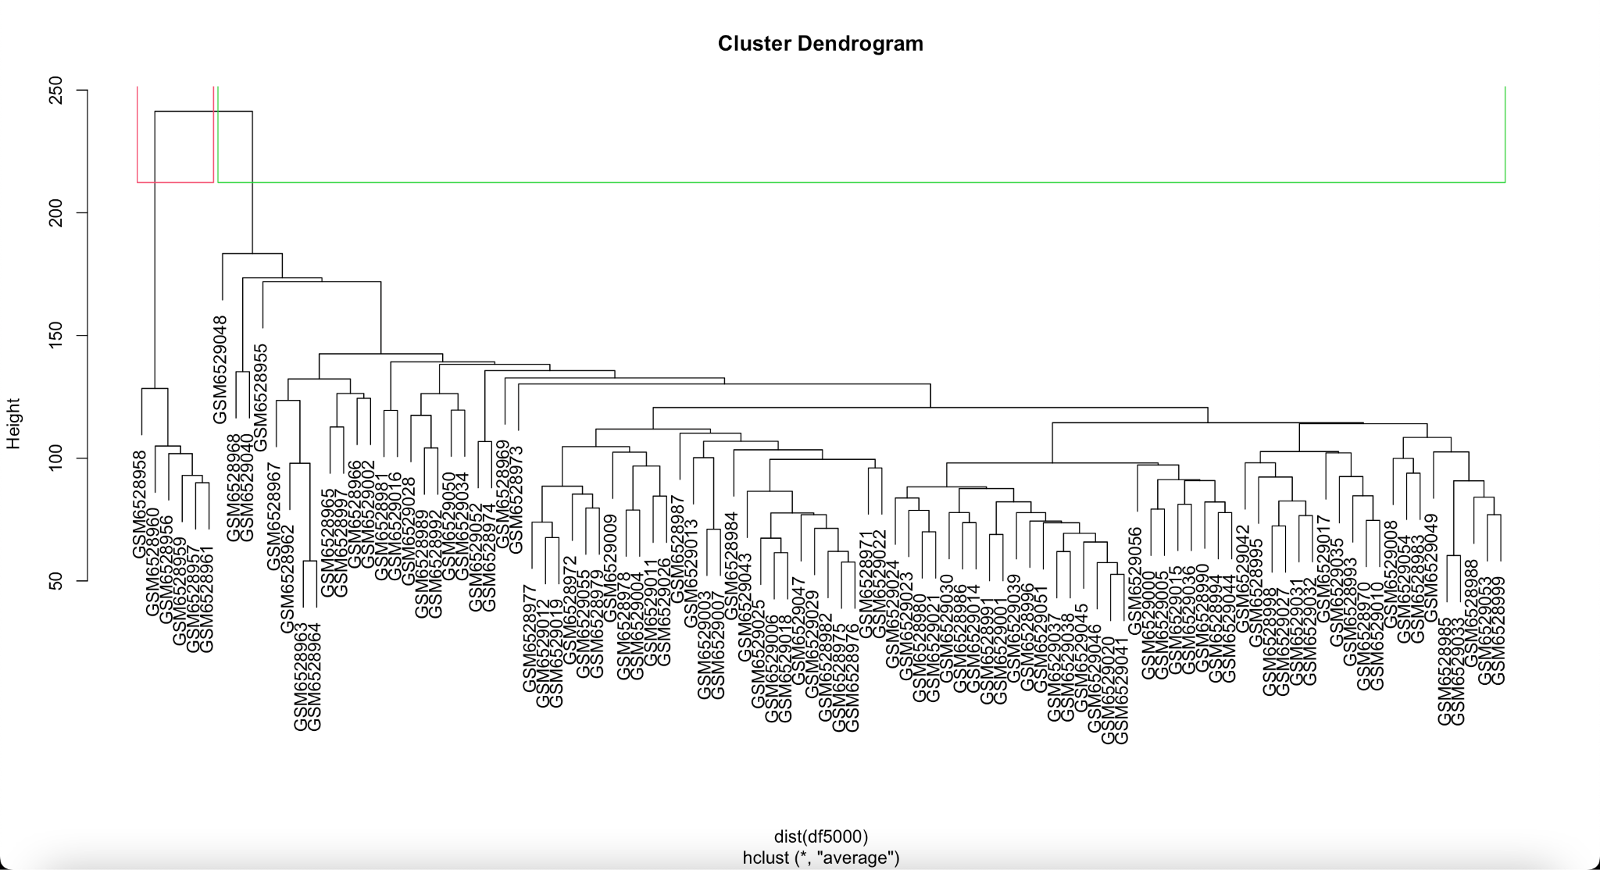
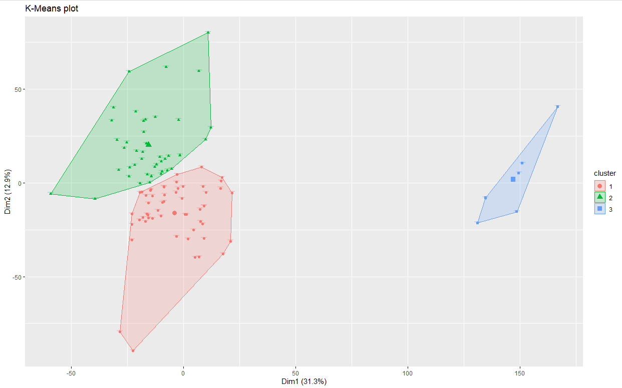
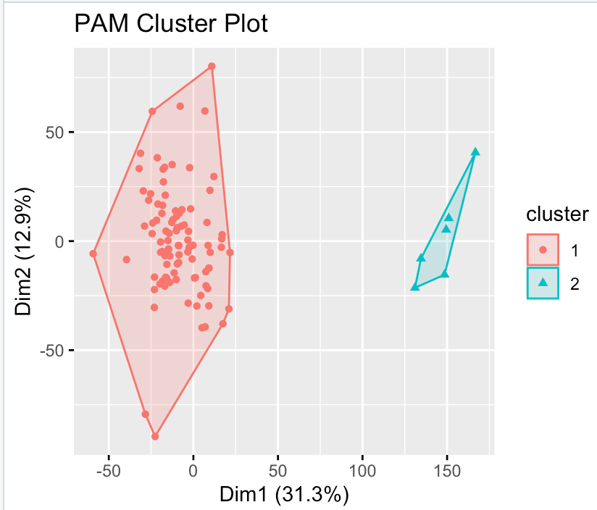
Clustering & Enrichment Analysis
Three clustering methods: Hierarchical, K-means, and PAM
Plots using 5000 most variable
Generally agreed upon 2 clusters
One small group of outliers from every method
Notes:
Three clustering methods: Hierarchical, K-means, and PAM
Plots using 5000 most variable
Generally agreed upon 2 clusters
One small group of outliers from every method

Slide 8
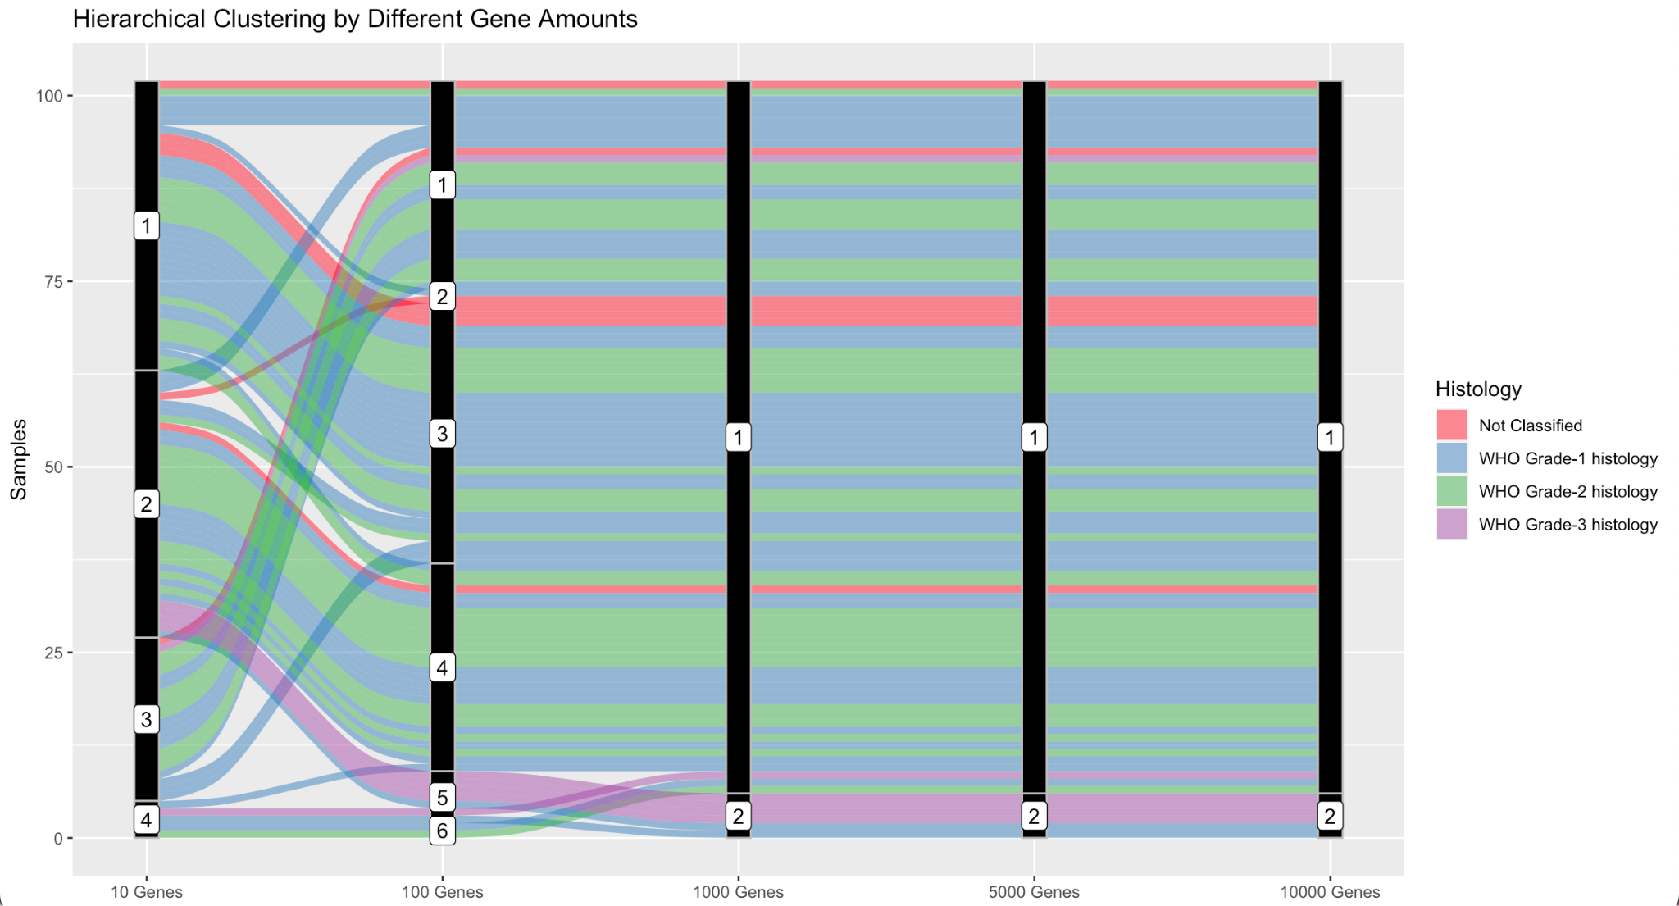
Clustering & Enrichment Analysis
Evens out after 1000 genes into 2 clusters (one big one small)
One small group almost exclusively Grade 3
Notes:
Evens out after 1000 genes into 2 clusters (one big one small)
Grade 3 seperate

Slide 9
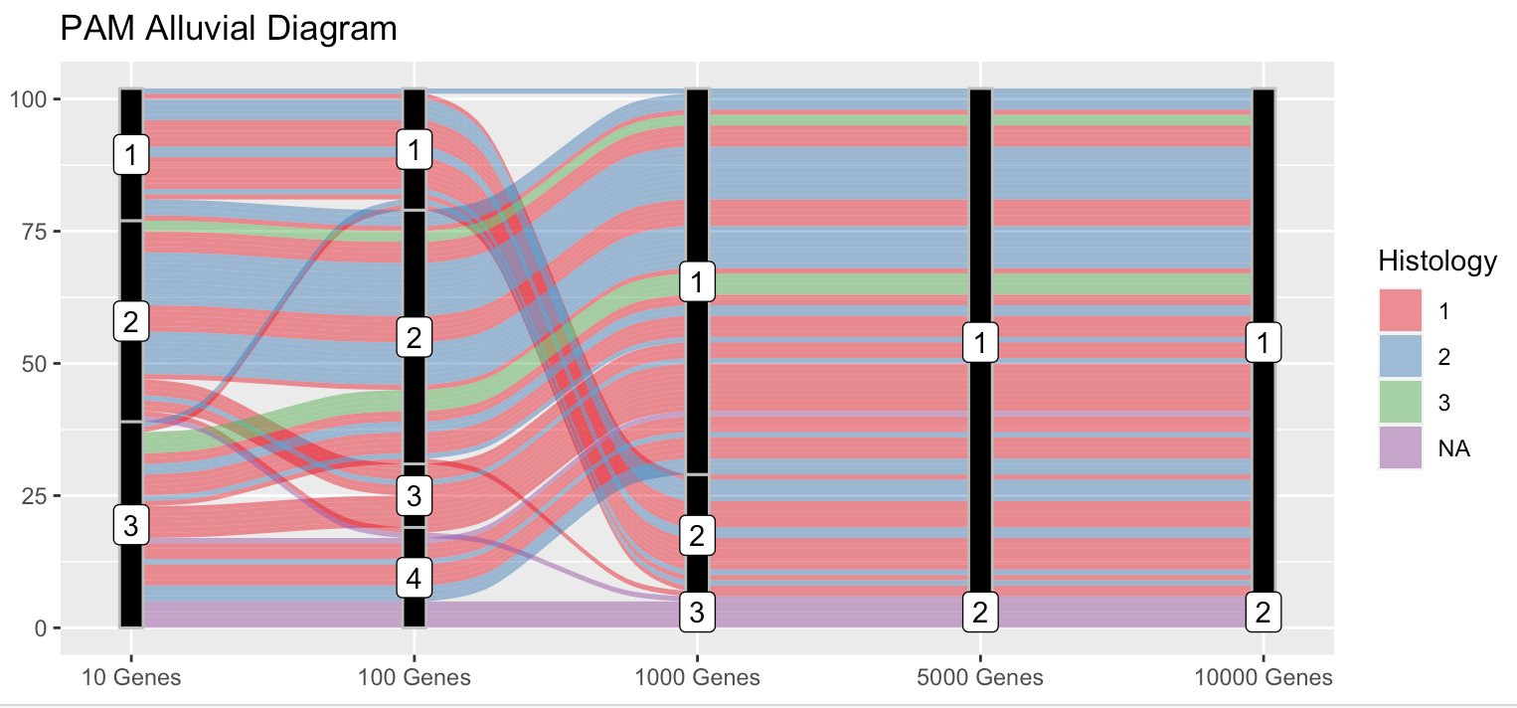
Clustering & Enrichment Analysis
Evens out after 1000 genes into 2 clusters (one big one small)
One small group almost exclusively NA
Notes:
Evens out after 1000 genes into 2 clusters (one big one small)
NA seperate

Slide 10
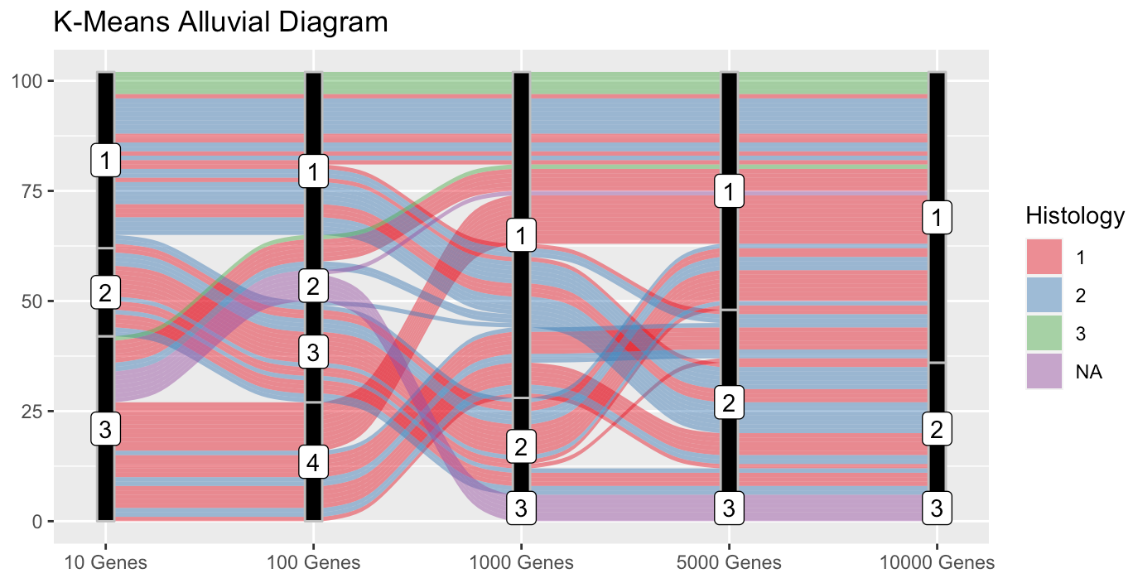
Clustering & Enrichment Analysis
Evens out after 5000 genes into 3 clusters
One small group almost exclusively NA
Notes:
Evens out after 5000 genes into 3 clusters
One small group almost exclusively NA

Slide 11
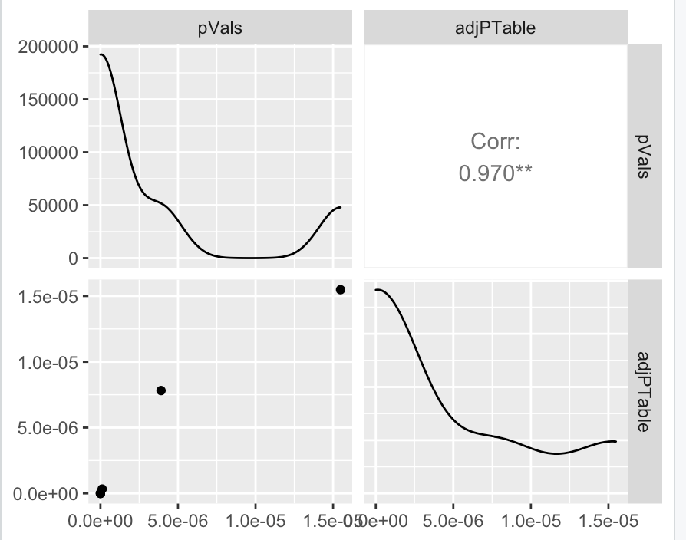
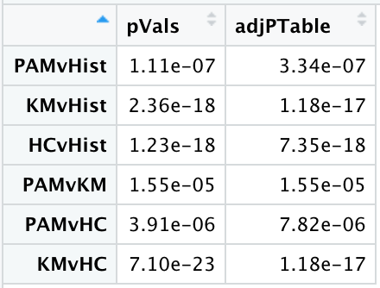
Clustering & Enrichment Analysis
Notes:
Heatmaps allow us to view levels of gene expression per cluster for each of the three clustering methods (deleted)
Statical tests confirmed that our clustering methods were statistically significant with each other and with histology
Need a statement about the enrichment plot.
Identification of groups of genes over-represented
Enrichment scores in regards to overrepresented genes
Correlation of genes to one another

Slide 12
Conclusions & Future Work
Could not answer part of question about precision cancer medicine
  However, there are patterns within gene expressions that correlate with WHO Grade Histology
    Can separate grade by gene expression
    Hierarchical separates Grade 3, K-means and PAM separate NA
  Clustering groups remained constant after a few thousand most variable genes (see alluvial diagrams)
  As number of variable genes increase, clusters become more consistent and are more strongly correlated with histology - up to a certain point
Future work
  Include samples from patients not treated with precision cancer medicine
  Compare gene expression to factors other than WHO Grade Histology (size, age, etc.)

