Slide 1

NEURAL NETWORK Perceptrons

Slide 2
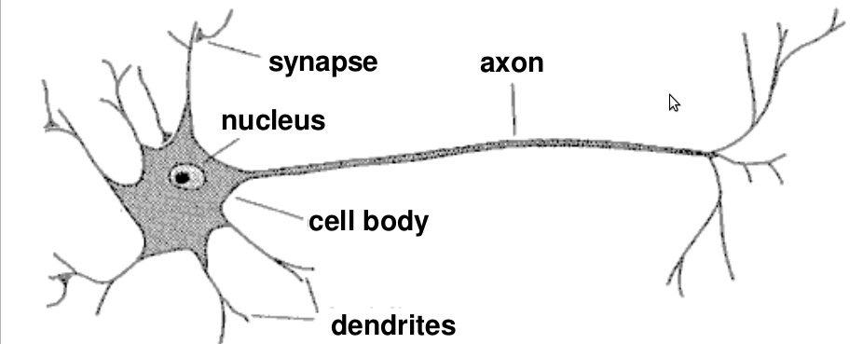
Structure of Neuron
A neuron has a cell body, a branching input structure (the dendrite) and a branching output structure (the axon).
Axons connect to dendrites via synapses.
Electro-chemical signals are propagated from the dendritic input, through the cell body, and down the axon to other neurons.

Slide 3
Structure of Neuron
A neuron has a cell body, a branching input structure (the dendrite) and a branching output structure (the axon).
Axons connect to dendrites via synapses.
Electro-chemical signals are propagated from the dendritic input, through the cell body, and down the axon to other neurons.

Slide 4
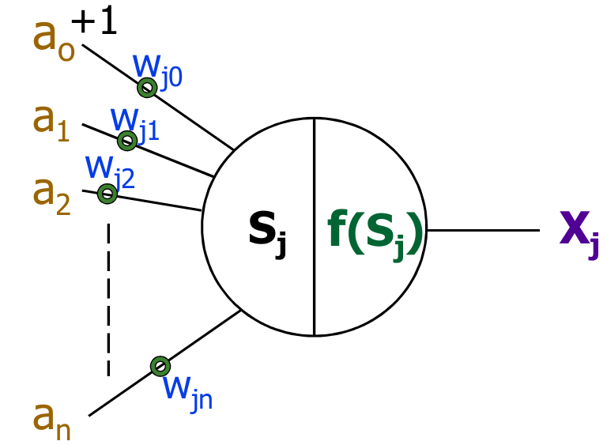
PERCEPTRON

Slide 5
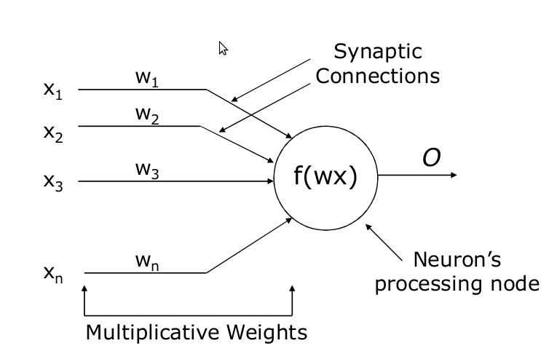
A Closer Look

Slide 6
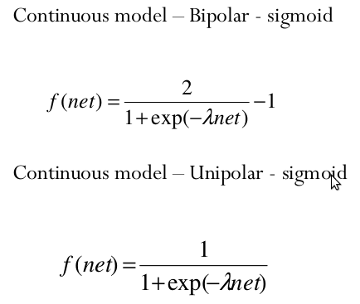
Activation Function- Sigmoid Function

Slide 7
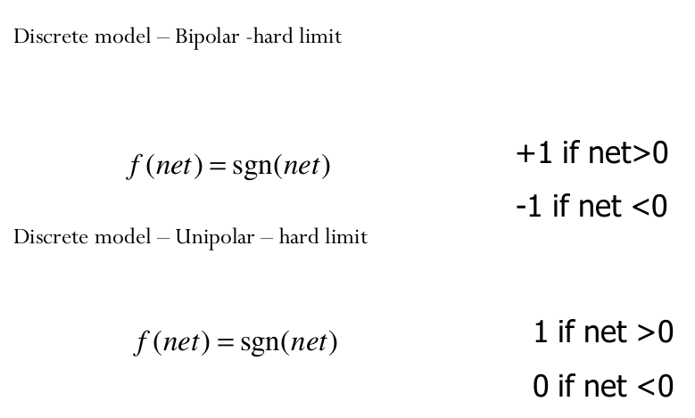
Activation Function- Sign Function

Slide 8
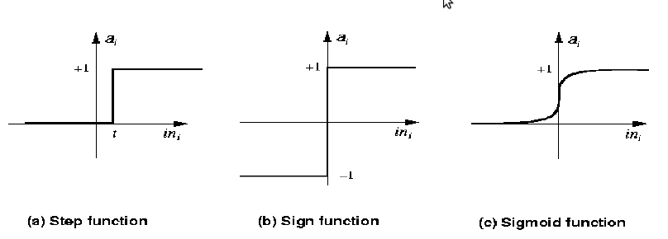
Activation Function

Slide 9
Learning in Neural Network
Start with random weights
Load training example’s input
Observe computed output
Modify weights to reduce difference
Iterate over all training examples
Terminate when weights stop changing OR when error is very small

Slide 10
Learning Algorithm Terminologies
EPOC : Presentation of the entire training set to the neural network. In the case of the AND function an epoch consists of four sets of inputs being presented to the network (i.e.[0,0], [0,1], [1,0], [1,1]).
ERROR : The error value is the amount by which the value output by the network differs from the target value. For example, if we required the network to output 0 and it output a 1, then Error = -1.
TARGET VALUE 'T' : When we are training a network we not only present it with the input but also with a value that we require the network to produce. For example, if we present the network with [1,1] for the AND function the target value will be 1.
OUTPUT 'O' : the output value from the Neuron.
LEARNING RATE : The learning dictates how quickly the network converges. It is set by matter of experiment.

Slide 11
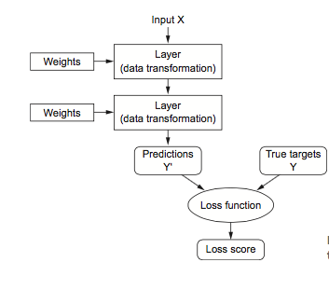
How to estimate the weights?
To know how closer or far our selection of weights gets us to our true answer, we must have a measure for error.
The loss function takes the predictions of the network and the true target and computes a distance score, capturing how well the network has done.

Slide 12

How to Update Weights
Where 't' is observation for which weight updation is required.

Slide 13
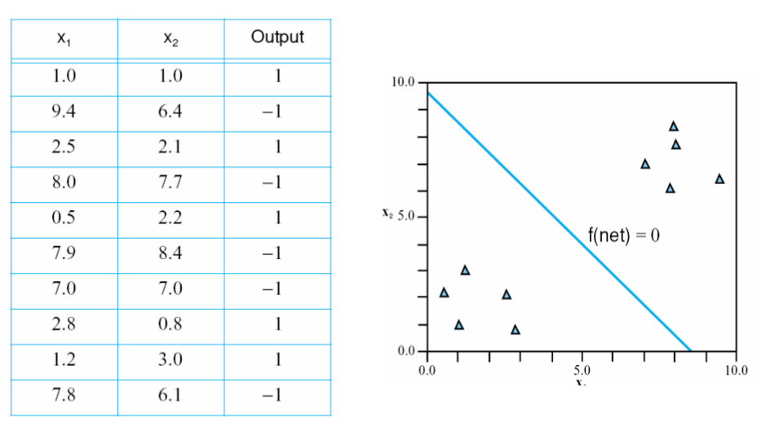
Working with perceptron for Classification

Slide 14
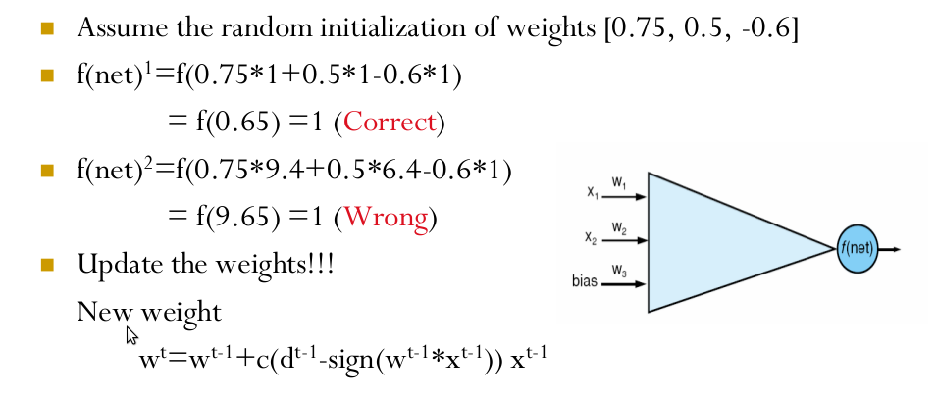
Working with Perceptron for Classification

Slide 15
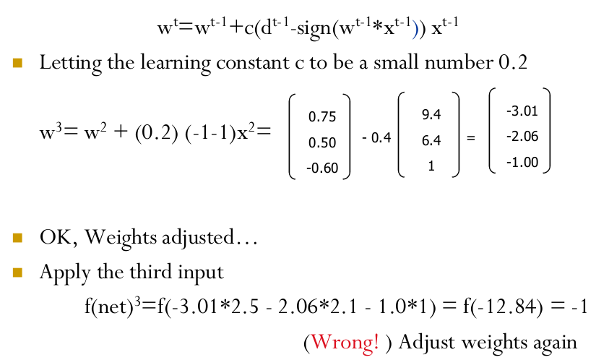
Working with Perceptron for Classification

Slide 16
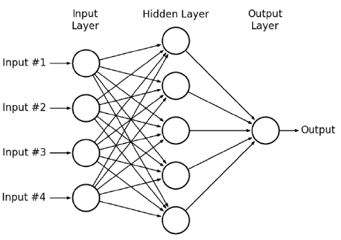
Multi Layer Perceptron(MLP)

Slide 17
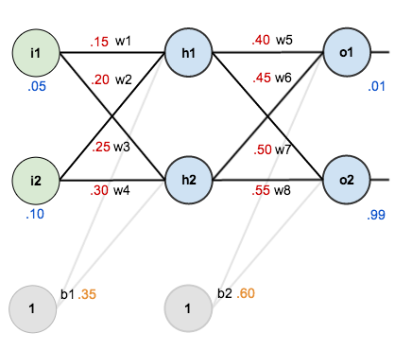
Assume these initial input values and weights

Slide 18
Steps
Step 1: Calculate activation on hidden layer 1
Step 2: Squash it using the logistic function
Doing the same for hidden layer 2 we get,
Step 3: Calculate input to final layer
Step 4: Calculate error. Error on 01 =

Slide 19

Weight updation
Step 5: Update ALL weights. Lets start with w5 . By the chain rule we know
So, the question we are asking here is how does change in weights affect the output.
First part

Slide 20
Weight updation
Second part - This part is about how the output changes with respect to input layer activation
The third part - how much does the total net input of o1 change with respect to w5?

Slide 21
Putting it all together
Now we have what we need to update weight

Slide 22
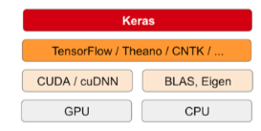
What is Keras?
Keras is a deep-learning framework for Python that provides a convenient way to define and train almost any kind of deep-learning model.
It has built-in support for convolutional networks (for computer vision), recur-
rent networks (for sequence processing), and any combination of both.
Keras is a model-level library, providing high-level building blocks for developing deep-learning models. It doesn’t handle low-level operations such as tensor manipulation and differentiation.
This is what TensorFlow is for as is Theano.

Slide 23
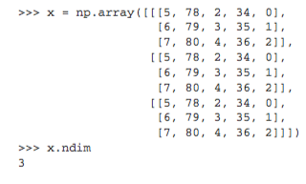
What is a Tensor?
Tensors, the data-storing objects going into the network.
tensor is a container for data—almost always numerical data.
An array of numbers is called a vector, or 1D tensor.
Below is a 3D tensor.
A tensor is defined by number of axis (3), shape (3, 3, 5), data type.

