Slide 1
Long Short-Term Memory (LSTM)

Slide 2
Issues with simple RNN
Although it should theoretically be able to retain at time 't' information about inputs seen many timesteps before, in practice, such long-term dependencies are impossible to learn.
This is due to the vanishing gradient problem, an effect that is similar to what is observed with non-recurrent networks (feedforward networks) that are many layers deep: as you keep adding layers to a network, the network eventually becomes untrainable.

Slide 3
LSTM
This layer is a variant of the SimpleRNN layer you already know about; it adds a way to carry information across many timesteps. Imagine a conveyor belt running parallel to the sequence you’re processing.
Information from the sequence can jump onto the conveyor belt at any point, be transported to a later timestep, and jump off, intact, when you need it.
This is essentially what LSTM does: it saves information for later, thus preventing older signals from gradually vanishing during processing.

Slide 4
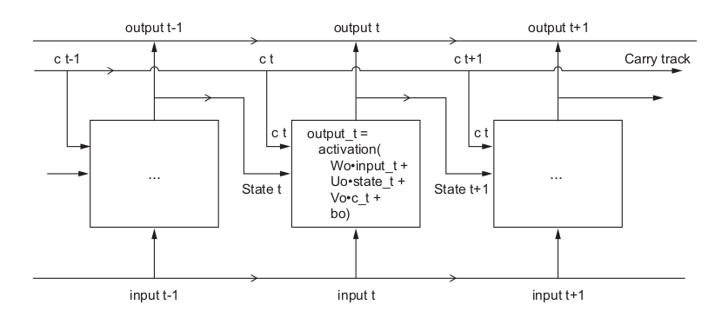
LSTM

Slide 5
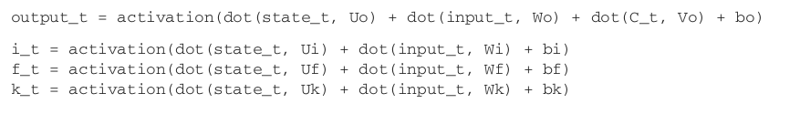

LSTM Architecture
Psedo Code:-

Slide 6
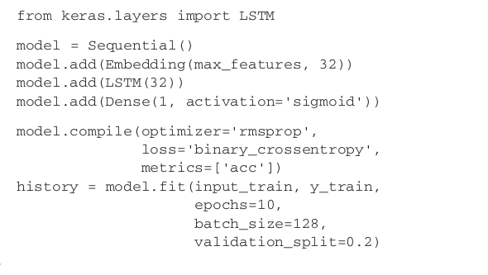
LSTM with Keras

Slide 7
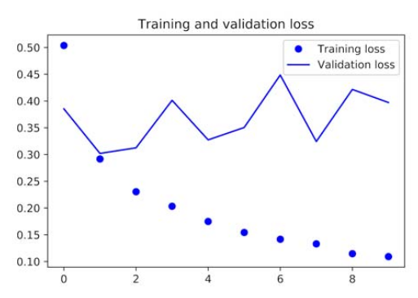
LSTM with Keras

Slide 8
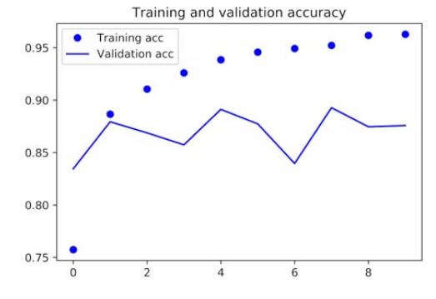
LSTM with Keras

