Slide 1
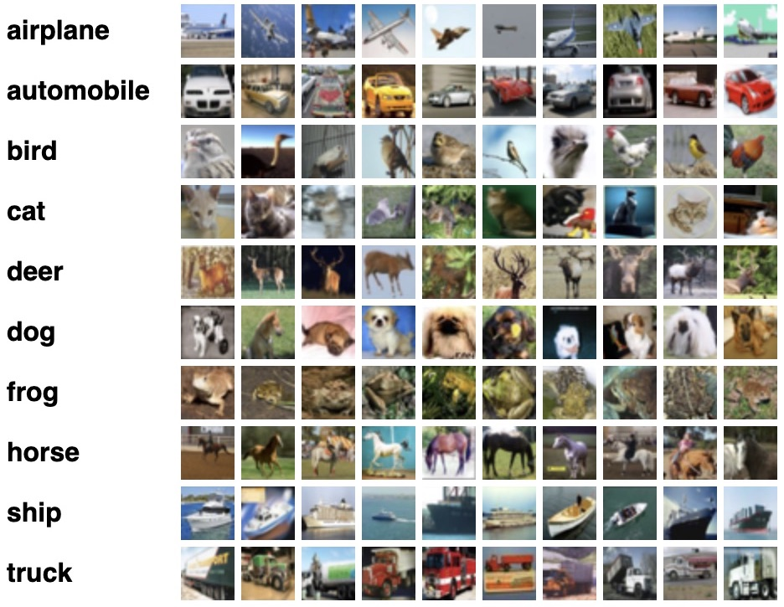
Project #2 – CIFAR10 Clustering
הגשה עד ה: 16.5.22
Use a subset of only 3 classes from CIFAR10 (32x32 RGB images)
Explore the database using unsupervised tools
Try to cluster into 3 different clusters
There is ground truth, but don’t use it for the fit, only for the evaluation and data exploration! (e.g. you can use rand index)
No need to split into Train & Test
Direct Download

Slide 2
Project #2 – CIFAR10 Clustering
The delivery should be a notebook consist of code, saved results and explanations
Delivery should be till lecture #18
It’s a research project without a quantitative goal (the clustering does not necessary correspond to the ground truth). A recommended research question is: According to which features does the clustering algorithms you will use split the space ?
We expect to see:
Data exploration
At least three different attitudes of clustering
Usage of metrics for evaluation
Comments and explanations for each step you did
Summaries what you learn from the project
Extra (for fit walkers only)

