Slide 1
More Geometric Data Structures Windowing
Min-Te Sun, Ph.D.

Slide 2
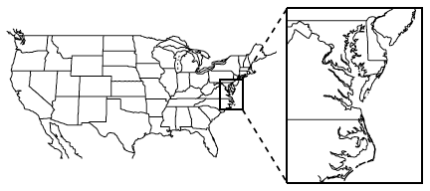
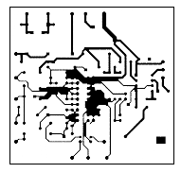
Window Queries
Navigations
Flight Simulations
CAD/CAM

Slide 3
Simplify the Problem
Consider the x-axis to be aligned with the bottom side of the board, and the y-axis to be aligned with the left side of the board
Any segment is parallel to either the x-axis or the y-axis
The segments are axis-parallel, or orthogonal
The query window is an axis-parallel rectangle, that is, a rectangle whose edges are axis-parallel.

Slide 4
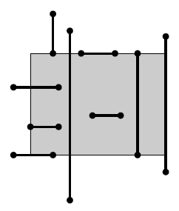
An Efficient Data Structure to Support Windowing Query
Let S be a set of n axis-parallel line segments. We need a data structure that stores S in such a way that the segments intersecting a query window W := [x : x’]X[y : y’] can be reported efficiently.
The segment can
lie entirely inside W
intersect the boundary of W once
intersect the boundary twice
(partially) overlap the boundary of W.
In most cases the segment has at least one endpoint inside W
Range tree can do it in O(log²n + k) time

Slide 5
Windowing Query
Let S be a set of n axis-parallel line segments in the plane. The segments that have at least one endpoint inside an axis-parallel query window W can be reported in O(logn + k) time with a data structure that uses O(nlogn) storage and preprocessing time, where k is the number of reported segments.
Fractional cascading needs to be applied (not covered)
How about the segments that do not have an endpoint inside the query window?

Slide 6
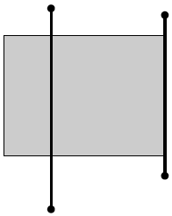
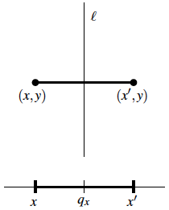
Further Simplification
Preprocess a set S of horizontal line segments in the plane such that the segments intersecting a vertical query segment can be reported efficiently.
Consider a simpler version where the query segment is a full line.
Let l := (x = q_{x}) denote the query line. A horizontal segment s := \line{(x,y)(x’,y)} is intersected by l if and only if x <= q_{x} <= x’.
The problem is now one-dimensional.

Slide 7
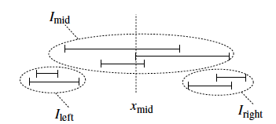
Borrow Idea of Binary Search Tree
Let I := {[x₁ : x₁’], [x₂ : x₂’], . . . , [x_{n} : x_{n}’]} be a set of closed intervals on the real line. Let x_{mid} be the median of the 2n interval endpoints. If the query value q_{x} lies to the left of x_{mid} then the intervals that lie completely to the right of x_{mid} obviously do not contain q_{x}.
A binary tree is constructed such that the right subtree of the tree stores the set I_{right} of the intervals lying completely to the right of x_{mid}, and the left subtree stores the set I_{left} of intervals completely to the left of x_{mid}.

Slide 8
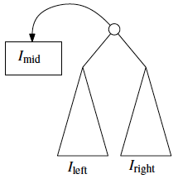
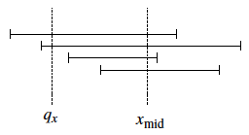
How about I_{mid}?
The intervals that contain x_{mid} are in I_{mid}.
Store it on both subtrees => too expensive!
Store it separately!
How to query I_{mid} with q_{x}?
All segments in I_{mid} contains x_{mid}
q_{x} is contained in an interval [x_{j} : x_{j}’] ∈ I_{mid} if and only if x_{j} <= q_{x}.
Store intervals in a list ordered on increasing left endpoint for the case when q_{x} < x_{mid}
The case when q_{x} > x_{mid} is similar
When q_{x} = x_{mid} return all intervals in I_{mid}

Slide 9
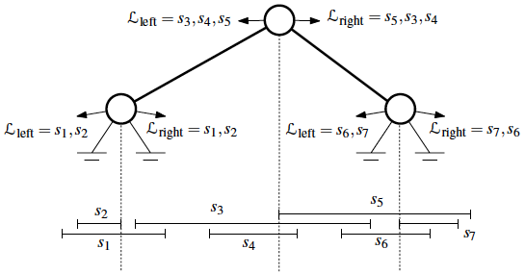
Interval Tree (1/2)
If I = \emptyset then the interval tree is a leaf.
Otherwise, let x_{mid} be the median of the endpoints of the intervals. Let
I_{left} := {[x_{j} : x_{J}’] ∈ I_{left} : x_{j} < x_{mid}},
I_{mid} := {[x_{j} : x_{j}’] ∈ I_{mid} : x_{j} <= x_{mid} <= x_{j}’},
I_{right} := {[x_{j} : x_{J}’] ∈ I_{right} : x_{mid} < x _{j}’}.

Slide 10
Interval Tree (2/2)
The interval tree consists of a root node ν storing x_{mid}. Furthermore,
the set I_{mid} is stored twice; once in a list L_{left}(ν) that is sorted on the left endpoints of the intervals, and once in a list L_{right}(ν) that is sorted on the right endpoints of the intervals,
the left subtree of ν is an interval tree for the set I_{left},
the right subtree of ν is an interval tree for the set I_{right}.
An interval tree on a set of n intervals uses O(n) storage and has depth O(logn).

Slide 11
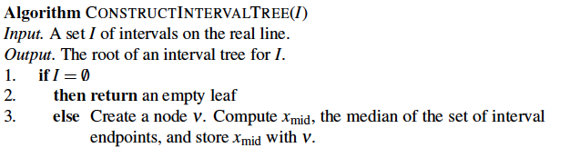
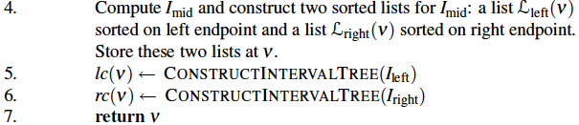
Interval Tree Construction Algorithm

Slide 12
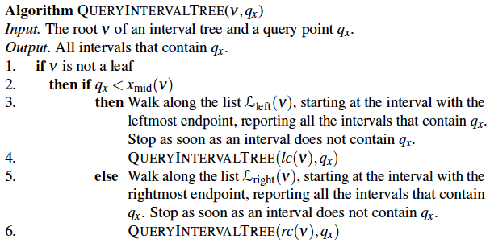
Query Interval Tree Algorithm

Slide 13
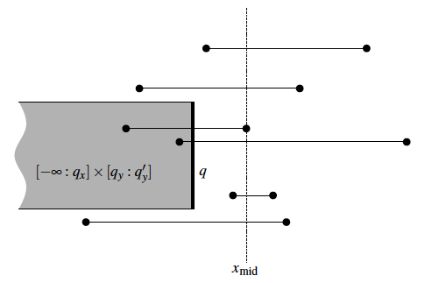
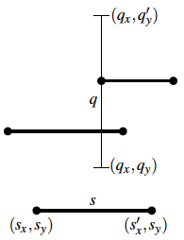
Interval Tree Complexity
An interval tree for a set I of n intervals uses O(n) storage and can be built in O(nlogn) time. Using the interval tree we can report all intervals that contain a query point in O(logn + k) time, where k is the number of reported intervals.

Slide 14
Back to Windowing Query
Let S be a set of n horizontal segments in the plane. The segments intersecting a vertical query segment can be reported in O(log²n + k) time with a data structure that uses O(nlogn) storage, where k is the number of reported segments. The structure can be built in O(nlogn) time.
Let S be a set of n axis-parallel segments in the plane. The segments intersecting an axis-parallel rectangular query window can be reported in O(log²n + k) time with a data structure that uses O(nlogn) storage, where k is the number of reported segments. The structure can be built in O(nlogn) time.

Slide 15
Range Queries in Windowing
They are unbounded on one side.
Can we utilize this property to reduce storage to O(n)?
Priority Search Tree!
No need for fractional cascading.
Note that the storage bound for windowing is still O(nlogn) because we still need a range tree to report the endpoints in the window

Slide 16
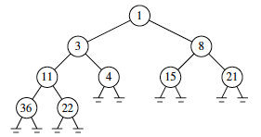
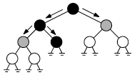
Before Priority Search Tree
Heap has the same query time as a sorted list, namely O(1+k), for 1-dimension queries.
When we search with (−∞ : 5]…

Slide 17
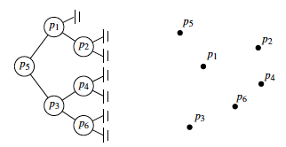
Priority Search Tree
Extend Heap to 2-dimensional:
Formal Definition of Priority Search Tree
If P = \emptyset then the priority search tree is an empty leaf.
Otherwise, let p_{min} be the point in the set P with the smallest x -coordinate.
Let y_{mid} be the median of the y -coordinates of the remaining points. Let
P_{below} := {p ∈ P\{p_{min}} : p_{y} < y_{mid}},
P_{above} := {p ∈ P\{p_{min}} : p_{y} > y_{mid}}.
The priority search tree consists of a root node ν where the point p(ν) := p_{min} and the value y(ν) := y_{mid} are stored. Furthermore,
the left subtree of ν is a priority search tree for the set P_{below},
the right subtree of ν is a priority search tree for the set P_{above}.

Slide 18
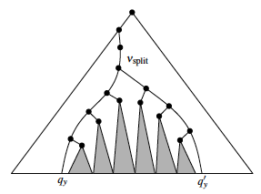
How Range Query is Done?
A query with a range (−∞ : q_{x}]x[q_{y} : q’_{y}] in a priority search tree is performed as follows.
We search with q_{y} and q’_{y} , as indicated in the figure below. All the shaded subtrees in the figure store only points whose y -coordinate lies in the correct range. So we can search those subtrees based on x -coordinate only.

Slide 19
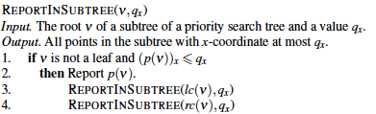
Query Algorithm
REPORTINSUBTREE(ν,q_{x}) reports in O(1+k_{ν} ) time all points in the subtree rooted at ν whose x-coordinate is at most q_{x}, where k_{ν} is the number of reported points.
Is it correct?
Any point stored at a node on the search path to q_{y} or q’_{y} may lie in the query range

Slide 20
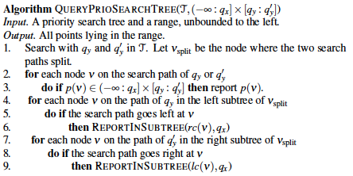
Correct Query Algorithm

Slide 21
Performance Analysis
Algorithm QUERYPRIOSEARCHTREE reports the points in a query range (−∞ : q_{x}] x [q_{y} : q’_{y}] in O(logn+k) time, where k is the number of reported points.
A priority search tree for a set P of n points in the plane uses O(n) storage and can be built in O(nlogn) time. Using the priority search tree we can report all points in a query range of the form (−∞ : q_{x}] x [q_{y} : q’_{y}] in O(logn+k) time, where k is the number of reported points.

Slide 22
Revisit Axis-Parallel Line Segments
Motivated by printed circuit board design
Roadmaps contain line segments at arbitrary orientation!
How to deal with segments of arbitrary orientation?

Slide 23
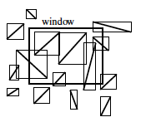
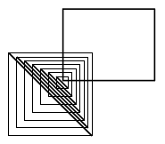
Bounding Box
Replace each segment by its bounding box
Find all the bounding boxes that intersect the query window W by using the data structure for axis-parallel segments
Pros: In practice this technique usually works quite well
Cons: In the worst case, however, the solution is quite bad

Slide 24
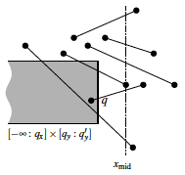
Does Previous Solution Work?
By searching with q_{x} in the interval tree we select a number of subsets I_{mid}(ν). For a selected node ν with x_{mid}(ν) > q_{x} , the right endpoint of any segment in I_{mid}(ν) lies to the right of q .
If the segment is horizontal, then it is intersected by the query segment if and only if its left endpoint lies in the range (−∞ : q_{x}] x [q_{y} : q’_{y}].
If the segments have arbitrary orientation, however, knowing that the right endpoint of a segment is to the right of q doesn’t help us much

Slide 25
Locus Approach (1/2)
A query is described by a number of parameters.
For the windowing problem, there are four parameters, namely q_{x} , q’_{x} , q_{y} , and q’_{y}.
For each choice of the parameters we get a certain answer.
Often nearby choices give the same answer; if we move the window slightly it will often still intersect the same collection of segments.

Slide 26
Locus Approach (2/2)
Let the parameter space be the space of all possible choices for the parameters. For the windowing problem this space is 4-dimensional.
The locus approach suggests partitioning the parameter space into regions such that queries in the same region have the same answer.
If we locate the region that contains the query then we know the answer to it.
Such an approach only works well when the number of regions is small.
For the windowing problem this is not true. There can be Θ(n⁴) different regions.
We can use the locus approach to create an alternative for the interval tree.

Slide 27
Data Structure for Intervals (1/2)
Let I := {[x₁ : x’₁], [x₂ : x’₂], . . . , [x_{n} : x’_{n}]} be a set of n intervals on the real line. The data structure that we are looking for should be able to report the intervals containing a query point q_{x}.
Our query has only one parameter, q_{x} , so the parameter space is the real line.

Slide 28

Data Structure for Intervals (2/2)
Let p₁, p₂, . . . , p_{m} be the list of distinct interval endpoints, sorted from left to right. The partitioning of the parameter space is simply the partitioning of the real line induced by the points p_{i}. We call the regions in this partitioning elementary intervals.
Thus the elementary intervals are, from left to right, (−∞ : p₁), [p₁ : p₁], (p₁ : p₂), [p₂ : p₂], . . . , (p_{m−1} : p_{m}), [p_{m} : p_{m}], (p_{m} : +∞).

Slide 29
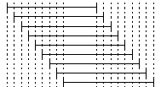
To find the intervals that contain a query point q_{x} , we must determine the elementary interval that contains q_{x}.
We build a binary search tree T whose leaves correspond to the elementary intervals.
We denote the elementary interval corresponding to a leaf μ by Int(μ).
If all the intervals in I containing Int(μ) are stored at the leaf μ , then we can report the k intervals containing q_{x} in O(logn+k).
Issue: The amount of storage can be as bad as quadratic.

Slide 30
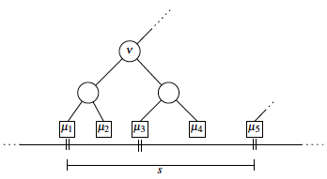
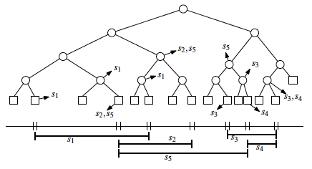
Segment Tree
Solution: store the interval at node ν (and at μ5 ) instead of at the leaves μ1 , μ2, μ3, and μ4 (and at μ5 ).

Slide 31
Definition of Segment Tree
The skeleton of the segment tree is a balanced binary tree T. The leaves of T correspond to the elementary intervals induced by the endpoints of the intervals in I in an ordered way: the leftmost leaf corresponds to the leftmost elementary interval, and so on. The elementary interval corresponding to leaf μ is denoted Int(μ) .
The internal nodes of T correspond to intervals that are the union of elementary intervals: the interval Int(ν) corresponding to node ν is the union of the elementary intervals Int(μ) of the leaves in the subtree rooted at ν. (This implies that Int(ν) is the union of the intervals of its two children.)
Each node or leaf ν in T stores the interval Int(ν) and a set I(ν) ⊆ I of intervals (for example, in a linked list). This canonical subset of node ν contains the intervals [x : x’] ∈ I such that Int(ν)⊆[x : x’] and Int(parent(ν)) !⊆ [x : x’] .

Slide 32
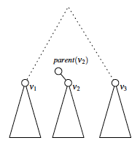
Storage Requirement of Segment Tree
A segment tree on a set of n intervals uses O(nlogn) storage.

Slide 33
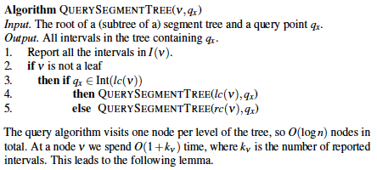
Query of Segment Tree

Slide 34
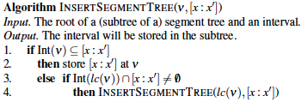
Segment Tree Construction
Using a segment tree, the intervals containing a query point q_{x} can be reported in O(logn+k) time, where k is the number of reported intervals.

Slide 35
Conclusion of Segment Tree
A segment tree for a set I of n intervals uses O(nlogn) storage and can be built in O(nlogn) time. Using the segment tree we can report all intervals that contain a query point in O(logn+k) time, where k is the number of reported intervals.

Slide 36
Go Back to Windowing Problem
Let S be a set of arbitrarily oriented, disjoint segments in the plane. We want to report the segments intersecting a vertical query segment q :=q_{x} x [q_{y} : q’_{y}].
We build a segment tree T on the x-intervals of the segments in S. A node ν in T can be considered to correspond to the vertical slab Int(ν) x (−∞ : +∞).
A segment is in the canonical subset of ν if it completely crosses the slab corresponding to ν — we say that the segment spans the slab — but not the slab corresponding to the parent of ν.
We denote these subsets with S(ν).

Slide 37
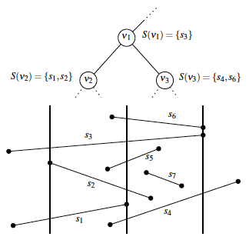
Illustration of S(v)

Slide 38
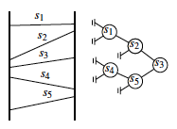
Segments in a Slab
The segments in the canonical subset S(ν) span the slab corresponding to ν and that they do not intersect each other => This implies that the segments can be ordered vertically.
Hence, we can store S(ν) in a search tree T(ν) according to the vertical order.

Slide 39
Total Data Structure for Windowing
The total data structure for the set S is thus as follows.
The set S is stored in a segment tree T based on the x -intervals of the segments.
The canonical subset of a node ν in T , which contains the segments spanning the slab corresponding to ν but not the slab corresponding to the parent of ν, is stored in a binary search tree T(ν) based on the vertical order of the segments within the slab.

Slide 40
Final Remarks
Let S be a set of n disjoint segments in the plane. The segments intersecting a vertical query segment can be reported in O(log²n+k) time with a data structure that uses O(nlogn) storage, where k is the number of reported segments. The structure can be built in O(nlogn) time.
Let S be a set of n segments in the plane with disjoint interiors. The segments intersecting an axis-parallel rectangular query window can be reported in O(log²n+k) time with a data structure that uses O(nlogn) storage, where k is the number of reported segments. The structure can be built in O(nlogn) time.

