Slide 1
The Power of Programmable Parsing
Dan Talayco
Barefoot Networks
November 2014
P4: Programming Protocol-Independent Packet Processors
ACM CCR. Volume 44, Issue #3 (July 2014)

Slide 2
Protocols
FLIP
CAPWAP
DCTCP
L2TP
UDP
IPSEC
Protocols are what allow networking to work
There are a lot of protocols out there already
TCP
HTTP
RARP
SMTP
NSH
GENV
IBGP
ARP
IP
SSL
RIP
SNAP
POP
FTP
IPv6
ICMP
Ethernet
BGP
IPv4
OSPF
NVGRE
GRE
PPP
VLAN
POP
SCTP
MPLS
BFD
FCOE
ERSPAN
IMAP
Notes:
Assuming familiarity with OF model, match+action as the right way to model the fundamental operation of the data plane. Will discuss P4 which takes on the pesky questions of complete specification of action semantics and of control flow. But for today, looking at low hanging fruit of…. The parser.

Slide 3
Protocols Evolve
Protocols change
New encapsulations: VXLan, NVGRE, GENV…
Notes:
Protocols are agreements between two agents on the meaning of information.
Layers are important, but not pure
Pseudo header for TCP/UDP checksums
This coupling complicates parsing

Slide 4
Protocols Evolve
Protocols change
New encapsulations: VXLan, NVGRE, GENV…
And we want them to be extensible
For example, option lists in headers
Variable length lists
Variable length options
New type values over time
Notes:
Protocols are agreements between two agents on the meaning of information.
Layers are important, but not pure
Pseudo header for TCP/UDP checksums
This coupling complicates parsing

Slide 5
Networks are Diverse
Seeing the growth of MSDCs and other networks with high performance demands
Requirements fundamentally different from e.g. WAN
Network performance has become a competitive advantage
Deployments are becoming more specialized.
Yes, we can adapt BGP to work to the TOR or even the v-Switch, but is there a better way?
“One size fits all” is no longer acceptable

Slide 6
Networks are Diverse
Seeing the growth of MSDCs and other networks with high performance demands
Requirements fundamentally different from e.g. WAN
Network performance has become a competitive advantage
Deployments are becoming more specialized.
Yes, we can adapt BGP to work to the TOR or even the v-Switch, but is there a better way?
“One size fits all” is no longer acceptable

Slide 7
Networks are Diverse
Seeing the growth of MSDCs and other networks with high performance demands
Requirements fundamentally different from e.g. WAN
Network performance has become a competitive advantage
Deployments are becoming more specialized.
Yes, we can adapt BGP to work to the TOR or even the v-Switch, but is there a better way?
“One size fits all” is no longer acceptable

Slide 8
Parsing
Protocols are defined by field semantics
…and parsers identify fields
Yet parsers have not gotten much attention
Too easy? Just a state machine
Too hard? Difficult to make programmable and line rate
Too important? Controlling the protocols means controlling the feature set

Slide 9
Parsers are Stuck in the Past
Static Parsing Slows Innovation
Binds feature changes to slower development cycle (esp in HW, but SW too).
OpenFlow History
Avoided taking on the challenge; just identified fields for match/action
Field count, 1.0 to 1.4: 12 => 15 => 36 => 40 => 41

Slide 10
Programmable Parsers
Programmable parsing is the key to unlocking OpenFlow’s Match+Action processing model
Obviously, possible in SW
But not (yet) in OVS
Also possible in HW
Gibb, et al, Design Principles for Packet Parsers

Slide 11
High Level Language Support
The P4 language
Based on an abstract forwarding model
With a programmable parser
Allows the definition of arbitrary headers and fields
Provides a context for match+action definitions

Slide 12
High Level P4 Abstraction
Switch Configuration
Parse
Graph
Control
Program
Match+Action Table Config
Run Time Forwarding rules
I
N
P
U
T
P
A
R
S
E
R
O
U
T
P
U
T
Queues
and/or
Buffers
Match
Action
Match
Action
Ingress Match+Action
Egress Match+Action
Packet Modifications +
Egress Selection
Packet Modifications

Slide 13
Headers and Fields
Fields have a width and other attributes
Headers are collections of fields
These are types which are used to declare instances
header_type egress_metadata_t {
fields {
nhop_type : 8; /* 0: L2, 1: L3, 2: tunnel */
encap_type : 8; /* L2 Untagged; L2ST; L2DT */
vnid : 24; /* gnve/vxlan vnid/gre key */
tun_type : 8; /* vxlan; gre; nvgre; gnve*/
tun_idx : 8; /* tunnel index */
}
}
metadata egress_metadata_t egress_metadata;
Metadata is a header instance
header_type ethernet_t {
fields {
dstAddr : 48;
srcAddr : 48;
etherType : 16;
}
}
/* Instance of eth header */
header ethernet_t inner_ethernet;
Notes:
From glass/parser/examples/dc_genv_lat + additions
Note time stamps
Discuss metadata (field granularity) vs packet headers; tag stacks; field attributes like signed, saturating, etc.
----- Meeting Notes (6/24/14 16:48) -----
Syntax highlighting!
Fix declaration syntax for header instances.
Discuss type/instance; visually combine

Slide 14
Headers and Fields
Fields have a width and other attributes
Headers are collections of fields
These are types which are used to declare instances
header_type egress_metadata_t {
fields {
nhop_type : 8; /* 0: L2, 1: L3, 2: tunnel */
encap_type : 8; /* L2 Untagged; L2ST; L2DT */
vnid : 24; /* gnve/vxlan vnid/gre key */
tun_type : 8; /* vxlan; gre; nvgre; gnve*/
tun_idx : 8; /* tunnel index */
}
}
metadata egress_metadata_t egress_metadata;
Type used in Instance Declaration
header_type ethernet_t {
fields {
dstAddr : 48;
srcAddr : 48;
etherType : 16;
}
}
/* Instance of eth header */
header ethernet_t inner_ethernet;
Notes:
From glass/parser/examples/dc_genv_lat + additions
Note time stamps
Discuss metadata (field granularity) vs packet headers; tag stacks; field attributes like signed, saturating, etc.
----- Meeting Notes (6/24/14 16:48) -----
Syntax highlighting!
Fix declaration syntax for header instances.
Discuss type/instance; visually combine

Slide 15
The Parser
Imperative functions for “states”
Extract header instances
Select a next “state” by returning a parser function
parser parse_ethernet {
extract(ethernet);
return select(latest.etherType) {
ETHERTYPE_CPU : parse_cpu_header;
ETHERTYPE_VLAN : parse_vlan;
ETHERTYPE_MPLS : parse_mpls;
ETHERTYPE_IPV4 : parse_ipv4;
ETHERTYPE_IPV6 : parse_ipv6;
ETHERTYPE_ARP : parse_arp_rarp;
ETHERTYPE_RARP : parse_arp_rarp;
ETHERTYPE_NSH : parse_nsh;
}
}
Produces a Parsed Representation of the packet
Notes:
“nsh” is network service header, ietf quinn.
CPU header is from dc_genv.
#defines C pre-processor; use of current. Extracting to tag stacks.

Slide 16
The Parser
Imperative functions for “states”
Extract header instances
Select a next “state” by returning a parser function
parser parse_ethernet {
extract(ethernet);
return select(latest.etherType) {
ETHERTYPE_CPU : parse_cpu_header;
ETHERTYPE_VLAN : parse_vlan;
ETHERTYPE_MPLS : parse_mpls;
ETHERTYPE_IPV4 : parse_ipv4;
ETHERTYPE_IPV6 : parse_ipv6;
ETHERTYPE_ARP : parse_arp_rarp;
ETHERTYPE_RARP : parse_arp_rarp;
ETHERTYPE_NSH : parse_nsh;
}
}
Produces a Parsed Representation of the packet
Notes:
“nsh” is network service header, ietf quinn.
CPU header is from dc_genv.
#defines C pre-processor; use of current. Extracting to tag stacks.

Slide 17
The Parser
Imperative functions for “states”
Extract header instances
Select a next “state” by returning a parser function
parser parse_ethernet {
extract(ethernet);
return select(latest.etherType) {
ETHERTYPE_CPU : parse_cpu_header;
ETHERTYPE_VLAN : parse_vlan;
ETHERTYPE_MPLS : parse_mpls;
ETHERTYPE_IPV4 : parse_ipv4;
ETHERTYPE_IPV6 : parse_ipv6;
ETHERTYPE_ARP : parse_arp_rarp;
ETHERTYPE_RARP : parse_arp_rarp;
ETHERTYPE_NSH : parse_nsh;
}
}
Produces a Parsed Representation of the packet
Notes:
“nsh” is network service header, ietf quinn.
CPU header is from dc_genv.
#defines C pre-processor; use of current. Extracting to tag stacks.

Slide 18
Parsing and Headers Give Context for Match + Action
table acl {
reads {
ipv4.dstAddr : ternary;
ipv4.srcAddr : ternary;
ipv4.protocol : ternary;
udp.srcPort : ternary;
udp.dstPort : ternary;
ethernet.dstAddr : exact;
ethernet.srcAddr : exact;
ethernet.etherType : ternary;
}
actions {
no_op; /* permit */
acl_drop; /* reject */
nhop_set; /* policy-based routing */
}
}

Slide 19
Programmable Parsing in OVS
Supporting a programmable parser in OVS is tractable
OVS is critical for providing deployment specific features in the future
Selective protocol engagement
Agile response to protocol evolution
Overlay/underlay architectures

Slide 20
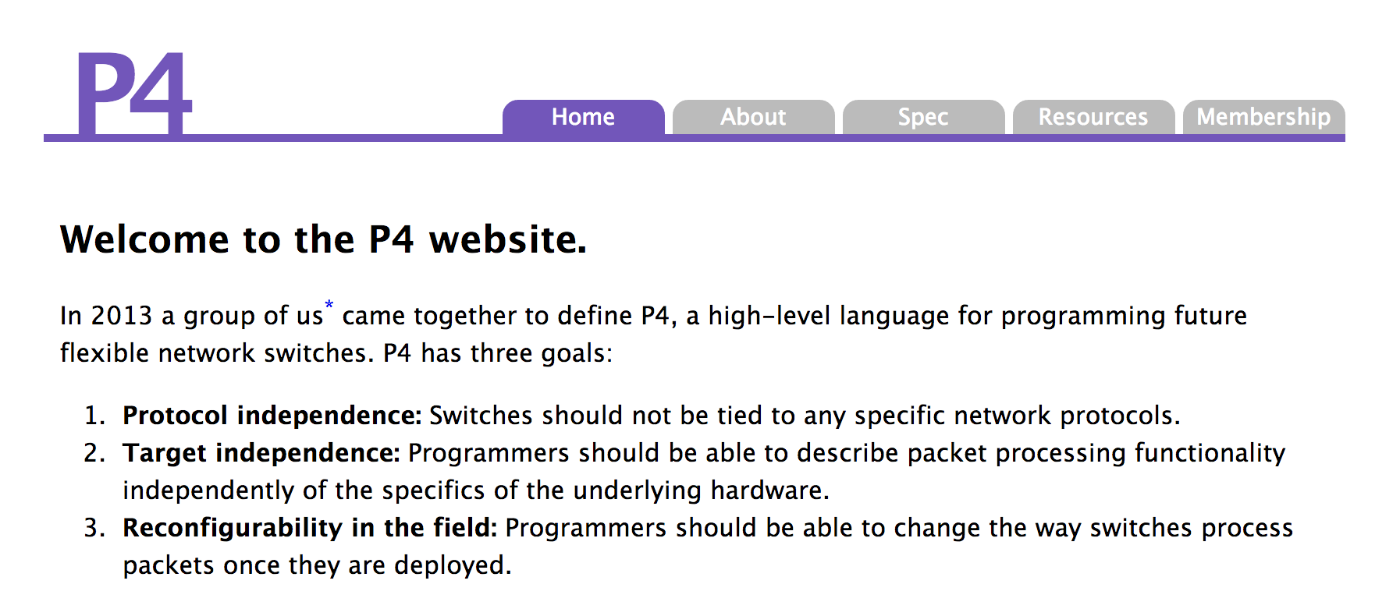
The P4 Language Consortium
Consortium: Independent, open-source, CA non-profit.
Original authors from Google, Microsoft, Intel, Princeton, Stanford, Barefoot
Sign up for the P4 Announcement mailing list: www.p4.org
Currently on the site: P4 Language Spec, the original paper, reference links

